Slide 1
Objective 6: Development of extension and outreach services and products for industry and public stakeholders.

Slide 2
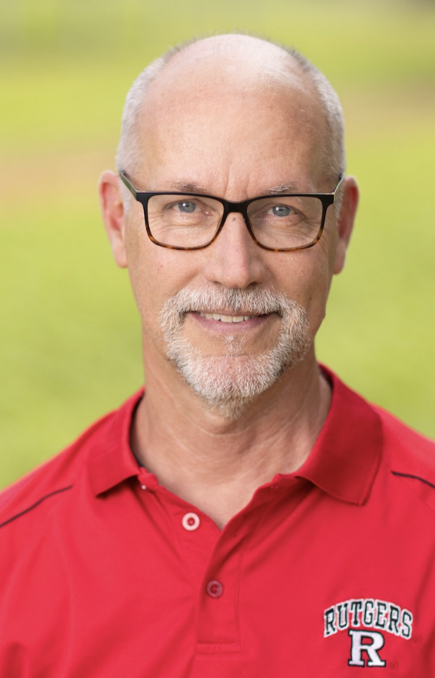
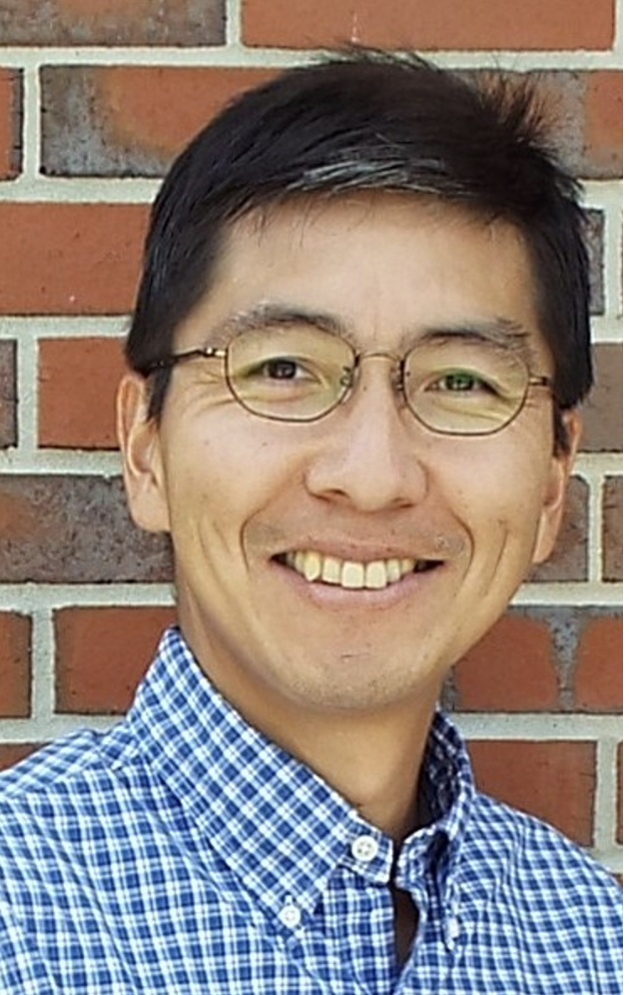
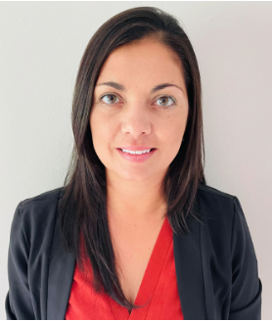
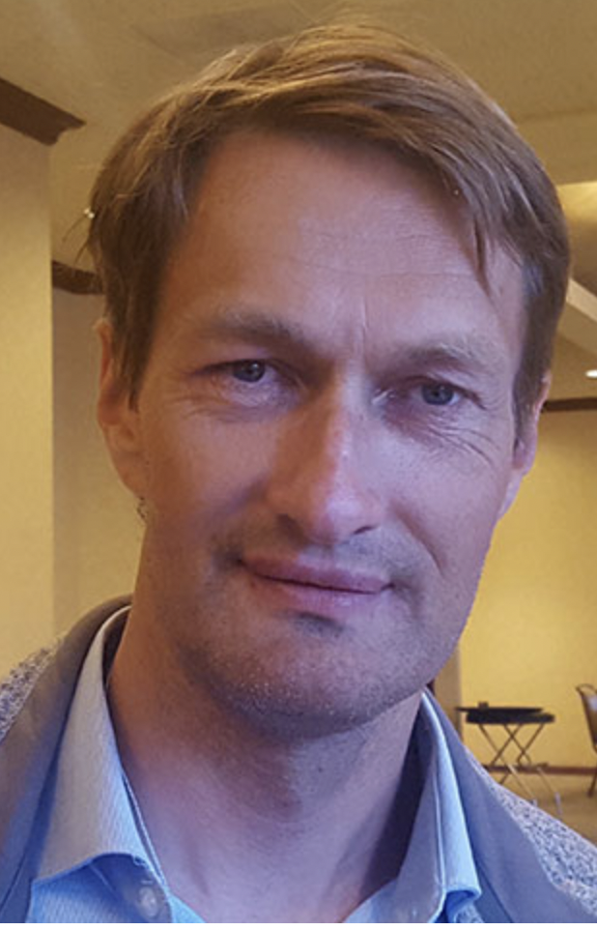
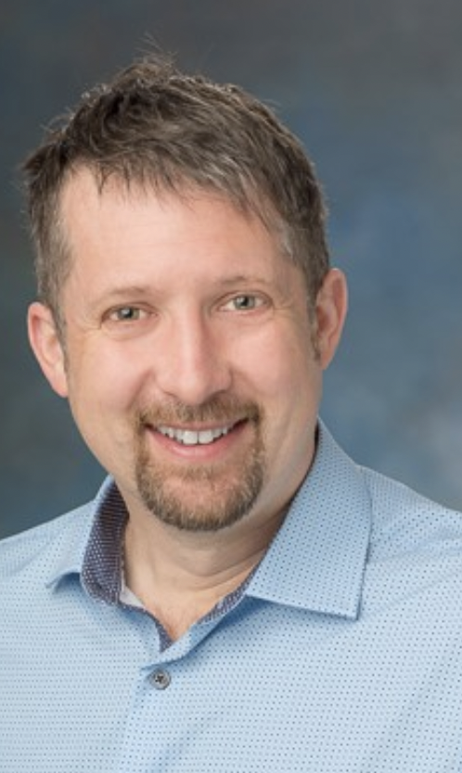
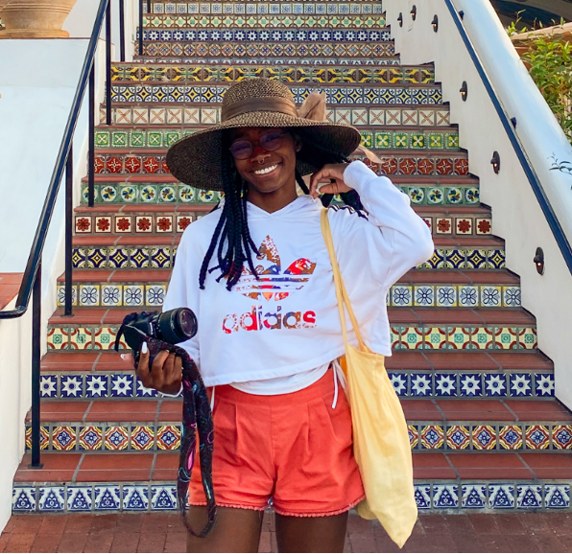
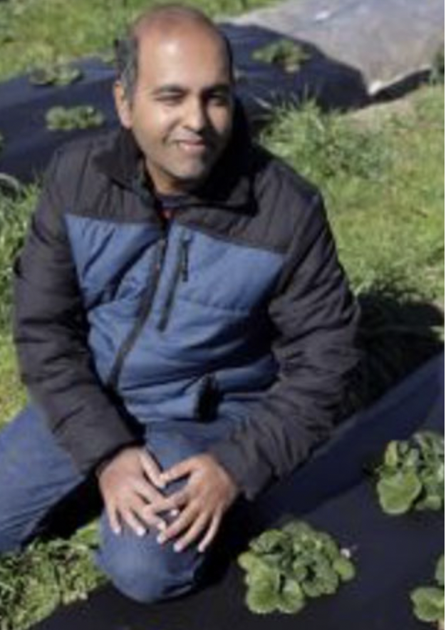
Extension & Outreach Team Members
Peter Nitzsche
–Agriculture & Natural Resources Agent, Rutgers NJAES Cooperative Extension of Morris County
Shinsuke Agehara
–Assistant Professor of Horticulture, Institute of Food & Agricultural Sciences, UF
Lizeth Vigil
–NC State Program Manager
Oleg Daugovich
–Strawberry Vegetable Crop Advisor, Cooperative Extension Ventura County, UC ANR
Mark Hoffmann
–Small Fruits Extension Specialist, North Carolina State Extension, NCSU
Alexa Artis
–NC State Communications Team
Jayesh Samtani
–Small Fruit Extension Specialist, Virginia Agricultural Experiment Station, VT

Slide 3
Objective 6: Development of extension and outreach services and products for industry and public stakeholders.
Objectives:
6.1.a Project website and blog.
6.1.b Newsletters and public relations.
6.1.c Strawberry propagation guidelines and recommendations.
6.1.d Educational video series and webinars.
6.1.e Regional and national field day.
6.1.f Development of Spanish outreach material.
6.2 Development of an international conference on CE
6.3 In-service Train the Trainer education.
6.4 Development of a student exchange program.
Outcomes:
Bilingual webinars; workshops; print and online information
Field demonstrations; regional and national field days;
Flower mapping workshops.
International conference on CE propagation and production techniques.
Student Exchange Program

Slide 4
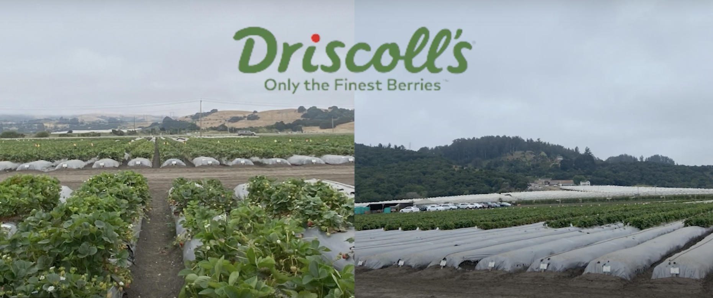
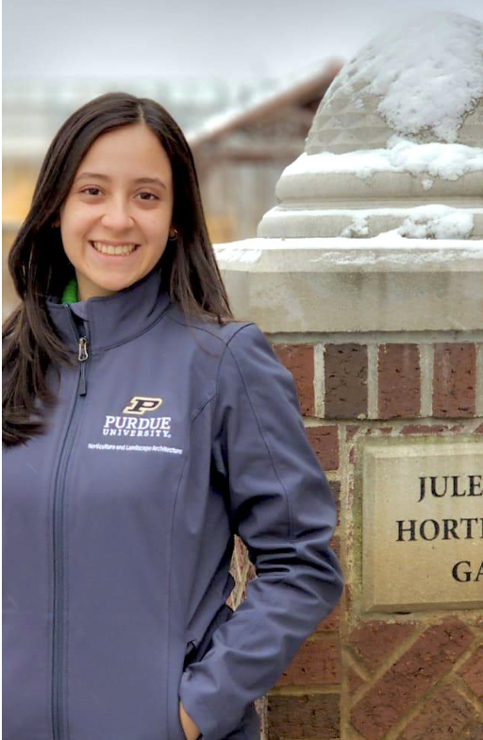
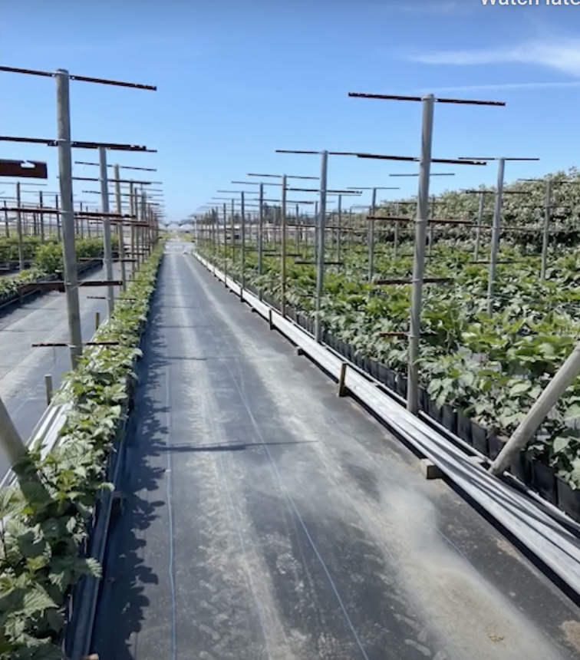
Summer Internship 2024
Driscoll’s Headquarters
Lian is a Masters student in the department of Horticulture and Landscape Architecture at Purdue University, visited Driscoll’s. Her internship motivated her to continue to improve and develop innovative solutions to benefit growers!

Slide 6
YouTube Link

Slide 7
6.1.c Strawberry propagation guidelines and recommendations
Table of contents developed
Assign Authors
Assign Extension editors

Slide 8
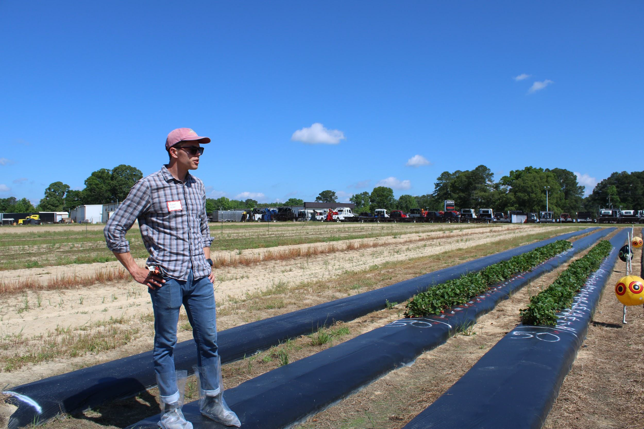
6.1.e Regional and national field day.
Clayton, NC
Oxnard CA
Virginia
Geneva, NY
Florida spring 2025
National virtual field day

Slide 9
6.2 Development of an international conference on CE

Slide 10
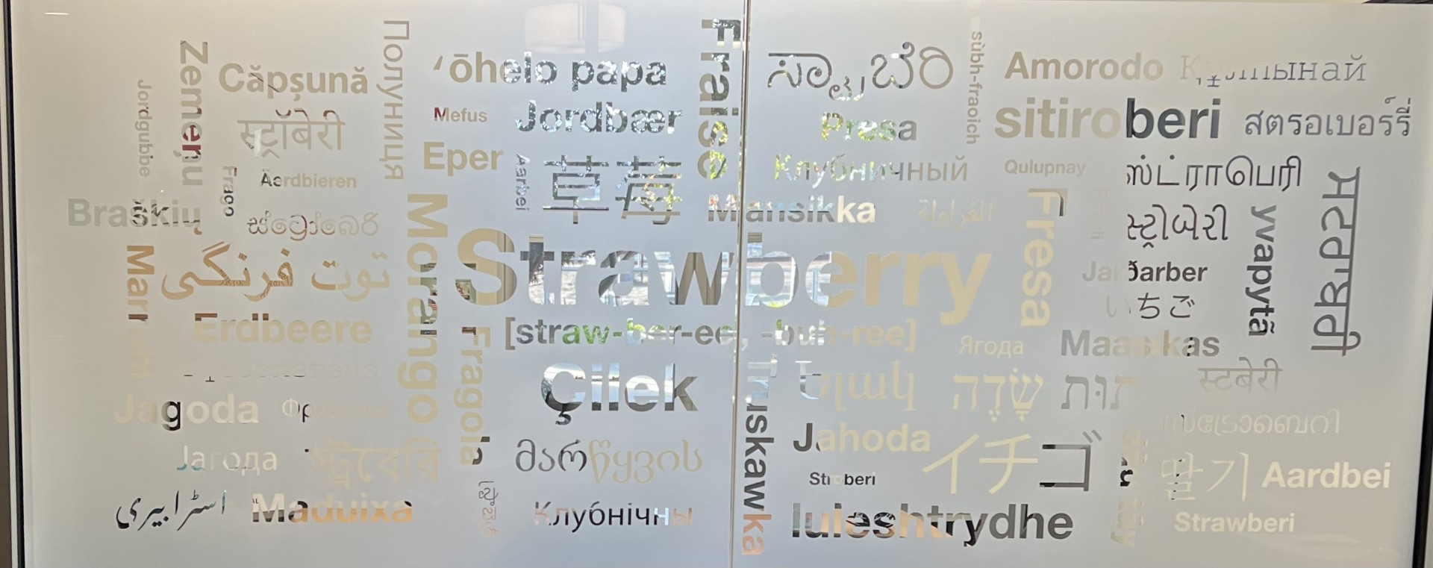
Question?

