Slide 1
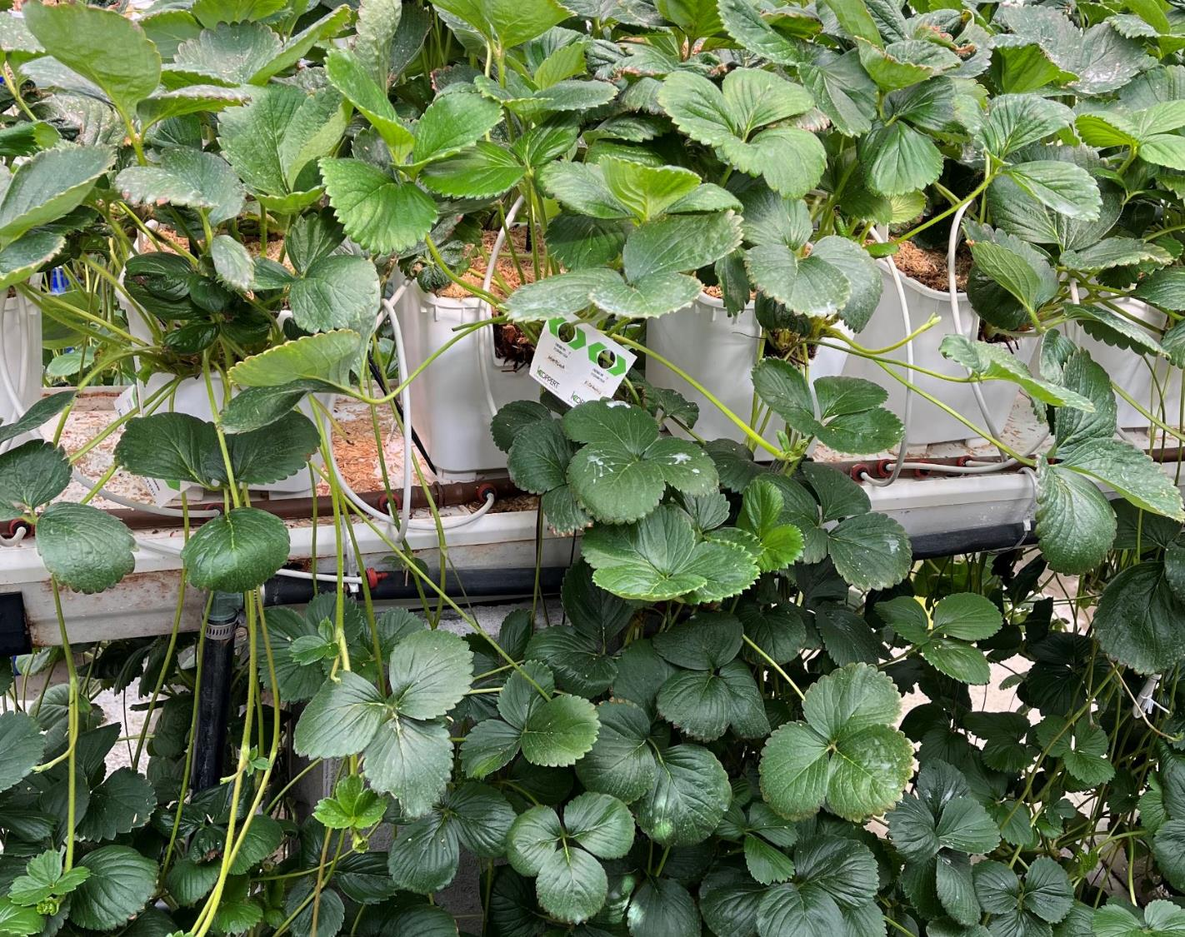

Objective 2
Environmental protocols for transplant establishment, conditioning (runnering/flowering), and long-term storage
Research Highlights
Chieri Kubota (Ohio State Univ.)
Edward Durner (Rutgers Univ.)
Celina Gomez (Purdue Univ.)

Slide 2
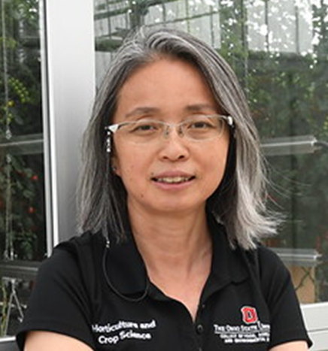
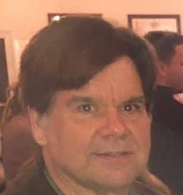

Obj. 2 Environmental protocols for transplant establishment, conditioning (runnering/flowering), and long-term storage
Team members:
Chieri Kubota
The Ohio State University
Edward Durner
Rutgers University
Celina Gomez
Purdue University

Slide 4
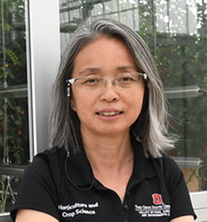
Obj. 2.1 – Conditioning plants for propagation, update
Chieri Kubota
The Ohio State University
Research focus: Artificial chilling treatment over propagation transplants for promoting runnering
Cultivars used: LD ‘Albion’ and SD ‘Fronteras’
Finding:
Experiments (two years) confirmed that ‘Albion’ respond positively to chilling treatment (1050 hrs) over mother plants prior to transplanting
‘Fronteras’ did not respond to chilling (450 hrs) and may require additional pre-conditioning of optimum temperature and daylength
  SD pre-conditioning enhanced branch-crown development in ‘Fronteras’
2025 plan: Developing optimum conditioning protocols for both cultivars

Slide 5
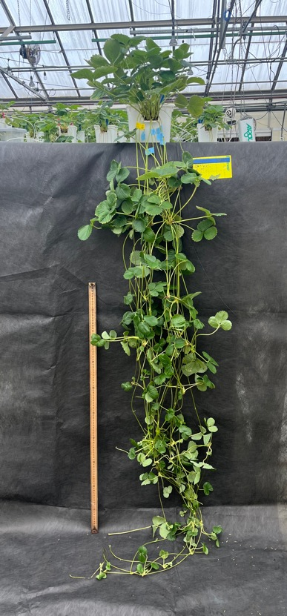
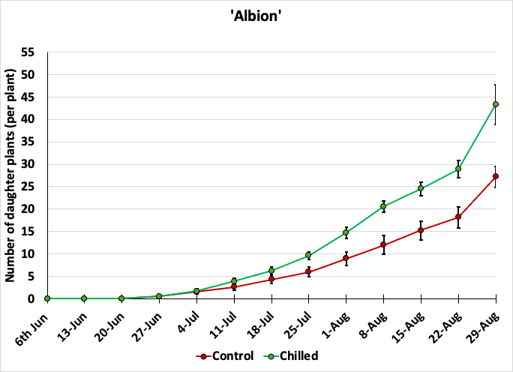
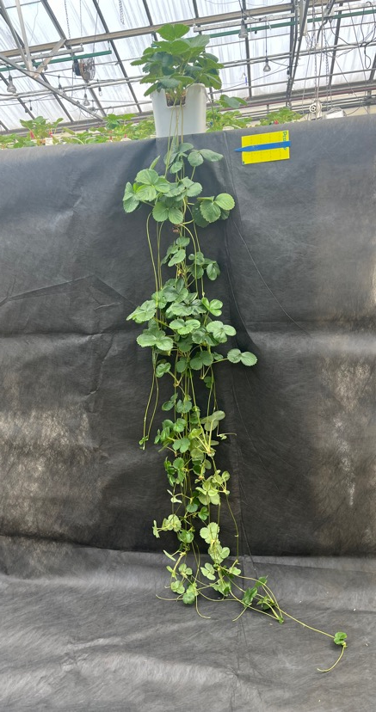
Chilling effects in ‘Albion’
Photos at the end of 12-week runnering
Number of ‘Albion’ daughter plants produced during 12 weeks of propagation as affected by chilling (1,050 h at 0°C) prior to transplanting (means± S.E., n=12)
#DP = 27 ± 2.3b
#DP = 43 ± 4.4a
Control (no chilling)
Chilled (1050 h)

Slide 6
Obj. 2.2 – Conditioning plants for fruit production, update
Edward Durner
Rutgers University
Research focus: Photoperiodic lighting quality for conditioning transplants for fruit production in different cropping systems
Cultivars used: LD ‘Soraya’ (F1 hybrid seed cultivar), LD ‘Albion’, SD ‘Sweet Charlie’ and SD ‘Chandler’
Status: 21 photoperiod lighting treatments (BOD, EOD, NI with different spectra for 6 or 12 weeks) were examined for flower and crown development
Finding:
BOD R or FR+R NI promoted flower development in ‘Soraya’
EOD R, R NI, B+R NI, and B+FR NI promoted flower development in ‘Sweet C.’
R NI, FR+R NI, and B+R+FR NI largely promoted flower development in ‘Albion’
No light treatment responses in ‘Chandler’
2025 plan: Testing fruit production of light treated transplants in a greenhouse and a field plot.

Slide 7
Flower Mapping Results Fall 2024 | Cultivar
Light source | ‘Sweet Charlie’ | ‘Albion’ | ‘Chandler’ | ‘Soraya’ (2023)
Control | 0.4 | 0 | 1.2 | 0.6
Far-red BOD | 0.8 | 0 | 0.8 | 0.0
Far-red EOD | 1.4 | 1.8 + | 2.8 | 0.2
Far-red NI | 0.0 | 2.4 + | 0.4 | 0.0
Red BOD | 0.6 | 0 | 2.6 | 2.6 +
Red EOD | 2.6 +^{z} | 0 | 1.8 | 0.4
Red NI | 2.6 + | 3.6 + | 2.0 | 1.2
Far-red + Red BOD | 0.0 | 0 | 1.2 | 1.5
Far-red + Red EOD | 0.8 | 3.6 + | 1.8 | 0.3
Far-red + Red NI | 0.4 | 0 | 0.6 | 2.9 +
Blue BOD | 1.0 | 1.4 | 1.8 | 0.0
Blue EOD | 0.6 | 1.6 + | 2.6 | 0.0
Blue NI | 0.0 | 0 | 2.4 | 0.3
Blue + red BOD | 1.0 | 0 | 2.4 | -
Blue + red EOD | 0.0 | 0 | 0.8 | -
Blue + red NI | 2.2 + | 0.8 | 2.0 | -
Blue + far-red BOD | 0.0 | 0 | 2.0 | -
Blue + far-red EOD | 0.6 | 0 | 2.0 | -
Blue + far-red NI | 2.2 + | 0.4 | 1.2 | -
Blue + red + far-red BOD | 0.0 | 0 | 0.0 | -
Blue+ red + far-red EOD | 0.0 | 0 | 2.2 | -
Blue+ red + far-red NI | 1.2 | 3.4 + | 0.0 | -
- or + indicates significantly different (+ is greater than and - is less than) from the control within treatment duration by Dunnett’s Procedure, α = 0.10.
EOD = end of dark period, BOD = beginning of dark period and NI = night interruption. Blue lighting was continuous rather than a night interruption, - not tested.
Notes:
Flower mapping results including the results from last year using ‘Soraya’ for easy comparison.
Note that the long day cultivars were different in their response suggesting that we can’t assume that long day cultivars respond similarly as suggested by Sonsteby and Heide in their work.
‘Sweet Charlie’ seems to be much more sensitive to treatment than ‘Chandler’.
However, this is only one method of evaluation. I also have plants being forced in a long day greenhouse and have a field planting to be evaluated in the spring for inflorescence number, crown number, yield, etc.

Slide 8
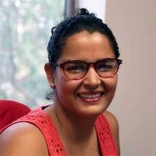
Obj. 2.3 – Low-temperature storage of unrooted runner tips and plugs, update
Celina Gómez
Purdue University
Research focus: Development of low temperature storage protocols for unrooted runner tips and rooted plugs (4 weeks old)
Cultivar used: LD ‘Albion’
Status: Plugs were stored for 28 days at varied temperatures (-1.6 to 5.8°C) and light (dark vs. dim light). Runner tips were stored for 30 days at varied temperatures (-1.5 to 4.7°C) in darkness; planted into greenhouse to evaluate
Finding:
No light needed during plug storage
2°C storage maintained visual quality higher than other temperatures; however, the post-storage productivity was not affected by temperatures
Runner tips storability was greater for tips with larger crowns
Notes:
Below is an overview of the main findings to emphasize:
1. The use of light during CS seems to be unnecessary.
2. Petiole length increased under darkness at warmer temperatures (>3 °C)
3. Quality of transplants decreased at low temperatures regardless of crown diameter.
4. Transplants exposed to cold storage had lower root dry mass compared to those that were not stored.
5. Transplants stored at low temperatures, especially those at or below -1.5 °C, experienced reduced quality and affected subsequent growth. Therefore, storage decisions should prioritize cost-effectiveness to ensure optimal outcomes.

Slide 9
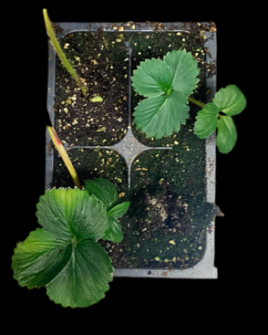
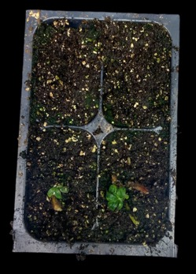
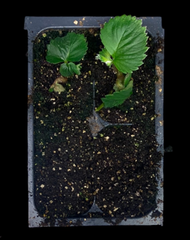
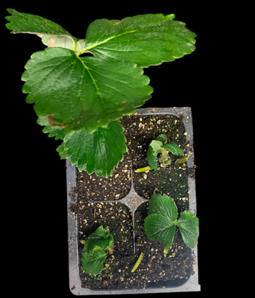
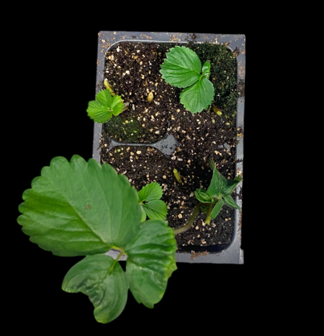
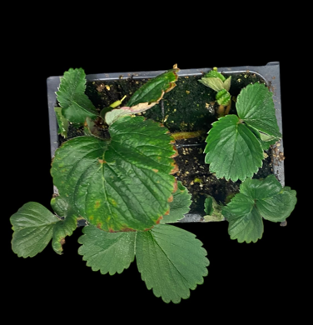
Plants after 28 d under indoor propagation
Temperature (°C)
- 1.5 2 4.7
Crown size
Small (< 10 mm)
Crown size
Large (> 10 mm)

Slide 10




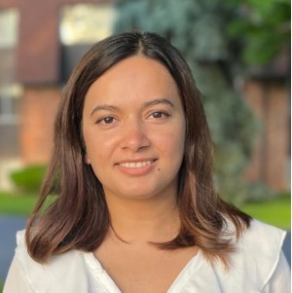
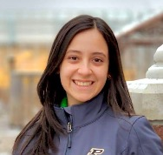
Thank you!
Chieri Kubota
Ohio State University
Edward Durner
Rutgers University
Celina Gomez
Purdue University
Pooja Tripathi
Lian M. Duron Alvarado

