Slide 1




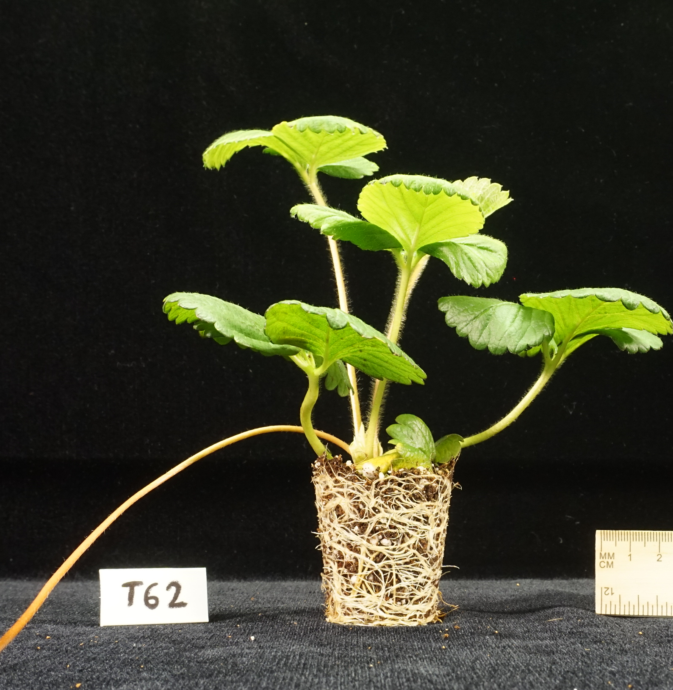

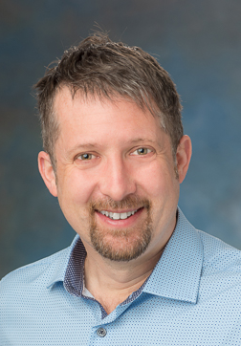

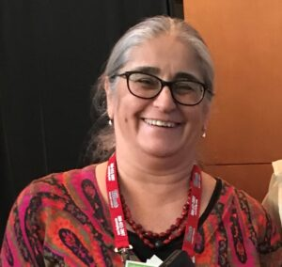
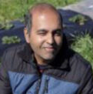
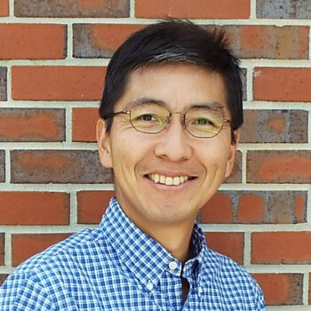
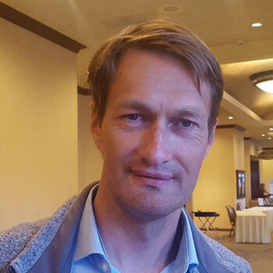
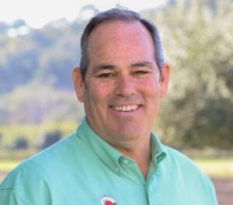
Plant
Performance
Ibraheem Olasupo
Mark Hoffmann
Courtney Weber
Gina Fernandez
Jayesh Samtani
Shinsuke Agehara
Oleg Daugovich
Gerald Holmes

Slide 2
Assess field performance of CEA produced plants
Field days in 2023 and 2024.
Optimize use of row-covers in nursery and early production
Plant
Performance

Slide 3
Contribute to nursery production guide with plant performance data across a variety of industry relevant genetics.
Plant
Performance

Slide 4
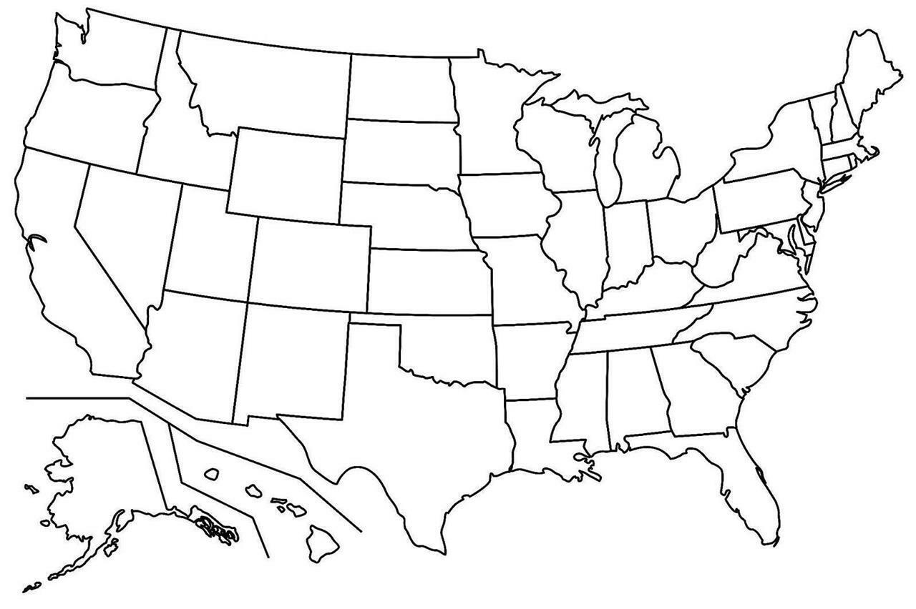

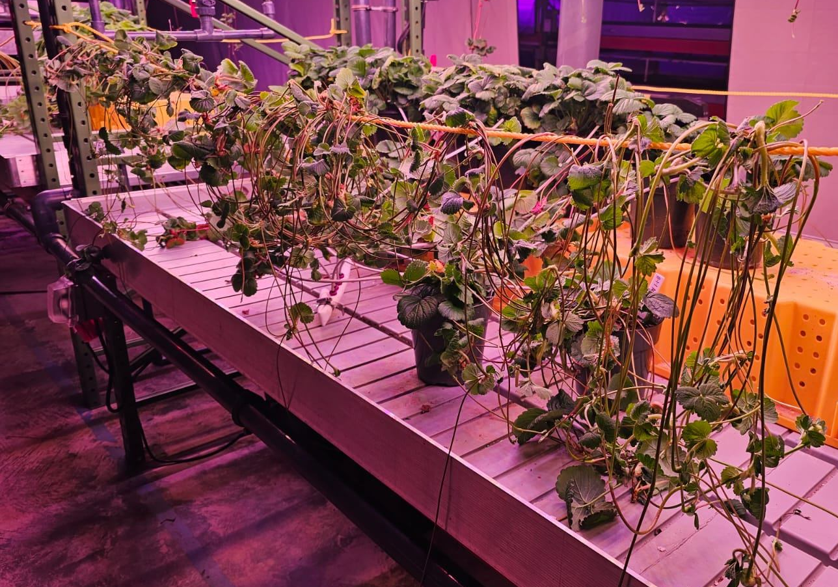

CEA plants 2023-2025
Cabrillo, Monterey, Albion
Monterey
Fronteras
Chandler, Camarosa
Brilliance, Sensation

Slide 5
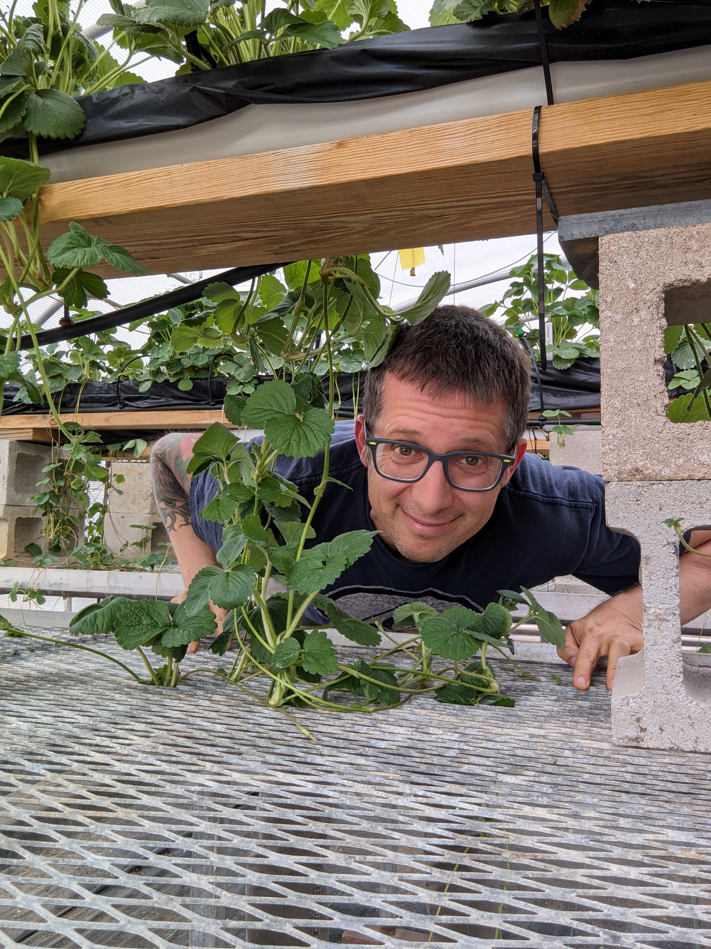
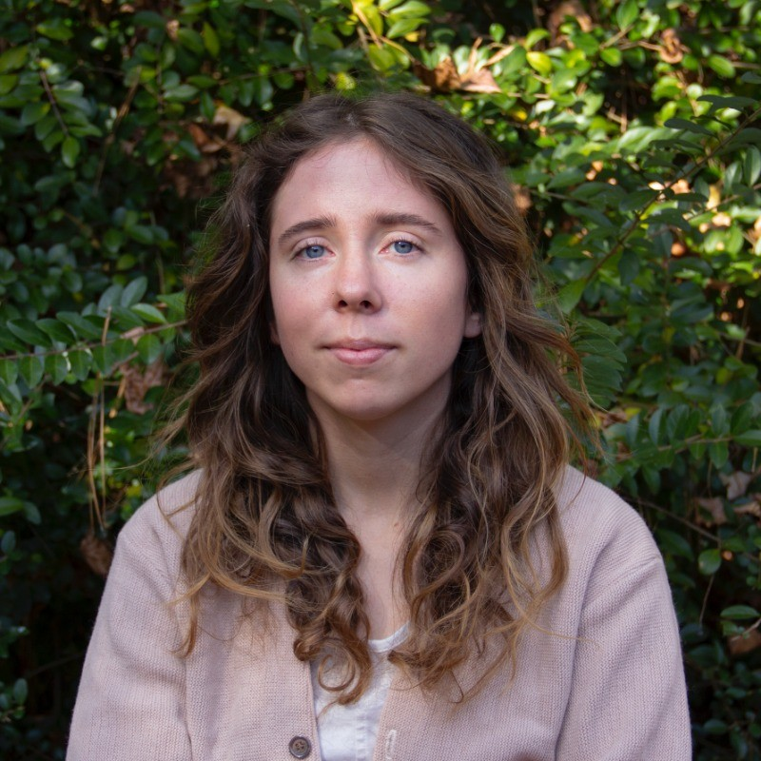
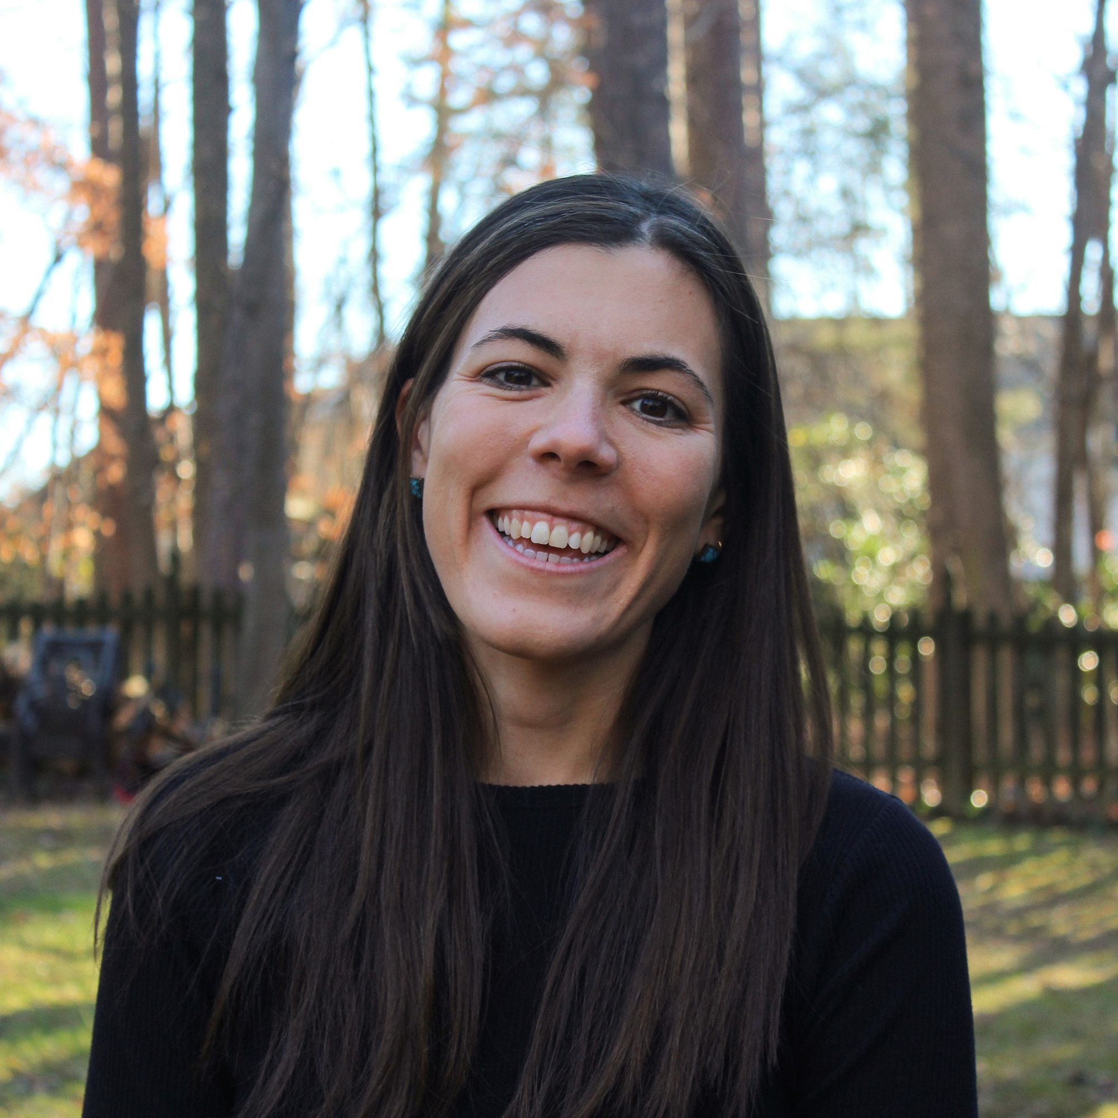
NCSU HFL Greenhouse Nursery
Albion, Monterey, Cabrillo
Rooting in Misting Chamber 28 days
Emma Volk
Kim Heagy

Slide 6
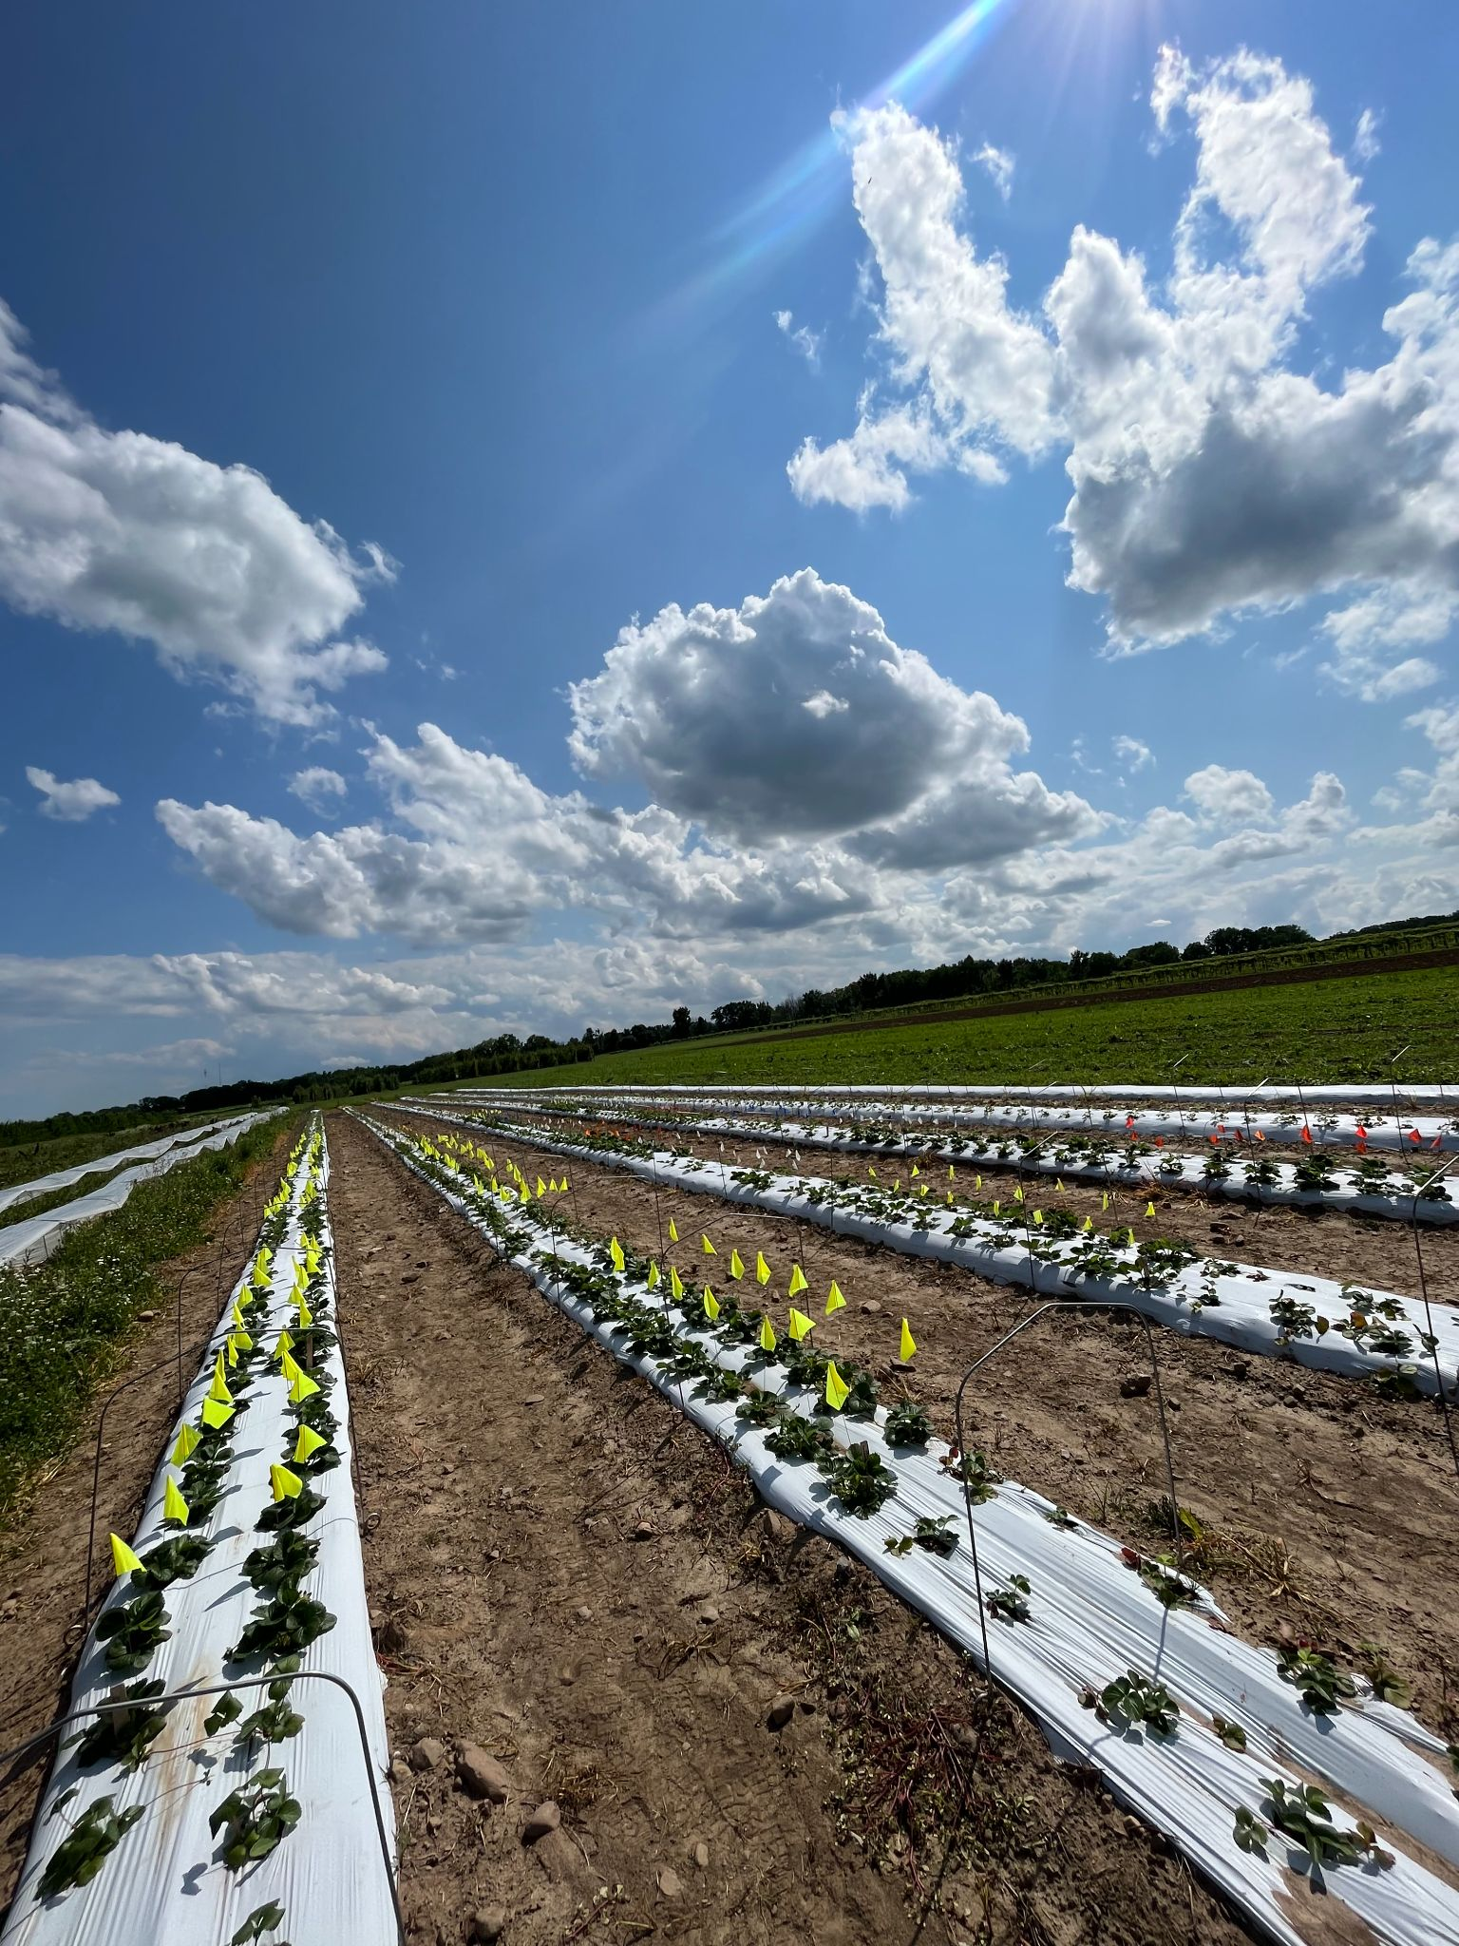
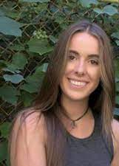
Courtney Weber
Ava Forysteck
Evaluate plug plants vs. industry standard frigo-plants

Slide 7
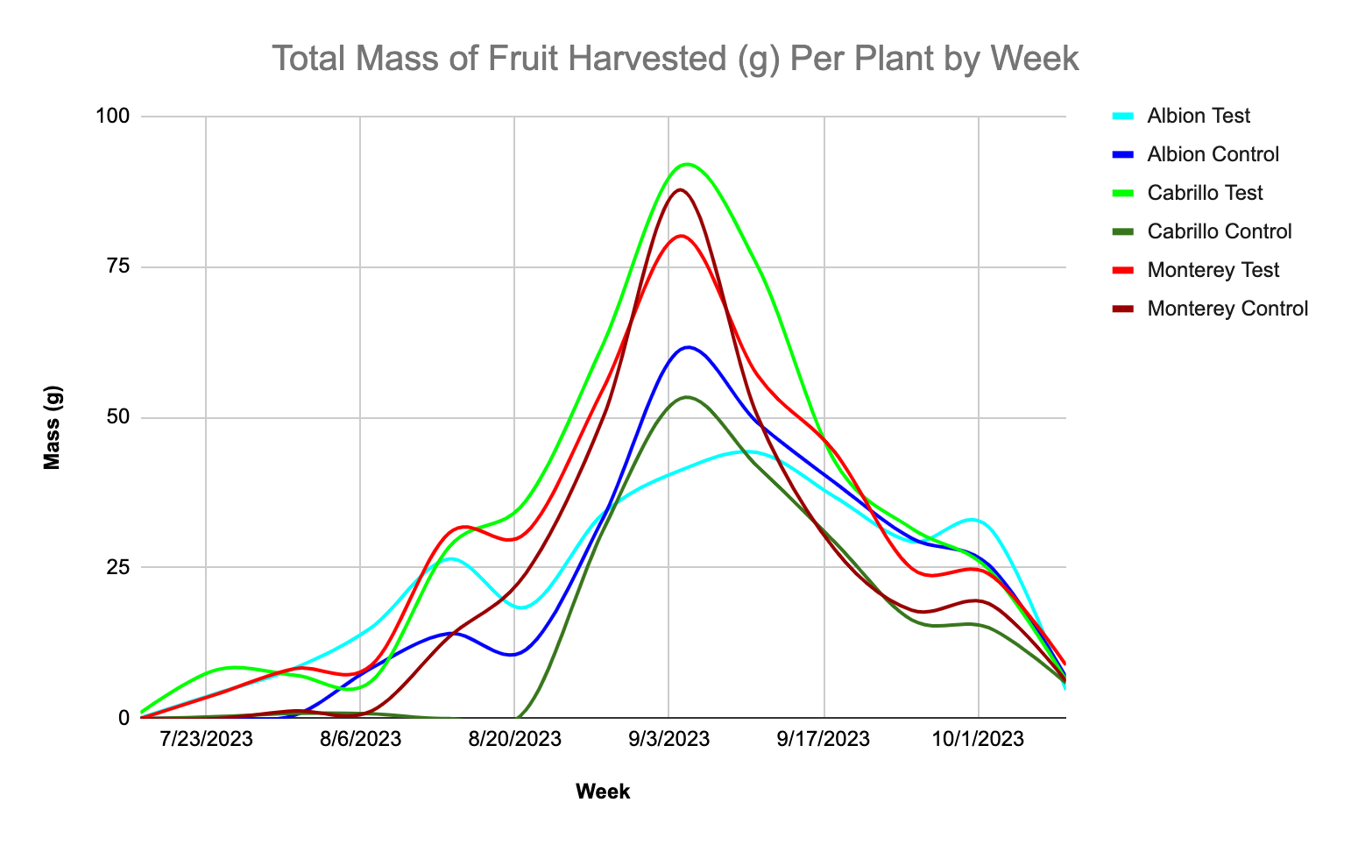

Slide 8
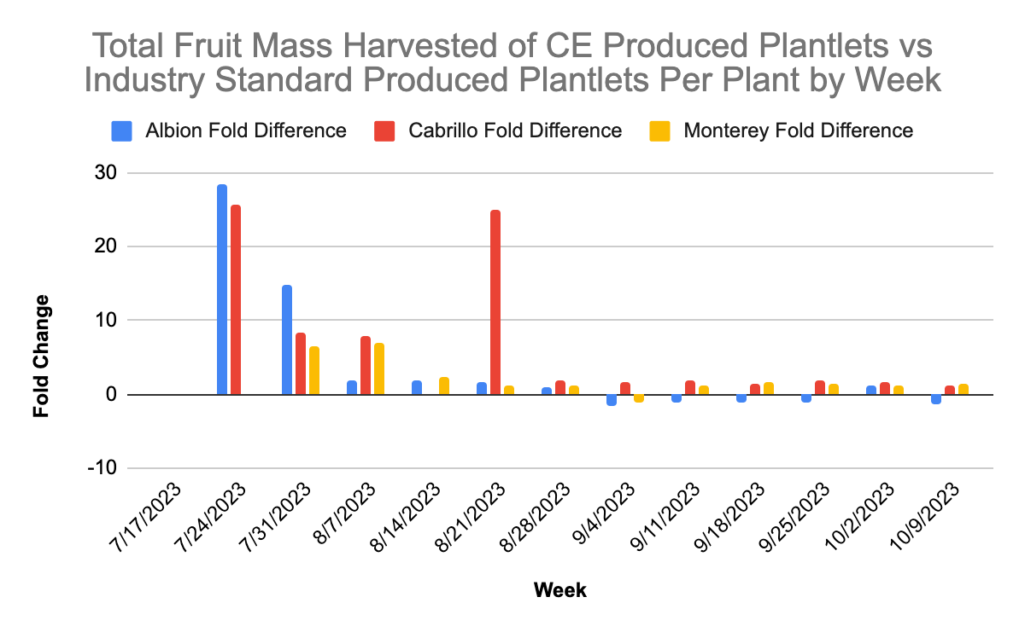

Slide 9
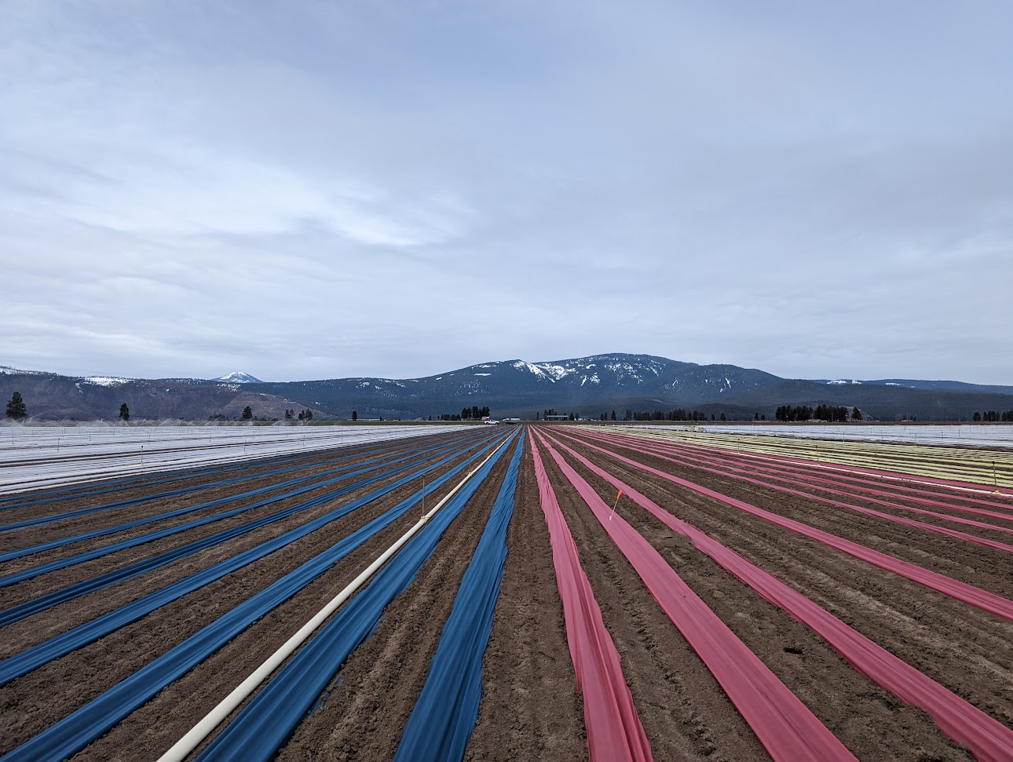
How can we optimize row cover use?
Jayesh Samtani
Mark Hoffmann

Slide 10
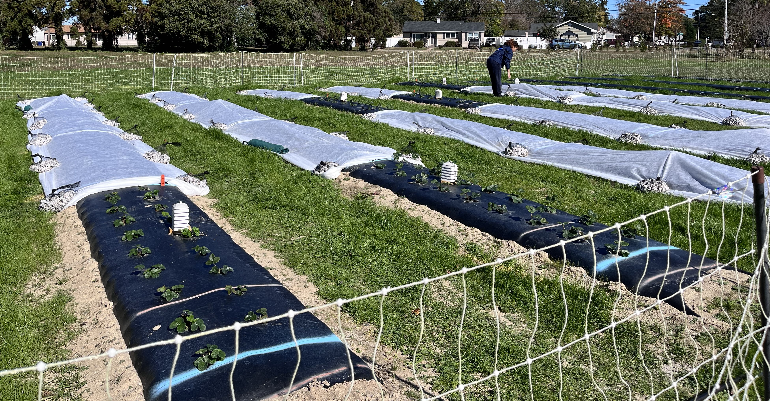
Field Study, Year 1, Virginia Beach, VA
Objective: To assess impact of additional GDD: 100, 200, and 400 GDD in fall and early winter on crop canopy, yield, and flower development
Copyright, Samtani 2024

Slide 11
Treatments | RowCover application date | RowCover removal date | GDD achieved
NRC | - | - | 530
100 GDD | 11/02/2023 | 11/15/2023 | 630
200 GDD | 11/02/2023 | 12/11/2023 | 730
400 GDD | 11/02/2023 | 01/04/2024 | 930
Copyright, Samtani 2024

Slide 12
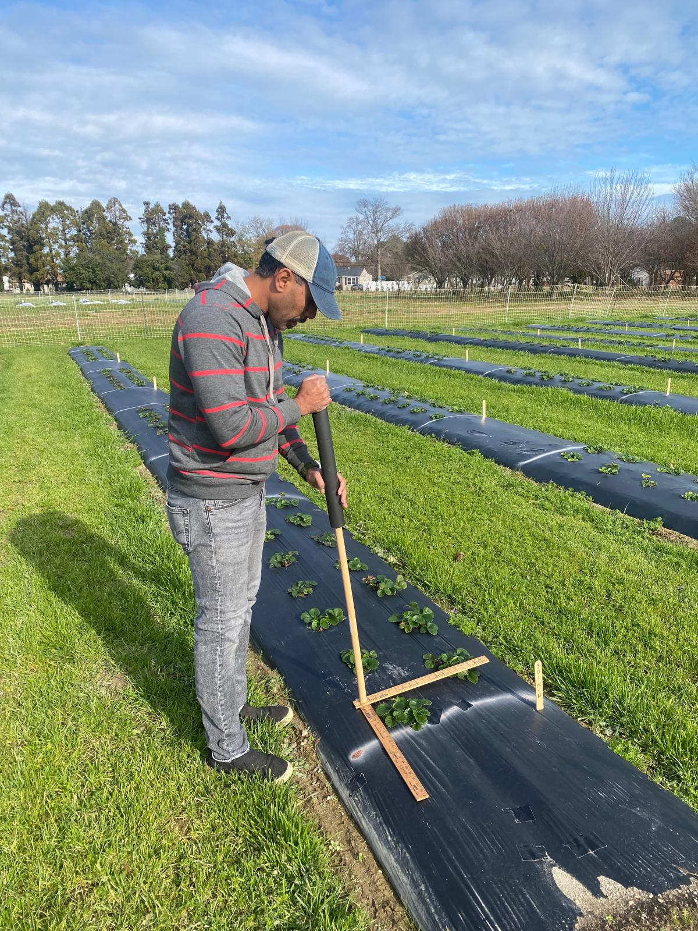
Plant canopy data was collected on January 8, 2024.
Cultivars | Marketable Yield (lb/Acre) | NonMarketable Yield (lb/Acre) | Total Yield (lb/Acre) | Small fruit (lb/Acre)
Chandler | 17,075b | 8908a | 25,955b | 3234a
Ruby June | 23,982a | 6688b | 30,697a | 699b
Copyright, Samtani 2024

Slide 13
CEA plants 2023-2025
Cabrillo, Monterey, Albion
Monterey
Fronteras
Chandler, Camarosa
Brilliance, Sensation

Slide 14
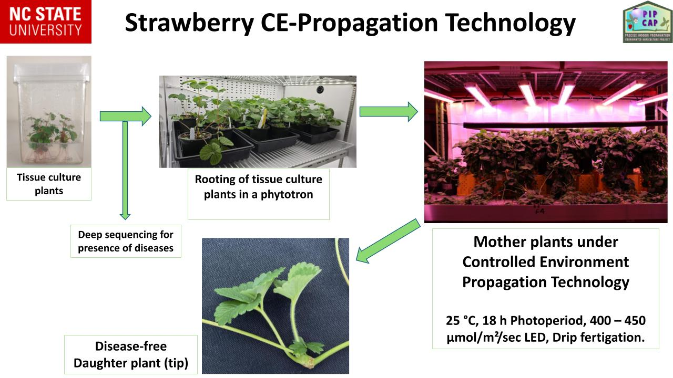

Slide 15
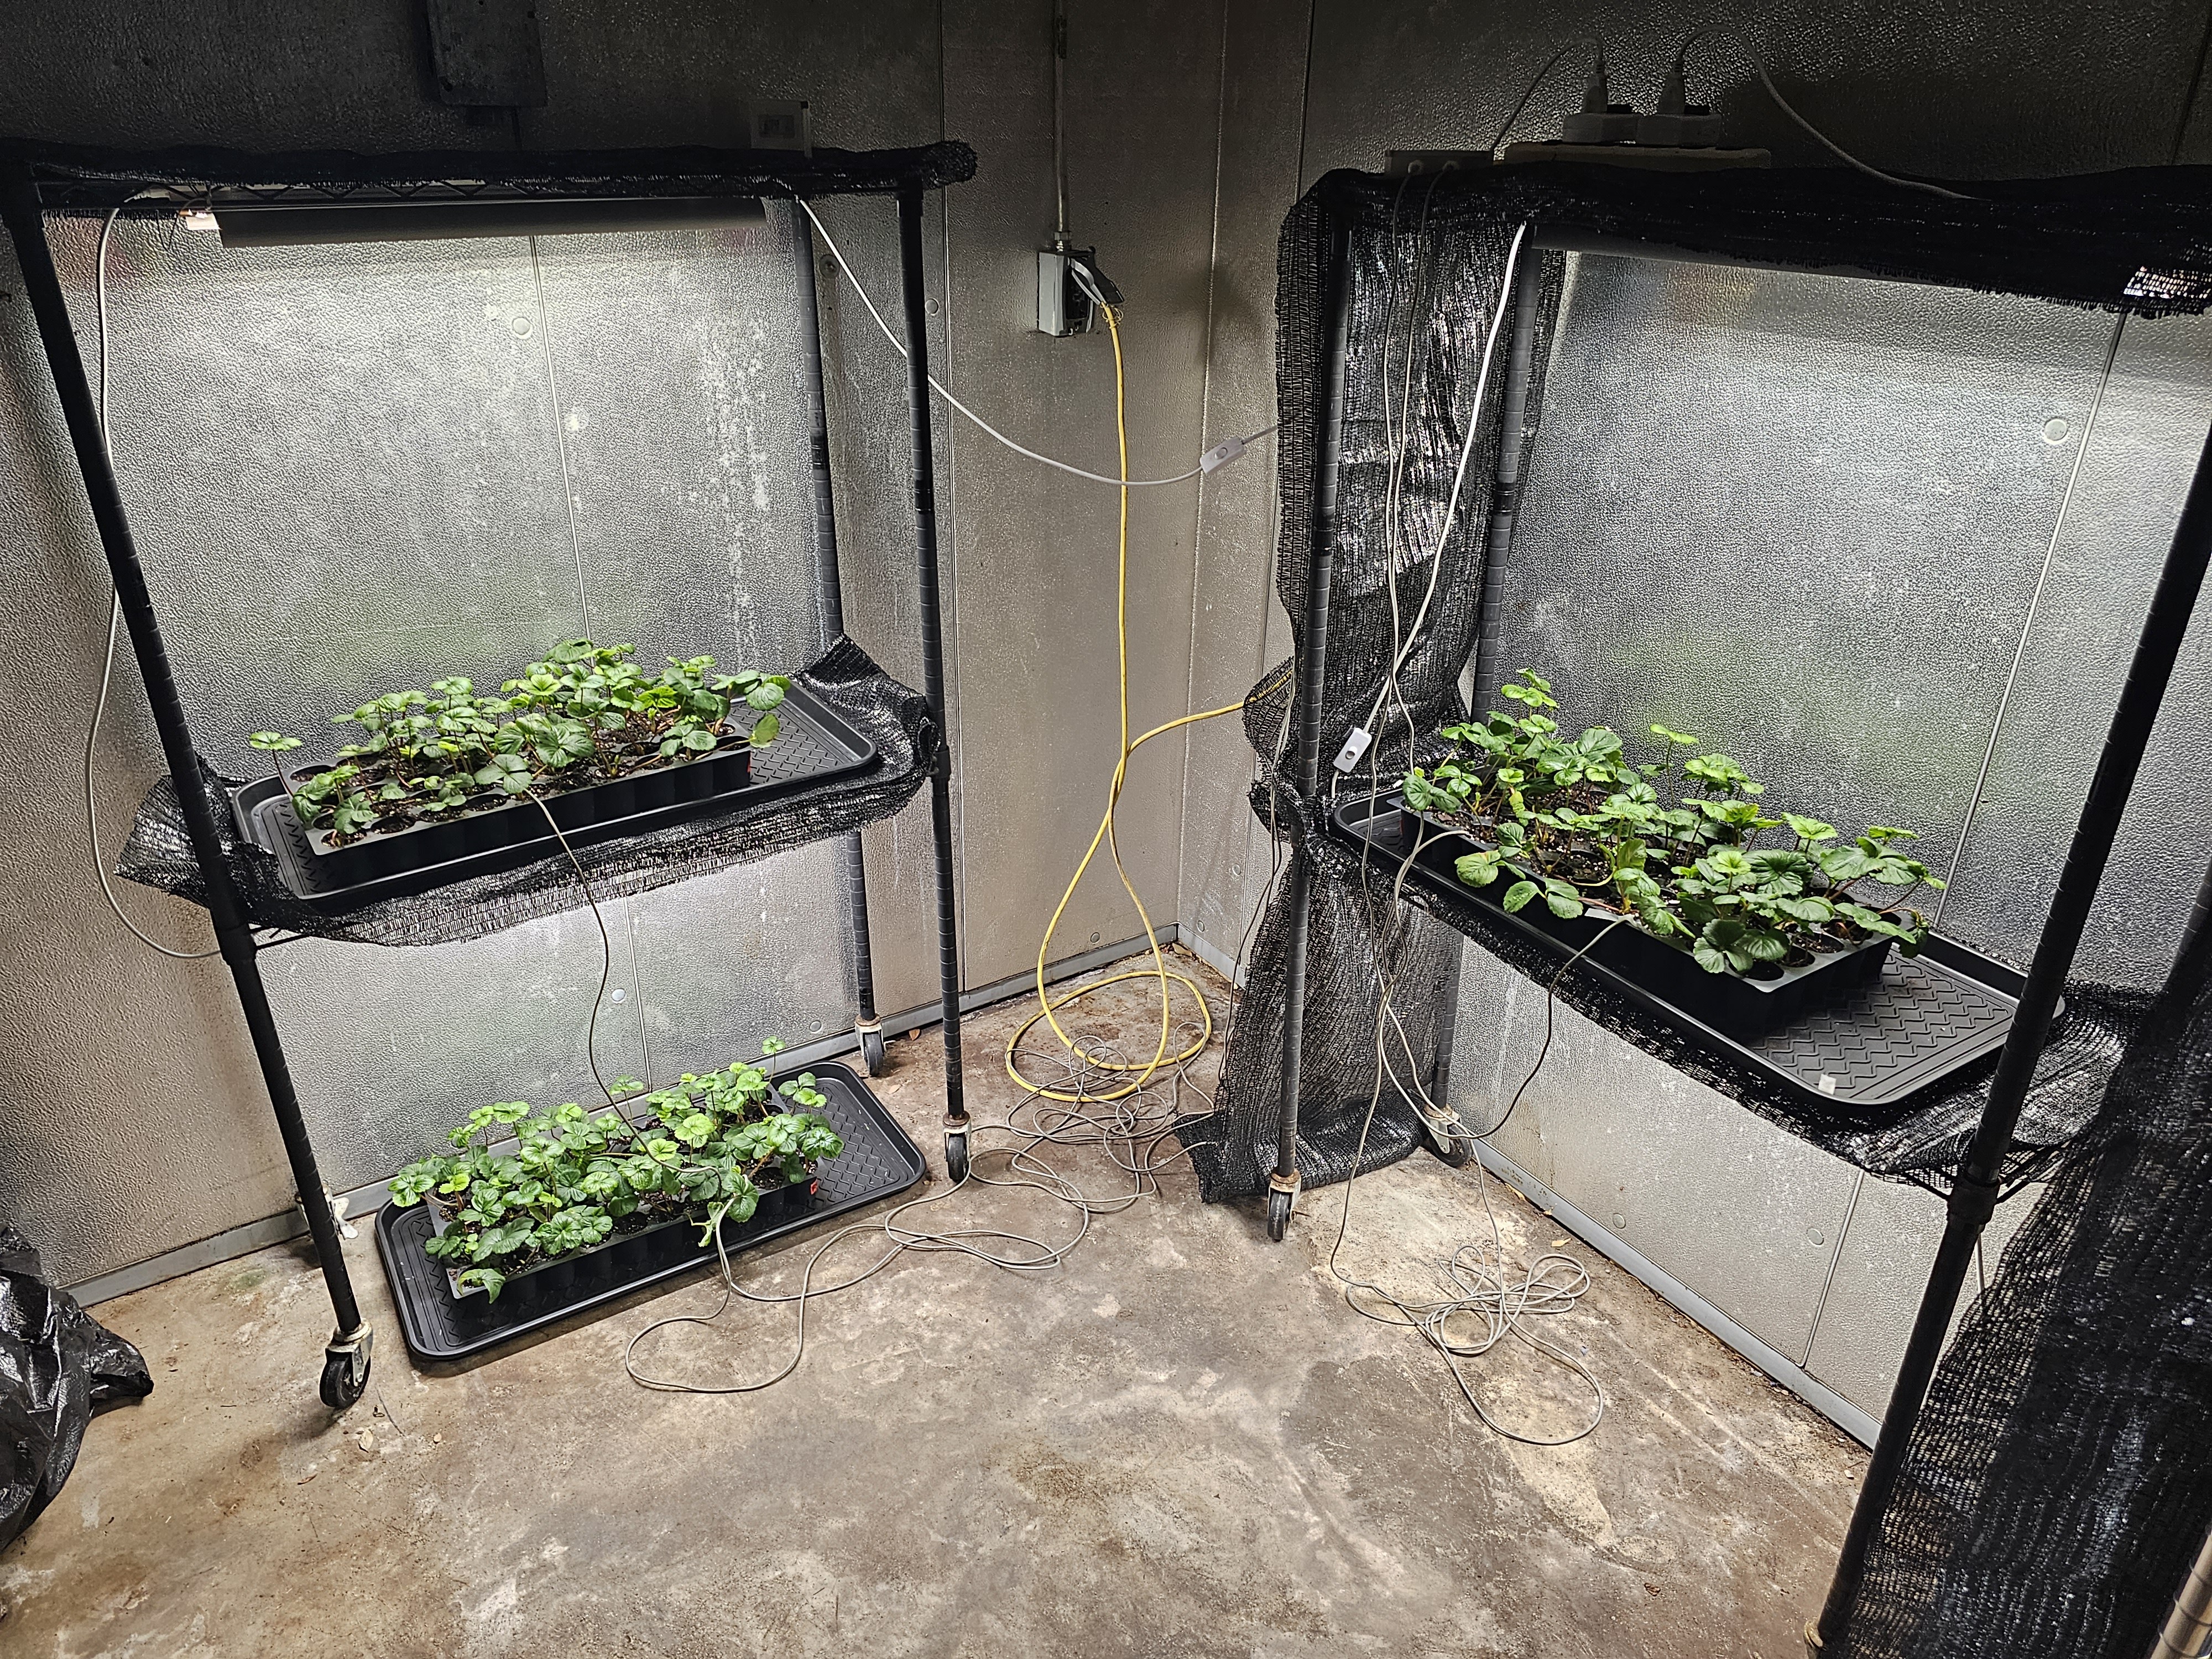
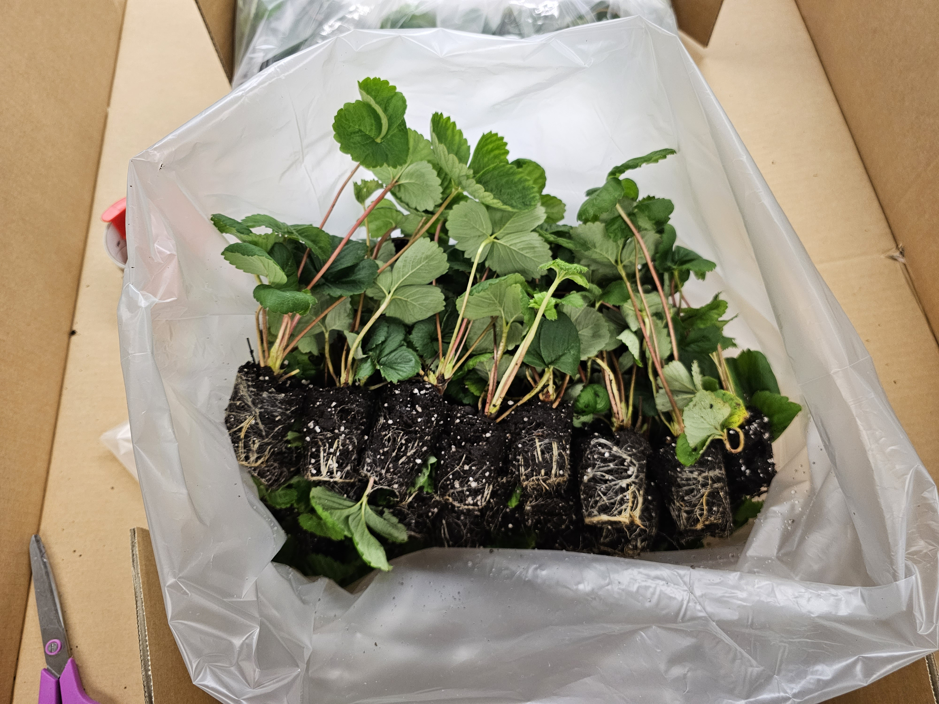
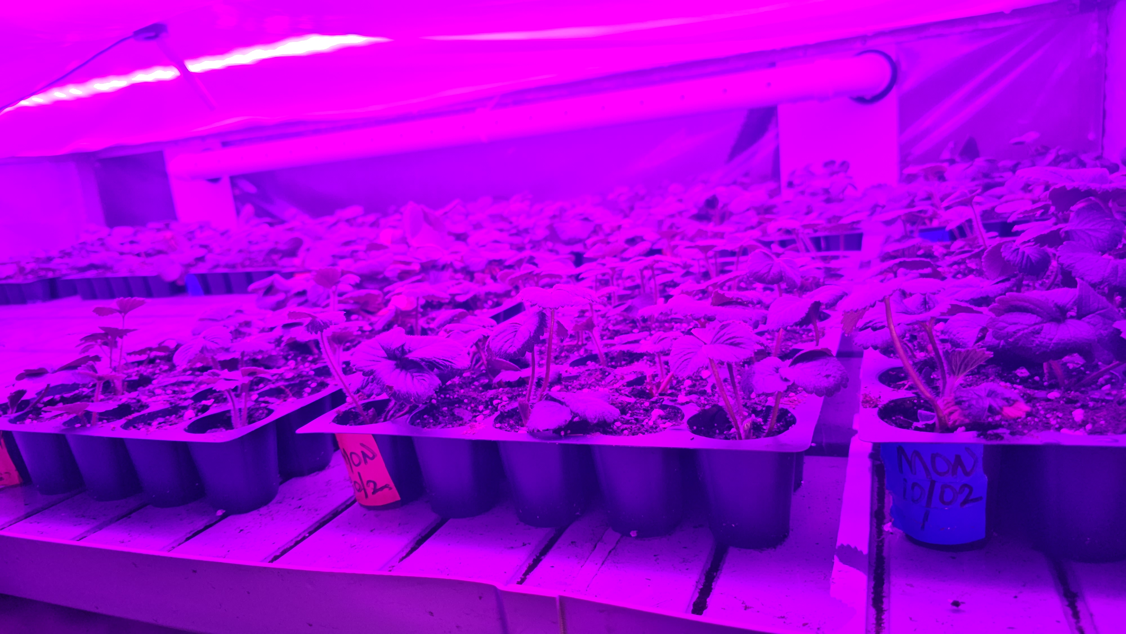
Strawberry Center SLO
Monterey
Southern CA (Ventura Co.)
Fronteras
Chilling Chamber
400-450 chilling hours
North Carolina
Chandler, Camarosa
Florida Gulf Research Center
Sensation, Brilliance
Rooting Chamber

Slide 16
Dr. Ibraheem Olasupo

