Slide 1
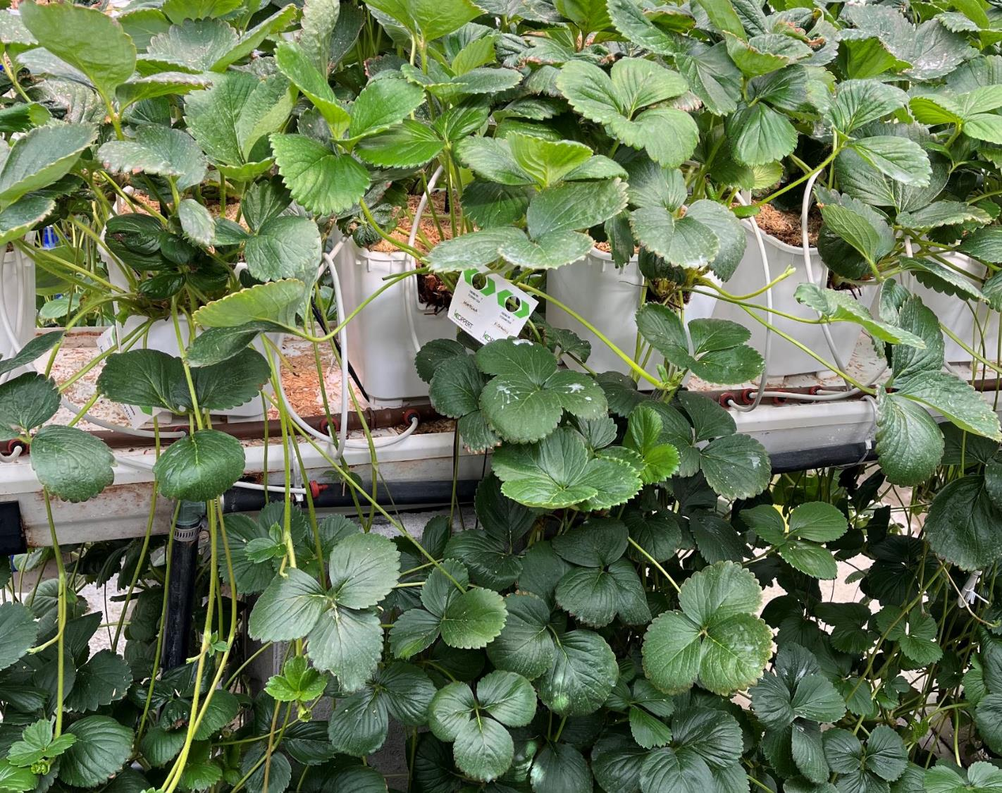

Objective 2
Environmental protocols for transplant establishment, conditioning (runnering/flowering), and long-term storage
Research Update (overviews)
Chieri Kubota (Ohio State Univ.)
Edward Durner (Rutgers Univ.)
Celina Gomez (Purdue Univ.)
Notes:
20 min

Slide 2
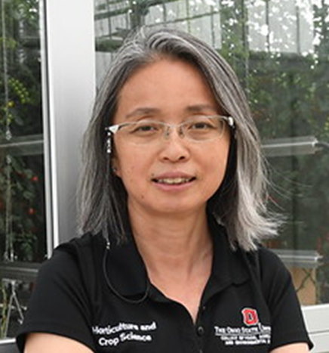
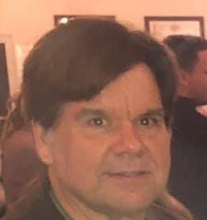
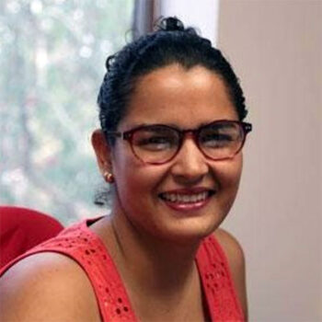
Obj. 2 Environmental protocols for transplant establishment, conditioning (runnering/flowering), and long-term storage
Team members:
Chieri Kubota
The Ohio State University
Edward Durner
Rutgers University
Celina Gomez
Purdue University

Slide 4
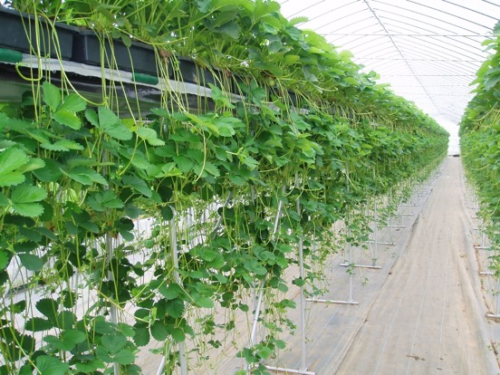
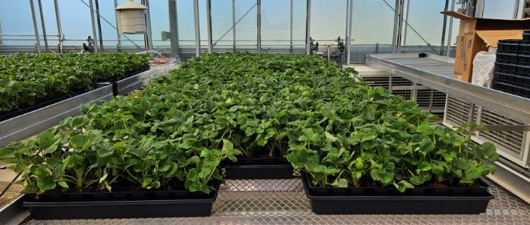
Greenhouse strawberry propagation (runnering & daughter plant production)
Current standard for greenhouse strawberry producers
Lower costs (Capex and Opex) than fully controlled indoor propagation
Disease and pest management can be a challenge in some cases

Slide 5
Transplant production cycles in greenhouse
August transplanting using trayplants or mini-trays is becoming common for North American greenhouses
Use of long-day cultivars is common in North America
Trayplant production must be in May – July (2-3 months)?
Runner tips must be obtained in May?
Runnering for March through May (12-14 weeks)?
Mother plant growing in January – February (2 months)?
Runner tips in December-January?
Stock plant maintenance year-round?

Slide 6
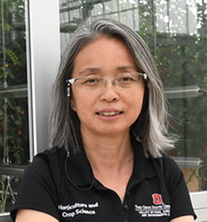
Obj. 2.1 – Conditioning plants for propagation, update
Chieri Kubota
The Ohio State University
Research focus: Artificial chilling treatment over propagation transplants for promoting runnering
Cultivars used: LD ‘Albion’ and SD ‘Fronteras’
Finding:
Experiments (two years) confirmed that ‘Albion’ respond positively to chilling treatment (1050 hrs) over mother plants prior to transplanting
‘Fronteras’ did not respond to chilling and may require additional pre-conditioning of optimum temperature and daylength
  SD pre-conditioning enhanced branch-crown development in ‘Fronteras’
2025 plan: Developing optimum conditioning protocols for both cultivars

Slide 7
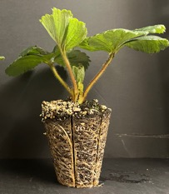
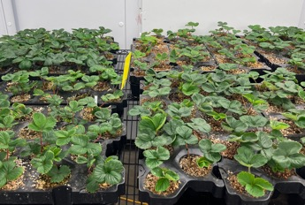
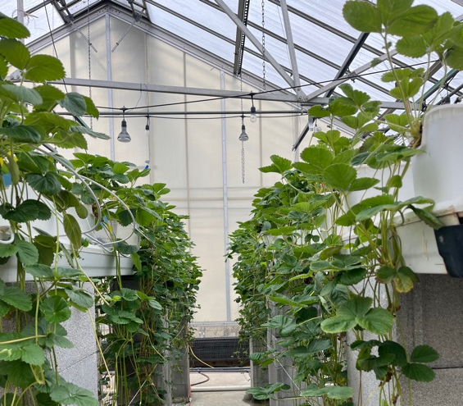
“Can chilling mother plants enhance runnering?”
Experimental process
Trayplants were grown starting from rooted runner tips (8 weeks) to use as mother plants in a growth chamber (28/22°C, ADT 22°C; 16-h long day, 21 mol m⁻² d⁻¹ DLI; T8 fluorescent lamps)
Chilling at 0°C in darkness for cultivar-specific durations (44 d for ‘Albion’, 19 d for ‘Fronteras’)
  Some plants were treated under 15/4 °C (day/night), 10-h short-day, 1.4 mol m⁻² d⁻¹ DLI to provide 30% of total chilling hours (25 d for ‘Albrion’, 10 d for ‘Fronteras’) prior to chilling [Pre-Conditioning]
Transplanted for runnering and daughter plant production over 12 weeks in greenhouse (target ADT 26C; 16-h long day)
Notes:
40 micro-mol PPFD x 10 hours

Slide 8
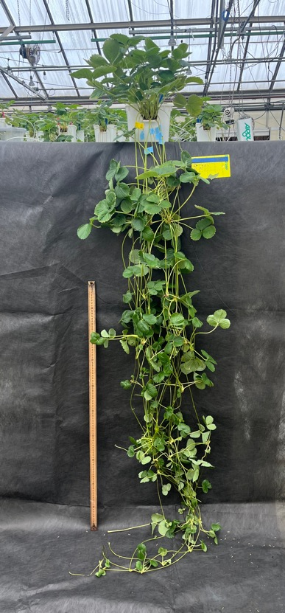
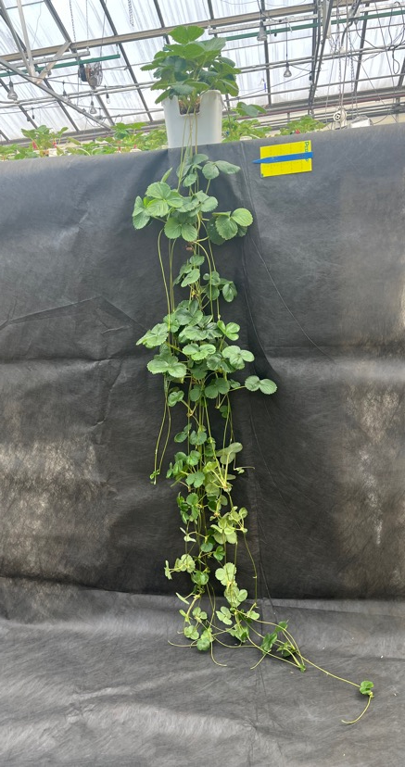
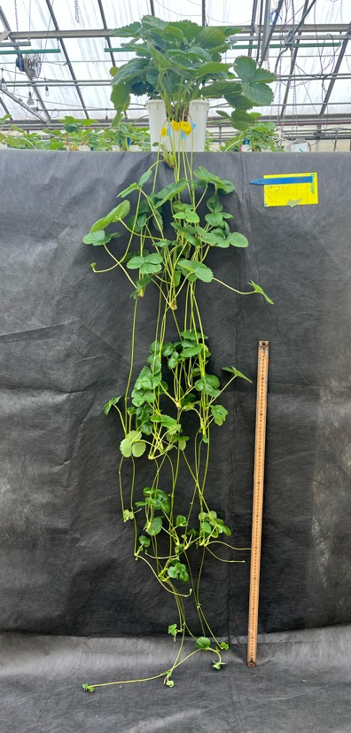
‘Albion’ runnering and number of daughter plants were enhanced by chilling
Photos were taken after 12 weeks of transplanting
#DP = 27 ± 2.3b
#DP = 43 ± 4.4a
#DP = 32 ± 4.2ab
Control (no chilling)
Chilled (1050 h)
Pre-condition. + chilling

Slide 9
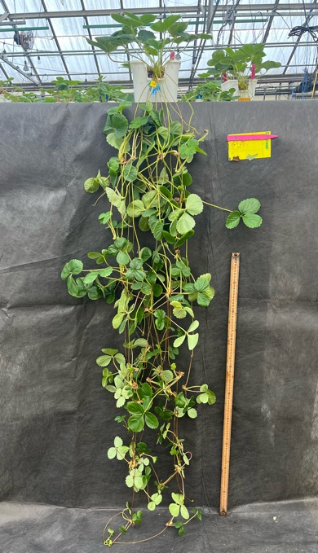
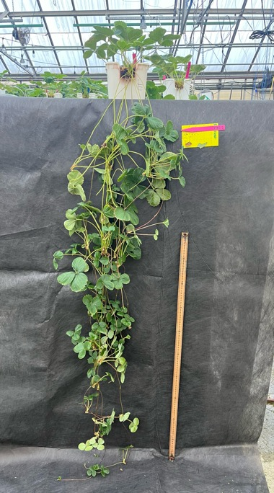
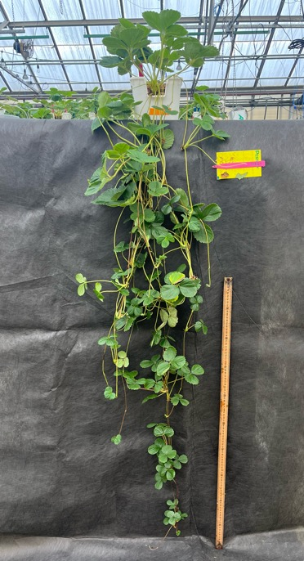
‘Fronteras’ plants were not affected by chilling regardless of pre-conditioning
Photos were taken after 12 weeks of transplanting
#DP = 41 ± 1.9
#DP = 42 ± 2.5
#DP = 34 ± 2.7
NS for all treatment means
Control (no chilling)
Chilled (450 h)
Pre-condition. + chilling

Slide 10
Other key data
‘Albion’ (LD, high chill)
Total number of runners
Control < Chilling (↑170%)
Total runner length
Control < Chilling (↑ 53%)
Number of runner branching
Control > Chilling (↓ 60%)
Number of crowns (mother plants)
Control = Chilling (Avg. 4.3)
Mother plant photosynthesis
Control = Chilling
Mother plant biomass
Control = Chilling
‘Fronteras’ (SD, low chill)
Total number of runners
Control = Chilling
Total runner length
Control = Chilling
Number of runner branching
Control = Chilling
Number of crowns (mother plants)
Control = Chilling [No branch crowns]
Mother plant photosynthesis
Control = Chilling
Mother plant biomass
Control = Chilling

Slide 11
“Will a dormancy-inducing pre-conditioning maximize the chilling responses?”
On-going experiments [confirming conditions that induce dormancy]
Trayplants were produced from rooted runner tips (8 weeks) to use as mother plants in a growth chamber (28/22°C (day/night), ADT 26°C ; 16-h long day, 21 mol m⁻² d⁻¹ DLI; T8 fluorescent lamps)
Conditioning at 9, 16, or 23 °C in a growth chamber (10-h short day, 11 mol m⁻² d⁻¹ DLI; T8 fluorescent lamp) or no conditioning (control)
Growing out in a greenhouse for 4 weeks to identify semi-dormancy characteristics (morphology and carbohydrate accumulations)

Slide 12
Our hypothetical “optimum” procedures for preparing mother plants (to be tested in 2025)
Rooting tips
(10 d)
Transplant production in LD (&
pre-conditioning in SD as
needed) (8-10 wks)
Chilling
(20-45 d)
Runnering in LD
(> 3 months)
Additional points of investigation:
Low chill cultivars may not significantly respond to chilling
Branch crown induction prior to transplanting under SD may be beneficial for cultivars like SD ‘Fronteras’ that do not otherwise produce branch crowns

Slide 13
Obj. 2.2 – Conditioning plants for fruit production, update
Edward Durner
Rutgers University
Research focus: Photoperiodic lighting quality for conditioning transplants for fruit production in different cropping systems
Cultivars used: LD ‘Soraya’ (F1 hybrid seed cultivar), LD ‘Albion’, SD ‘Sweet Charlie’ and SD ‘Chandler’
Status: 16 photoperiod lighting treatments (6 or 12 weeks) were examined for flower and crown development
Finding:
BOD R or FR+R NI promoted flower development in ‘Soraya’
EOD R, R NI, B+R NI, and B+FR NI promoted flower development in ‘Sweet C.’
R NI, FR+R NI, and B+R+FR NI largely promoted flower development in ‘Albion’
No light treatment responses in ‘Chandler’
2025 plan: Testing fruit production of light treated transplants in a greenhouse and a field plot.
Notes:
10 umol

Slide 14
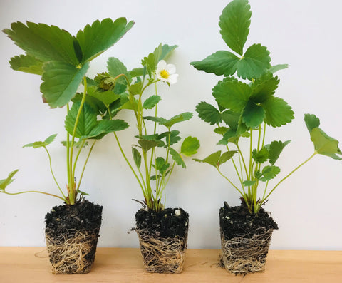
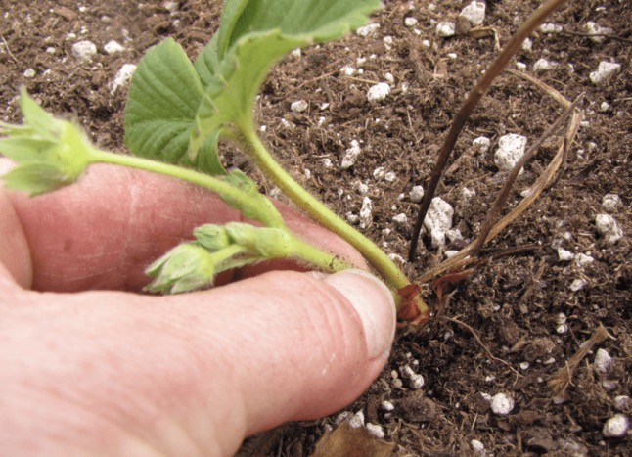
Rutgers Research
Can we keep long-day cultivars (i.e. ‘Albion) vegetative during propagation and immediately thereafter to produce a larger plug before it flowers to reduce labor cost of inflorescence removal?

Slide 15
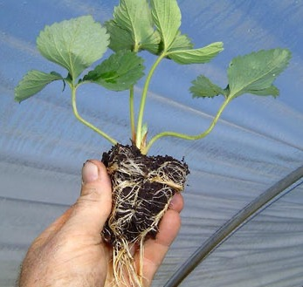
Rutgers Research
Can we encourage branch crown development during propagation in a short-day cultivar (i.e. ‘Chandler’) to reduce the sensitivity to planting date in the plasticulture system?

Slide 16
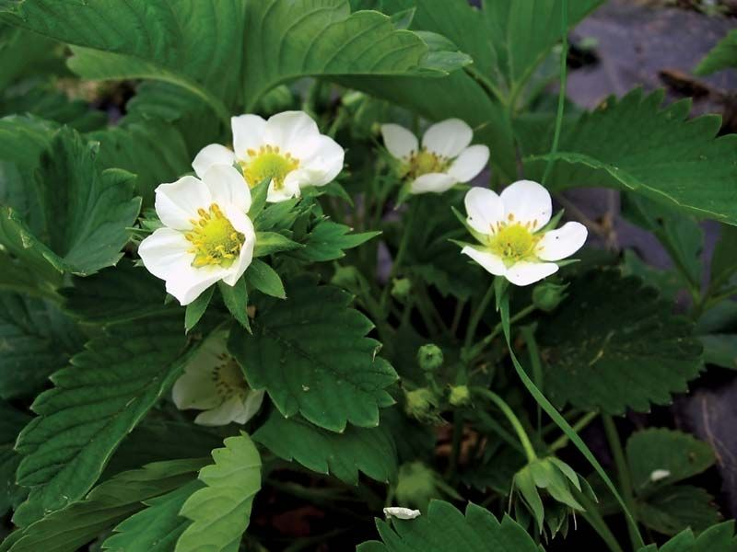
Rutgers Research
Can we encourage branch crown development with one wavelength followed by a different wavelength during propagation to encourage flower bud development to produce a ‘production-ready’ plug plant with 5 or 6 branch crowns for the greenhouse or field?

Slide 17

Material & Methods
Transplant growing system:
50-cell plug seedlings transplanted into 275 mL cell trays
Treatment:
10 hr photoperiod, 150 µmoles m⁻² s-¹, 85-95ºF (29-35ºC)
6 or 12 weeks exposure
22 Treatments: Control
R – BOD, EOD, NI
Fr – BOD, EOD, NI
R + Fr – BOD, EOD, NI
B – BOD, EOD, NI
B + R – BOD, EOD, NI
B + FR – BOD, EOD, NI
B + R + FR – BOD, EOD, NI
BOD (3am – 8am), EOD (6pm – 11pm), NI (10:30pm – 3:30am)
Phenology evaluated during treatment
Notes:
This was the work I completed last year to evaluate the methodology I developed for testing different light exposures.
I used ‘Soraya’ to ensure I had enough plants to complete the experiment.
This slide describes the treatment protocol and the next slide describes the evaluation procedure.

Slide 18
Flower Mapping Results Fall 2024 | Cultivar
Light source | ‘Sweet Charlie’ | ‘Albion’ | ‘Chandler’ | ‘Soraya’ (2023)
Control | 0.4 | 0 | 1.2 | 0.6
Far-red BOD | 0.8 | 0 | 0.8 | 0.0
Far-red EOD | 1.4 | 1.8 + | 2.8 | 0.2
Far-red NI | 0.0 | 2.4 + | 0.4 | 0.0
Red BOD | 0.6 | 0 | 2.6 | 2.6 +
Red EOD | 2.6 +^{z} | 0 | 1.8 | 0.4
Red NI | 2.6 + | 3.6 + | 2.0 | 1.2
Far-red + Red BOD | 0.0 | 0 | 1.2 | 1.5
Far-red + Red EOD | 0.8 | 3.6 + | 1.8 | 0.3
Far-red + Red NI | 0.4 | 0 | 0.6 | 2.9 +
Blue BOD | 1.0 | 1.4 | 1.8 | 0.0
Blue EOD | 0.6 | 1.6 + | 2.6 | 0.0
Blue NI | 0.0 | 0 | 2.4 | 0.3
Blue + red BOD | 1.0 | 0 | 2.4 | -
Blue + red EOD | 0.0 | 0 | 0.8 | -
Blue + red NI | 2.2 + | 0.8 | 2.0 | -
Blue + far-red BOD | 0.0 | 0 | 2.0 | -
Blue + far-red EOD | 0.6 | 0 | 2.0 | -
Blue + far-red NI | 2.2 + | 0.4 | 1.2 | -
Blue + red + far-red BOD | 0.0 | 0 | 0.0 | -
Blue+ red + far-red EOD | 0.0 | 0 | 2.2 | -
Blue+ red + far-red NI | 1.2 | 3.4 + | 0.0 | -
- or + indicates significantly different (+ is greater than and - is less than) from the control within treatment duration by Dunnett’s Procedure, α = 0.10.
EOD = end of dark period, BOD = beginning of dark period and NI = night interruption. Blue lighting was continuous rather than a night interruption, - not tested.
Notes:
Flower mapping results including the results from last year using ‘Soraya’ for easy comparison.
Note that the long day cultivars were different in their response suggesting that we can’t assume that long day cultivars respond similarly as suggested by Sonsteby and Heide in their work.
‘Sweet Charlie’ seems to be much more sensitive to treatment than ‘Chandler’.
However, this is only one method of evaluation. I also have plants being forced in a long day greenhouse and have a field planting to be evaluated in the spring for inflorescence number, crown number, yield, etc.

Slide 19

Obj. 2.3 – Low-temperature storage of unrooted runner tips and plugs, update
Celina Gómez
Purdue University
Research focus: Development of low temperature storage protocols for unrooted runner tips and rooted plugs (4 weeks old)
Cultivar used: LD ‘Albion’
Status: Plugs were stored for 28 days at varied temperatures (-1.6 to 5.8°C) and light (dark vs. dim light). Runner tips were stored for 30 days at varied temperatures (-1.5 to 4.7°C) in darkness; planted into greenhouse to evaluate
Finding:
No light needed during plug storage
2°C storage maintained visual quality higher than other temperatures; however, the post-storage productivity was not affected by temperatures
Runner tips storability was greater for tips with larger crowns
Notes:
Below is an overview of the main findings to emphasize:
1. The use of light during CS seems to be unnecessary.
2. Petiole length increased under darkness at warmer temperatures (>3 °C)
3. Quality of transplants decreased at low temperatures regardless of crown diameter.
4. Transplants exposed to cold storage had lower root dry mass compared to those that were not stored.
5. Transplants stored at low temperatures, especially those at or below -1.5 °C, experienced reduced quality and affected subsequent growth. Therefore, storage decisions should prioritize cost-effectiveness to ensure optimal outcomes.

Slide 20
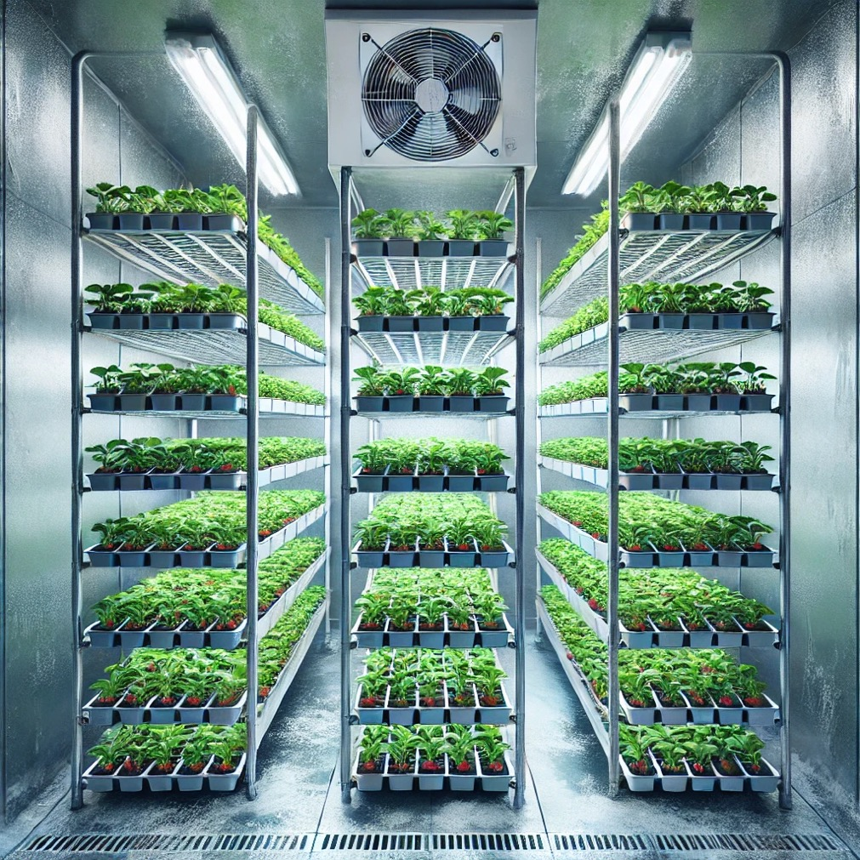
Short-term storage of transplants
Adds more flexibility in propagation schedule
Increases the volume to ship at a time
Species/cultivar specific temperature and light optimum for preserving plant growth without impacting their growth and development
Image by Lian Duron Alvarado

Slide 21
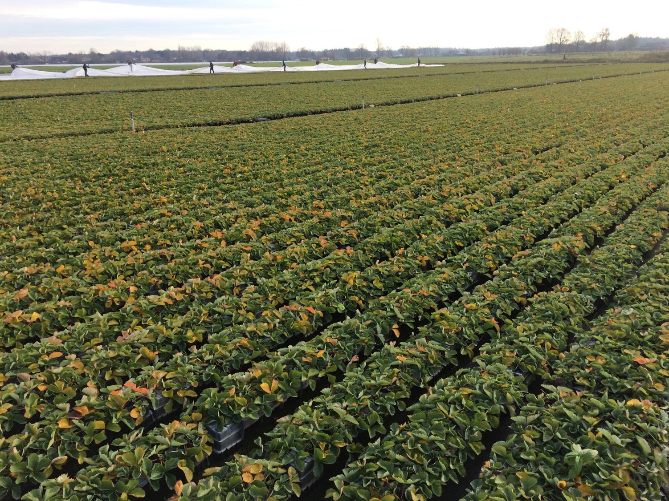
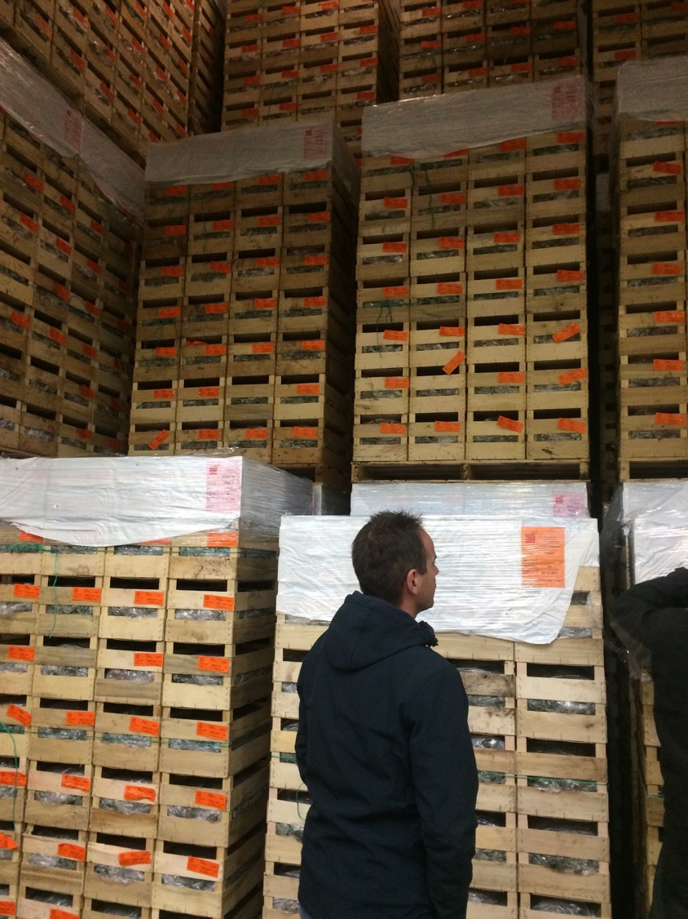
Trayplant production and long-term storage (-1.5 °C) after dormancy

Slide 22
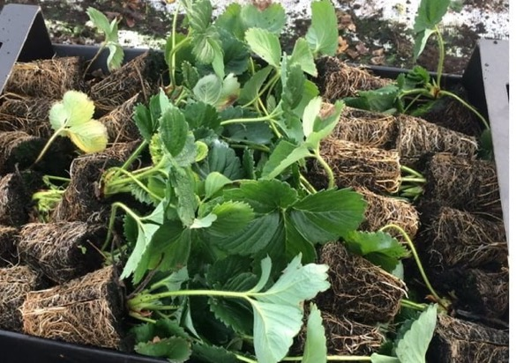
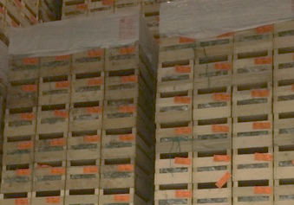
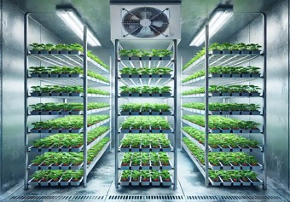
Possible stages to introduce a short-term storage
Runnering
Runner tips
Plugs (traysplants)
Storage
Storage

Slide 23
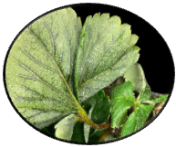
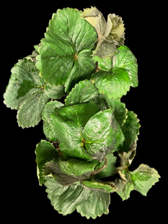
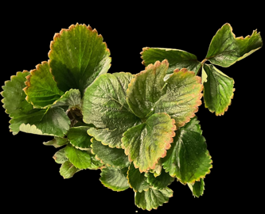
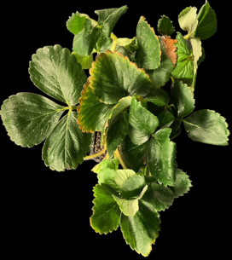
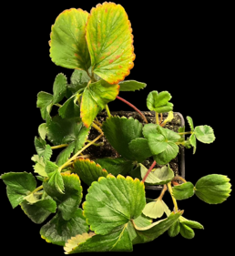
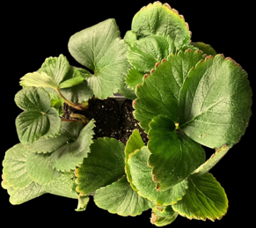
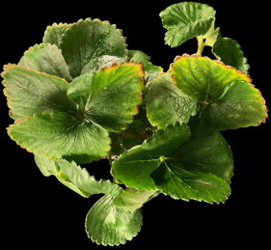
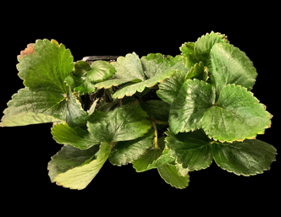
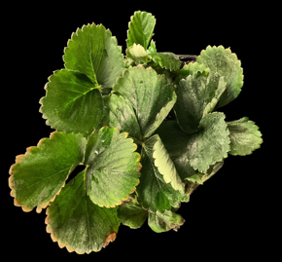
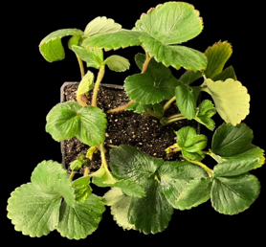
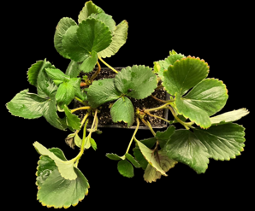
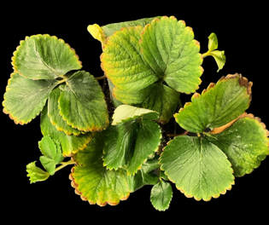
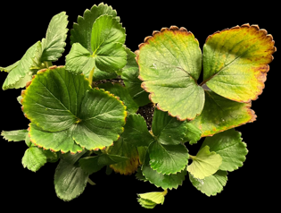
Plants after 4 weeks of CS propagated under 24 h∙d⁻¹
Temperature (°C)
- 2.2 - 1.9 0.6 0.3 3.8 8.9
With light
Quality (1-4)
4 3 2 2 2 2
- 0.9 - 0.5 2.0 2.3 4.6 5.2
Without light
Quality (1-4)
2 3 1 2 3 3
Notes:
1 = most leaves were dark, green with a healthy appearance
2 = most transplants had slight chlorosis or leaf discoloration
3 = leaves of most transplants showed chlorosis or browning and sings of water-soaked tissues
4 = leaves of most transplants showed necrosis and severe water-soaked tissues.

Slide 24
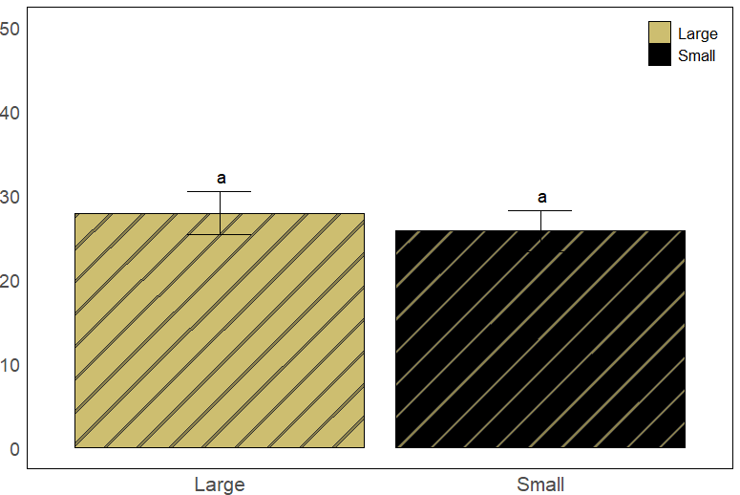
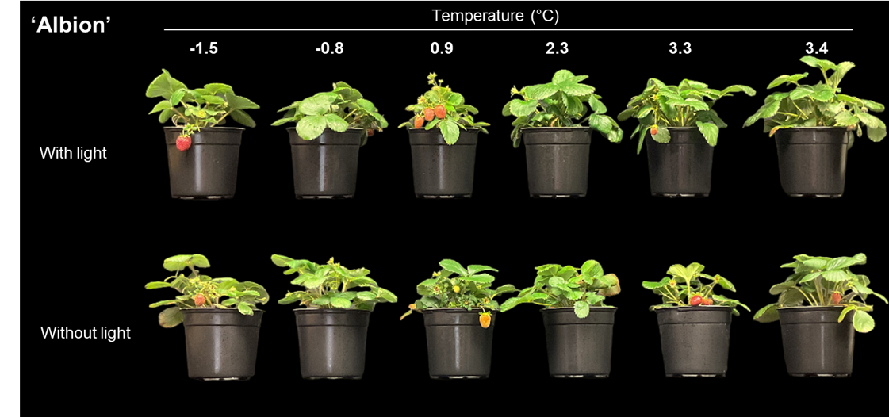
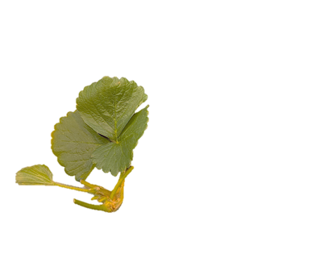
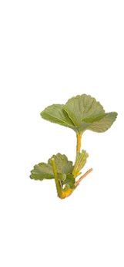
Plants after 8 weeks in a common greenhouse environment
Temperature NS
Light use NS
Crown diameter NS
Temperature * Light NS

Slide 25
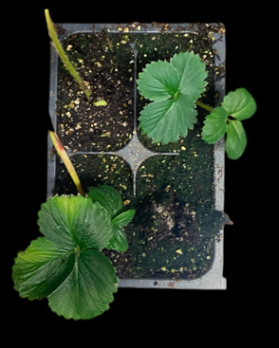
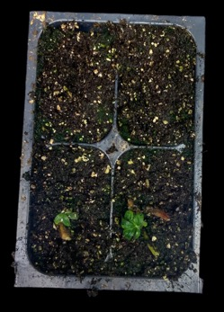
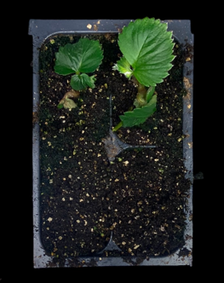
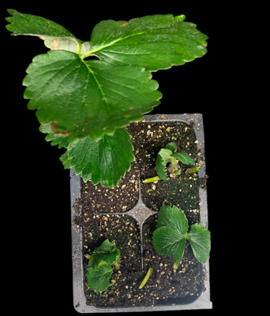
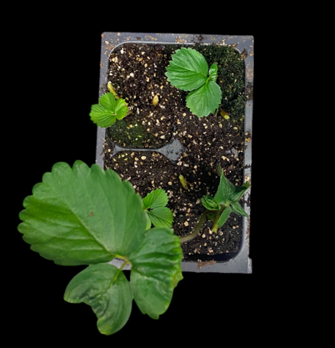
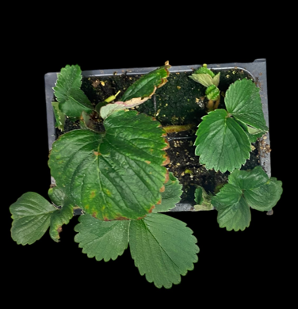
Plants after 28 d under indoor propagation
Temperature (°C)
- 1.5 2 4.7
Crown size
Small (< 10 mm)
Crown size
Large (> 10 mm)

Slide 26
Factors that need further optimization
More cultivars need to be tested for their responses to the protocols developed based on our standard cultivars ‘Albion’, ‘Fronteras’, and others
Cost analyses for the new protocols of conditioning plants
  Chilling and preconditioning treatments
  Lighting treatments
Cost analyses for the short-term storage of transplants and daughter plants

Slide 27




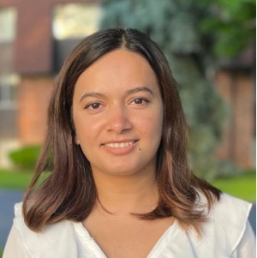

Thank you!
Chieri Kubota
Ohio State University
Edward Durner
Rutgers University
Celina Gomez
Purdue University
Pooja Tripathi
Lian M. Duron Alvarado

