Slide 1
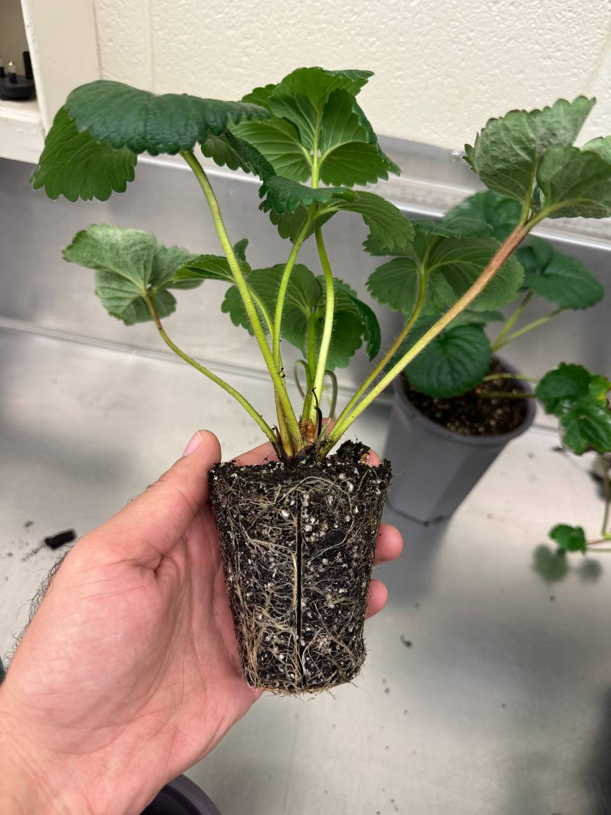
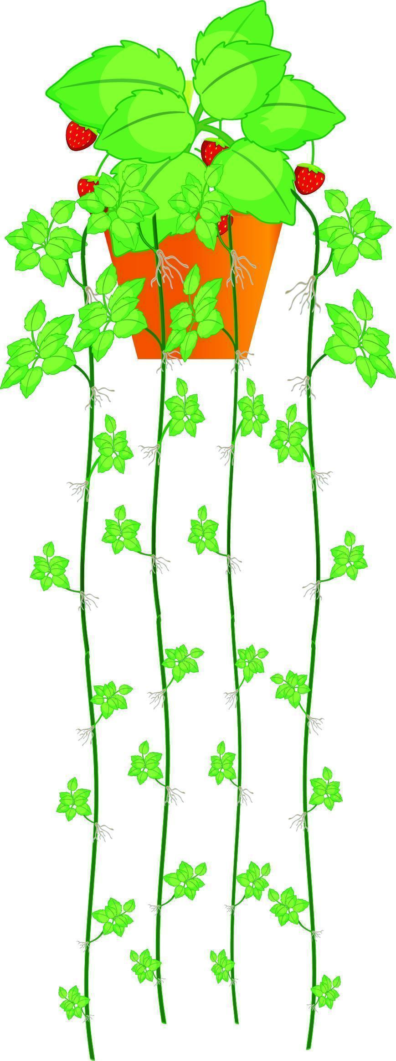
Update on the strawberry propagation research in the Hernandez lab Nov 13, 2024
Presenters:
Ricardo Hernandez
Moein Moosavi

Slide 2
01
02
03
04
05
06
Experiments
Light intensity & CO₂
Samson Humphrey
Photoperiod
Moein Moosavi
Increasing plant density based on LAI
Moein Moosavi
Light Spectrum
Moein Moosavi
DP size estimation with image analysis
Moein Moosavi
Top vs. intracanopy lighting
Moein Moosavi

Slide 3
01
02
03
04
05
06
Experiments
Light intensity & CO₂
Samson Humphrey
Photoperiod
Moein Moosavi
Increasing plant density based on LAI
Moein Moosavi
Light Spectrum
Moein Moosavi
DP size estimation with image analysis
Moein Moosavi
Top vs. intracanopy lighting
Moein Moosavi

Slide 4
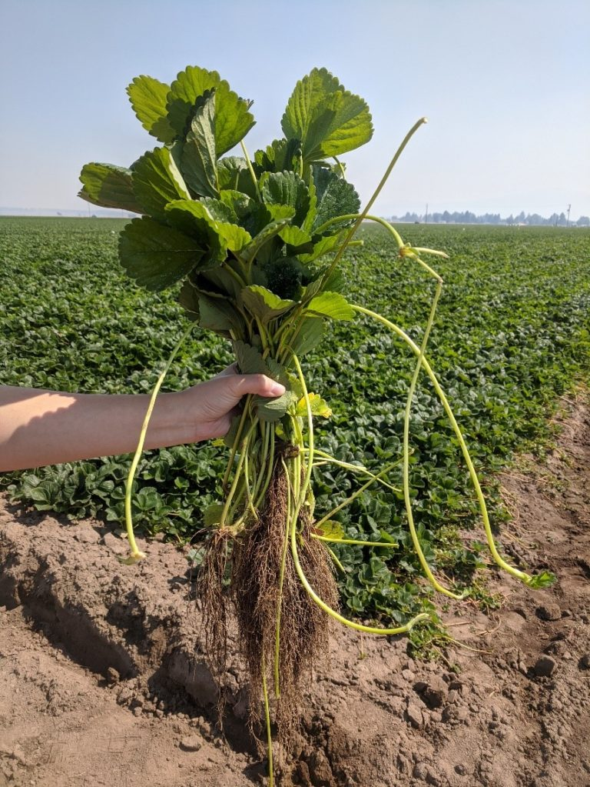
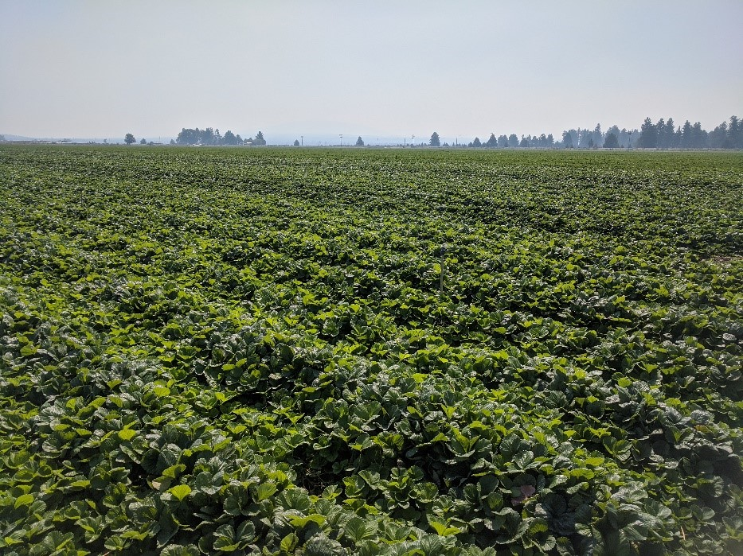
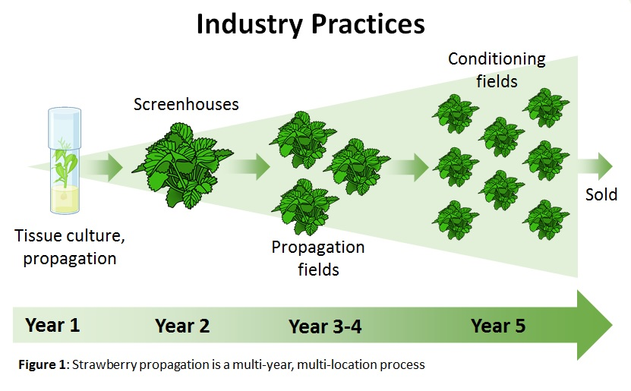
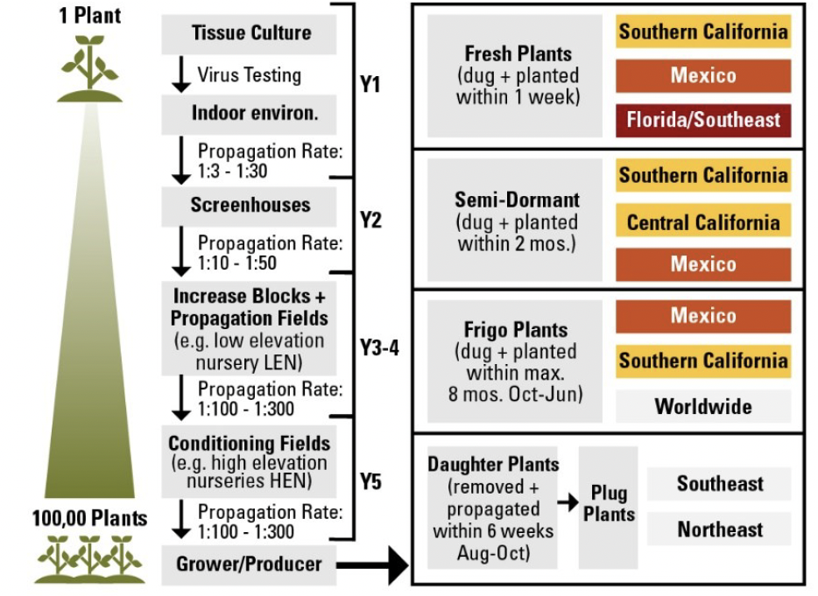
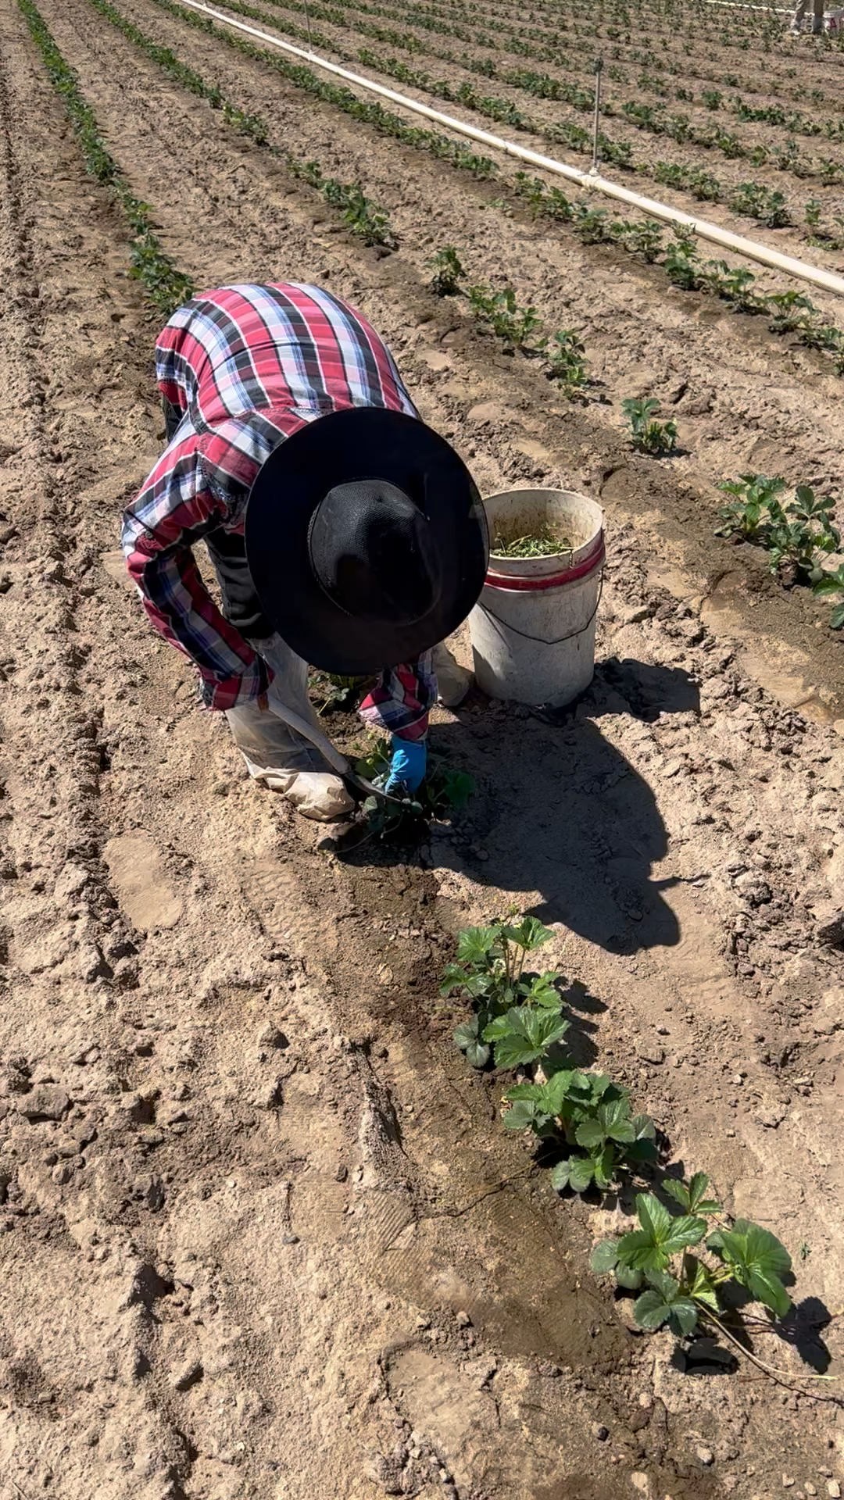
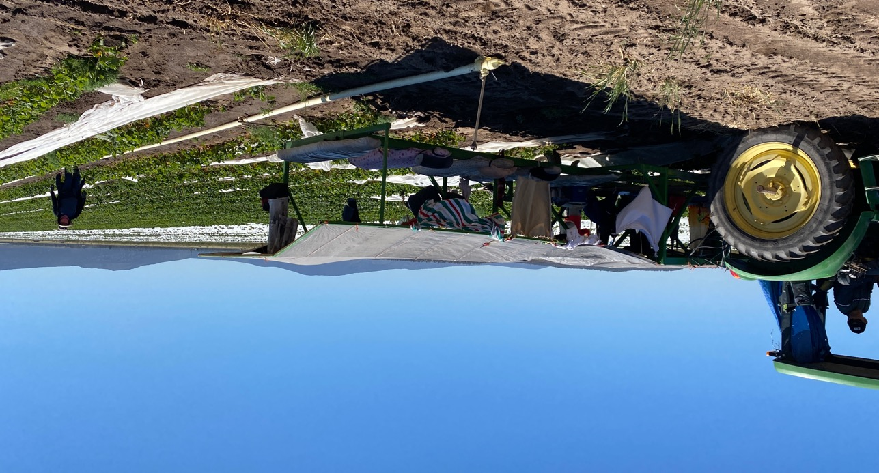
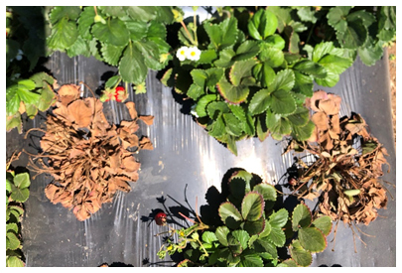
Introduction
https://smallfruits.org/2022/01/develop-cleaner-propagation-technology-for-the-strawberry-industry/

Slide 5
What has been done?

Slide 6
Light intensity & CO2 - Researcher: Samson Humphrey
Objective:
Determine what CO₂ and light intensity conditions lead to the greatest number of daughter plants per mother plant
Hypotheses:
CO₂ enrichment increases plant growth in strawberry and therefore will increase the size and number of daughter plants
Increasing light intensity will increase the total number of daughter plants per mother

Slide 7
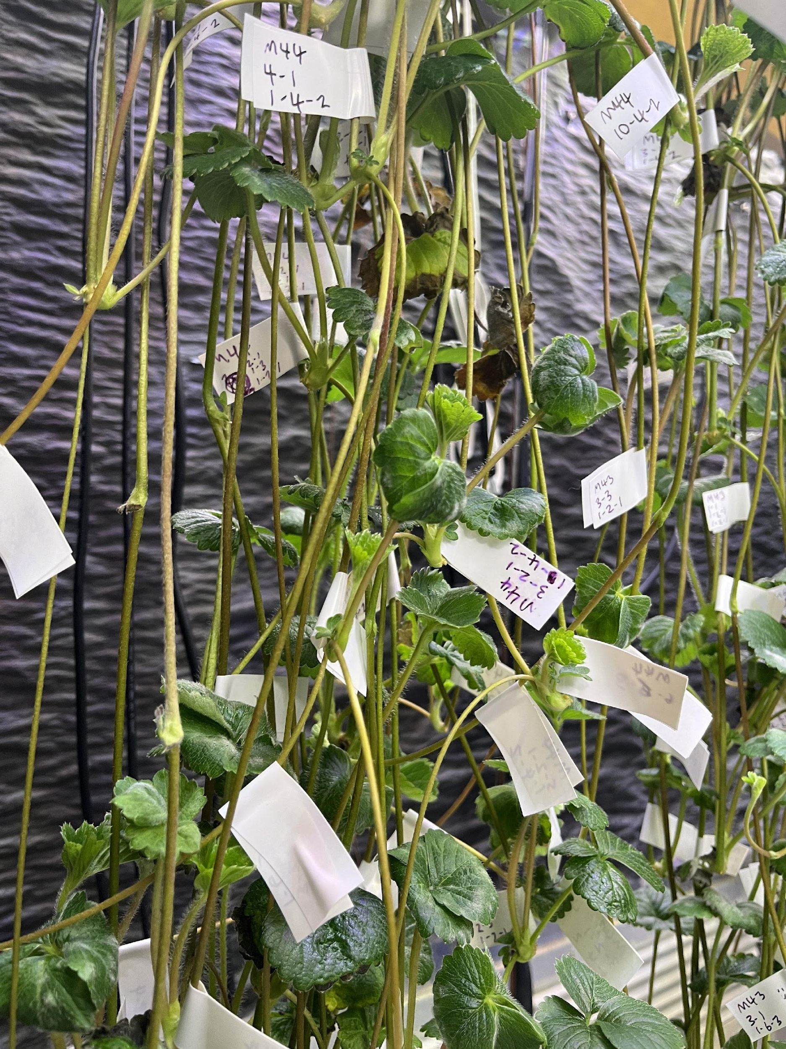
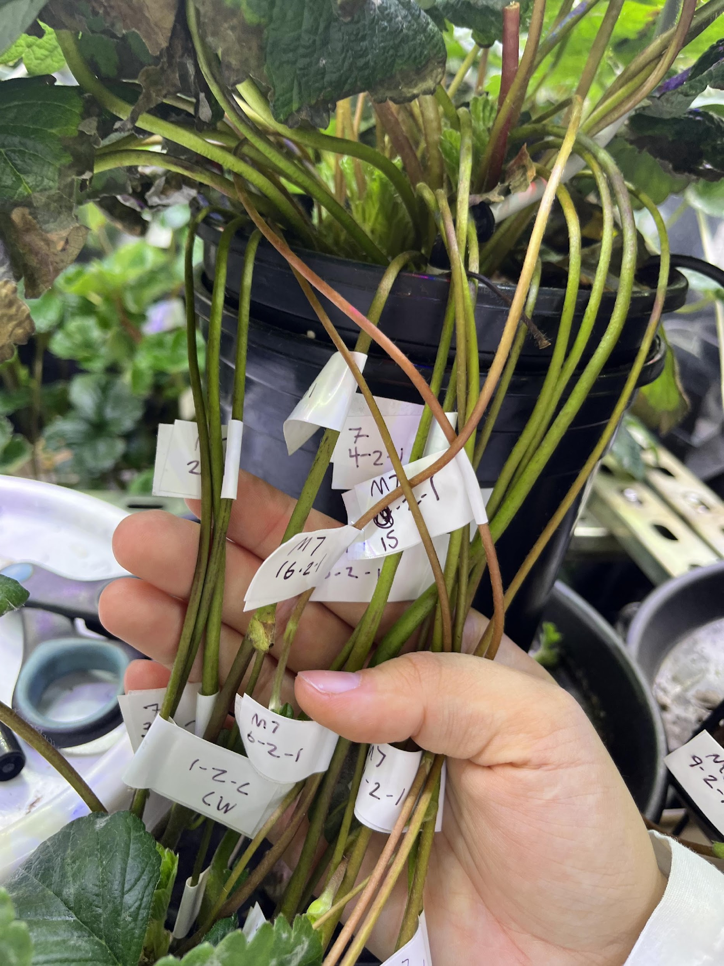
Materials and Methods
Light intensity & CO2 - Researcher: Samson Humphrey

Slide 8
Materials and Methods
Light intensity & CO2 - Researcher: Samson Humphrey
Cultivar: Monterey
Split plot design
Duration: 70 days
n=4 in rep 1, n=8 in rep 2
Light treatments:
250 μmol m⁻² s⁻¹
500 μmol m⁻² s⁻¹
500 μmol mol⁻¹
850 μmol mol⁻¹
1200 μmol mol⁻¹

Slide 9
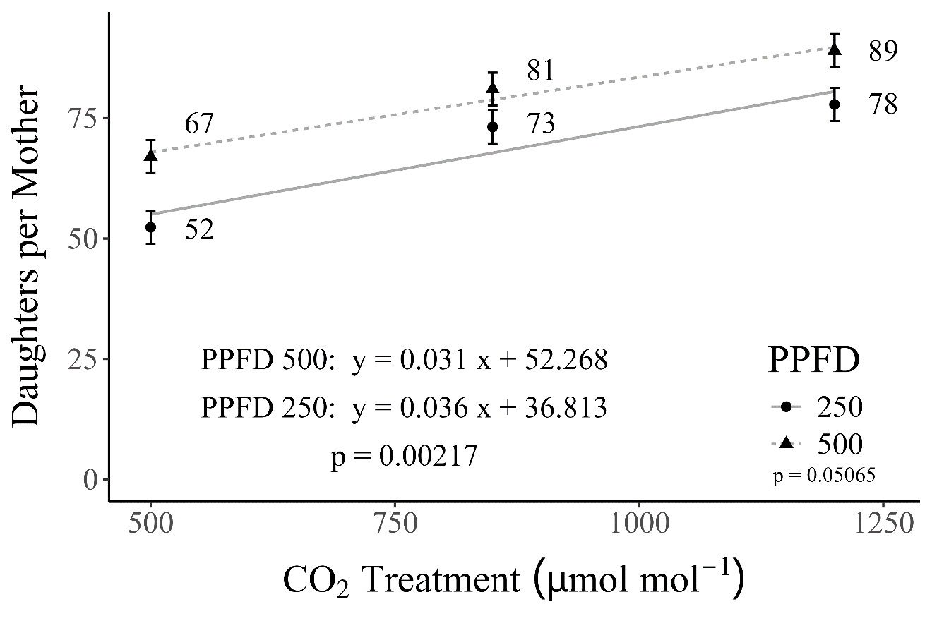
Results
Light intensity & CO2 - Researcher: Samson Humphrey
Hypothesis 1: CO₂ enrichment increases plant growth in strawberry and therefore will increase the size and number of daughter plants.
Hypothesis 2: Increasing light intensity will increase the total number of daughter plants per mother.
Confirmed
Confirmed
11%
14%
33%
28%
49%

Slide 10
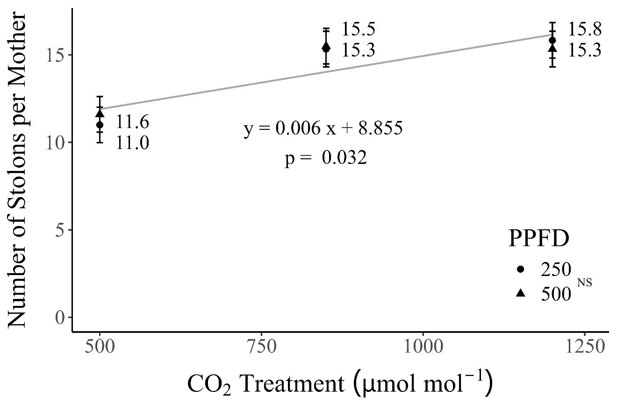
Results
Light intensity & CO2 - Researcher: Samson Humphrey
CO₂ primarily affects development
Light intensity primarily affects growth

Slide 11
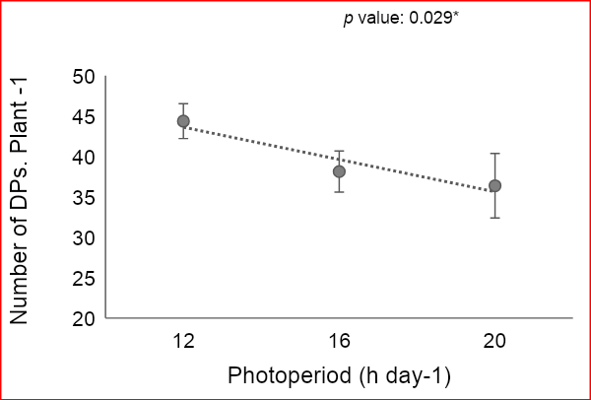
02. Photoperiod - Researcher: Moein Moosavi
A short photoperiod = 12 h
Light intensity = 600 µmol m⁻² s⁻¹
18%
A relatively long photoperiod = 16 h
Light intensity = 450 µmol m⁻² s⁻¹
Please join Moein’s full presentation on this research
A long photoperiod = 20 h
Light intensity = 360 µmol m⁻² s⁻¹

Slide 12
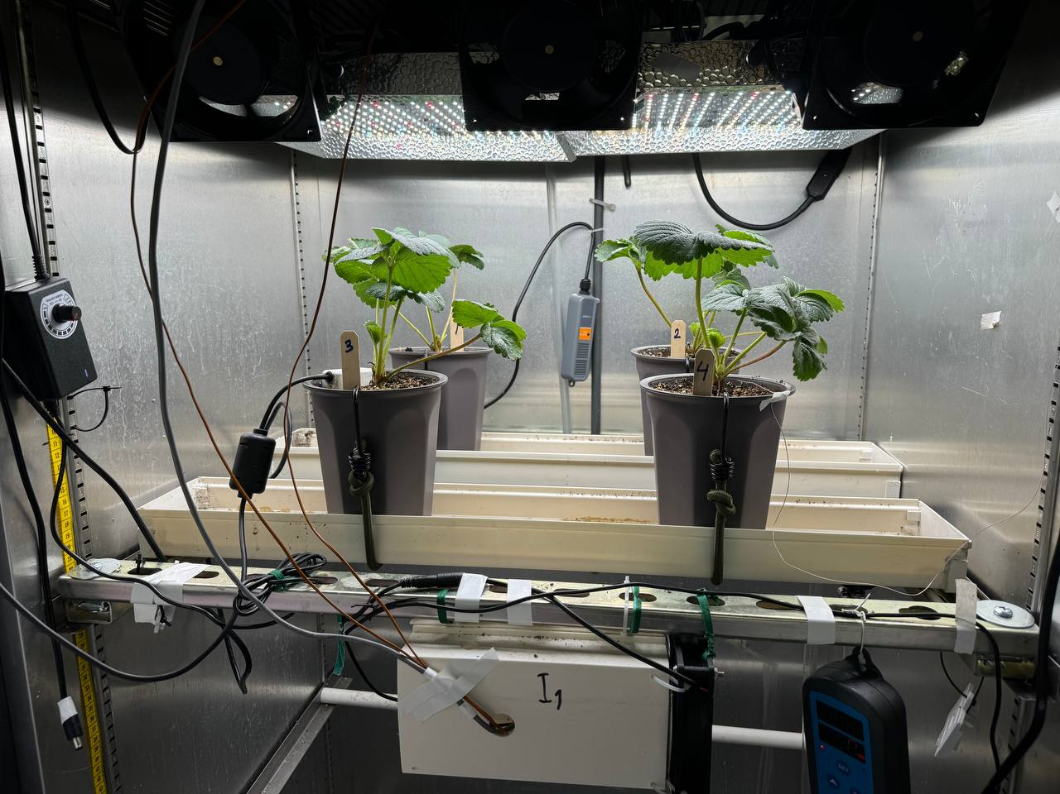
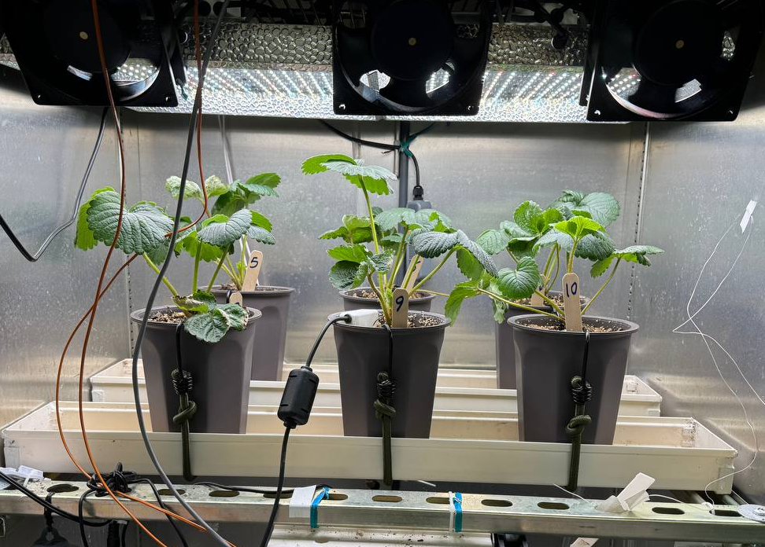
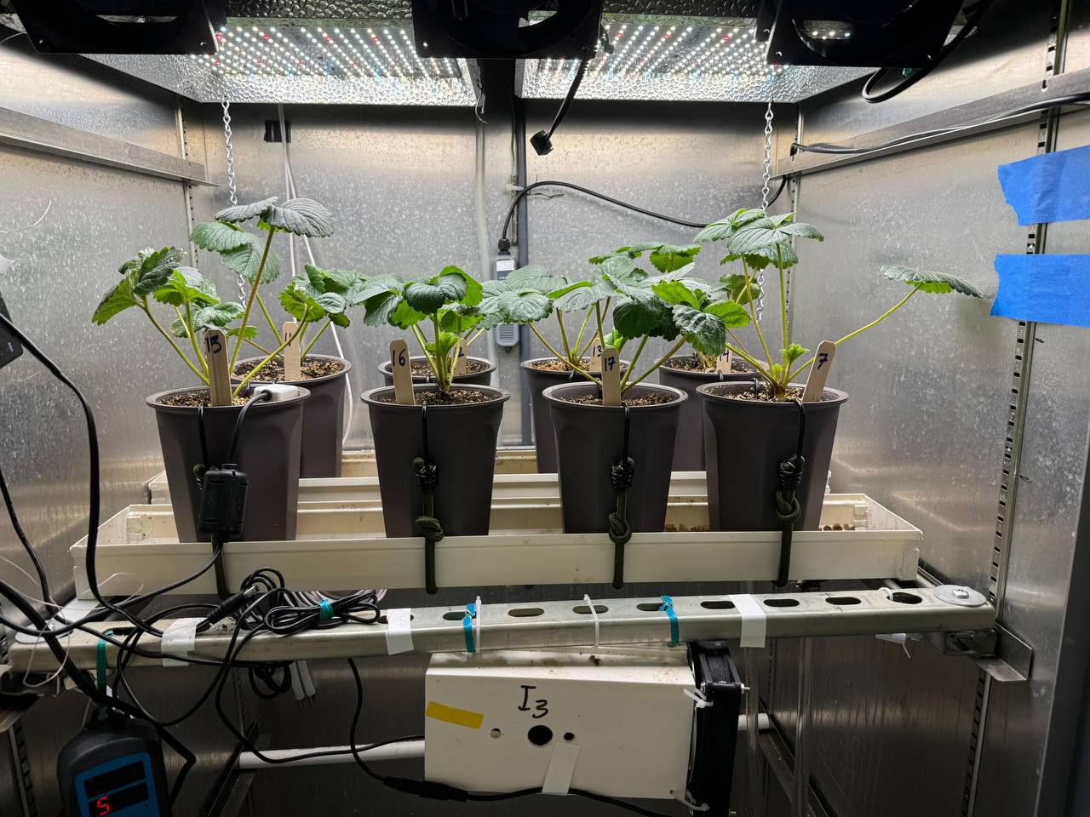
03. Increasing plant density based on LAI- Researcher: Moein Moosavi
Treatments:
4, 6 and 8 plant per chamber
around 9, 13.5, 18 plant m²
76 cm / 30 in
61 cm / 24 in

Slide 13
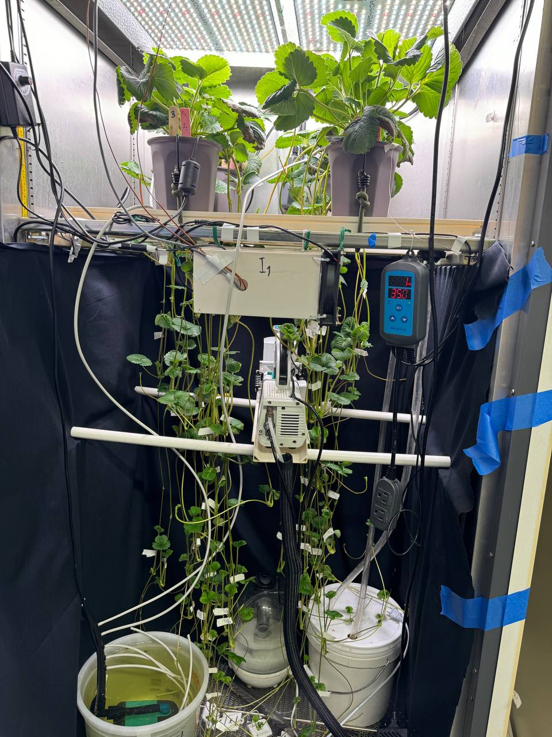
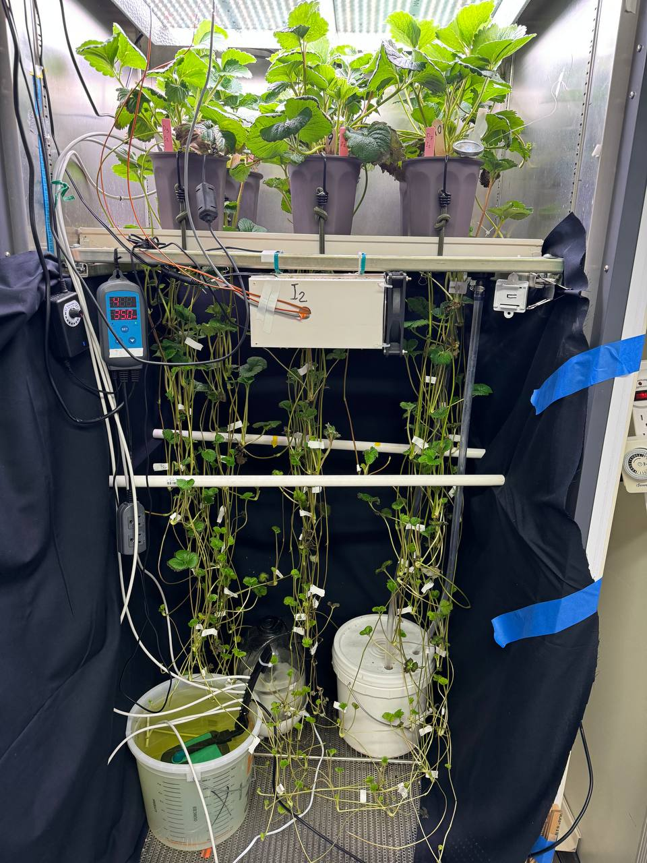
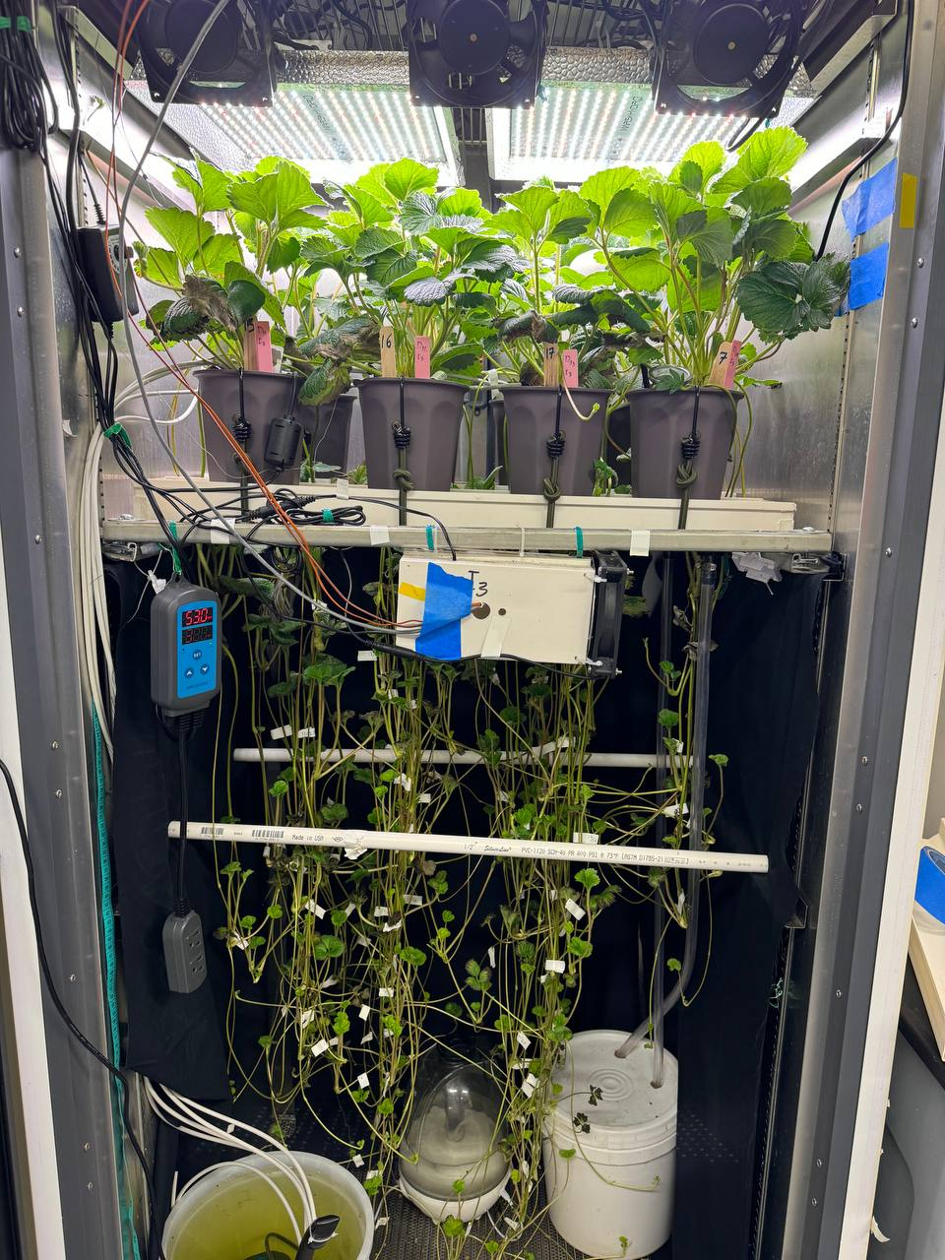
03. Increasing plant density based on LAI - Researcher: Moein Moosavi
9 plant m⁻²
13.5 plant m⁻²
18 plant m⁻²

Slide 14
Objective?
03. Increasing plant density based on LAI - Researcher: Moein Moosavi
To increase the number of daughter plants per area and increase photon use efficiency
To gain a better knowledge of plant-light interactions under high density canopy
To find the threshold of plant density that negatively impact production and yield

Slide 15
Hypothesis?
03. Increasing plant density based on LAI - Researcher: Moein Moosavi
The number of DPs (yield) per plant will drop by increasing plant density
Yield per area will be higher in higher plant density until a threshold
Quality of DPs will drop (longer petioles, higher SLA, lower Chl, etc.)
Need for ICL for the future

Slide 16
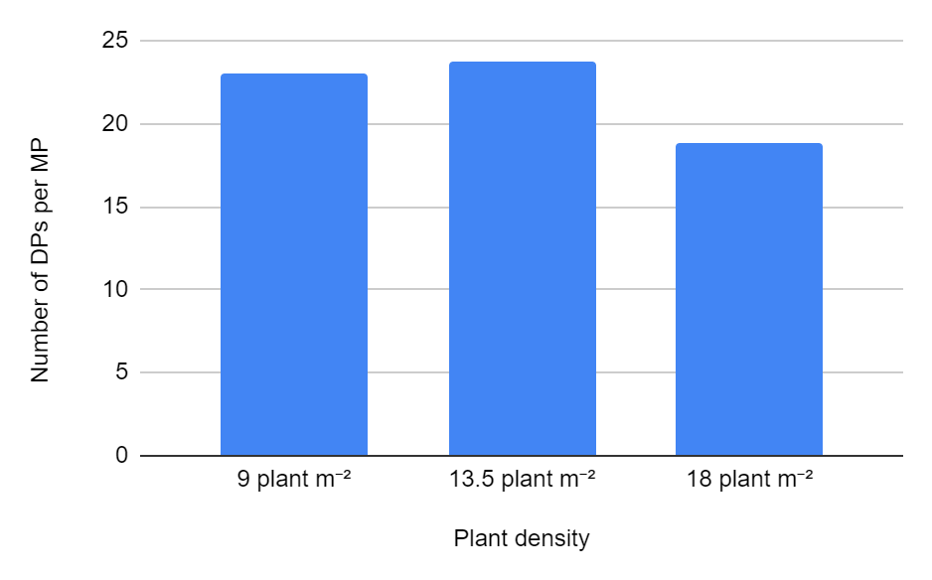
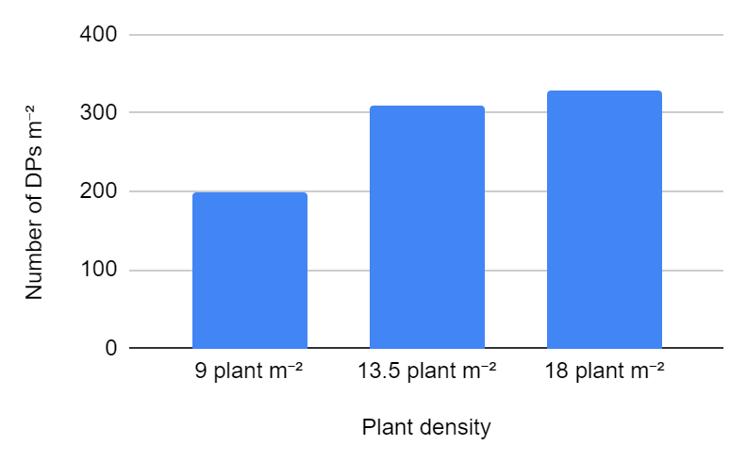
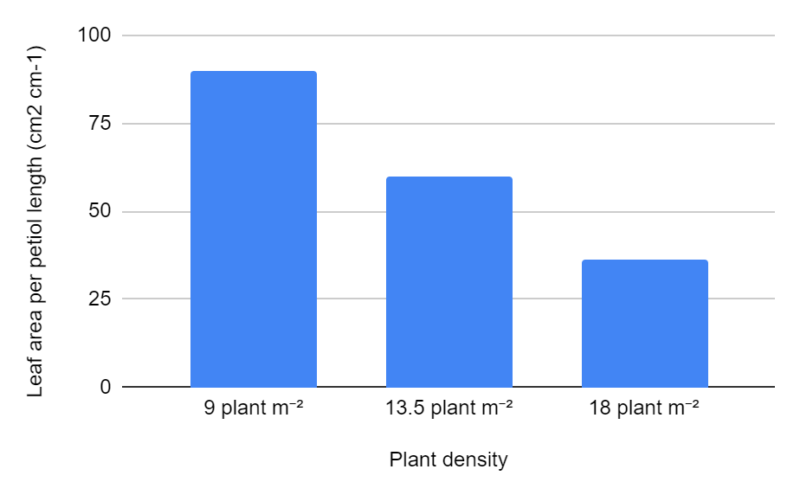
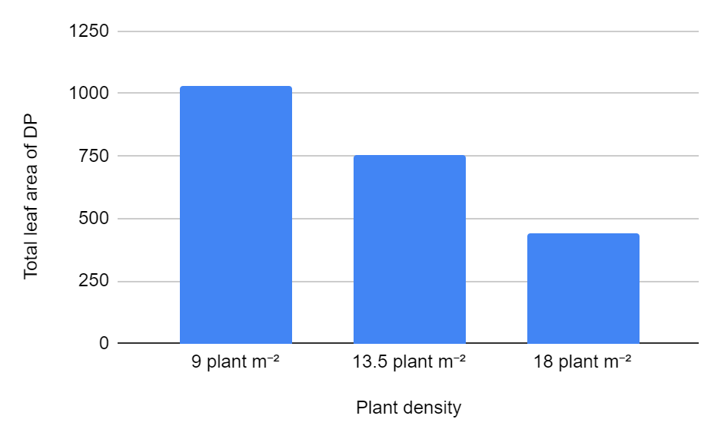
03. Increasing plant density based on LAI - Researcher: Moein Moosavi
Preliminary results
Yield:
-18%
55%
64%
Quality:

Slide 17
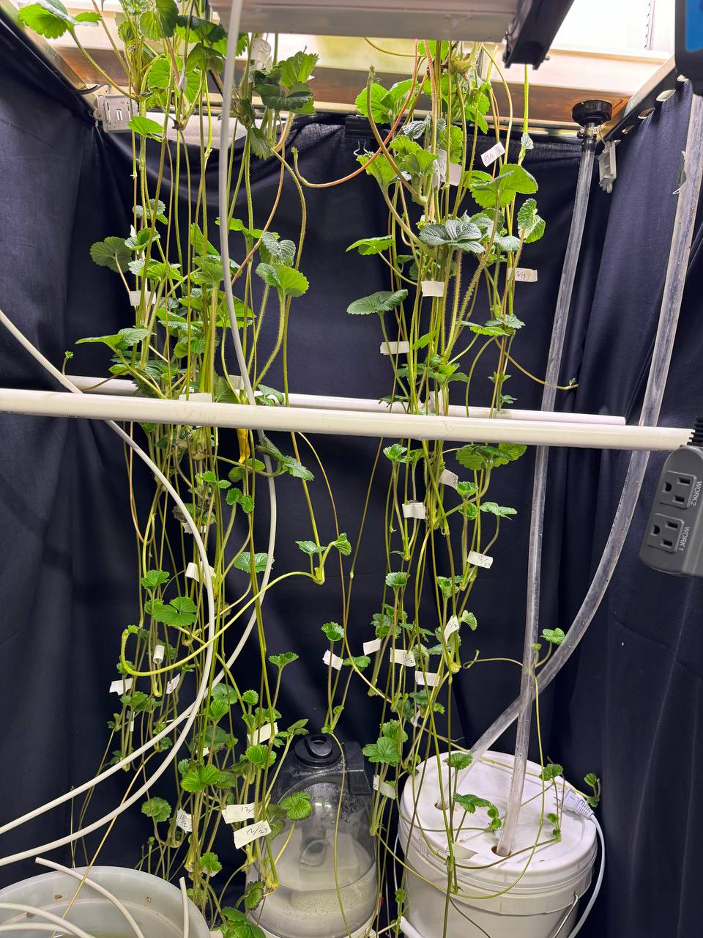
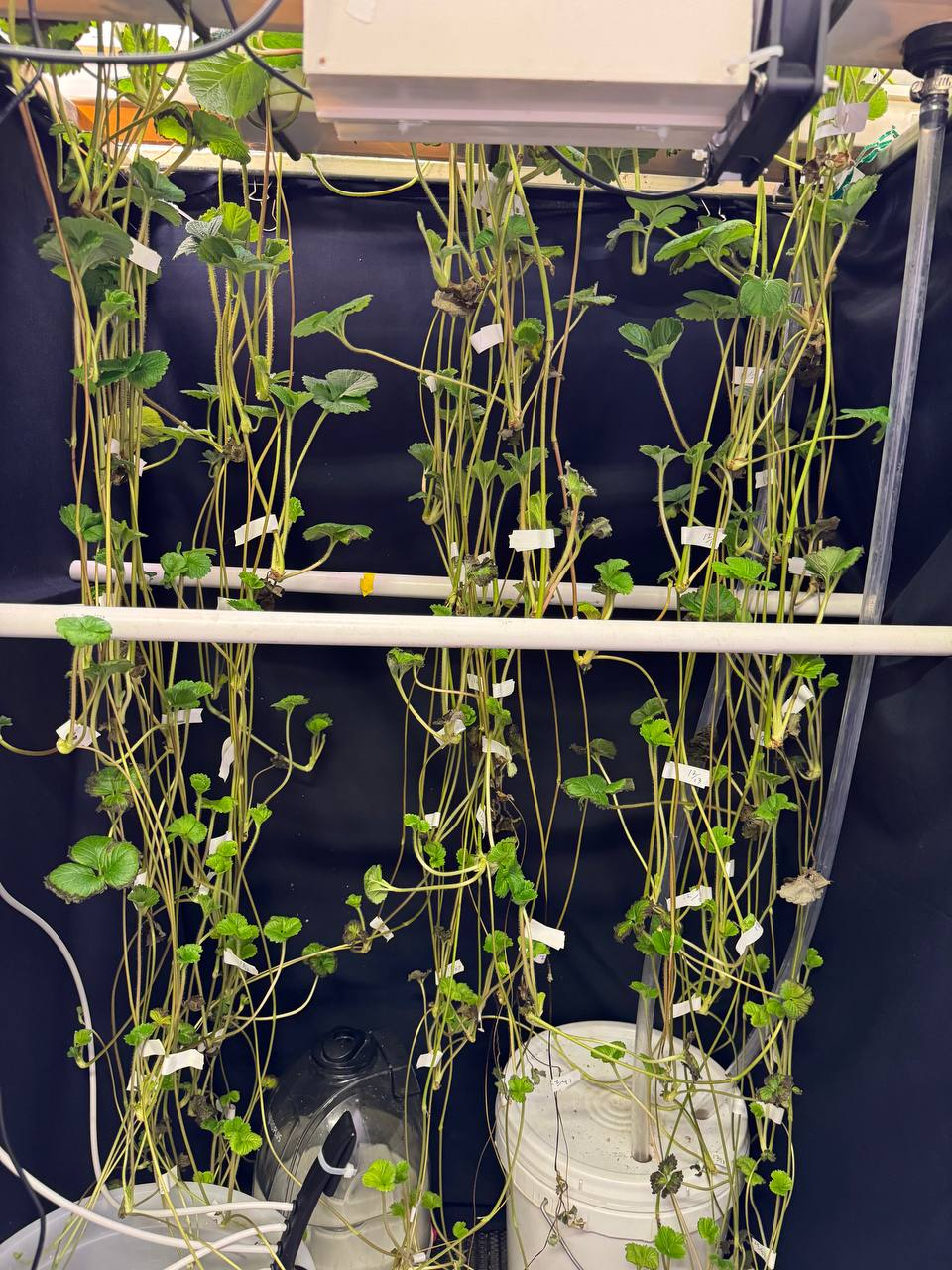
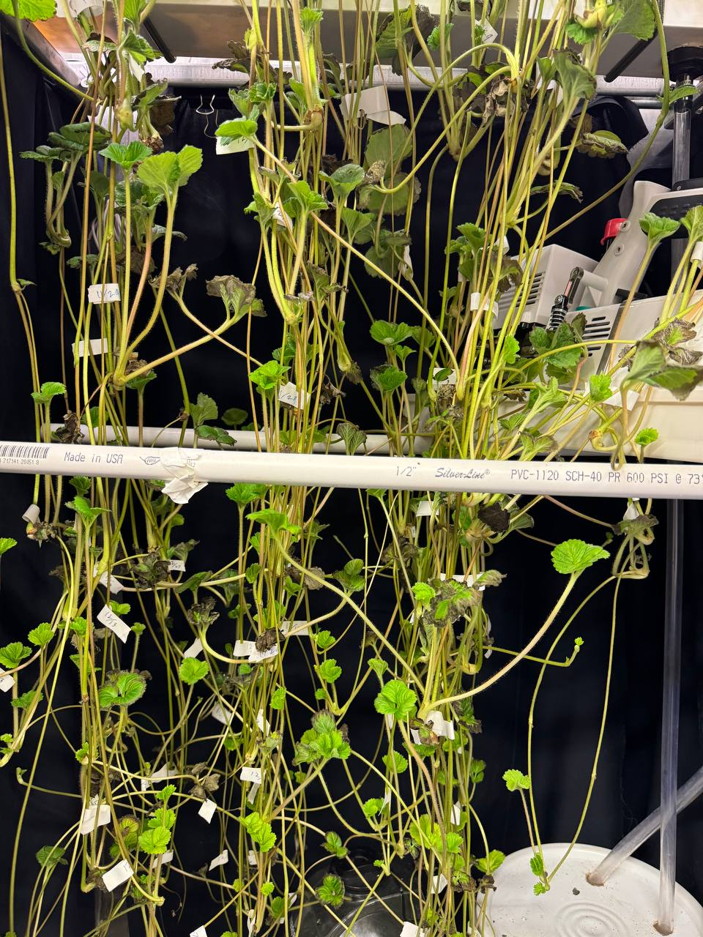
03. Increasing plant density based on LAI - Researcher: Moein Moosavi
9 plant m⁻²
13.5 plant m⁻²
18 plant m⁻²

Slide 18
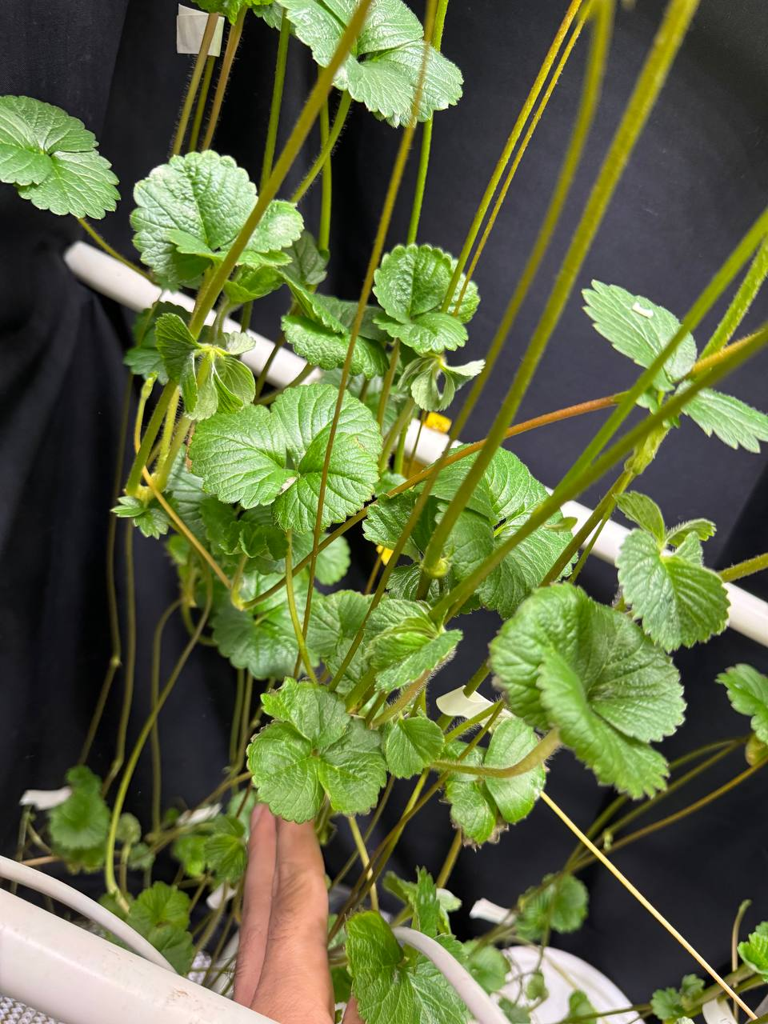
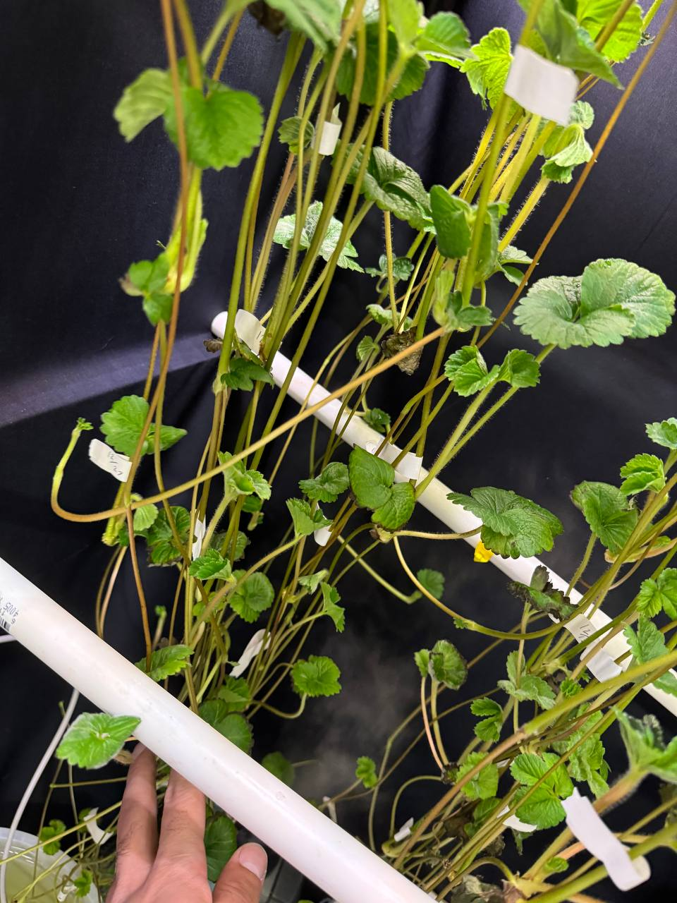
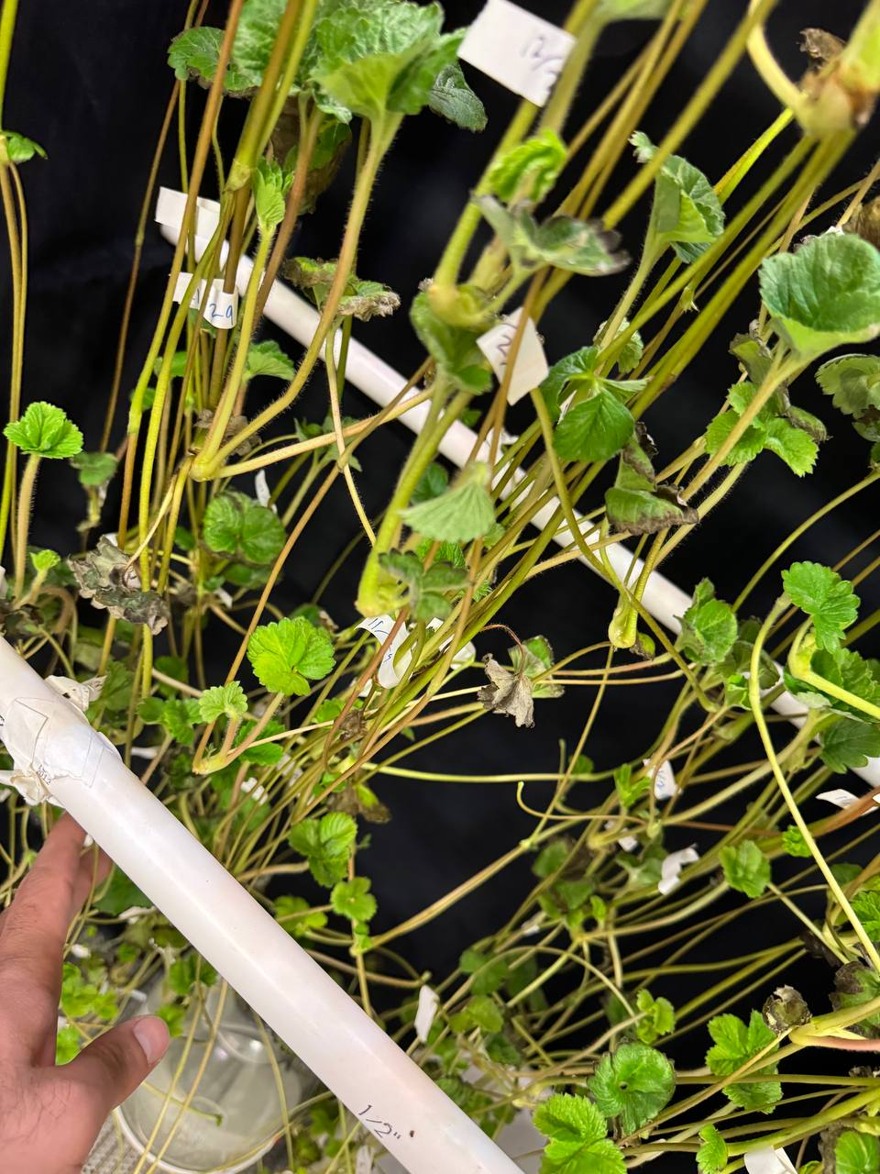
03. Increasing plant density based on LAI - Researcher: Moein Moosavi
9 plant m⁻²
13.5 plant m⁻²
18 plant m⁻²

Slide 19
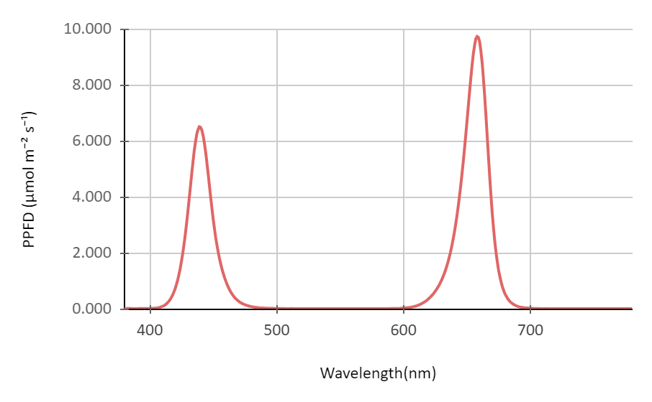
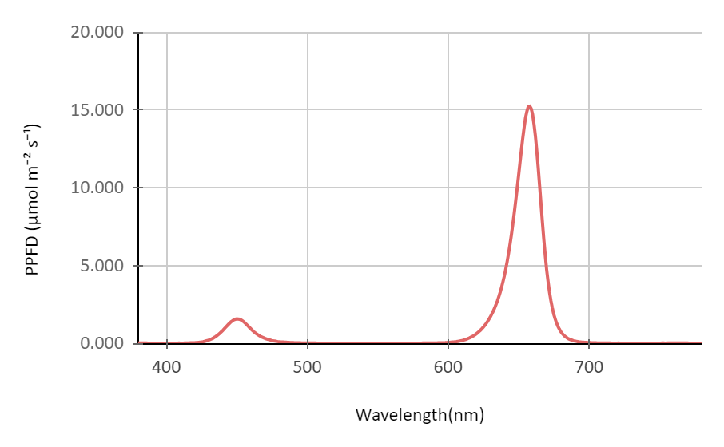
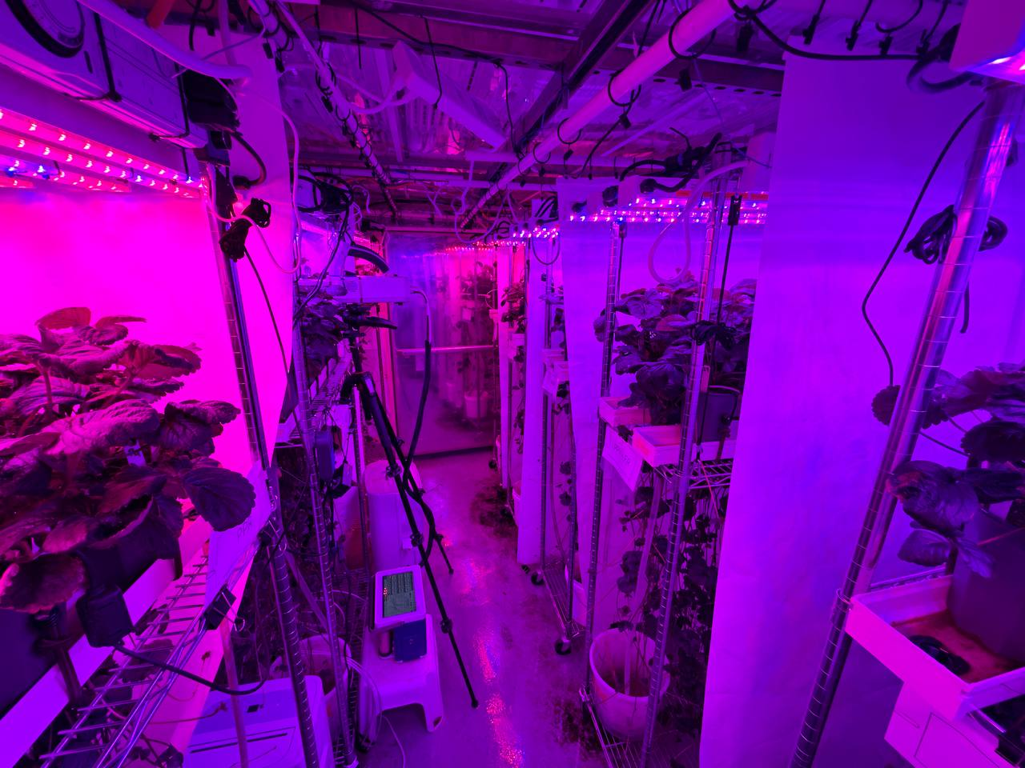
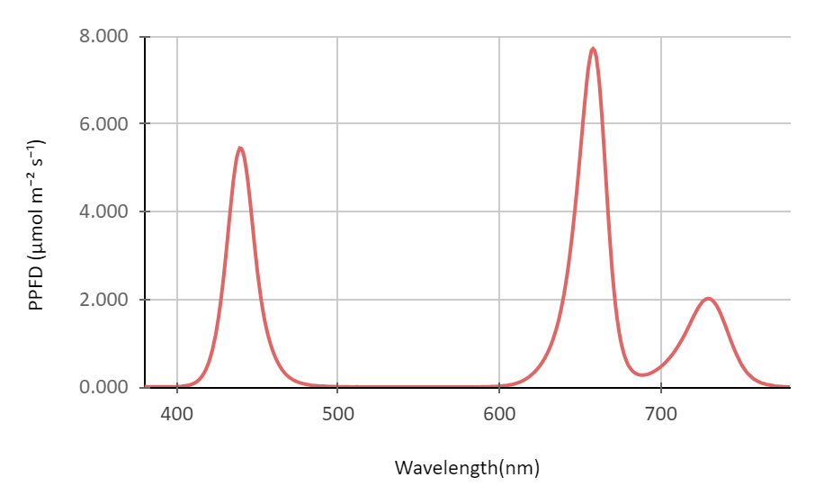
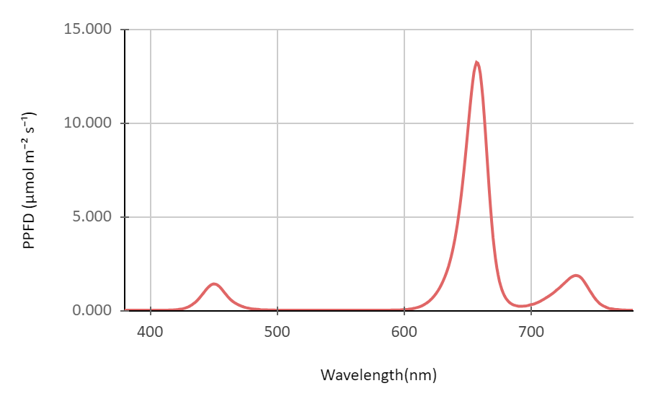
03. Light Spectrum - Researcher: Moein Moosavi
High blue: Low red
Low blue: High red
High blue : Low red + FR
Low blue: High red + FR
Please join Moein’s full presentation on this research

Slide 20
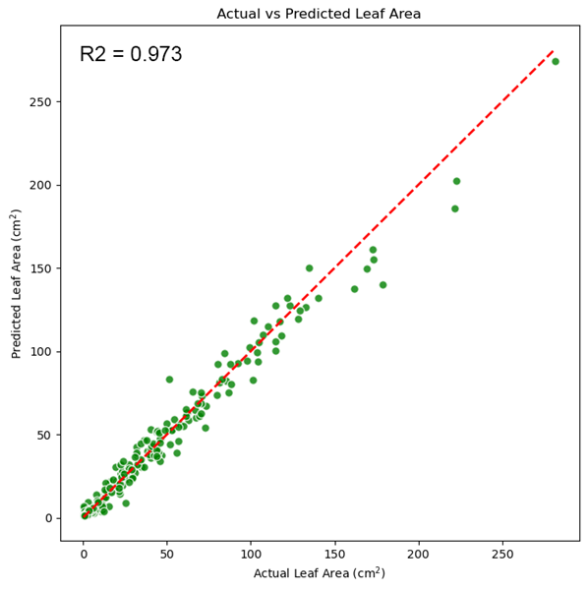
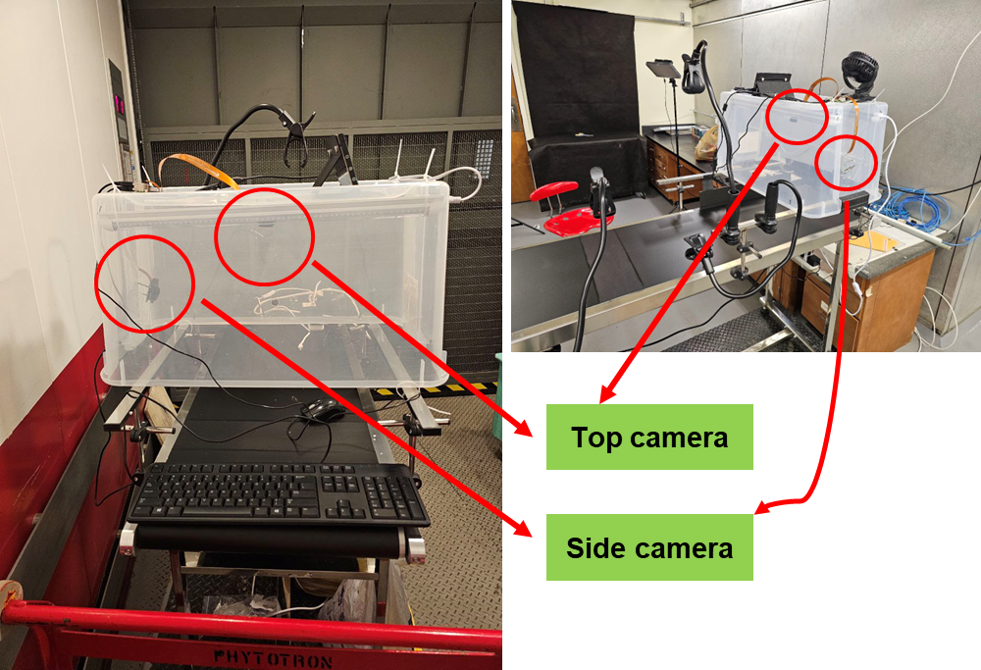
04. DP size estimation with imaging system - Researcher: Moein Moosavi
Please join Moein’s full presentation on this research

Slide 21
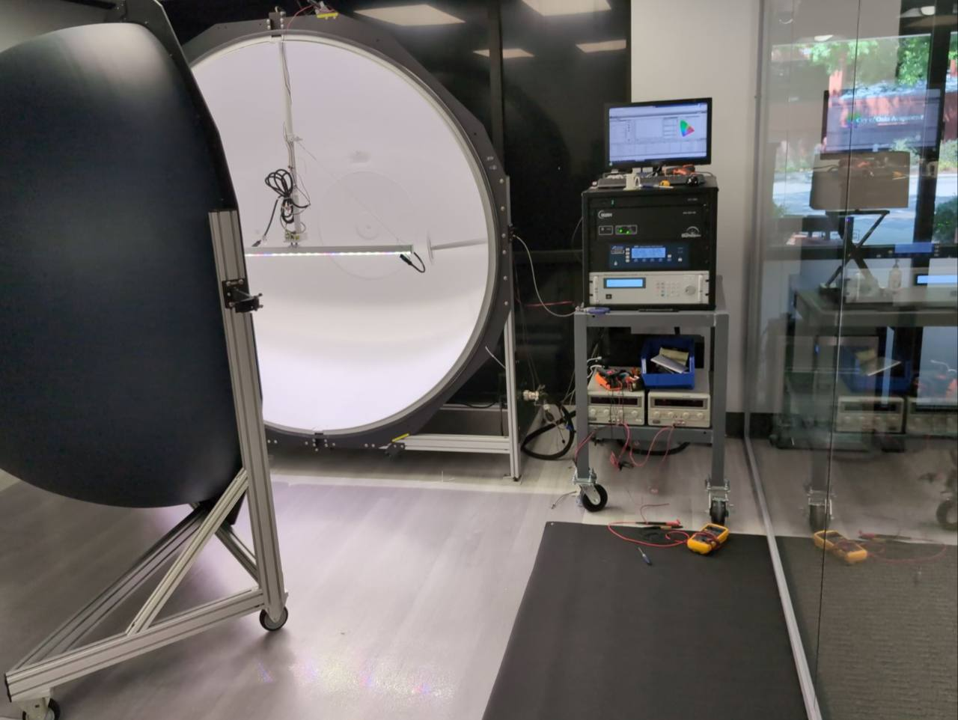
05. Top vs. Intracanopy lighting - Researcher: Moein Moosavi
Four treatments:
100% TL¹ : 0% ICL²
Based on the current approach
92% TL : 8% ICL
Based on the minimum light compensation point in DPs canopy
78% TL : 22% ICL
Based on the leaf area index of MP vs. runner canopy
Dynamic treatment
Based on the dynamic plant growth in the top vs. runner canopy
Integrating sphere at NewEnergy company
¹ TL = top light ² ICL = intracanopy light

Slide 22
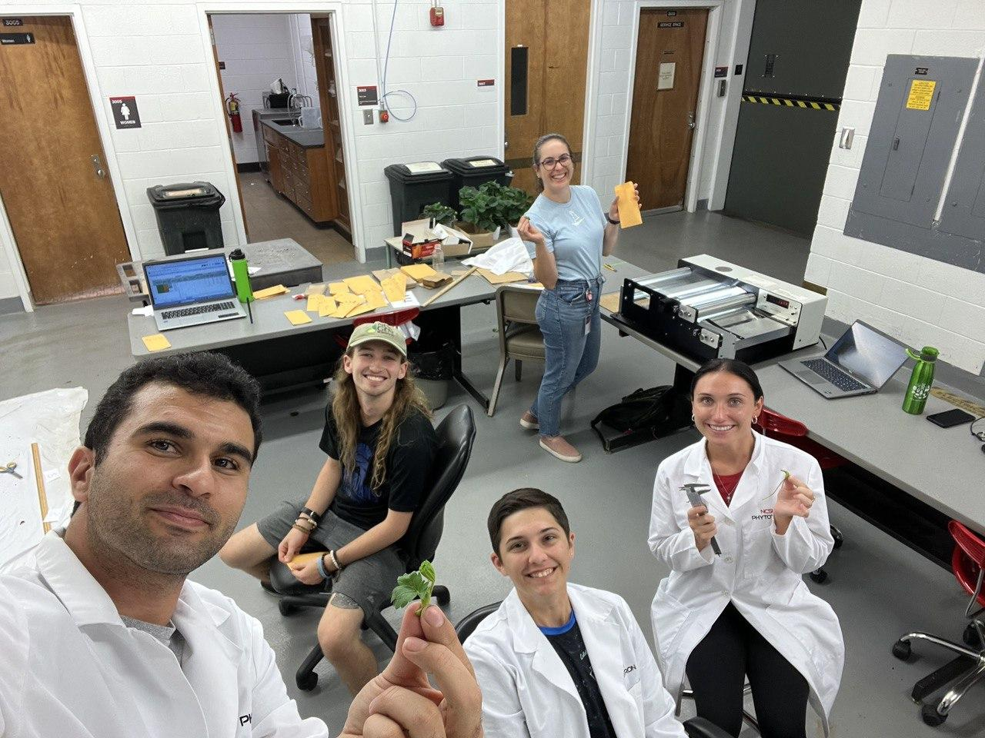
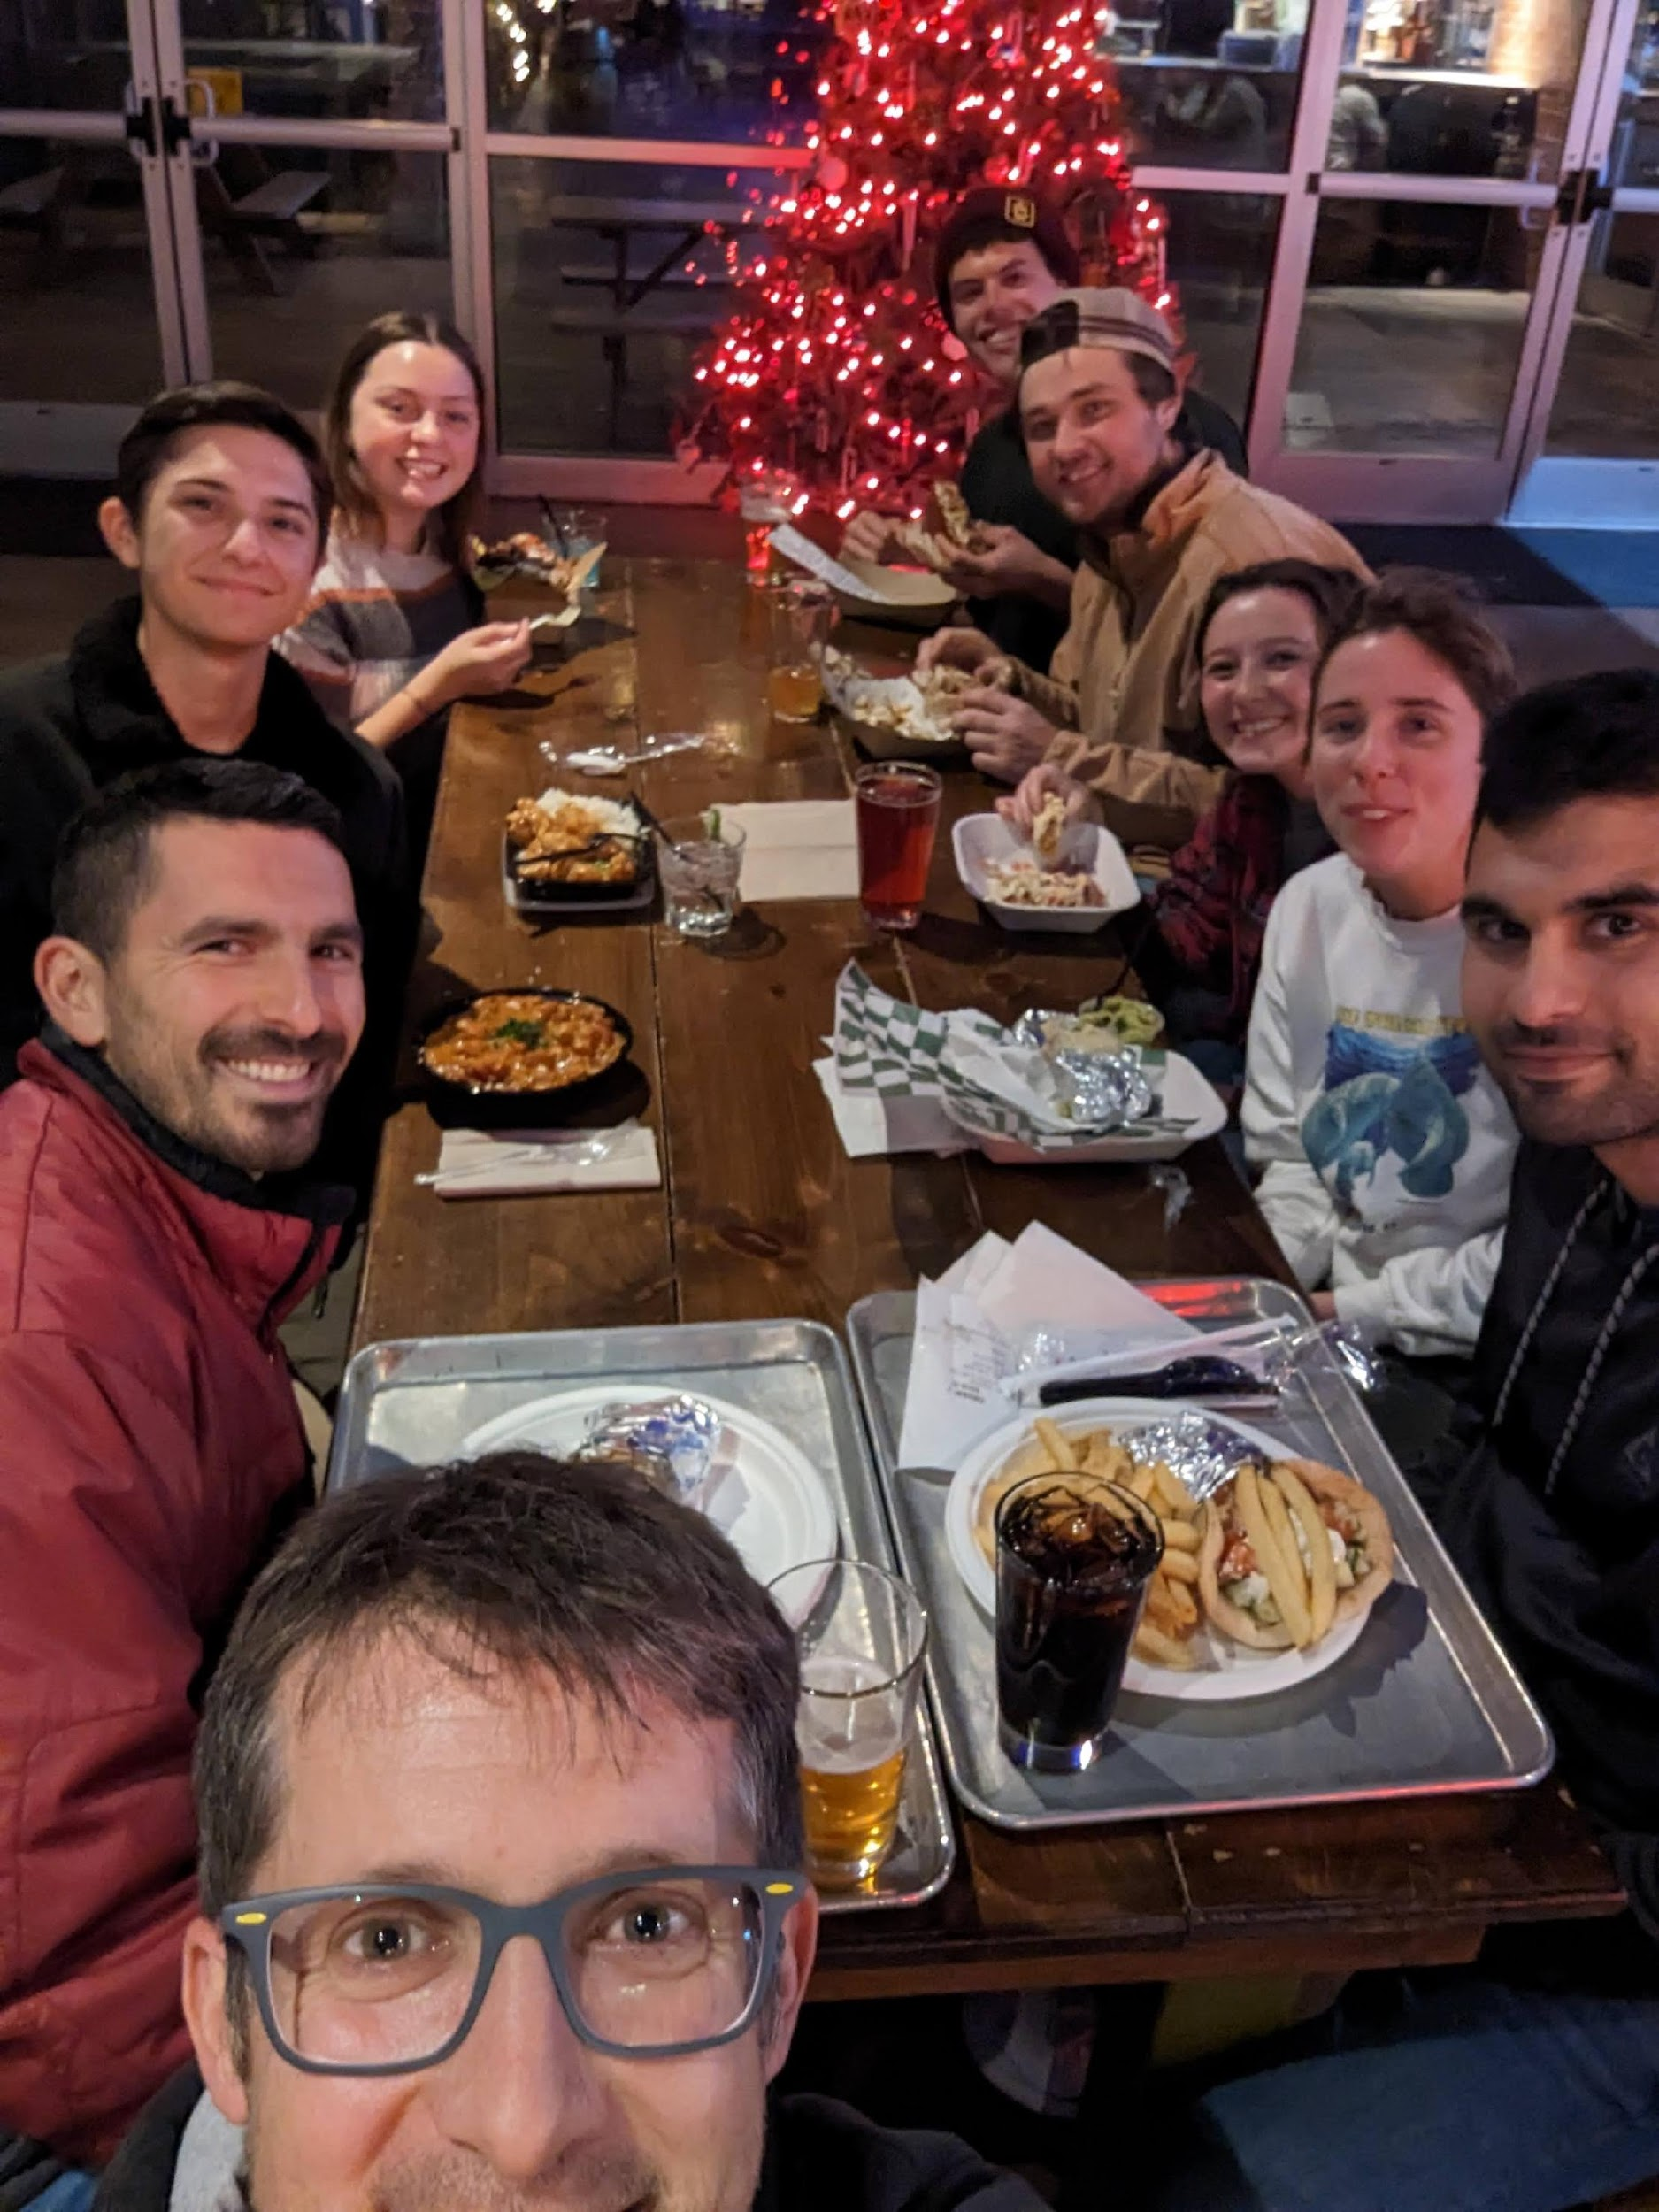
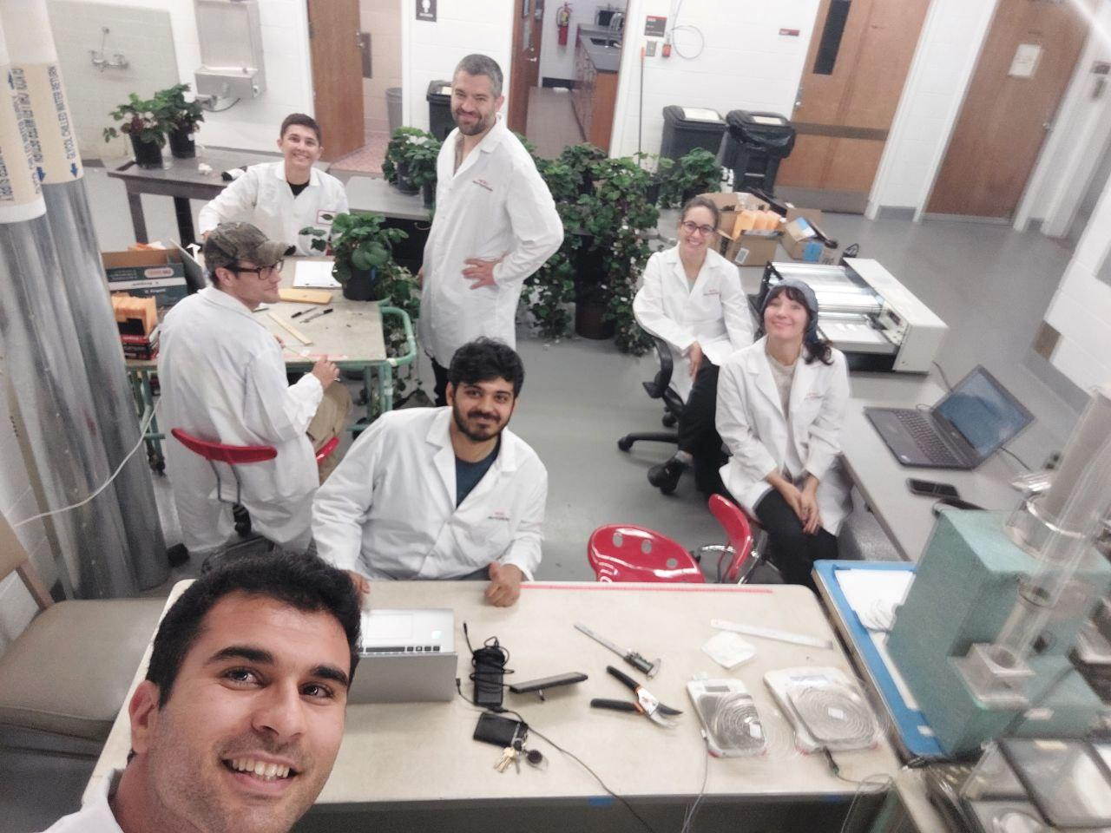
Acknowledgement :

Slide 23
Thanks!
Do you have any questions?

Slide 24
Bolt Lab

Slide 25
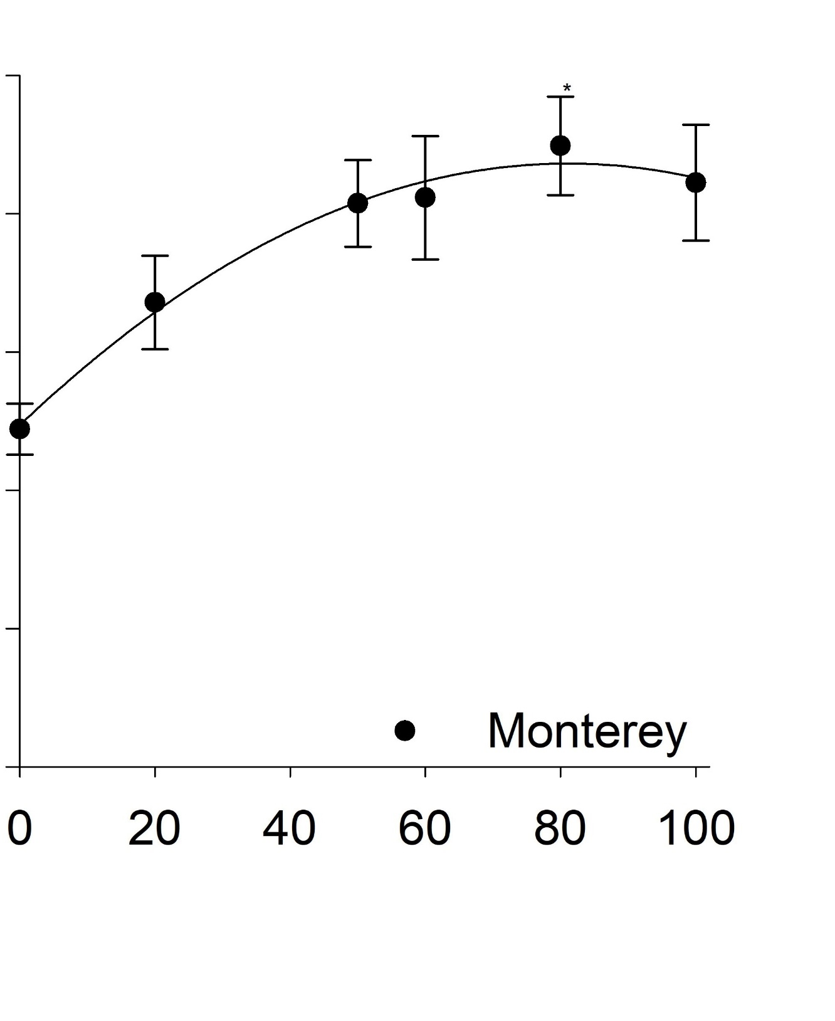
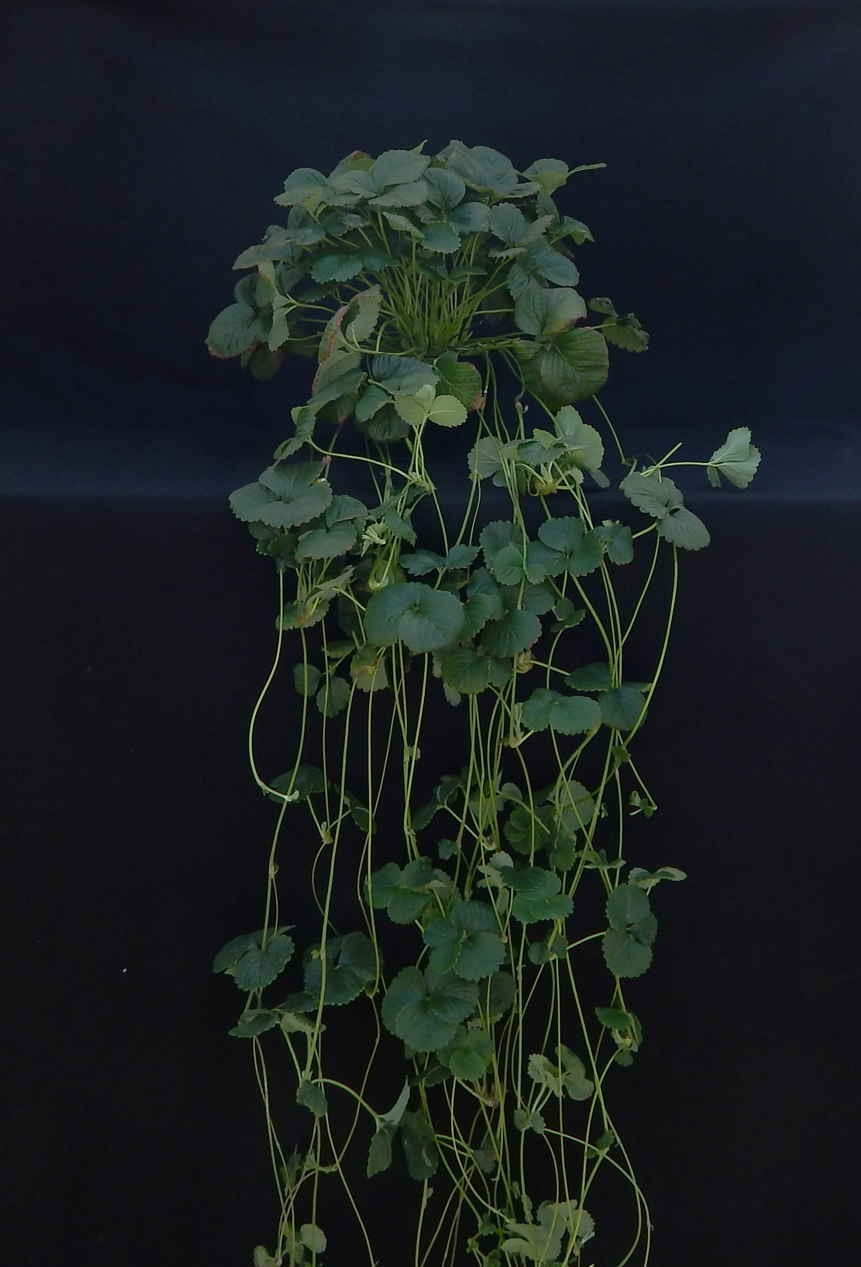
Obj. 1.1b Nutrient solution optimization
Fraction of total nitrogen supplied as nitrate (NO₃⁻) or ammonium (NH₄⁺)
We observed high daughter plant numbers when >65% N supplied as NO₃⁻
Cultivars varied in their responses
Challenge: Could we identify a range of NO₃⁻ which would be suitable for multiple cultivars?
y = 49.389 + 0.934x – 0.006x²
Adjusted R² = 0.39
‘Monterey’
80% NO₃⁻

Slide 26
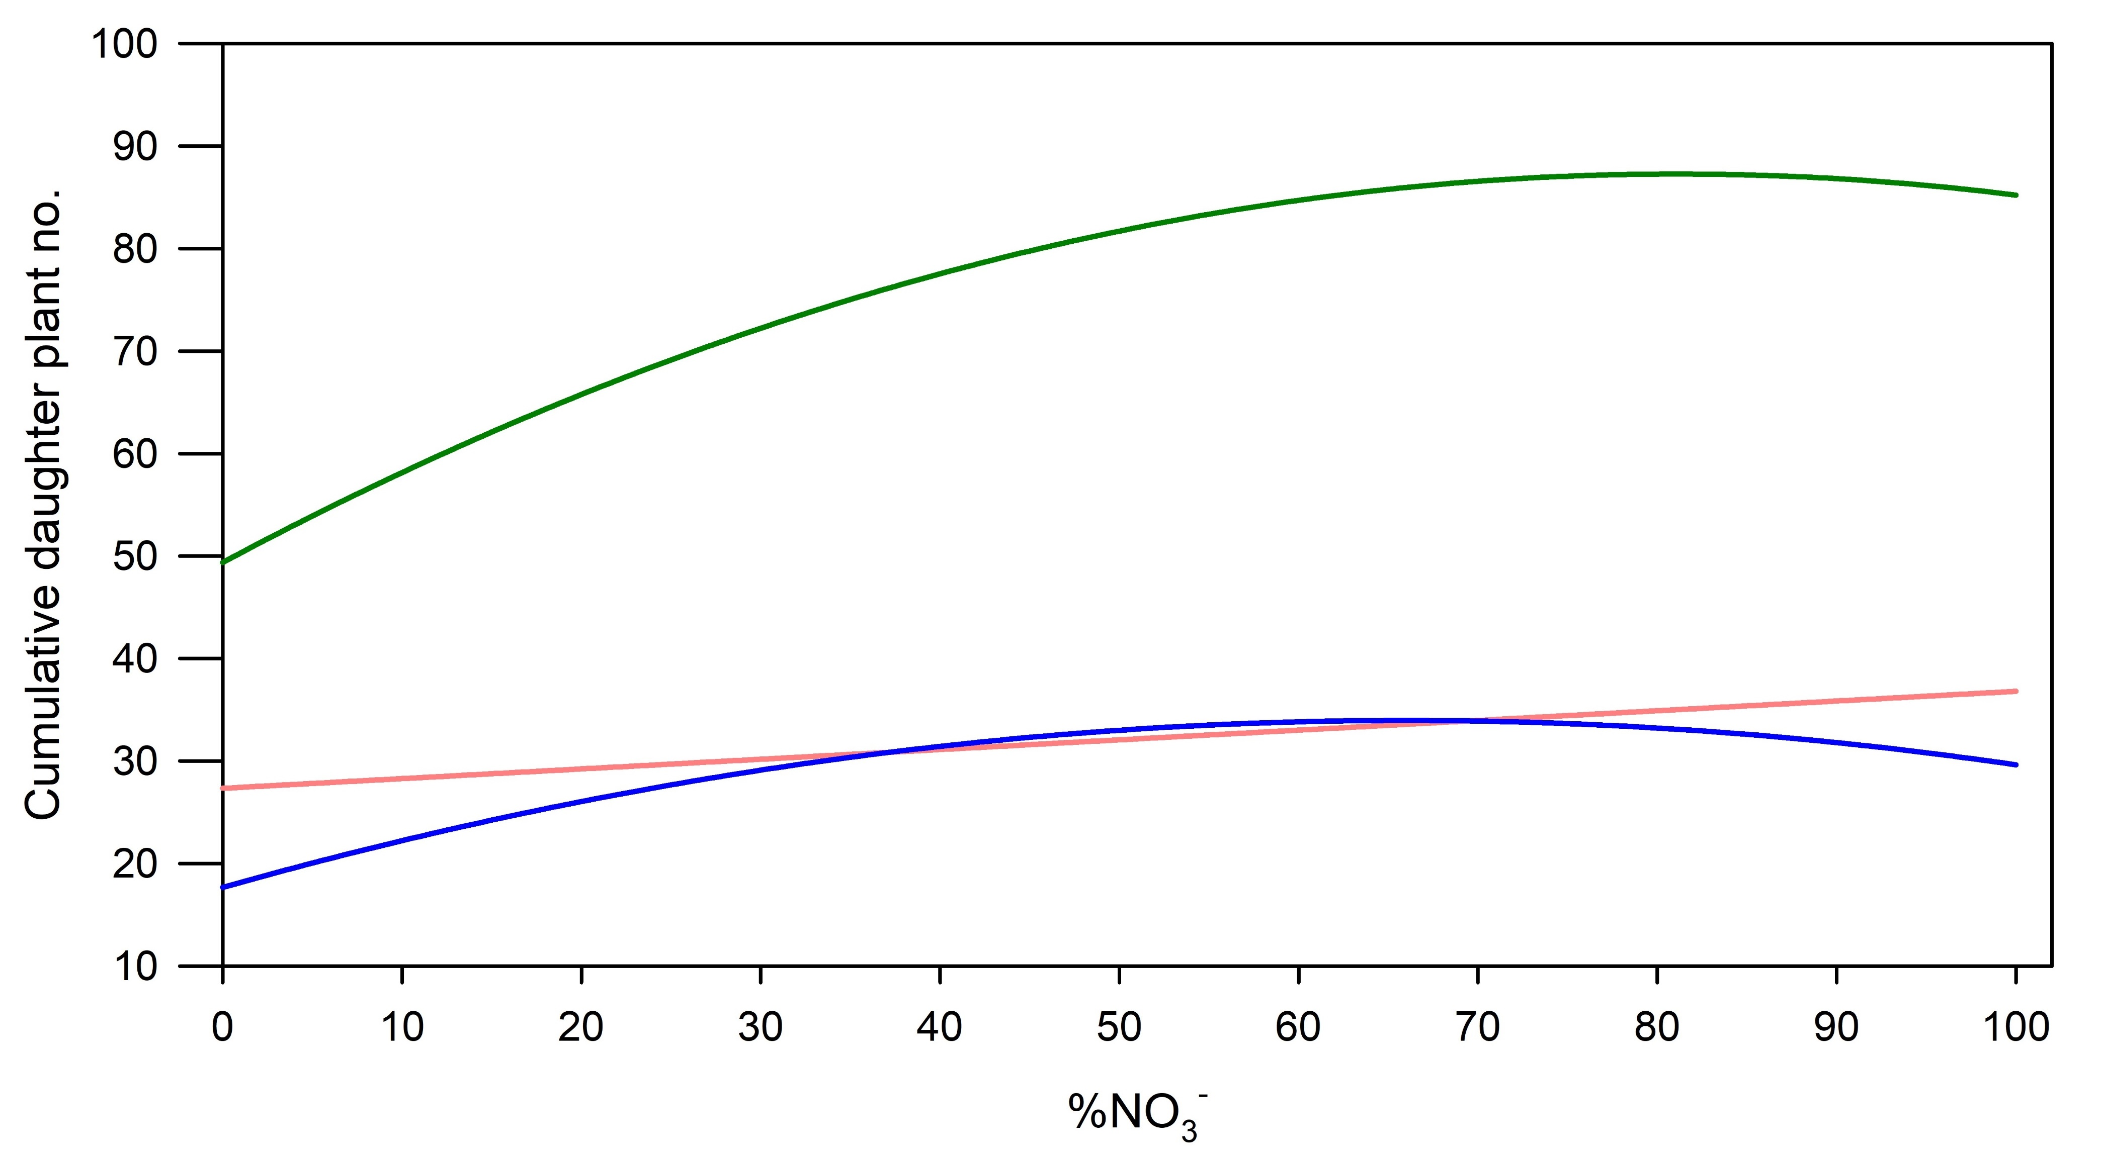
What if we can accept 95% of maximum yield? All cultivars overlapped between 81% to 87% NO₃⁻
Albion
Fronteras
Monterey

Slide 27
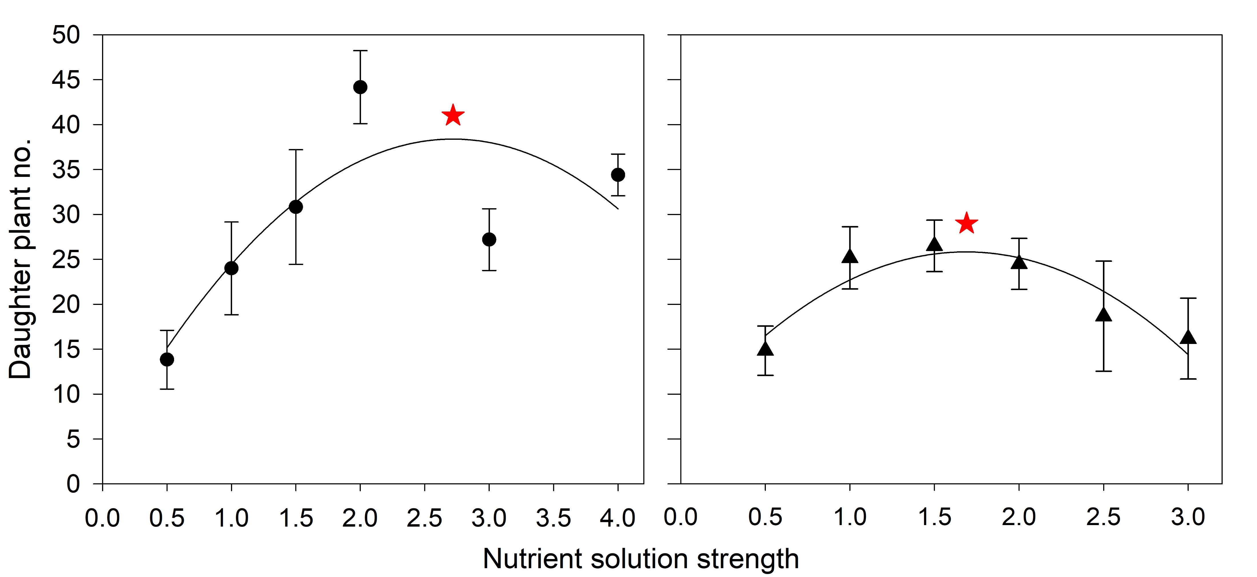
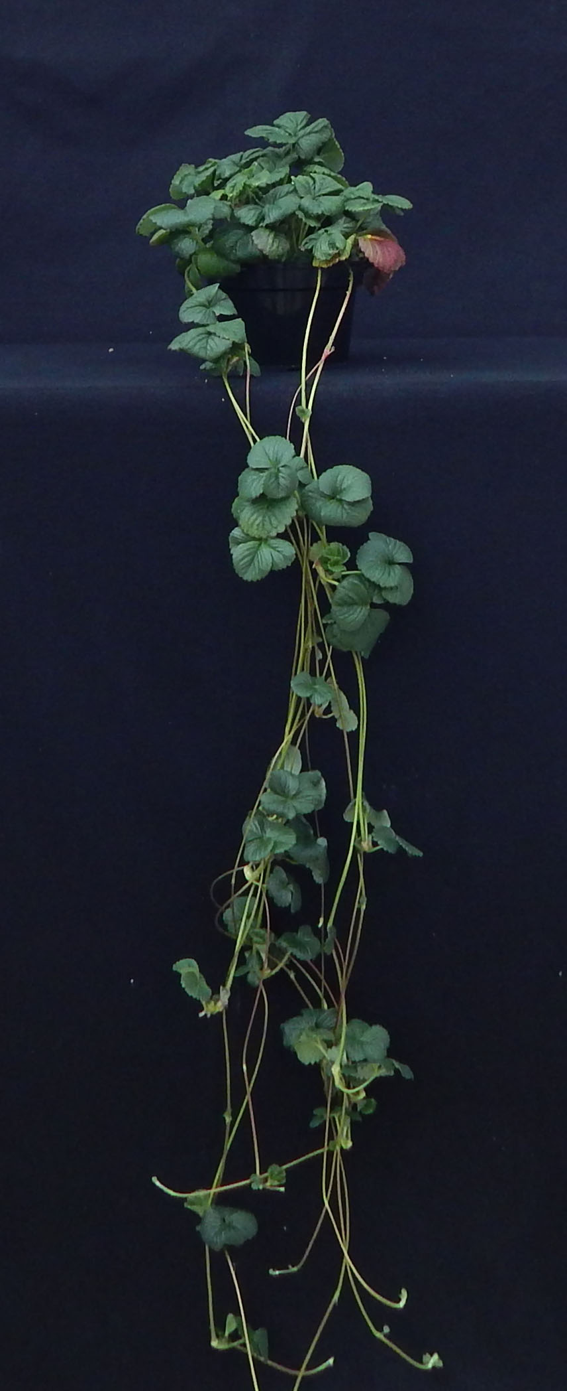
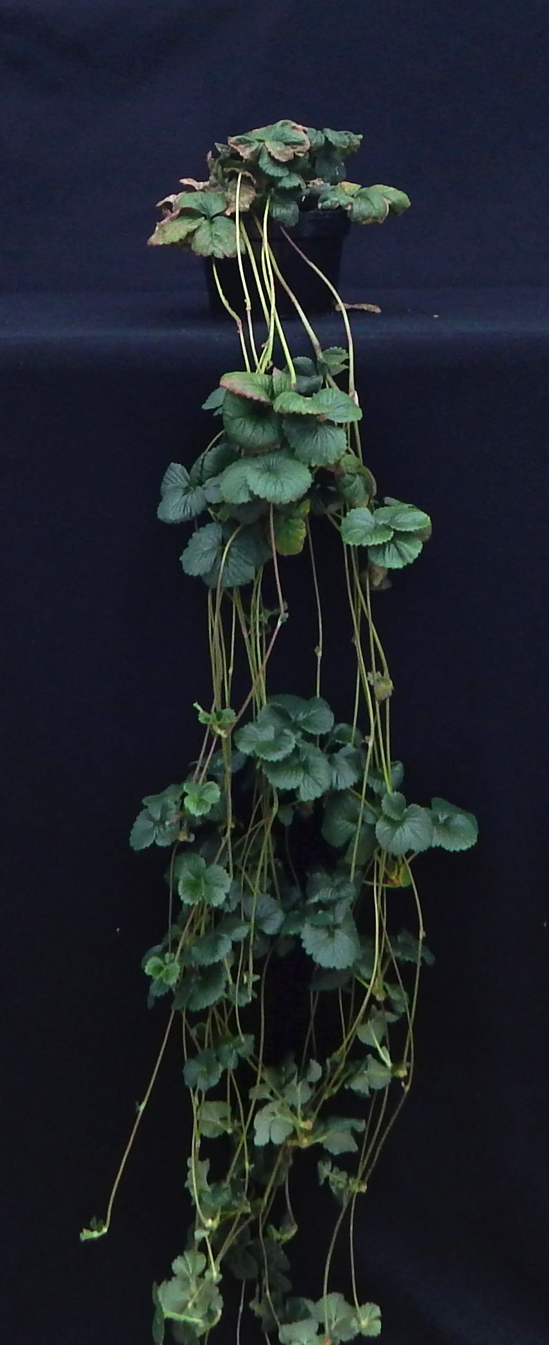
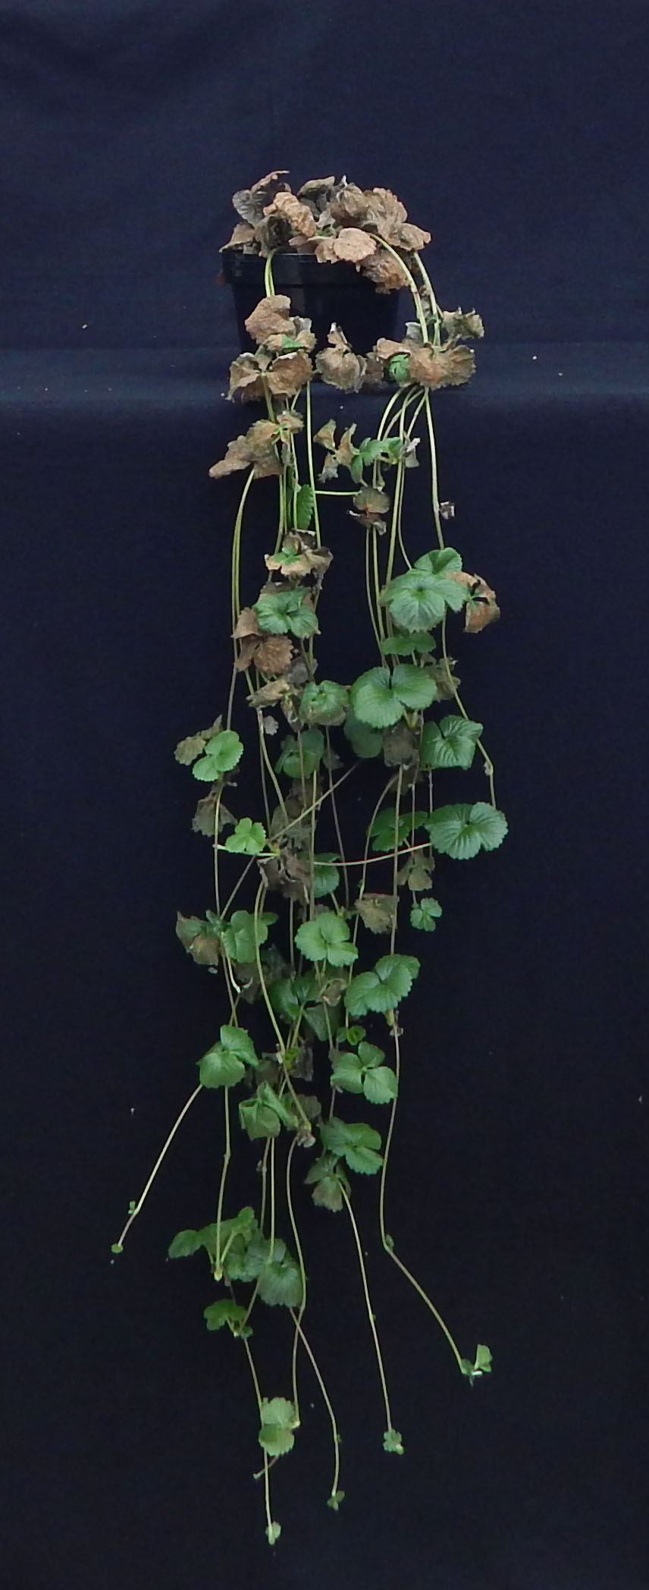
Obj. 1.1b Nutrient solution optimization
Nutrient solution concentration
Challenge: mother plant more sensitive to EC than daughter plants
A suitable EC at 12 weeks will be too high for a subsequent growth cycle
Outcome: Recommend 1.5 to 2x nutrient solution concentration
‘Monterey’
‘Monterey’
‘Albion’
y = 3.497 + 0.257x − 0.0005x²
Adj. R² = 0.32
y = 6.983 + 0.224x − 0.0007x²
Adj. R² = 0.13
1x 2x 4x

Slide 28
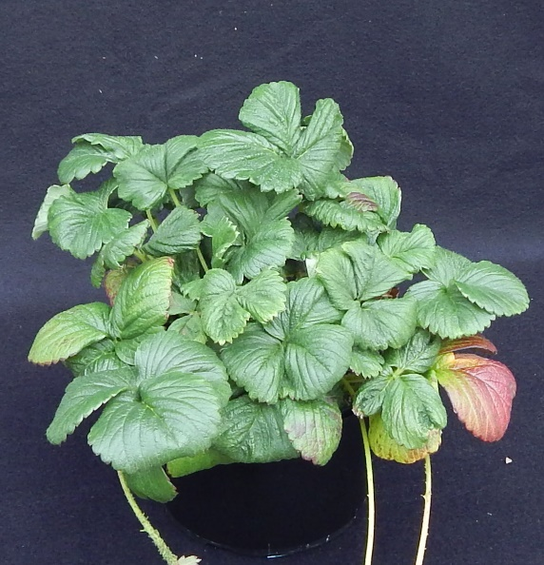
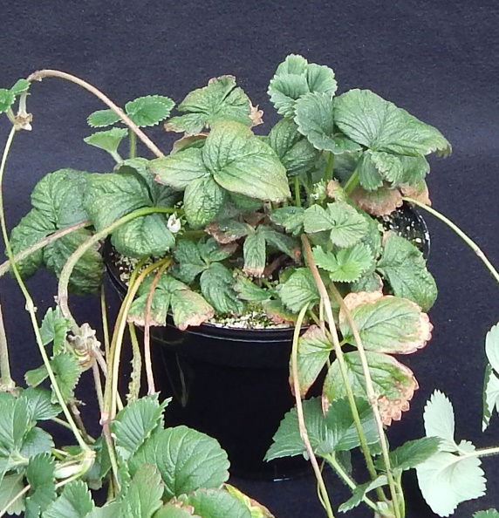
1 = none
2 = mild
3 = moderate
4 = severe
5 = very severe
‘Monterey’
Leaf burn rating
No to mild
Moderate
Very severe
No to mild
Moderate
Very severe
Nutrient solution strength

Slide 29
Obj. 1.1b Nutrient solution optimization
Nitrogen concentration
Study in progress (Rep 1: Fall 2024; Rep 2: Winter 2025)
Evaluating 50 – 400 ppm N
At transplant
5 weeks of treatment

Slide 30
Obj. 1.1b Nutrient solution optimization
Putting it all together (i.e., next steps)
Comparison trial of “standard” vs. best results from the three individual studies
Standard: 80 ppm N, 90% NO₃⁻, EC of ~1.3 mS/cm
Optimized: ? ppm N, 80% NO₃⁻, EC of 2.3 mS/cm
At transplant
5 weeks of treatment

Slide 31
Jackson Lab

Slide 32
The Characterization and Development of Soilless Substrate Systems for Mother Plant Production of Strawberries
Brandan A. Shur
North Carolina State University

Slide 33
Projects
#1: Substrate Composition’s Influence on Strawberry Mother Plant Production

Slide 34
Project 1: Peat-based Substrate Composition’s Influence on Strawberry Mother Plant Production
Objective #1: Determine the influence of peat amended with various products on physical and chemical properties.
Objective #2: Influence of substrate composition on daughter plant number.
Hypothesis: Substrate composition will vary in chemical and physical properties, thereby influencing daughter plant production.

Slide 35
1) Dry Weights
P = 0.506
No significant differences
S = Peat
P = Perlinte
GF = GreenFibre;
FG = ForestGold;
PTS = processed tree
substrate
*Little to no differences in plant traits
Notes:
Figure 2.6. Influence of peat (S) amended 20% or 40% (by volume) with perlite (P), aged pine bark (B), GreenFibre (GF), ForestGold (FG), and processed tree substrate (PTS) on Fragaria x anannasa ‘Albion’ mother plant growth 10 weeks after transplantation.

Slide 36
Daughter Plant Number
P < 0.001
S = Peat
P = Perlinte
APB = aged pine bark
Wood fiber products:
GF = GreenFibre;
FG = ForestGold;
PTS = processed tree
substrate
Notes:
Within the woods, the wood fiber type or rate had no effect on daughter plant number.
^{z}APB = aged pine bark; GF = GreenFibre; FG = ForestGold; PTS = processed tree substrate

Slide 37
Peat-based Trial Summary
Substrates with higher EC’s produced larger number of daughter plants.
In general, substrates with reduced air space and higher container capacity increased daughter plant numbers.
As wood fiber rate increased, pH increased and EC decreased, likely due to nitrogen immobilization and pH buffering capacity.

Slide 38
Objectives
#1: Substrate Composition’s Influence on Strawberry Mother Plant Production
#2: Container Geometry and Substrate Air Space Effect on Strawberry Mother Plant Growth

Slide 39
Project 2: Container Height/Volume and Substrate Air Space’s Influence on Mother Plant Growth
Objective #1: Determine the influence of container height and volume (2 and 3L) on mother plant production.
Objective #2: Determine the influence of a high and low air space substrate in varying container geometries.
Hypothesis: In shorter containers, high air space substrates will show increased performance compared to a low air space substrate. The opposite will occur in taller containers.

Slide 40
Figure 3.1. Four constructed PVC pipe containers used to study the effect of container geometry on ‘Albion’ strawberry mother plant growth. Identification code represent container diameter, container height, and container volume. PVC diameter: 15 and 10, represent 15.24- and 10.16-cm diameter PVC pipe, respectively. S = short (11.0- and 16.5-cm) and T = tall (24.7- and 37.0-cm). 2 = 2.0 L and 3 = 3.0 L container volume.
Notes:
Figure 3.1. Four constructed PVC pipe containers used to study the effect of container geometry on ‘Albion’ strawberry mother plant growth. Identification code represent container diameter, container height, and container volume. PVC diameter: 15 and 10, represent 15.24- and 10.16-cm diameter PVC pipe, respectively. S = short (11.0- and 16.5-cm) and T = tall (24.7- and 37.0-cm). 2 = 2.0 L and 3 = 3.0 L container volume.

Slide 41
Plant Quality
50% Perlite (high air space)
20% Perlite (low air space)

Slide 42
Daughter Plant Number: 50% Perlite
(High air space)
15
P = 0.024

Slide 43
Daughter Plant Number: 20% Perlite
(Low air space)
P = 0.024

Slide 44
Project Summary
2 Liter shorter containers with a low air space substrate led to lower daughter plant production.
Tall and short 2 Liter containers with a high AS substrate increased daughter plant number, while shorter 3L containers with a lower AS substrate led to more daughter plants.
Irrigation management plays a pivotal role in optimizing plant growth through manipulation of air and water profiles within a container.

Slide 45
Projects
#1: Substrate Composition’s Influence on Strawberry Mother Plant Production
#2: Container Geometry and Substrate Air Space Effect on Strawberry Mother Plant Growth
#3: Substrate Hydro-physical Properties: Investigating the Role of Container Geometry on Air-Water Profiles

Slide 46
Thank you very much

Slide 47
Extra slides

Slide 48
Selected Containers for Modeling
Lay-Flat Growbags and Troughs:
Represents commercially used containers for strawberry, tomato, cucumber, etc.

Slide 49
Lay-Flat Growbags and Troughs
Notes:
Bring CC in first. Add porometer values. Without getting into any of the specific we are able to predict what the air and water will be

Slide 50
Lay-Flat Growbags and Troughs
6.7-cm
14.1-cm
Notes:
Bring CC in first. Add porometer values. Without getting into any of the specific we are able to predict what the air and water will be

Slide 51
Project Summary
Container modeling displays the variations in air-water profiles of numerous substrates in different container shapes and sizes.
Using past and current abilities we are able to characterize substrates and predict air-water profiles for many other crops and new container designs.

Slide 52
“Berry Good” Key Takeaways
To continue to supply the international demand, precision indoor propagation utilizing soilless substrates could offer a solution to increase daughter plant production.
A holistic approach should be taken before selecting substrate materials and containers.
There is not a best substrate or container, but it comes down to the proper management of the soilless system altogether.

