Slide 1




Objective 6:
Extension and communication

Slide 2
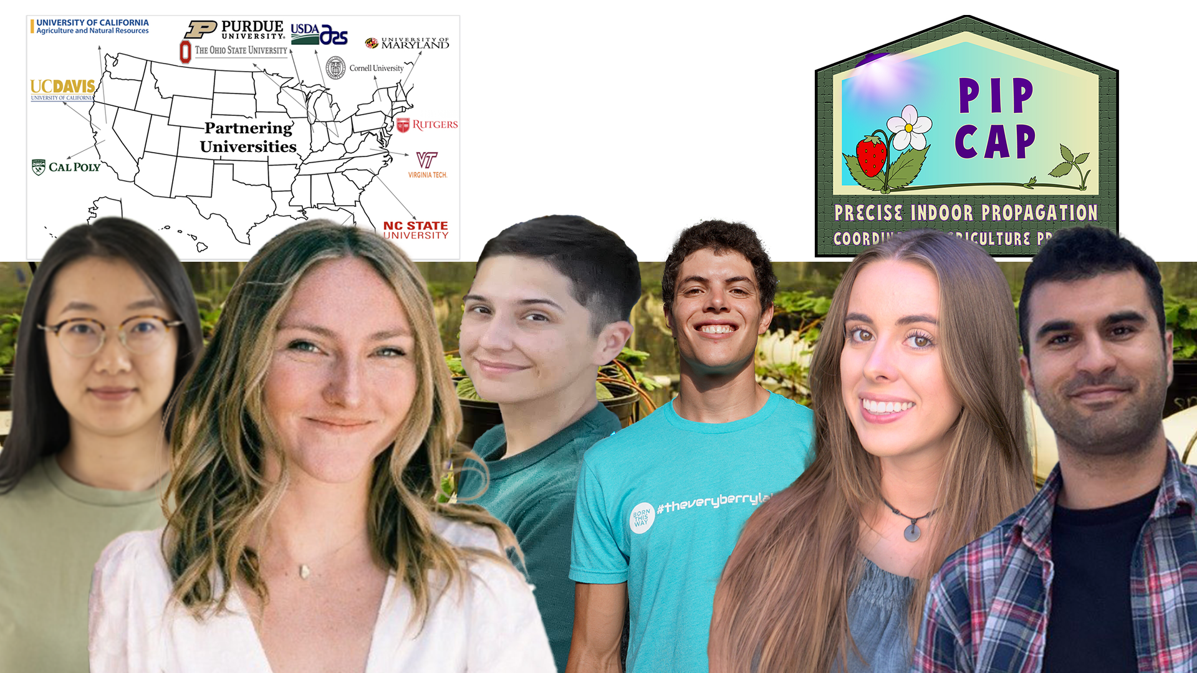
Extension and Communication Team
Topics:
Objective 6: Development of services and products, extension and outreach activities to industry and public stakeholders.
About me
Objective Overview
Website
Newsletters
Public Relations
Videos and Webinars
Notes:
All objective points:
1. 6.1.e Regional and national field day
2. 6.4 Development of a student exchange program (I can help you with these slides if you would like me to)
3. 6.1.c Strawberry propagation guidelines and recommendations (Have not completed, extension bulletin)
4. 6.1.f Development of Spanish outreach material (Upcoming)
5. 6.2 Development of an international conference on CE (Upcoming)
6. 6.3 In-service Train the Trainer education. (Unsure of this)
Alexa will focus
7. 6.1.a Project website and blog
8. 6.1.b Newsletters and public relations
9. 6.1.d Educational video series and webinars if necessary.

Slide 3
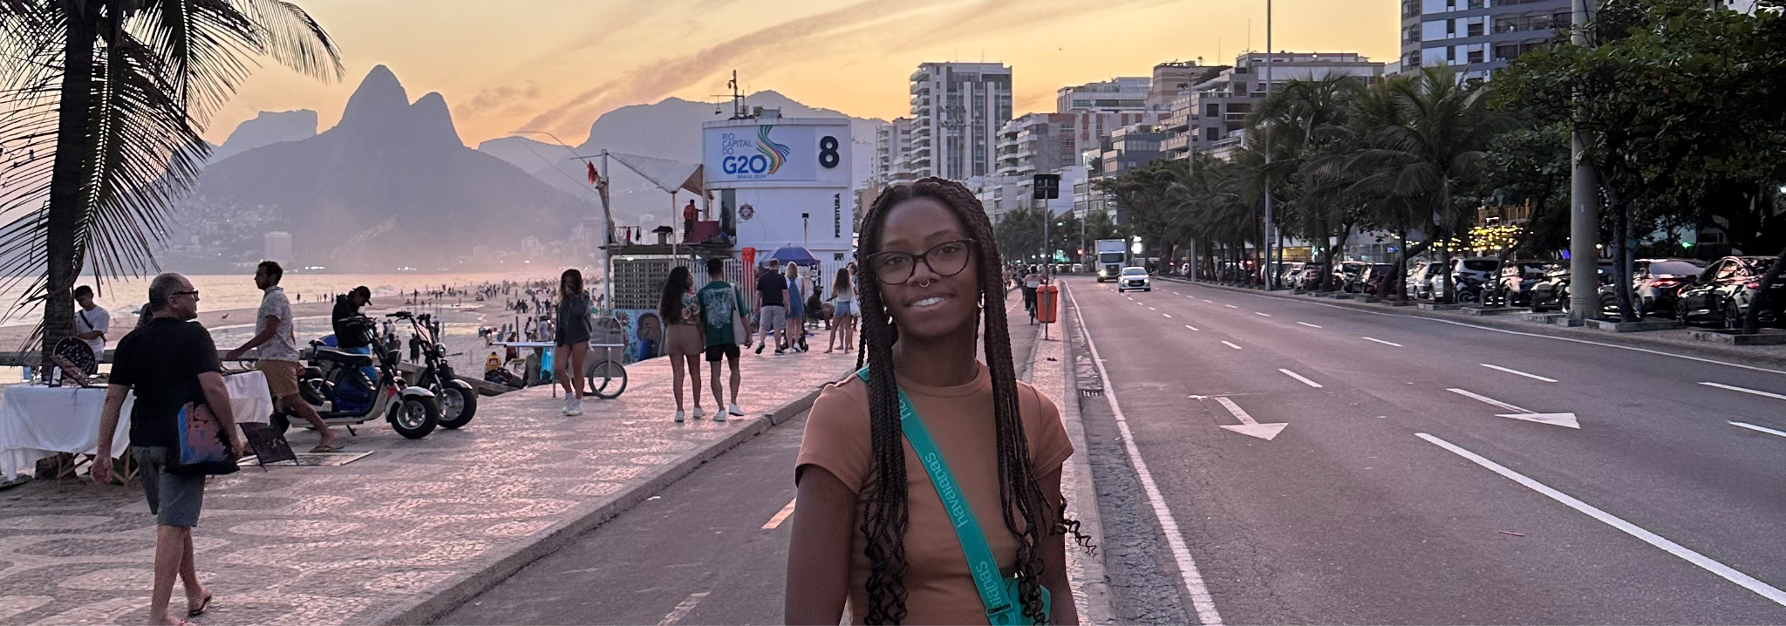
Alexa Artis
Team: Extension and Communication
Role: I make and do creative and communicative things for the project:
branding and illustrations
newsletters
annual meeting brochures
content creation
website management
public relations
About Me
Notes:
Hi everyone!
If you don’t already know me I’m Alexa
You’ve probably seen me walking around taking lots of pictures and videos of everyone going on

Slide 4

Objective overview
6.1.a Project website and blog
6.1.b Newsletters and public relations
6.1.c Strawberry propagation guidelines and recommendations
6.1.d Educational video series and webinars
6.1.e Regional and national field day
6.1.f Development of Spanish outreach material
6.2 Development of an international conference on CE
6.3 In-service Train the Trainer education
6.4 Development of a student exchange program

Slide 5
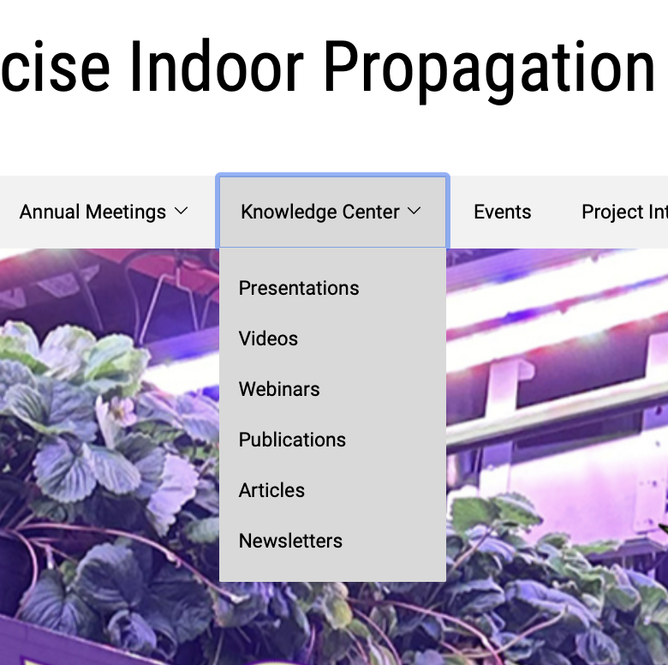
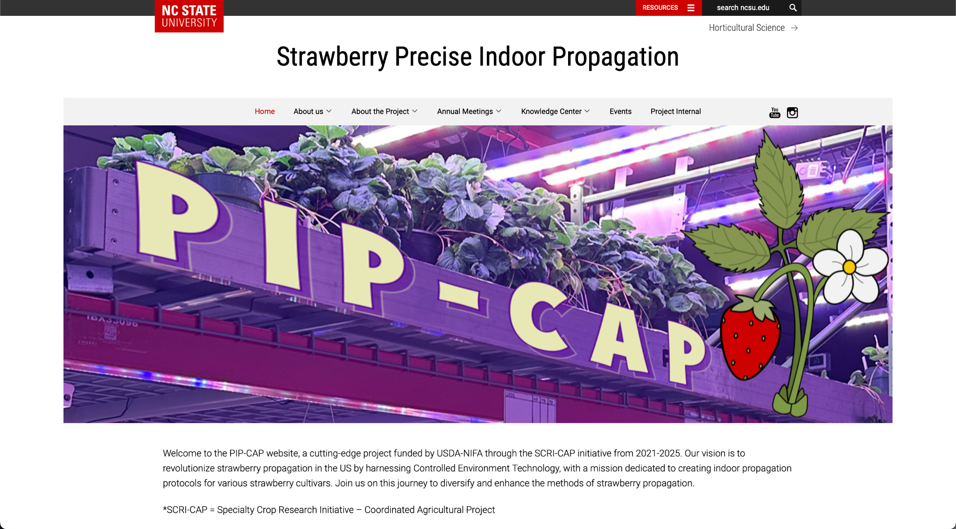
6.1.a Website and blog

Slide 6
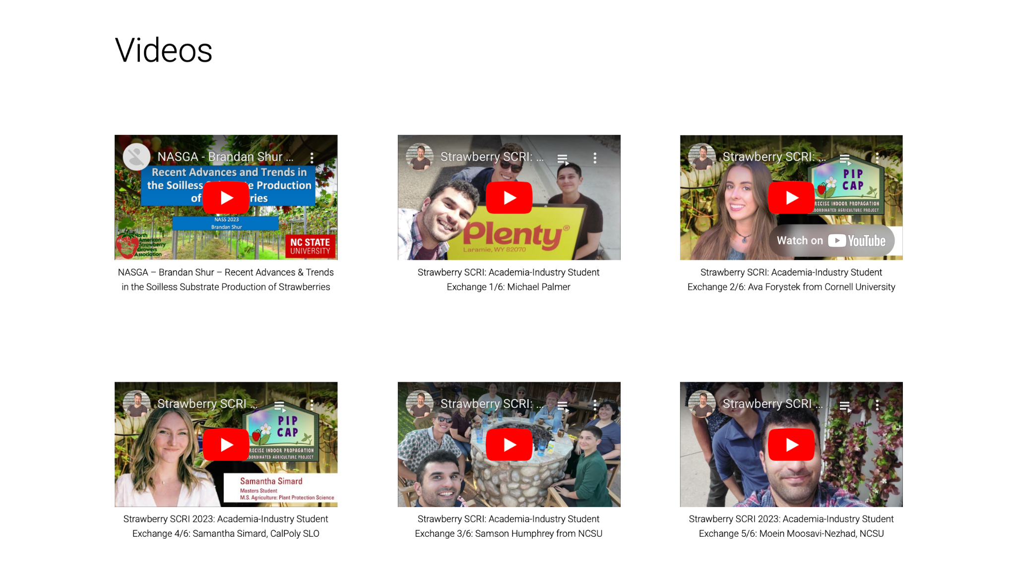
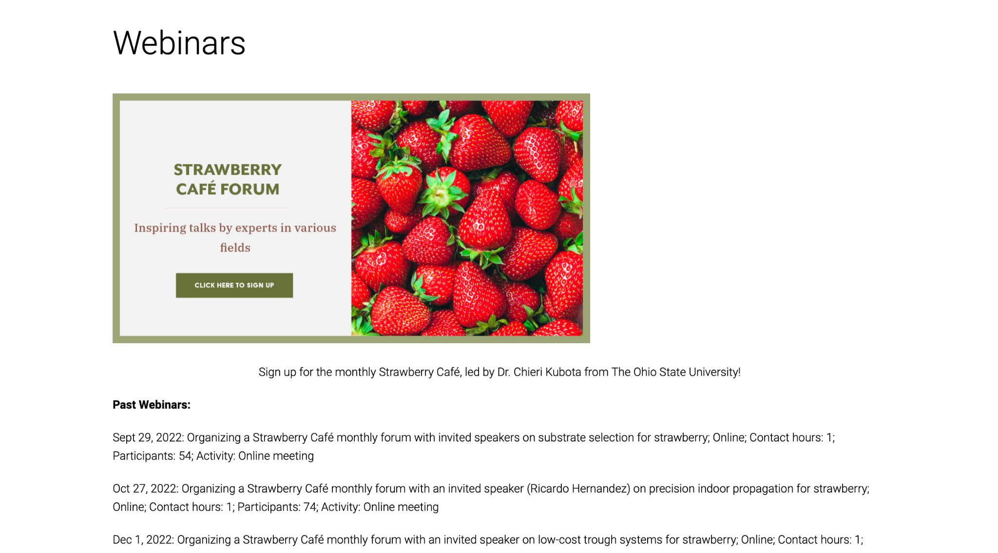
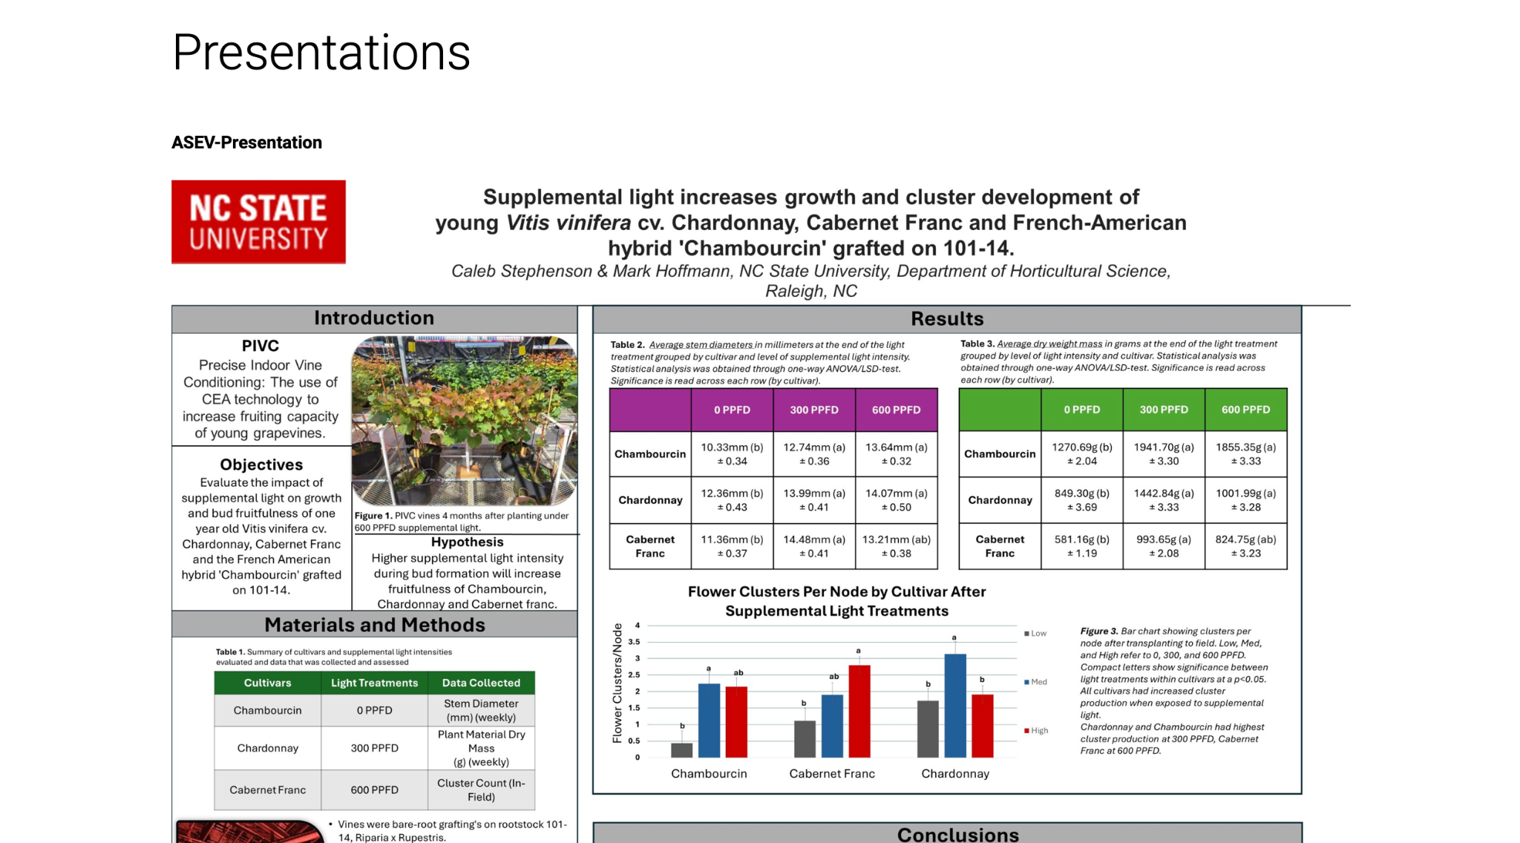
6.1.a Website and blog

Slide 7
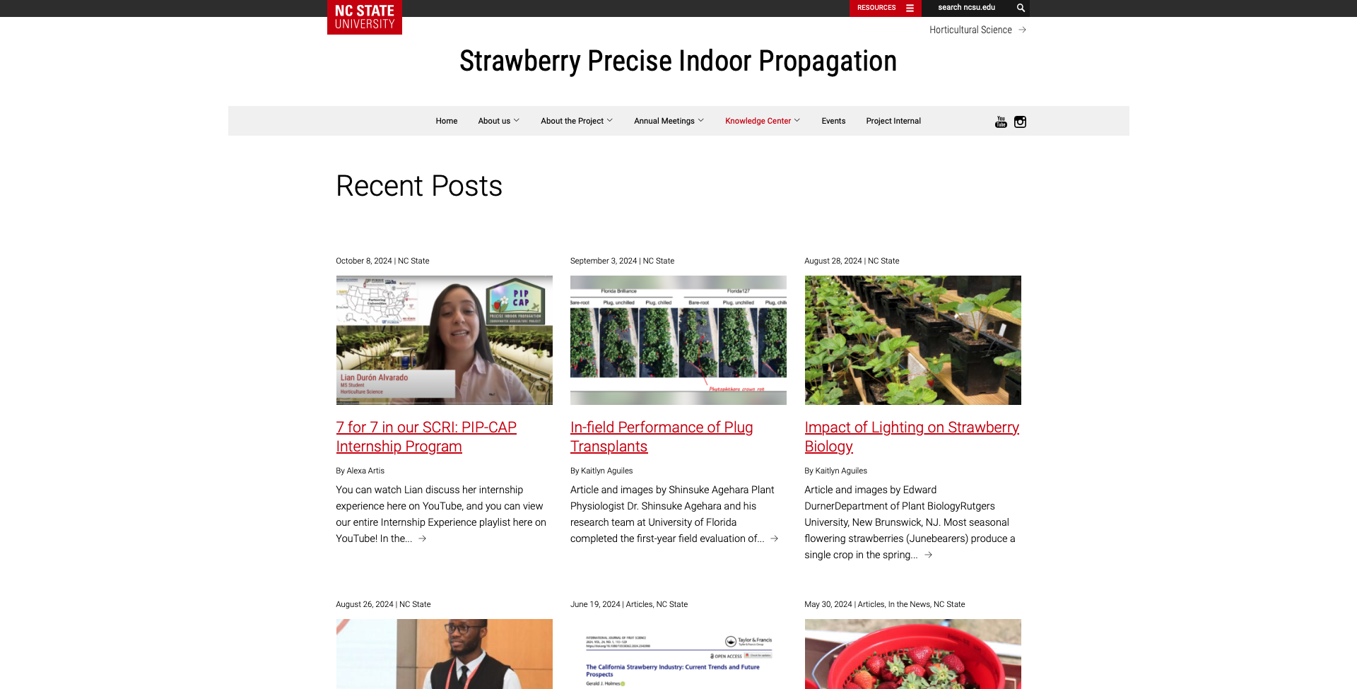
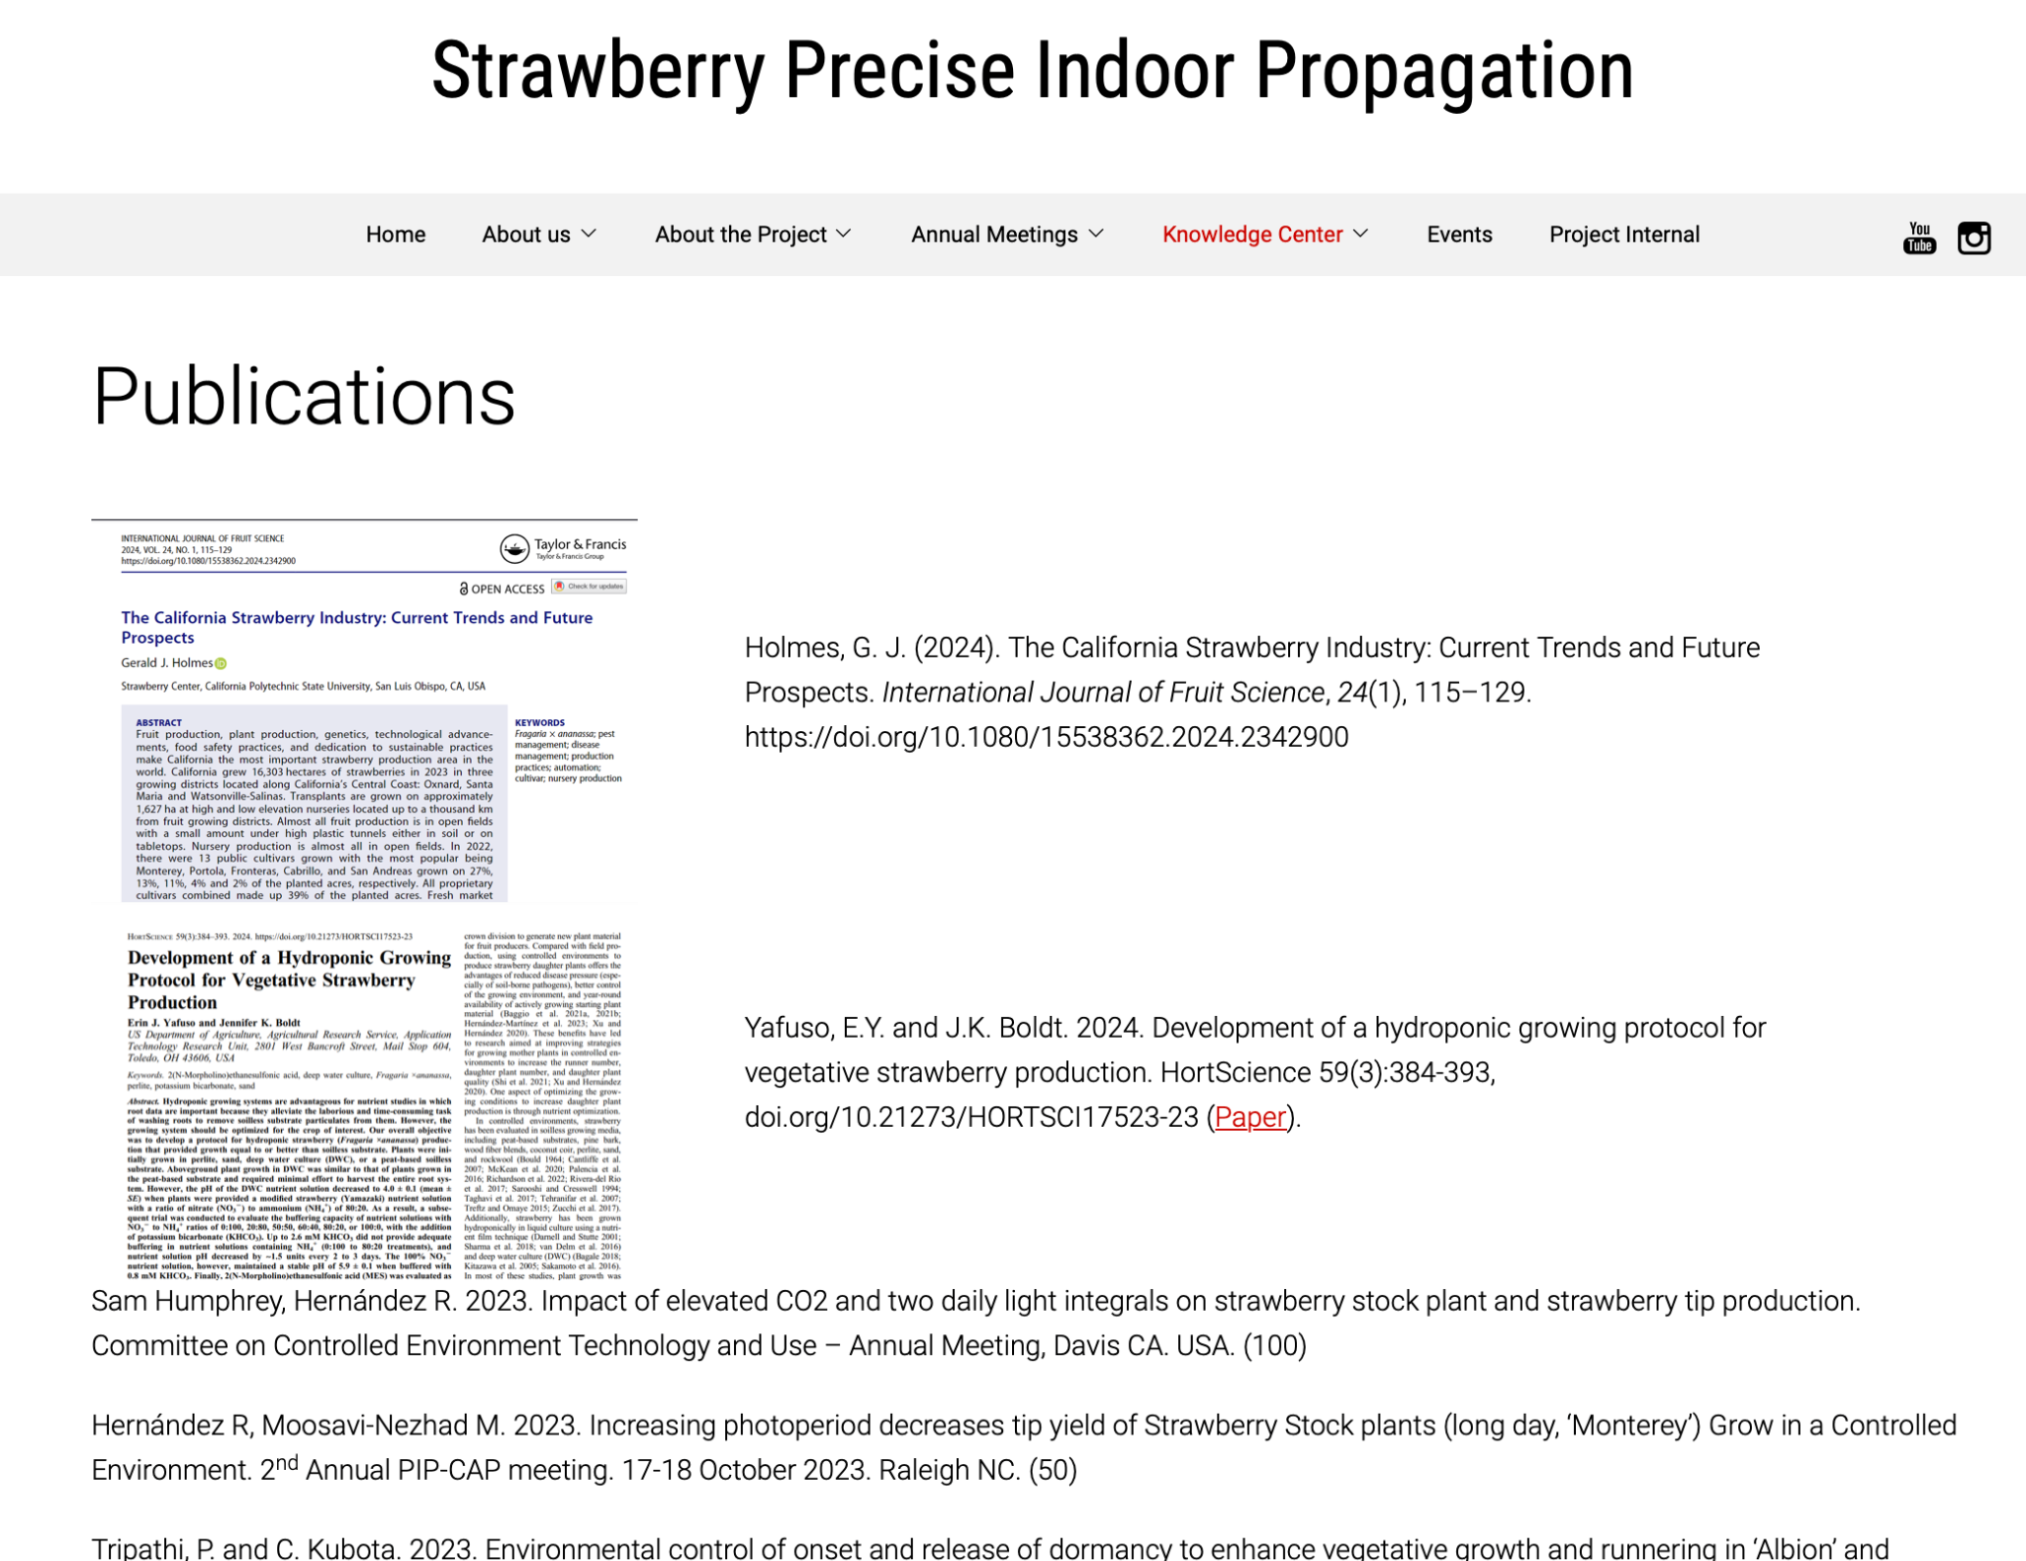
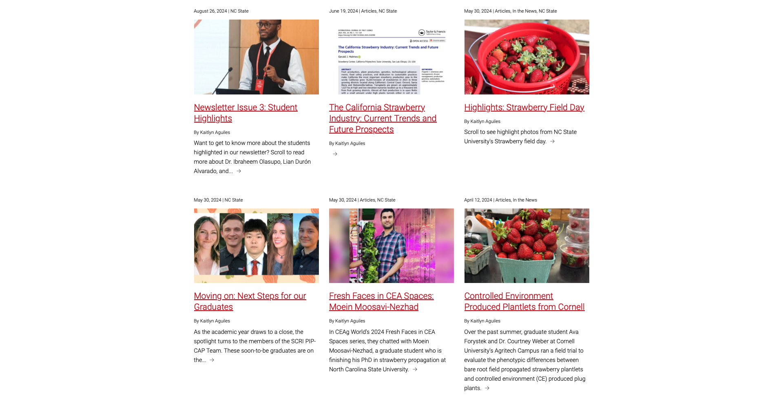
6.1.a Website and blog

Slide 8
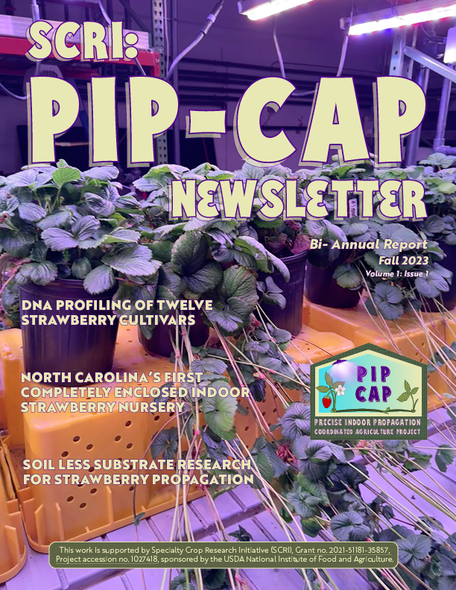
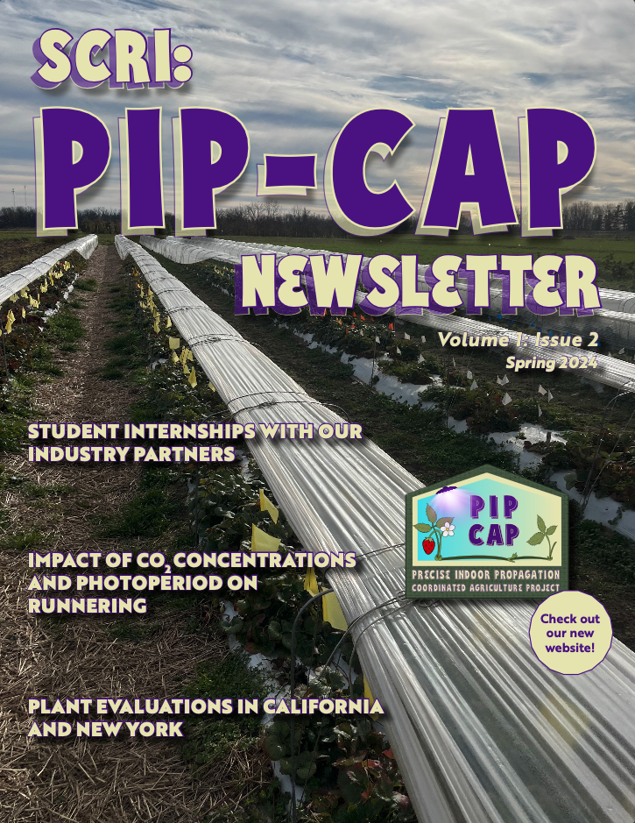
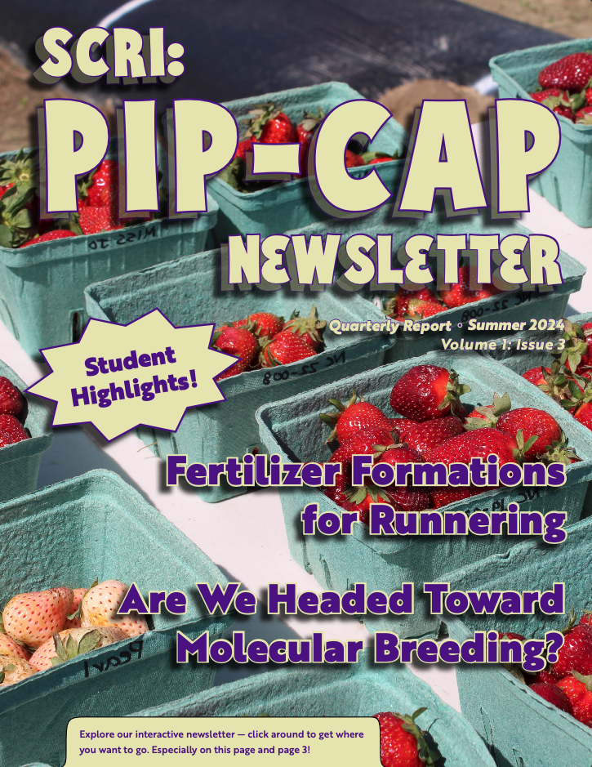
6.1.b Newsletters
Notes:
Talk about newsletter and HLA as well as during the final stretch of the project, I will be reaching out to more outlets such as HortiDaily and x, y, z to increase awearness about our project’s findings and how it’s helpful for growers

Slide 9
6.1.b Public Relations
Events:
Indiana Hort Conference
NCERA-101 conference
HLA Research Retreat (Purdue University)
New Jersey Agricultural Convention and Trade Show
New Jersey Vegetable Growers Meeting
Mid-Atlantic Fruit and Vegetable Convention
2023 and 2024 Southeastern Strawberry Expo
North American Strawberry Symposium
North American Raspberry and Blackberry Annual Conference
Cultivate
American Society for Horticultural Science
Greenhouse Strawberry School Online
NASGA and Brian’s video
Annual Meeting 3!
Features:
Inside Grower - Sam
Lian’s internship video was featured in HLA Happenings at Purdue University
On Facebook: Virginia Tech. Small Fruit Program at Hampton Roads AREC made a post about harvesting
Numerous LinkedIn posts
15 articles on the PIP-CAP blog
Urban Ag News - Brandan

Slide 10
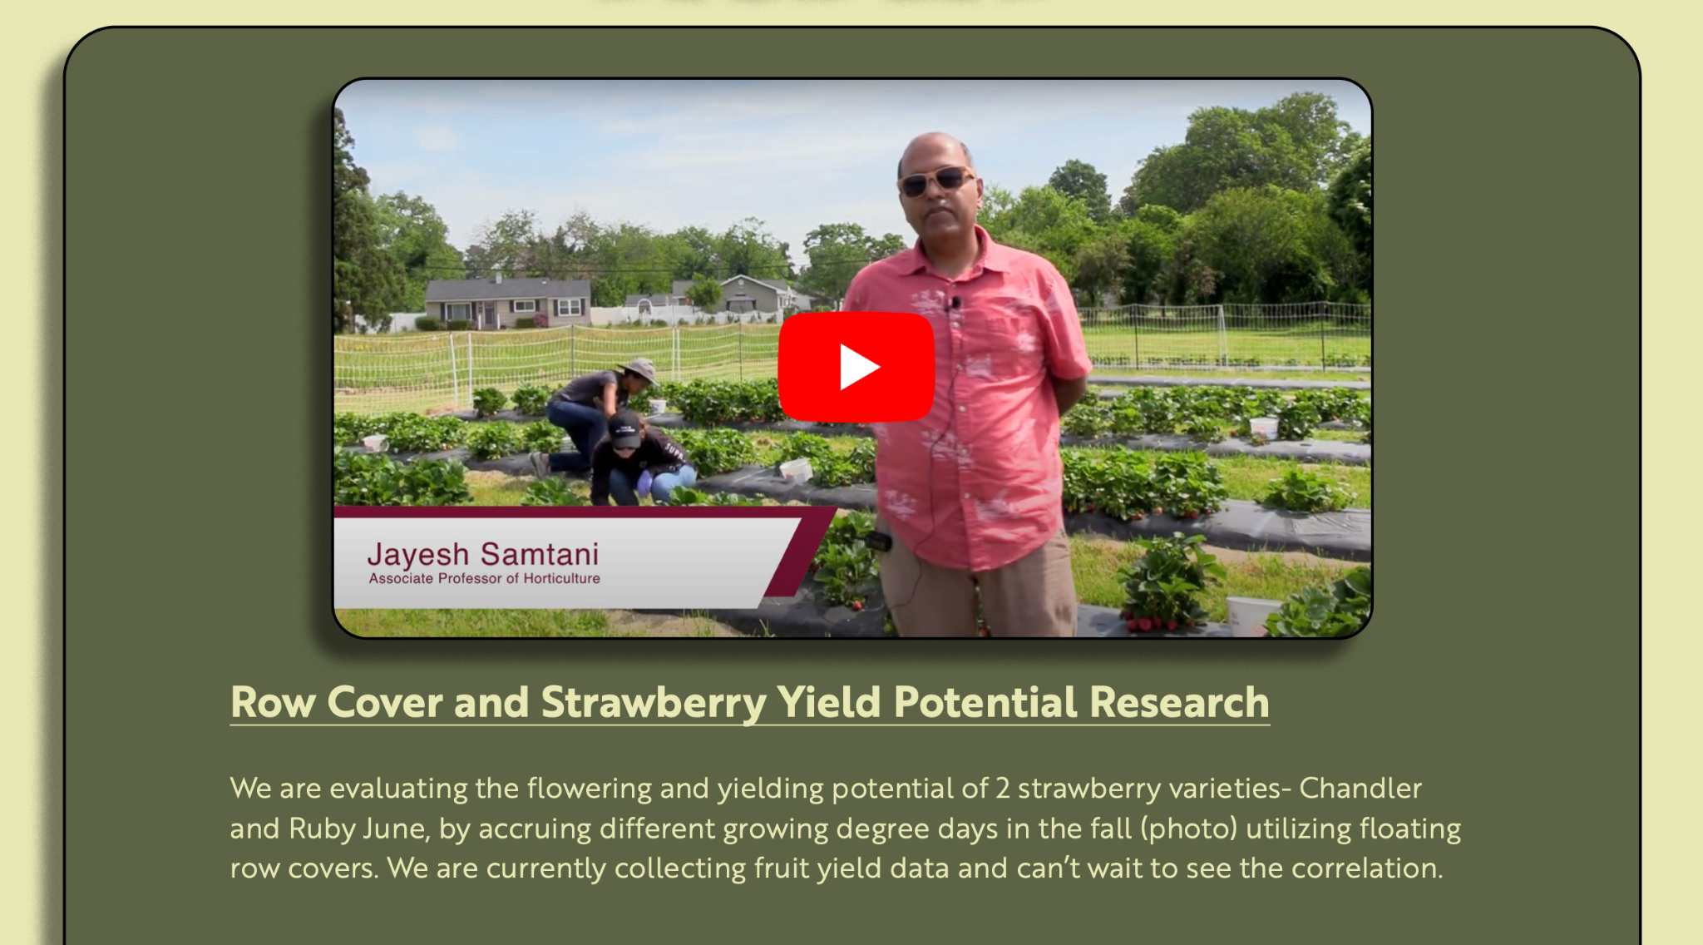
6.1.d Educational video series and webinars
2024 Greenhouse Strawberry School
9 previous webinars (2022-2023) reaching over 500 people in total

Slide 11
upcoming
More PR
Spring newsletter
Notes:
Hi everyone!
If you don’t already know me I’m Alexa
You’ve probably seen me walking around taking lots of pictures and videos of everyone going on

Slide 12
Thank you
Thank you so much to everyone who has submitted an article or photo or video or who sat for an interview with me. & Thank you to anyone who is involved in the project in any capacity!
Notes:
Hi everyone!
If you don’t already know me I’m Alexa
You’ve probably seen me walking around taking lots of pictures and videos of everyone going on

