Slide 1
Optimal Planting Date and Chilling for Plug Planted Strawberries in the California Central Coast Region
Samantha Simard
Cal Poly Strawberry Center Research Associate

Slide 2
Objectives-Planting date and chilling
Year 1(22-23): Determine the effect of planting date on yield of ‘Monterey’ and ‘Fronteras’
Year 2 (23-24): Determine the effect of chilling treatment on yield of ‘Monterey’
Year 3 (24-25): Determine the effect of chilling treatment on yield of ‘Monterey’
Determine yield differences, if any, between plants produced in controlled environments and plants produced in CA nurseries
Project-Long: Determine the feasibility of producing plug plants in controlled environment, shipping to California, and planting to produce fruit

Slide 3
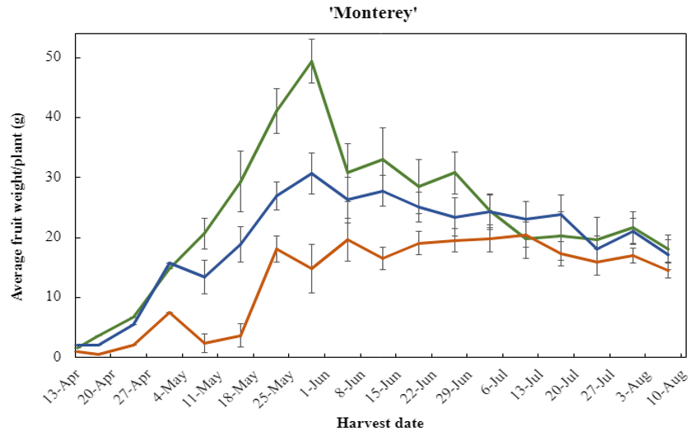
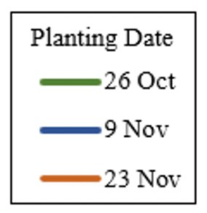
Year 1 – Planting date
Planted 26 Oct, 9 Nov, 23 Nov
Harvested twice weekly
13 Apr through 10 Aug 2023
Fruit weighed and counted
Analyzed yield per plant
Weekly plant mortality counts
Plated for disease screening
Recorded number of branch crowns at trial termination

Slide 4
Year 2- Chilling treatment

Slide 5
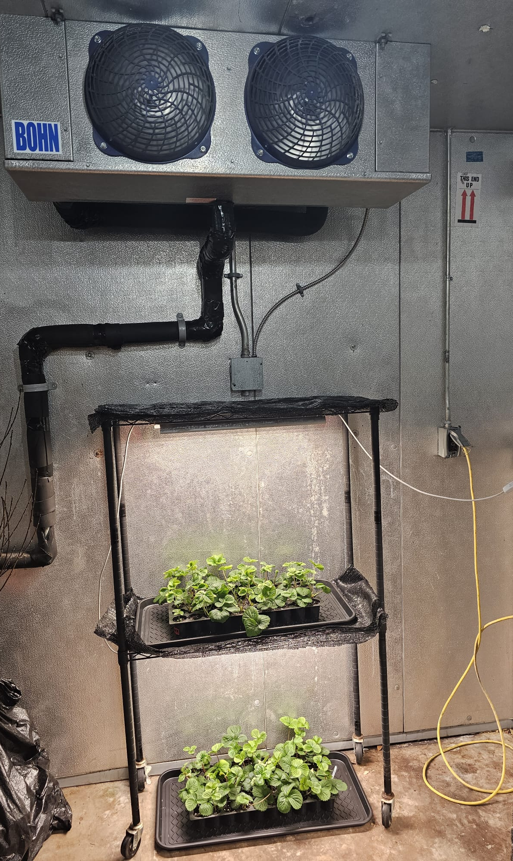
Methods: Chilling treatment
Cultivar: ‘Monterey’
Chilling hours: 350
Chilling temperature: 39.2 °F (4 ° C)
Photoperiod: 18 h
Fertigation: Bottle-fed with strawberry nutrient recipe
Fertigation regime: Every other day

Slide 6
Methods – Chilling treatment
Randomized complete block design
26 plant plots, replicated 4 times
Weekly plant mortality counts
Plated for disease screening
Harvested twice weekly
29 Mar through 2 Aug 2024
Fruit weighed and counted
Analyzed yield per plant
Recorded number of branch crowns at trial termination

Slide 7
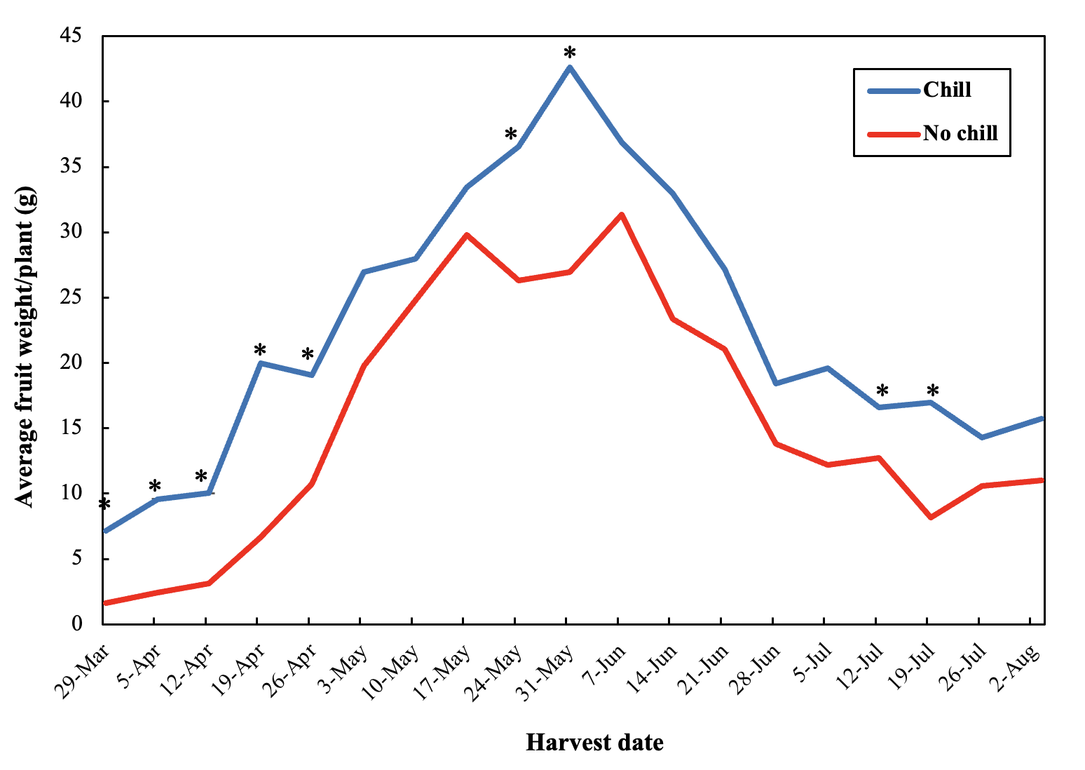
Results: Yield
Figure 1. Asterisk indicates a statistically significant difference in treatments (α=0.05)

Slide 8
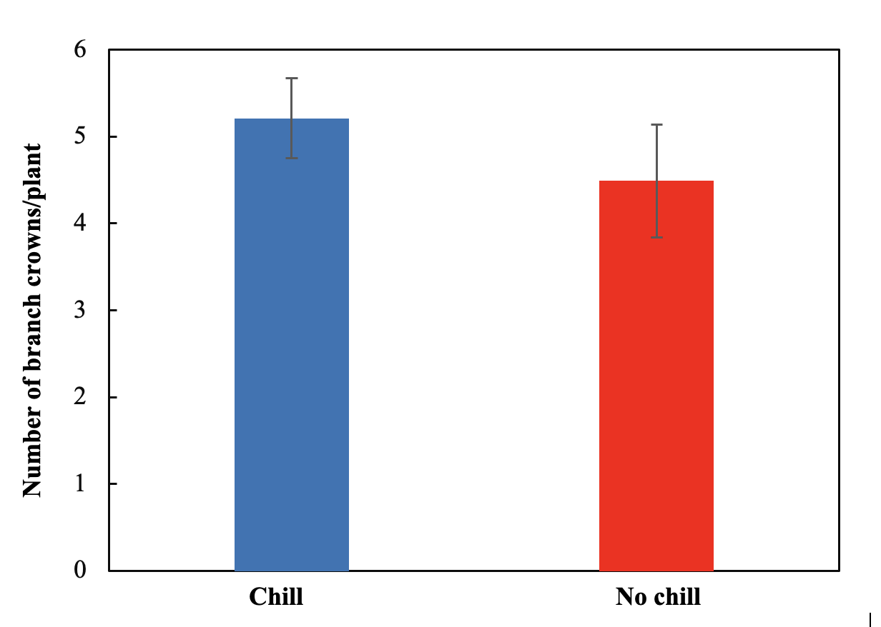
Results: Branch crowns
Figure 2. Error bars represent standard error of the mean. Treatments are not statistically different (α=0.05).

Slide 9
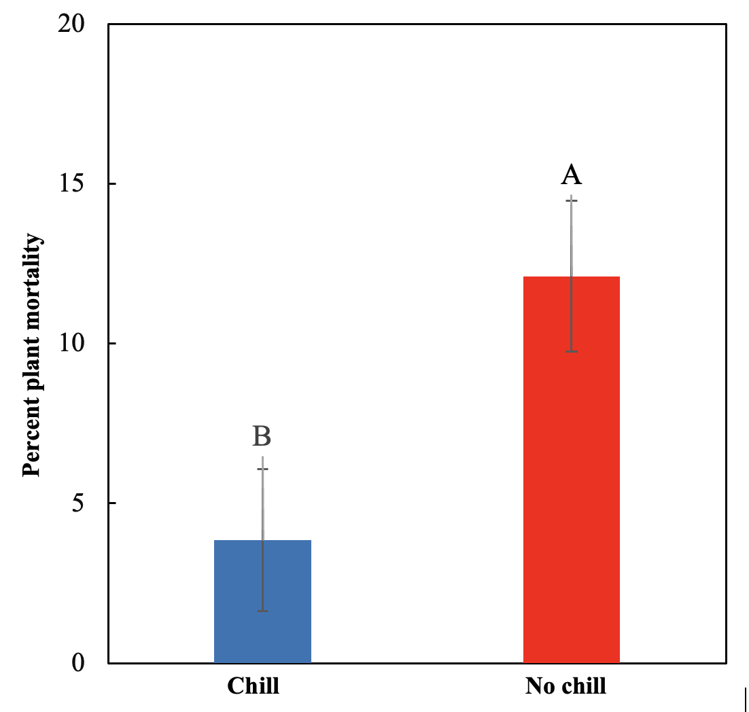
Results: Plant mortality
Figure 3. Error bars represent standard error of the mean. Treatments that do not share the same letter code are statistically different (α=0.05).

Slide 10
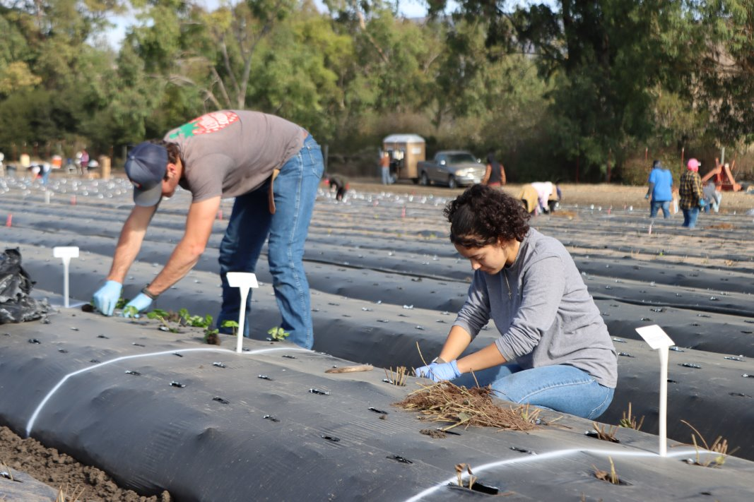
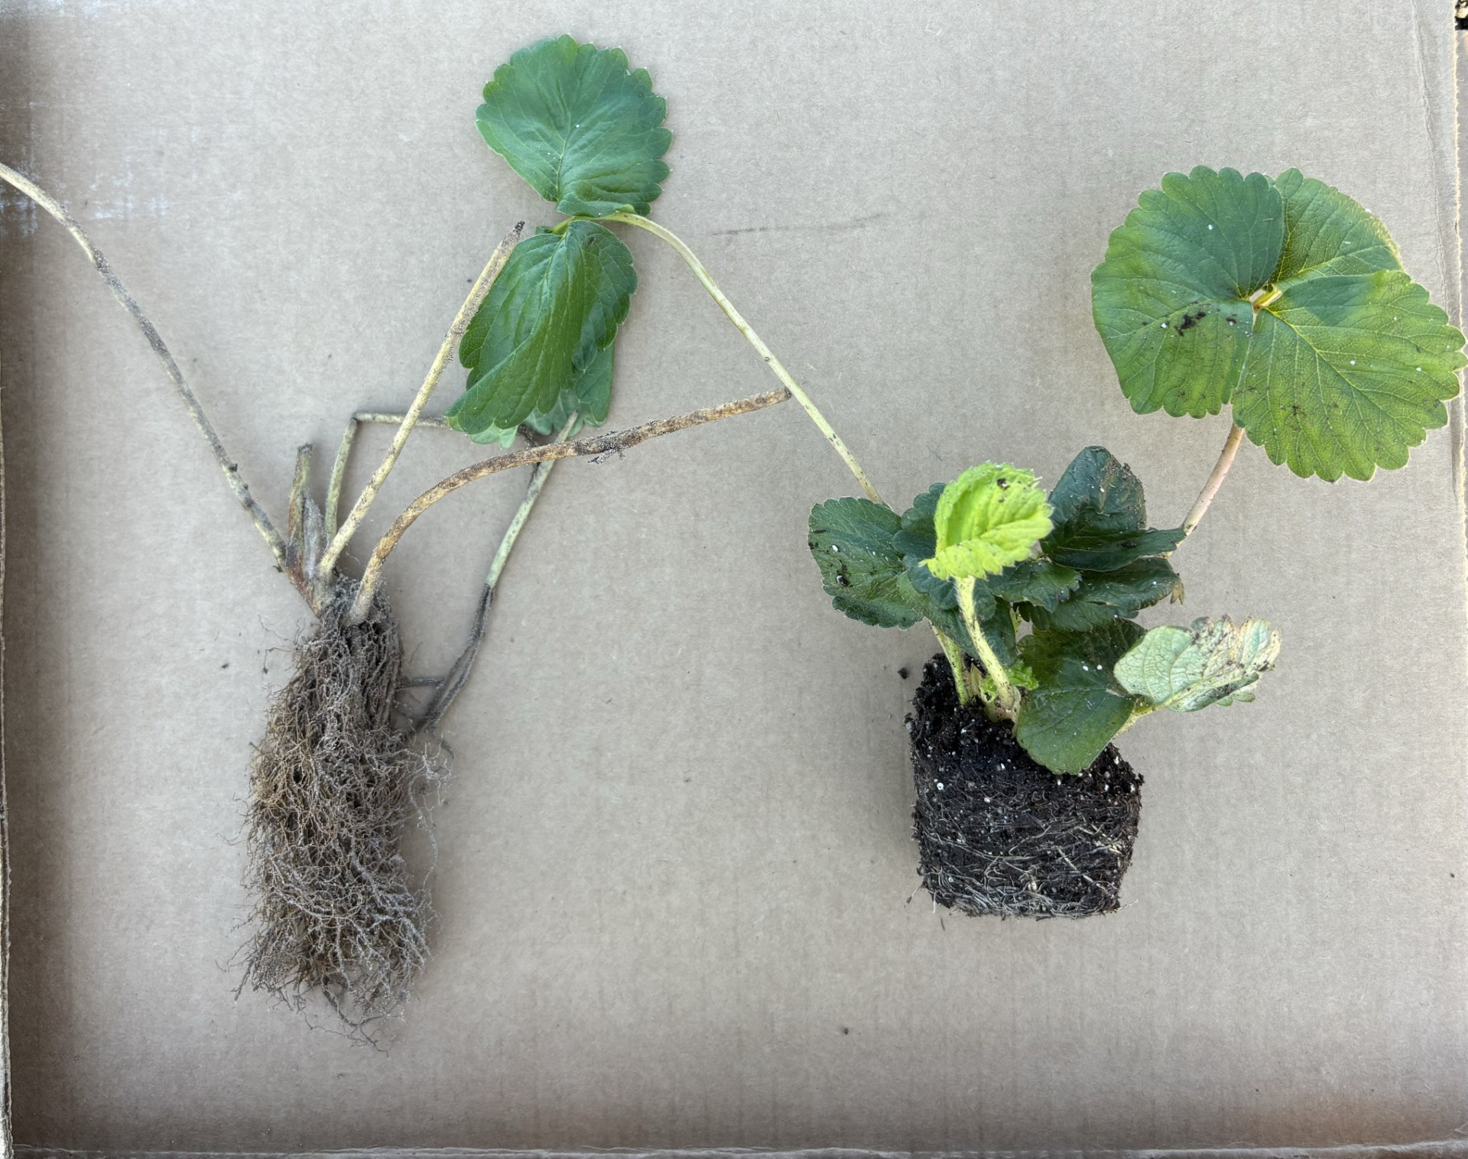
Year 3- Chilling treatment
Replicating the trial conducted in year 2
Adding a bareroot treatment sourced from California nursery

Slide 11
Thank you
Questions?

