Slide 1
Field Evaluations of Chill-Treated Strawberry Plants Propagated in Controlled Environments
Calyssa Stevenson
Fernandez Lab, NC State University

Slide 2
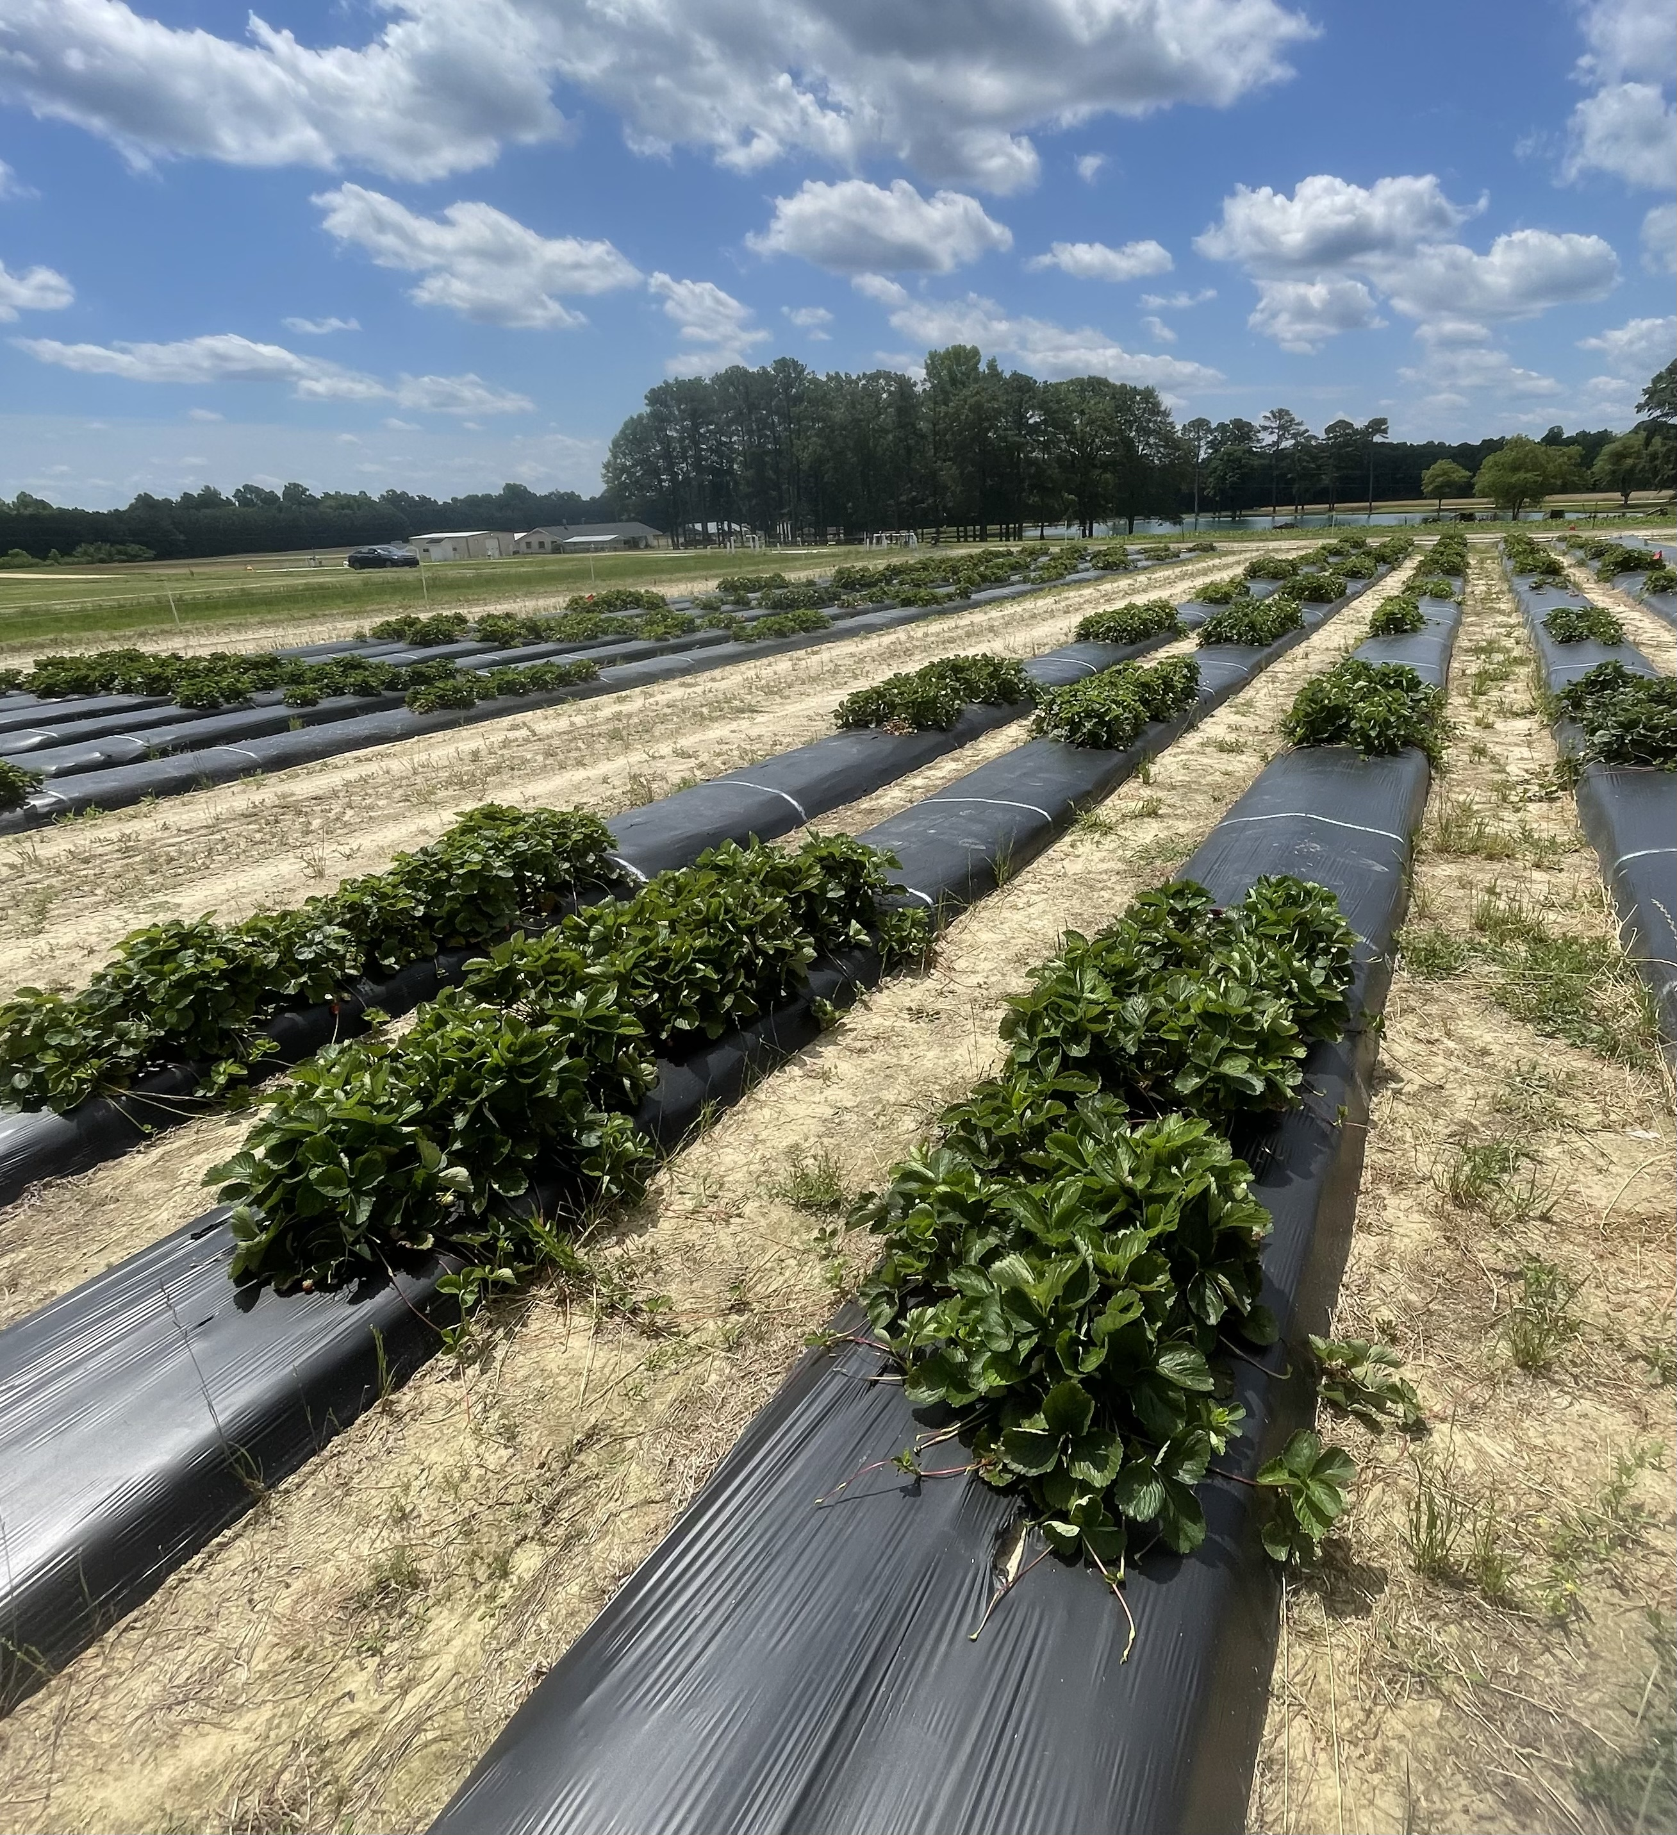
Overview
Background
Timeline
Materials/Methods
Data Collection
Results/Current Data Analysis
Challenges
Next Steps…

Slide 3
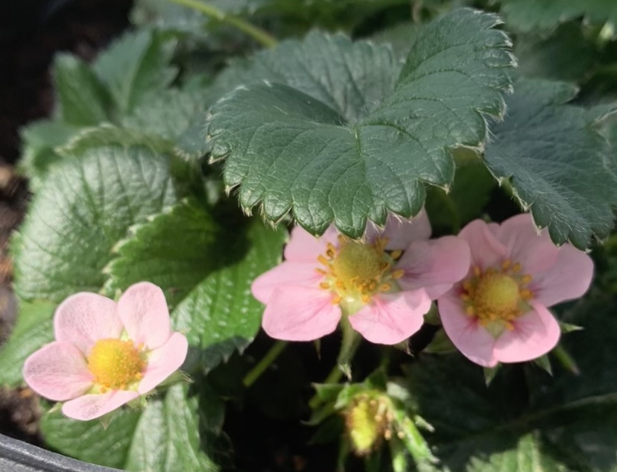
Background
Fragaria xananassa “strawberry plants” have a chilling requirement for floral development (Al-Madhagi et al., 2018)
Cultivars vary in number of chilling hours necessary for proper floral development (Al-Madhagi et al., 2018)
One major purpose of study is to see if there is a significant difference in yield and early flowering between strawberry plants that have received 450 hours of chilling versus those that have received none
1
Notes:
https://intapi.sciendo.com/pdf/10.2478/johr-2018-0013

Slide 4
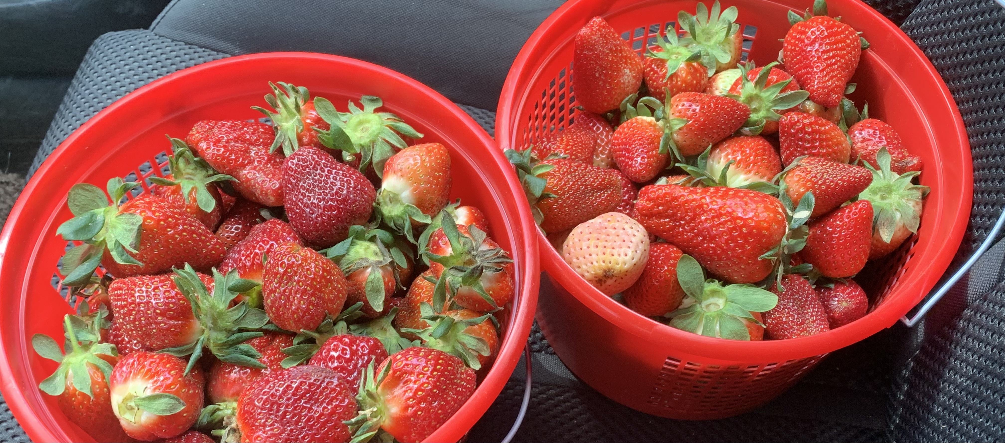
Objective 5.3b: Evaluation of fruiting capacity
The aim of this study is to evaluate yield differences between strawberry plugs propagated in commercial nurseries versus in controlled environments.

Slide 5
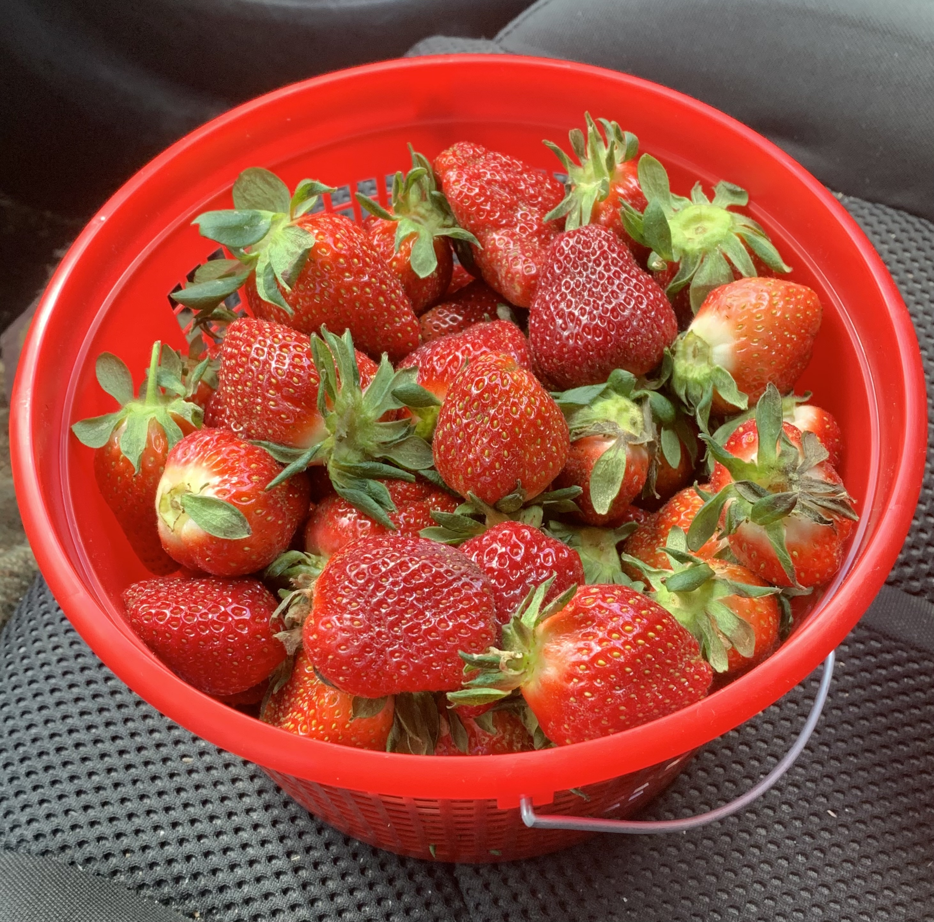
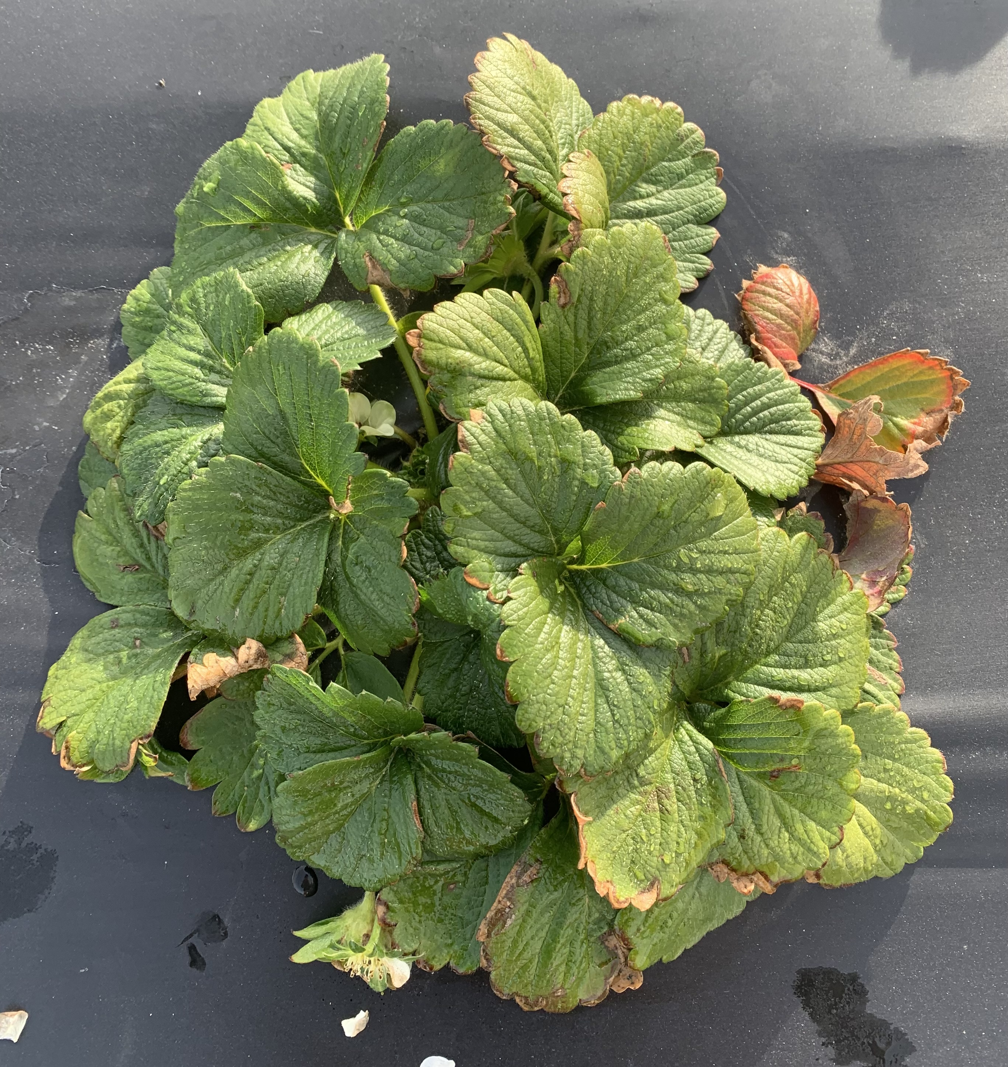
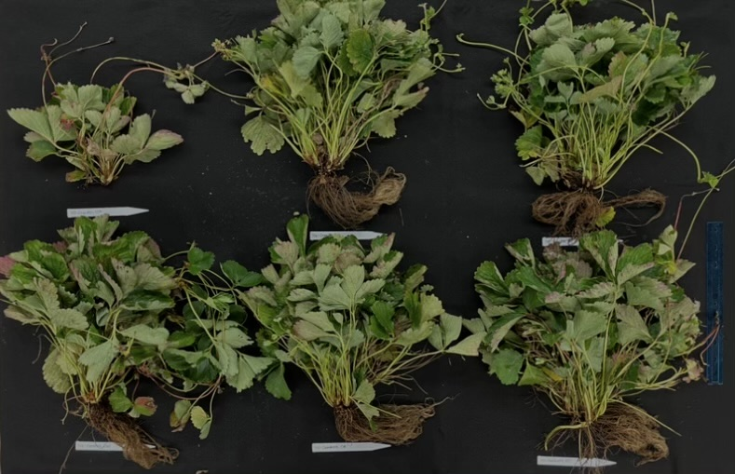
2023-2024 Field Season Timeline
Daughter plants propagated in controlled environments in late summer 2023.
Dry weight data collected on 6/24/24 and postharvest data collected on 6/27/24.
Vegetative data collected through the winter months.
Planted on October 16th, 2023
Harvest & yield data collection occurred twice a week from 4/4/24 – 5/28/24.
2

Slide 6
Materials/Methods
‘Camarosa’ & ‘Chandler’ plug plants
4 replicates of 6 treatments: No Chill, Chill & Commercial Nursery (24 plot trial)
Chilled plants received 450 hrs at 4 $℃$
Commercial plants sourced from a Canadian Nursery
13 plant plots were planted in October 2023 at Central Crops Research Station in Clayton, NC
Harvest occurred twice a week
Data collected: total, marketable, cull, and fruit weight, Botrytis, anthracnose fruit, and Neopestalotiopsis fruit occurrence
3

Slide 7
Results – Table of Means
Treatment | Total Yield/Plant (g) | LSD | Marketable Yield/Plant (g) | LSD | Average Marketable Fruit Weight (g) | LSD
Camarosa, Chill | 481.87 | A | 316.04 | A | 20.25 | ABC
Camarosa, Commercial | 286.46 | D | 176.91 | CD | 22.65 | A
Camarosa, No Chill | 408.80 | AB | 256.34 | B | 21.41 | AB
Chandler, Chill | 391.64 | BC | 226.90 | BC | 18.47 | D
Chandler, Commercial | 175.67 | E | 96.06 | E | 19.22 | BCD
Chandler, No Chill | 324.83 | CD | 179.80 | D | 19.44 | CD
*Tukey’s-LSD was performed for mean separation test with an α = 0.05.
4
Notes:
-Total Weight per plant (grams), marketable weight per plant, and berry weight average/time *changed

Slide 8
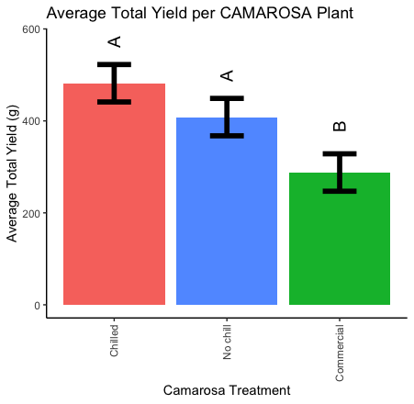
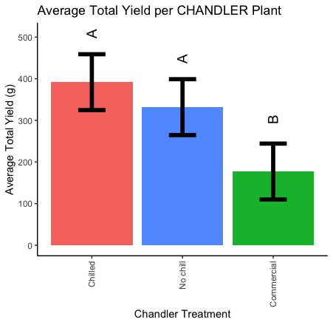
Results – Yield Differences
CAMAROSA
CHANDLER
5
Notes:
These are yields per plant

Slide 9
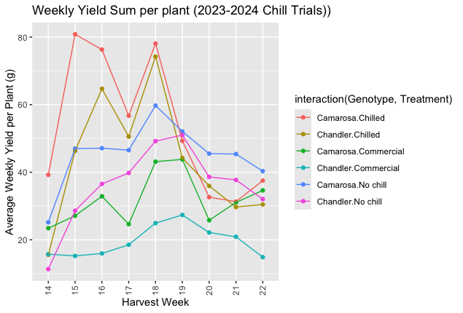
Results – Weekly Marketable Yield
6
Notes:
-Show marketable instead – REMOVE WEEKLY YIELD SUM

Slide 10
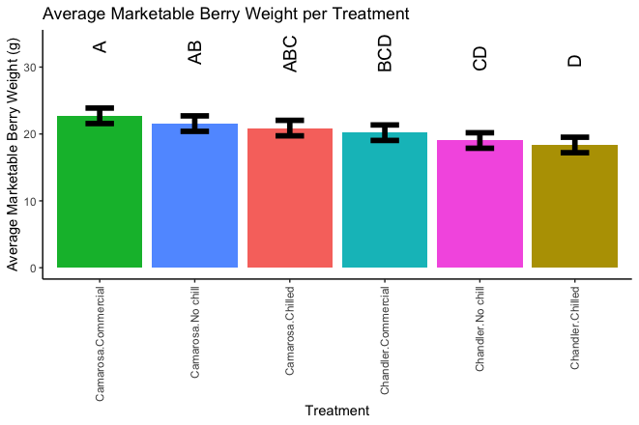
Results – Weekly Fruit Weight
7
Notes:
change

Slide 11
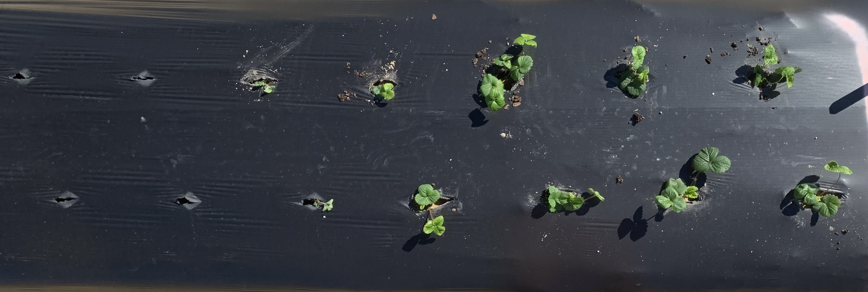
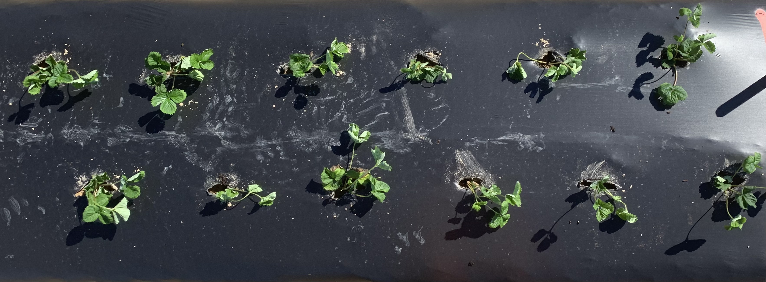
Challenges
Plant Quantity & Quality → stand establishment
Chandler, Chilled
Chandler, Commercial
Chandler, No Chill
Top is plants on planting date, while bottom is plants on last harvest date.
8

Slide 12
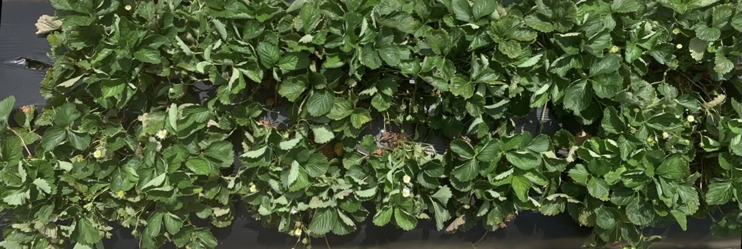
Challenges
Plant Quantity & Quality → stand establishment
Camarosa, Chilled
Camarosa, Commercial
Camarosa, No Chill
Top is plants on planting date, while bottom is plants on last harvest date.
9

Slide 13
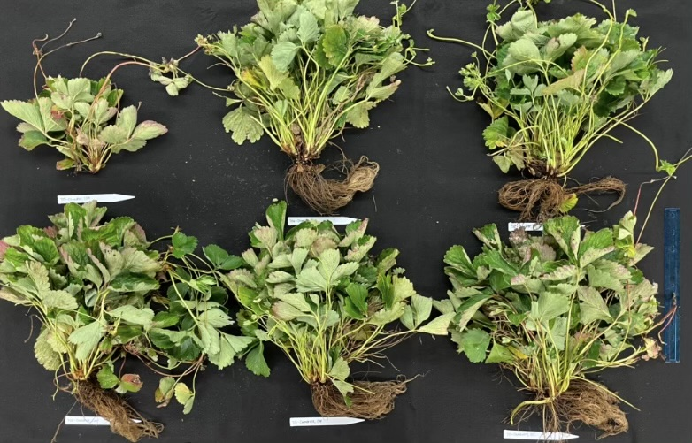
Next Steps
Analysis of:
Dry weights, including allocation of resources to shoots, roots/crowns, and runners
Postharvest factors, such as TSS, pH, and BRIX
2024-2025 Field Season
Expanded to 2 trial locations: Coastal and Central, NC
Harvest in spring, and final analysis in the summer of 2025
10

Slide 14
Acknowledgements
Dr. Gina Fernandez, Ian Mellon, Brianna Haynes, Makayla Gilland, Harmony Lewis, Anna Fail, & Olga Lialiuk
Drs. Mark Hoffman, Riccardo Hernandez, & Ibraheem Olasupo
Lizeth Vigil
Central Crops Research Station Staff, Austin Wrenn, Michael Palmer, & the PIP-CAP team

