Slide 1
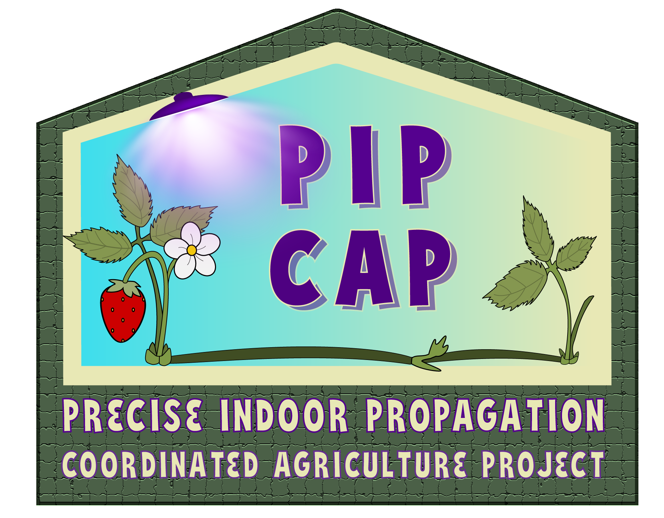
Grant 2021-51181-35857
Unravelling Runnering Architecture of Strawberry Cultivars Propagated in a Gutter System
Ibraheem Olamide Olasupo and Mark Hoffmann
Nov. 14, 2024

Slide 2
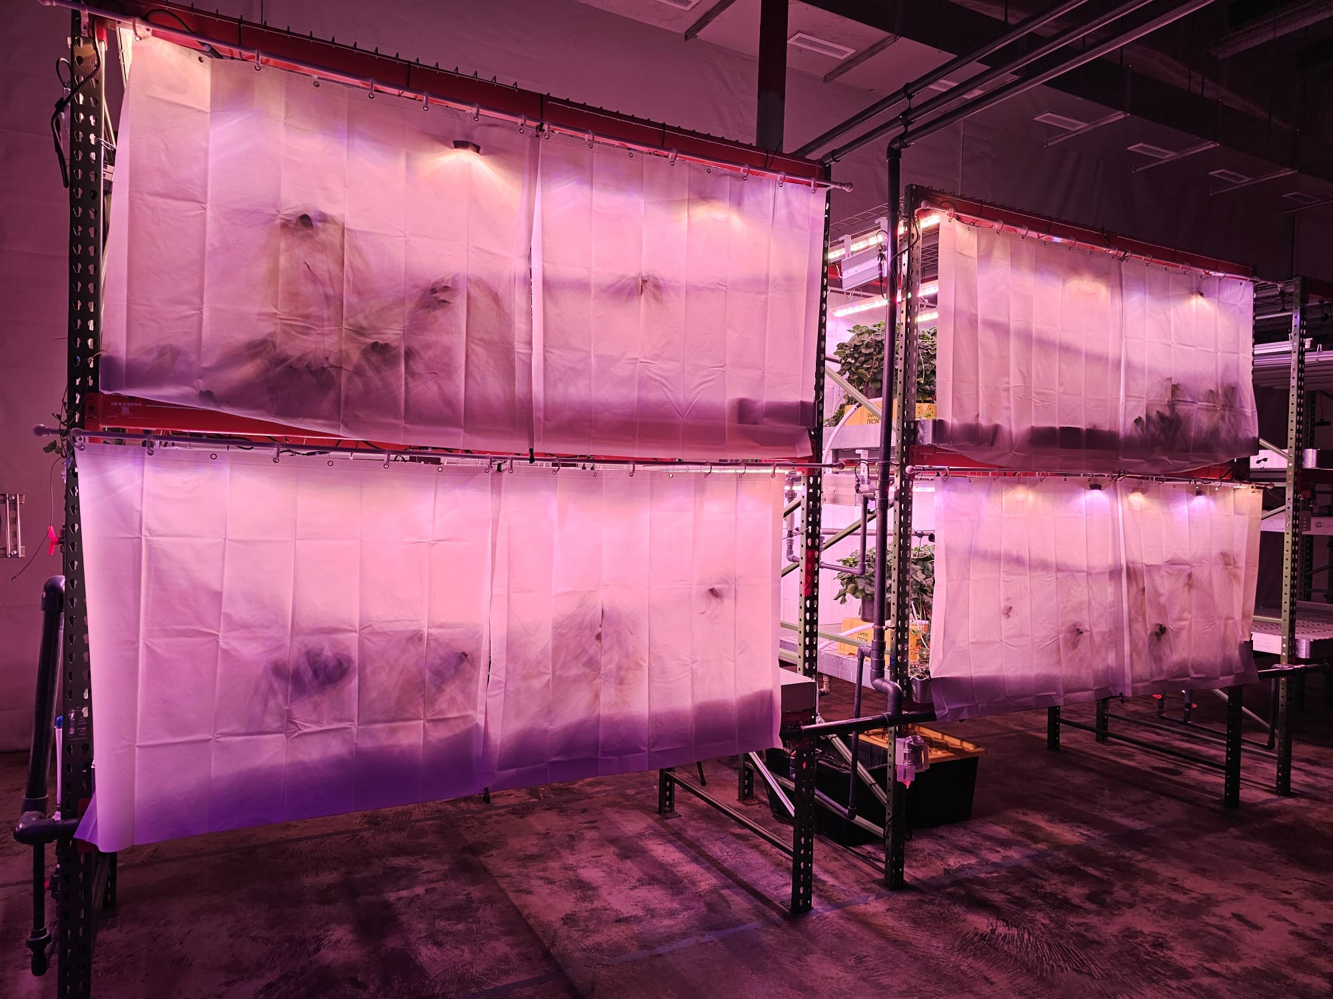
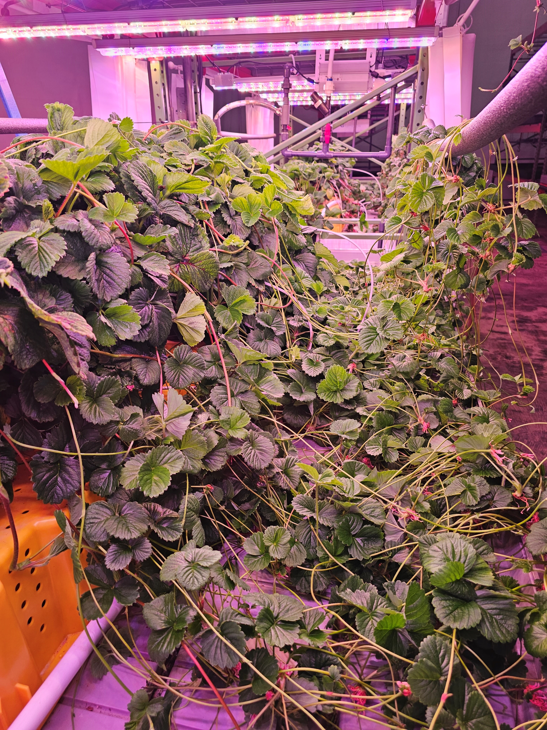
Background
Our quest for working alternatives to provide clean strawberry propagules for growers in the US has led us to developing controlled environment technologies in a plant factory.
2-tier vertical farming system in a plant factory, Grafted Growers in Raleigh

Slide 3
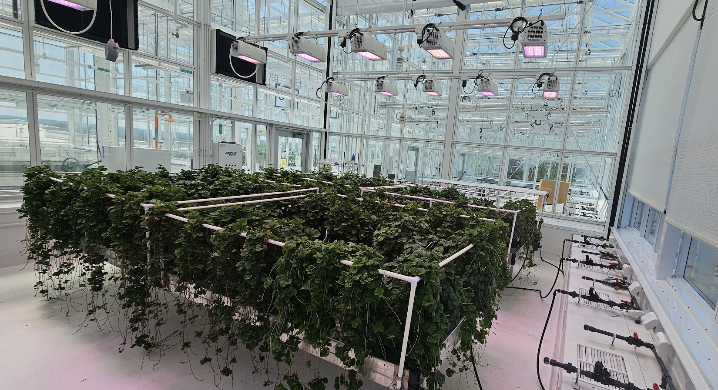
Background
Following the closure of the plant factory, we transitioned into a precision greenhouse at NC State University.
Strawberry propagation in a precision greenhouse at the Plant Science Building

Slide 4
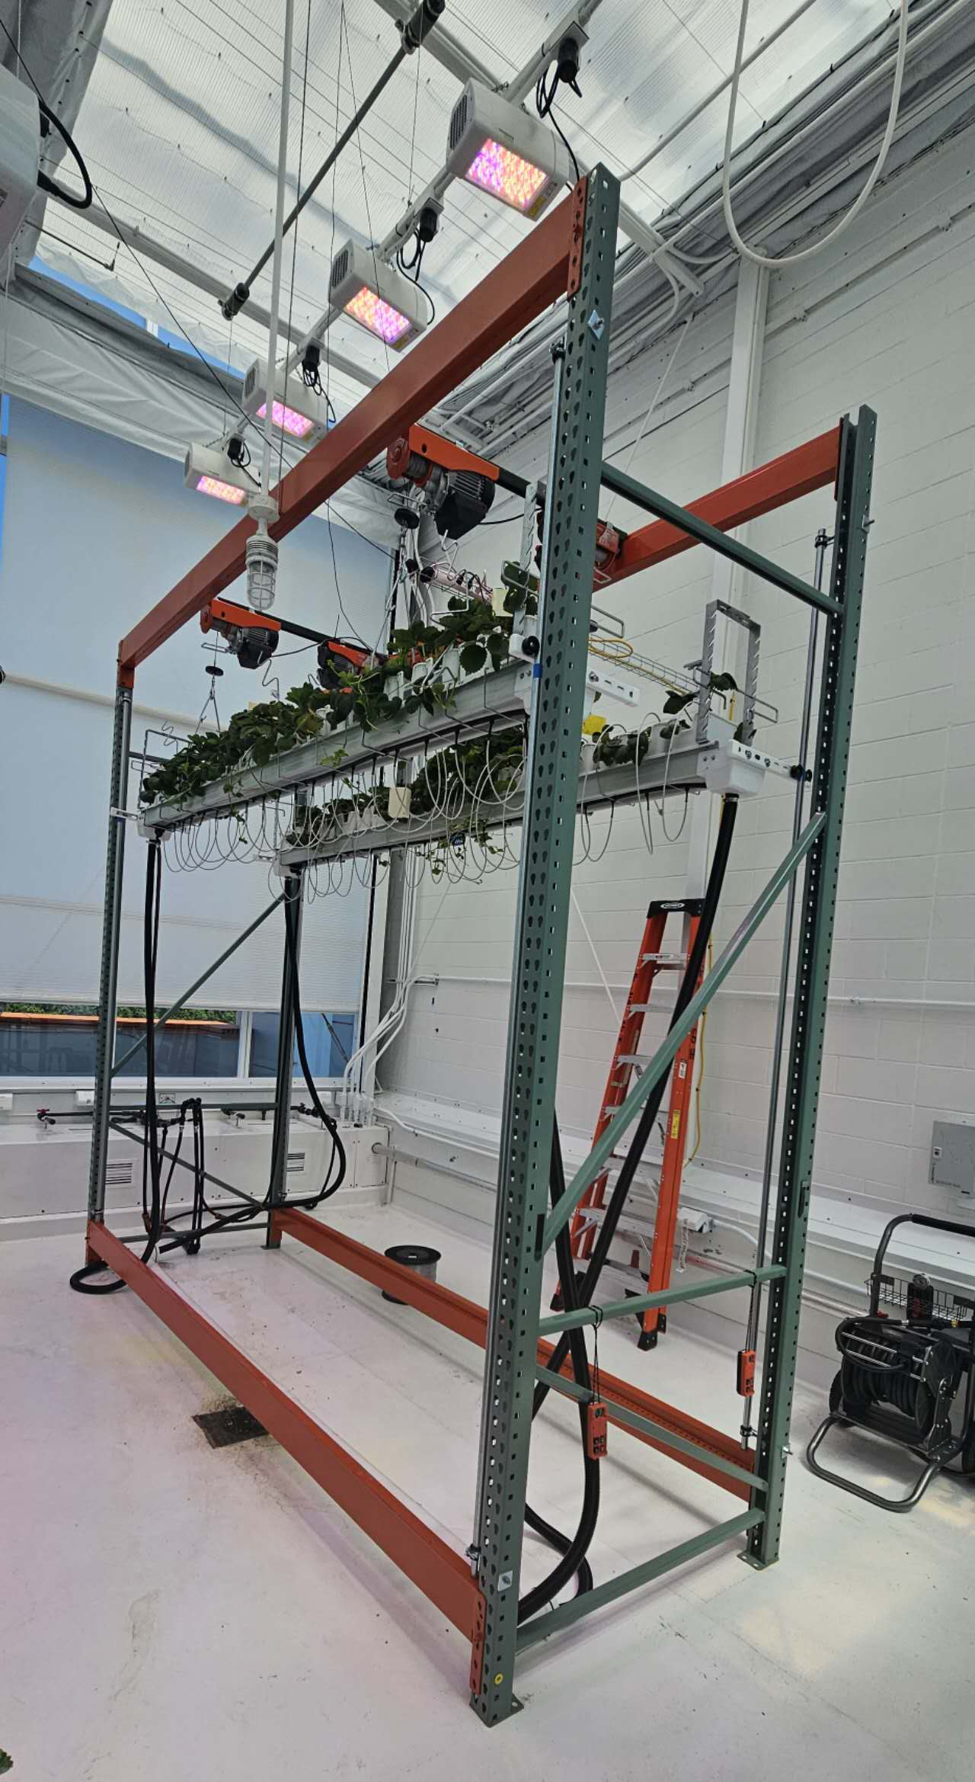
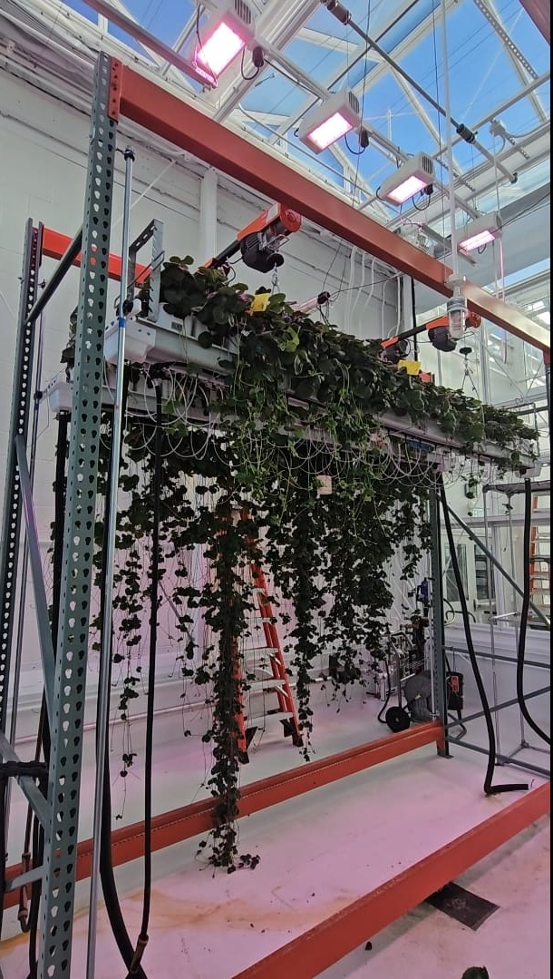
Background
Thereafter, we housed a gutter system, another system of vertical farming in the precision greenhouse.
With a plant population of 8 plants per sq meter, the gutter system allows enough room for plant stolons to hang down which makes the plants intercept light better
Gutter system for strawberry propagation in a precision greenhouse

Slide 5
Objective
Prior phenotyping study that we conducted unravelled the runnering architecture in Monterey and Fronteras which explains the disparity in the GA-regulating GA20oX4 gene in the DNAs of both cultivars (Published in the most recent SCRI PIP-CAP newsletter, Issue 3).
Further, phenotyping of the remaining 11 cultivars of interest to the PIP-CAP project.
For this batch, this study was conducted to unravel the runnering architecture of 6 cultivars of strawberry propagated in a gutter system in a precision greenhouse.

Slide 6
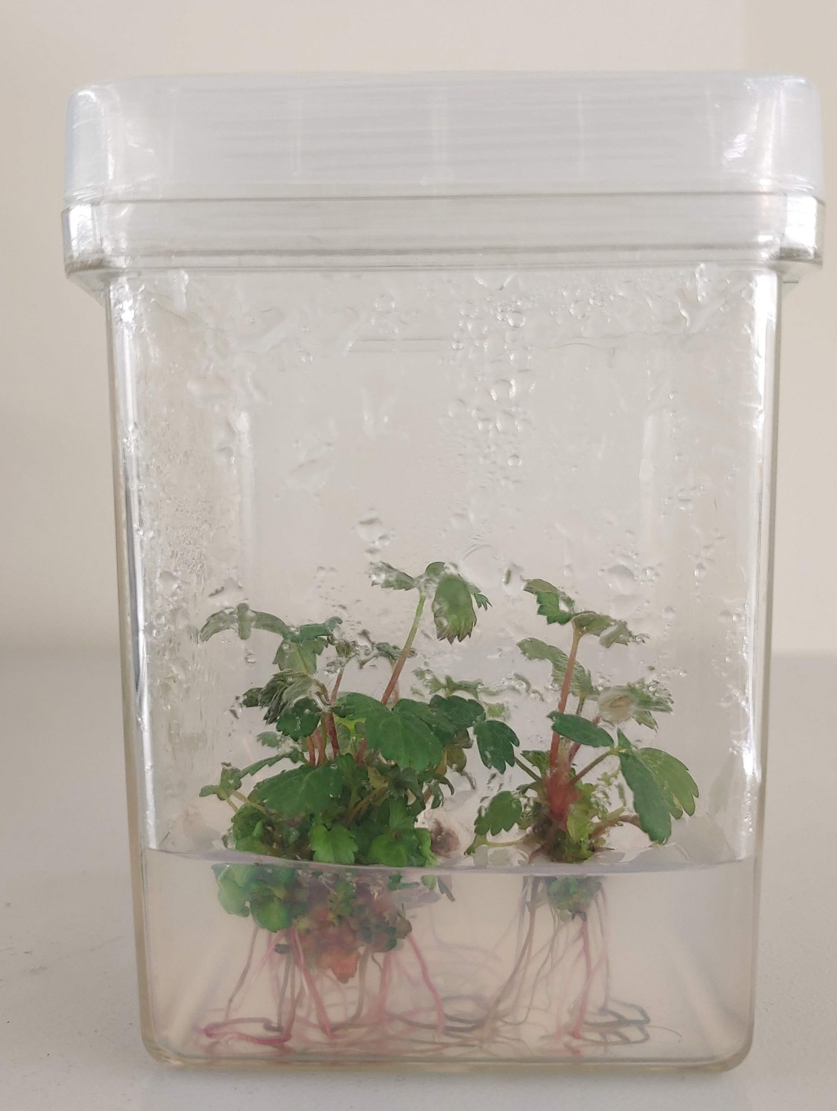
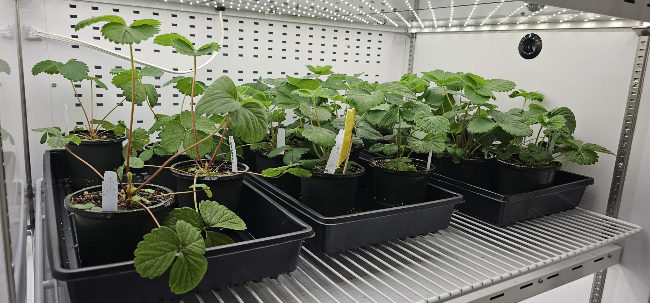
Materials and Methods
Tissue culture plants
Rooting of tissue culture plants in a phytotron for 12 weeks
Mother plants in the gutter system
25 - 27 °C, 14 h Photoperiod,
400 – 450 µmol/m²/sec supplemental LED, Drip fertigation.

Slide 7
Materials and Methods
Cultivars: Portola, Finn, Chandler, Camarosa, Sensation, and Brilliance.
Experimental duration: 12 weeks
Data collection: Number of : primary, secondary, and tertiary stolons
Number of daughter plants
Internode length
Daughter biomass dry biomass
Stolon length
Number of branch crown
Statistics: Analysis of variance was conducted using Rstudio and means separated by Tukey’s HSD test.

Slide 8
Results
Number of stolons and daughter plants of strawberry cultivars grown in the gutter system
 | Number per mother plant
Cultivar | Primary stolon | Sec. stolon | Ter. stolon
Portola | 16.0 ab | 10.5 | 1.5 ab
Finn | 19.0 a | 5.0 | 0.5 b
Camarosa | 16.5 ab | 5.0 | 2.0 ab
Chandler | 7.5 b | 6.5 | 4.5 a
Sensation | 13.0 ab | 6.5 | 2.0 ab
Brilliance | 9.0 ab | 6.5 | 4.0 ab
p-value | 0.02 | 0.1 | 0.03
Means followed by the same letter are not significantly different (Tukey’s HSD test p < 0.05)

Slide 9
Number of daughter plants per mother of strawberry cultivars
Portola
Finn
Camarosa
Chandler
Sensation
Brilliance
p = 0.04
115.0 ab
71.5 b
79.5 ab
138.5 a
89.5 ab
102.0 ab

Slide 10
Take away
The six cultivars produced between 71 – 138 daughter plants per mother plant which are still high and conforms with previous observations in other CE-studies.
Finn, a day-neutral cultivar produced the relatively highest number of primary stolons but the least number of daughter plants while Chandler, a short-day cultivar produced the least number of primary stolons but the highest number of tertiary stolons and daughter plants.
It would be interesting to dig deeper into the genomics traits of these cultivars to understand possible mechanisms underlying our observations.

Slide 11
Current and Future work
Analysis of other data collected: internode length, dry biomass …
Phenotyping of the remaining 5 cultivars of interest: Moxie, Albion, Cabrillo, Ruby June, and Radiance.
Development of machine learning models for predicting stolon numbers in strawberry using imagery data to reduce the drudgery that is associated with manual phenotyping.

Slide 12
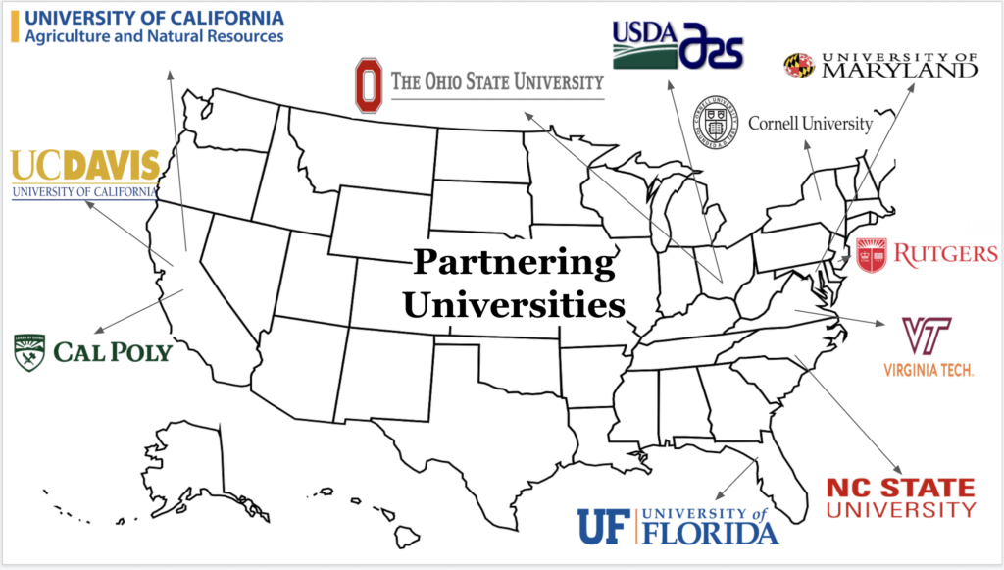
Acknowledgments
Grant 2021-51181-35857
Dr. Mark Hoffmann
Dr. Ricardo Hernandez
Abigail Bope
Dr. Christie Almeyda and her lab at the Micropropagation Repository Unit
Management Team of the Plant Science Building Greenhouse Facilities

