Slide 1
Impact of Chill Hour Accumulation under Diurnal Temperature Variation on Floral Development of Strawberry

Slide 2
Can chill hours be used to expedite fruiting of rooted transplants in US production systems?

Slide 3
Hypothesis and Objective
Hypothesis: Chill hours from diurnal temperature swings during establishment of 250 cc tray plants will increase early flower capacity of long day and short day strawberry plants.
Objective: Evaluate the impact of chilling from diurnal temperature swings during rooting on early flower development of 250cc tray plants (‘Albion’, ‘Monterey’, ‘Sensation’, ‘Chandler’).

Slide 4
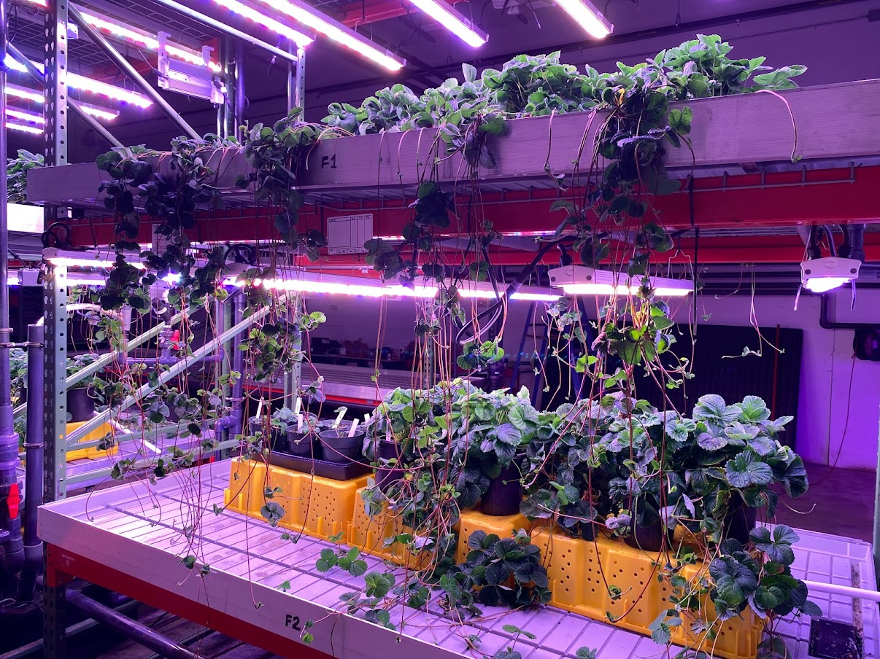
Materials and Methods
Materials
‘Chandler’
‘Sensation’
‘Albion’
‘Monterey’
15 plants/cv/tmnt
Measurements
Crown diameter
Root number
Leaf count
Fresh mass

Slide 5
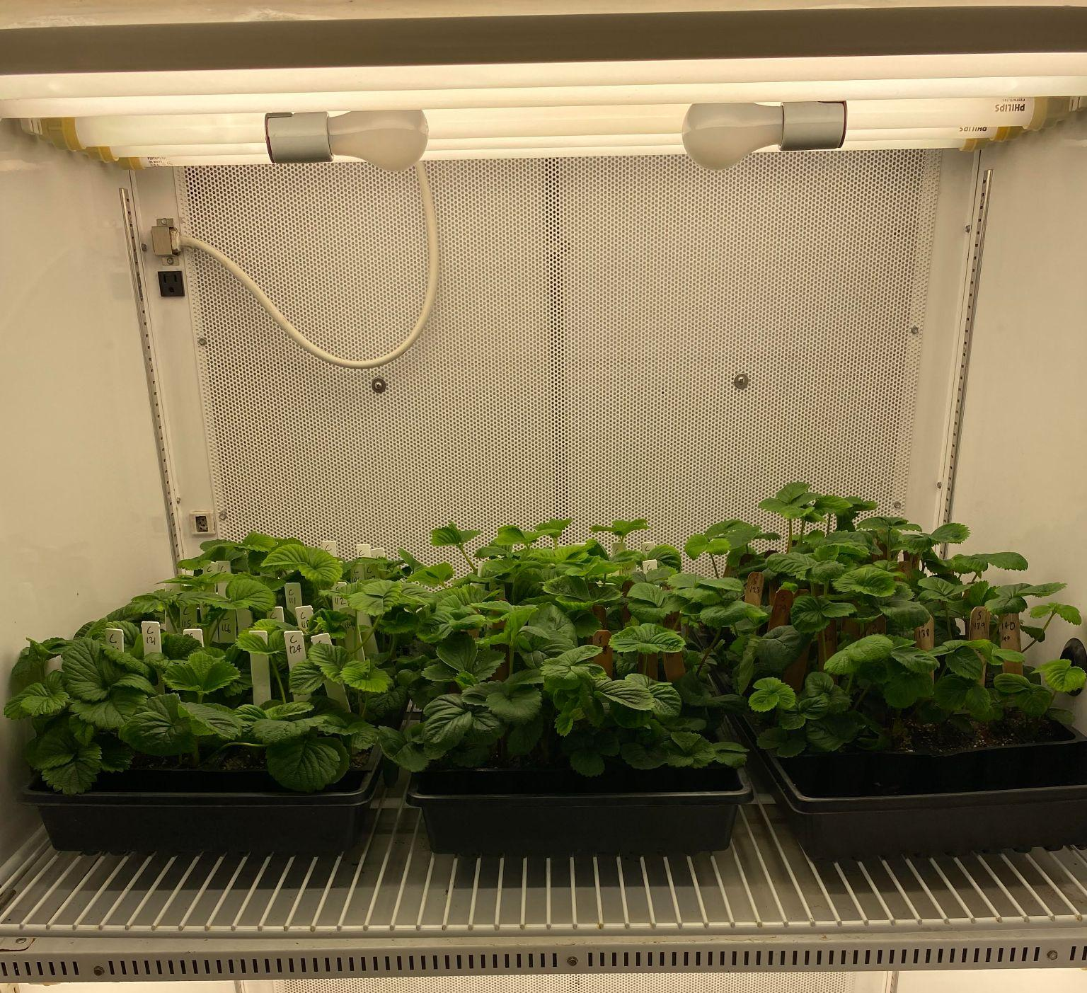
Materials and Methods
Rooting
28 days
15°C
12 hr photoperiod (SD)
16 hr photoperiod (LD)
95-105 µmol*m⁻²*s⁻¹
430-450 ppm CO₂
Measurements
Crown diameter
Root score
Leaf count

Slide 6
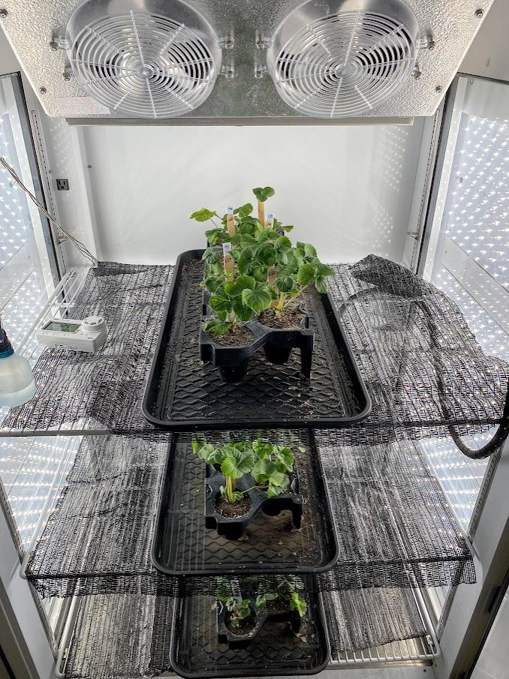
Materials and Methods
Treatments
42 days
12 hr photoperiod (SD)
16 hr photoperiod (LD)
138-150 µmol*m⁻²*s⁻¹
430-450 ppm CO₂
Measurements
Crown diameter
Root score
Leaf count
Fresh mass
Flower mapping
Shelf
Cultivar 1
Cultivar 2
Light

Slide 7
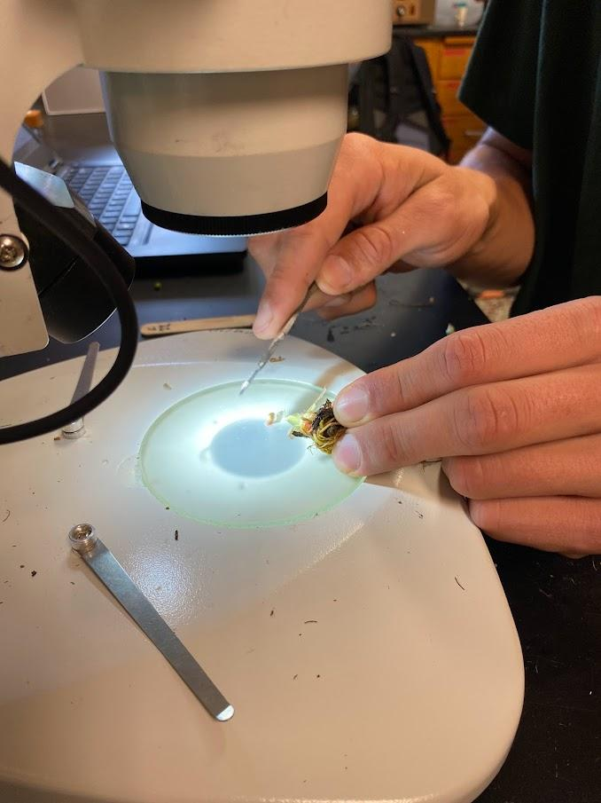
Flower Mapping

Slide 8
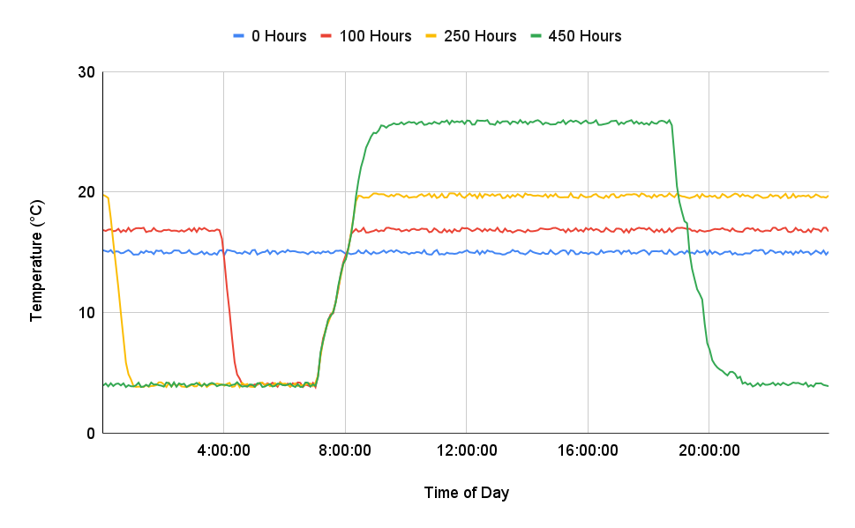
Treatments - Exp 1
SD Photoperiod
LD Photoperiod

Slide 9
Treatments - Exp 1
Total Chill Hours (4°C)
0
100
250
450

Slide 10
Treatments - Exp 1
Total Chill Hours (4°C) | Chill hours/day
0 | 0
100 | 2.4
250 | 6.0
450 | 10.7

Slide 11
Treatments - Exp 1
Total Chill Hours (4°C) | Chill hours/day | Non-chill Temp (°C)
0 | 0 | 15
100 | 2.4 | 16.2
250 | 6.0 | 18.6
450 | 10.7 | 25.8

Slide 12
Treatments - Exp 1
Total Chill Hours (4°C) | Chill hours/day | Non-chill Temp (°C) | Daily avg temp (°C)
0 | 0 | 15 | 15
100 | 2.4 | 16.2 | 15
250 | 6.0 | 18.6 | 15
450 | 10.7 | 25.8 | 15

Slide 13
Results
Trusses - Number of meristems that have switched from vegetative to floral
Illustrates chill hours effect on floral induction and initiation
Stats
ANOVA w/ Tukey HSD Means comparison (‘Chandler’ and ‘Sensation’)

Slide 14
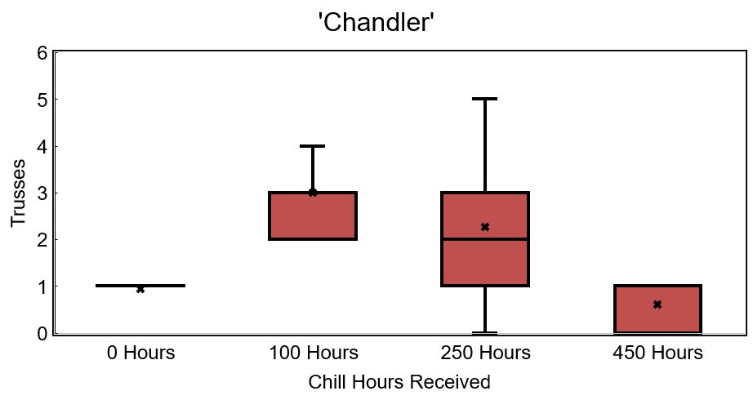
P < 0.0001
A
A
B
B

Slide 15
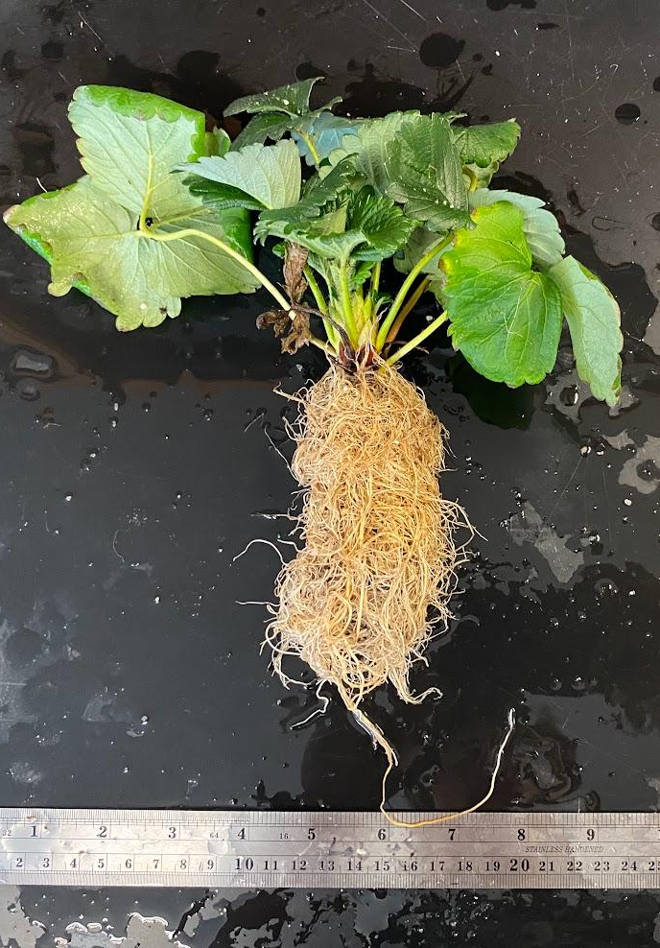
‘Chandler’
0 Hours
100 Hours
250 Hours
450 Hours

Slide 16
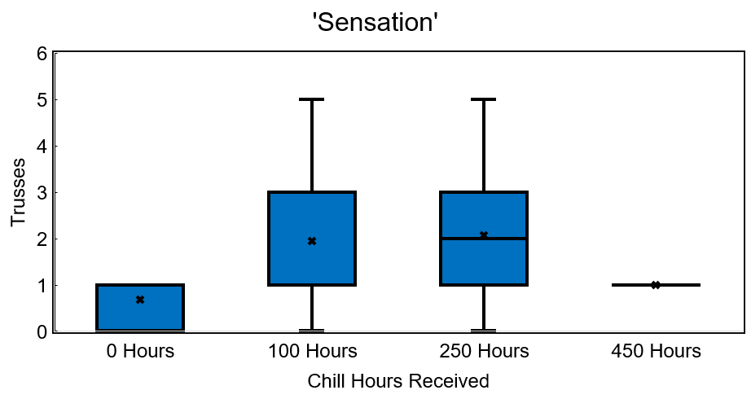
P < 0.0014
AB
A
C
BC

Slide 17
‘Sensation’
0 Hours
100 Hours
250 Hours
450 Hours

Slide 18
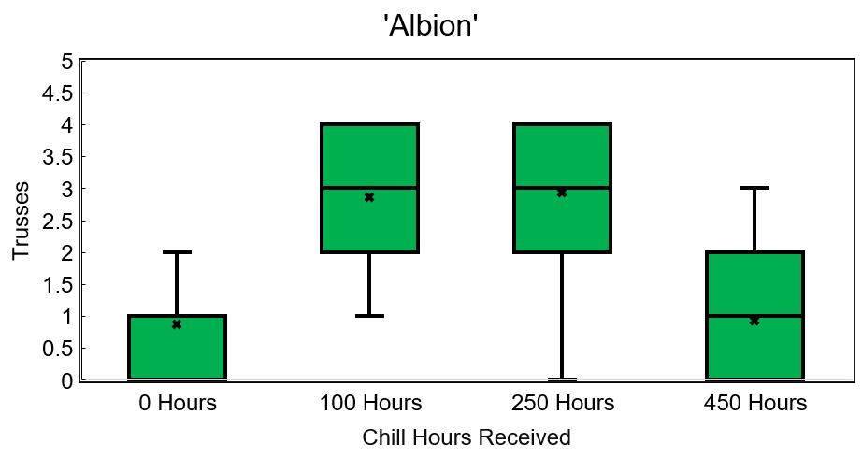
P < 0.0001
A
A
B
B

Slide 19
‘Albion’
0 Hours
100 Hours
250 Hours
450 Hours

Slide 20
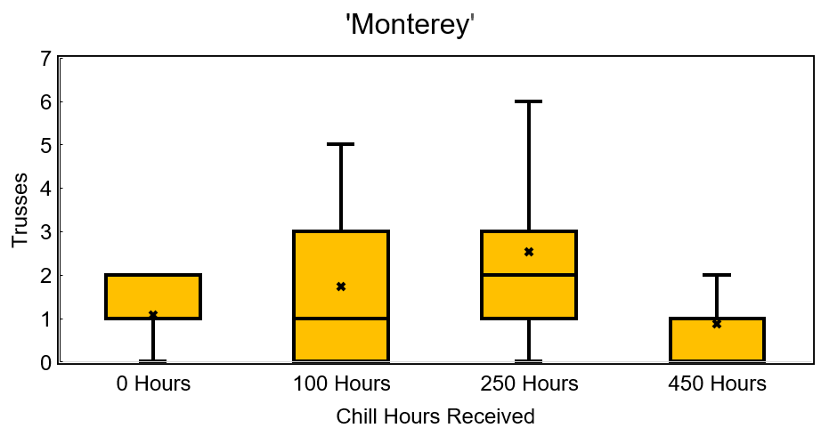
A
P = 0.0095
AB
B
B

Slide 21
‘Monterey’
0 Hours
100 Hours
250 Hours
450 Hours

Slide 22
Conclusions – Exp 1
0 hour and 450 hours produced less trusses across cultivars
Concern about difference of non-chill and chill temperatures in 450 Hour treatment

Slide 23
Treatments - Exp 1
~ 22°C swing

Slide 24
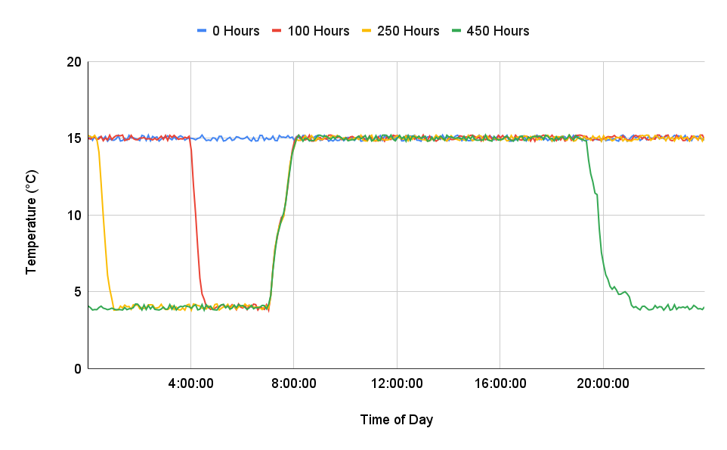
Treatments - Exp 2
SD Photoperiod
LD Photoperiod

Slide 25
Treatments - Exp 2
Total Chill Hours (4°C) | Chill hours/day
0 | 0
100 | 2.4
250 | 6.0
450 | 10.7

Slide 26
Treatments - Exp 2
Total Chill Hours (4°C) | Chill hours/day | Non-chill Temp (°C)
0 | 0 | 15
100 | 2.4 | 15
250 | 6.0 | 15
450 | 10.7 | 15

Slide 27
Treatments - Exp 2
Total Chill Hours (4°C) | Chill hours/day | Non-chill Temp (°C) | Daily avg temp (°C)
0 | 0 | 15 | 15
100 | 2.4 | 15 | 13.9
250 | 6.0 | 15 | 12.25
450 | 10.7 | 15 | 10.1

Slide 28
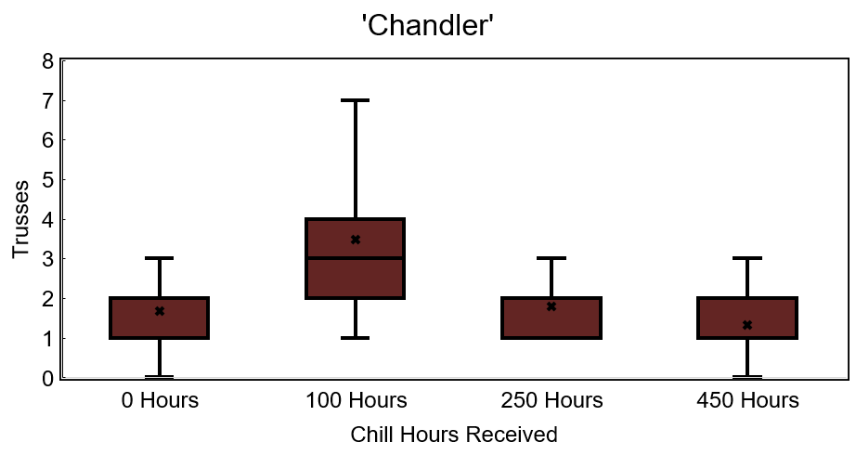
A
P < 0.0001
B
B
B

Slide 29
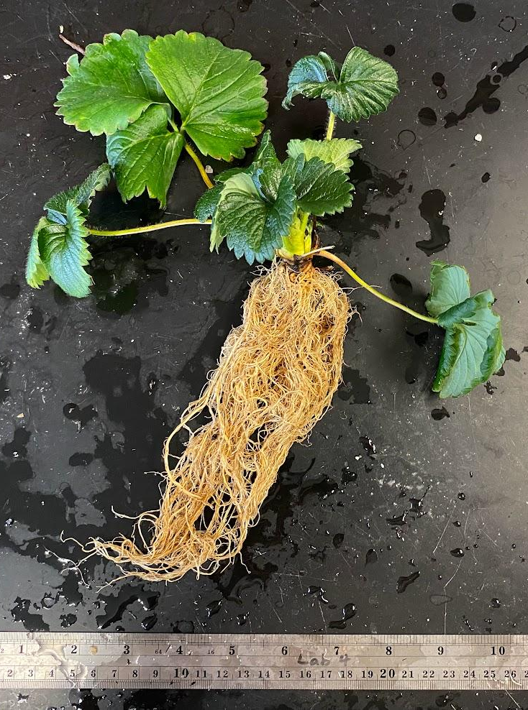
‘Chandler’
0 Hours
100 Hours
250 Hours
450 Hours

Slide 30
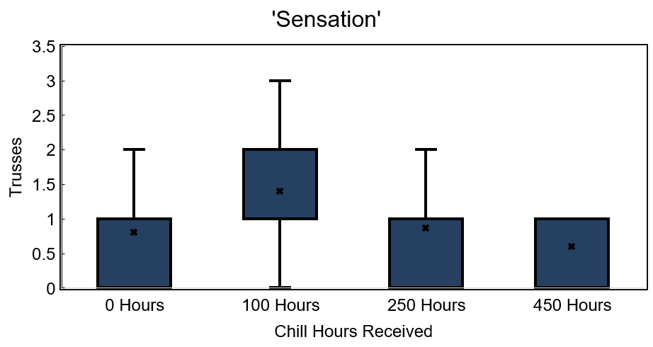
A
P = 0.0192
AB
AB
B

Slide 31
‘Sensation’
0 Hours
100 Hours
250 Hours
450 Hours

Slide 32
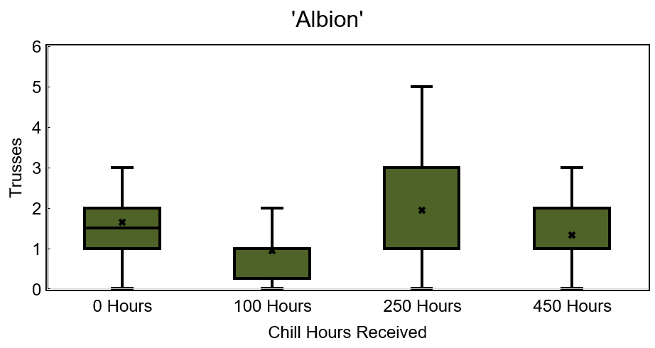
ns
ns
ns
ns

Slide 33
‘Albion’
0 Hours
100 Hours
250 Hours
450 Hours

Slide 34
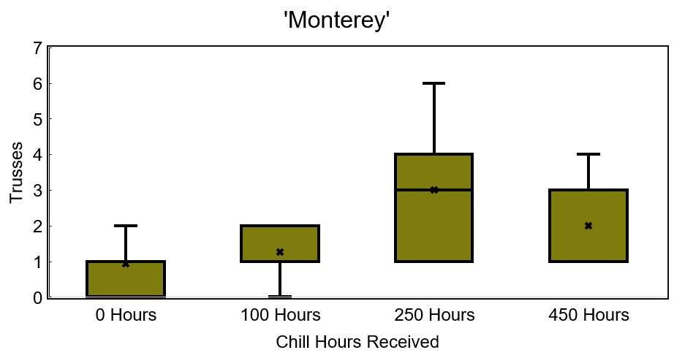
A
P = 0.0003
AB
B
B

Slide 35
‘Monterey’
0 Hours
100 Hours
250 Hours
450 Hours

Slide 36
Conclusions – Exp 2
0 hour and 450 hours produced less flowering across cultivars (except ‘Albion’)
100 hour treatment produced most trusses in SD cultivars

Slide 37
Main Takeaways
0 hour and 450 hours produced less floral trusses across cultivars and experiments
Vegetative metrics like branch crowns and fresh mass mirrored trusses in SD cultivars in both experiments
Regardless of daily average temperature, rooted strawberry plants receiving moderate chill hours will produce more trusses than plants that have not received chill hours

Slide 38
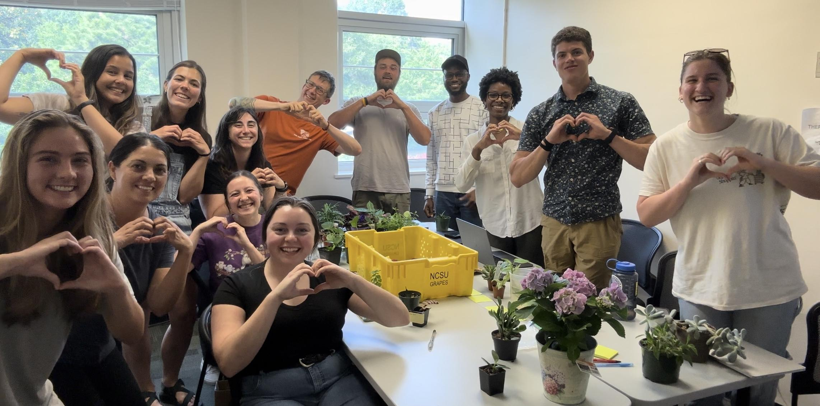
Acknowledgements
Mark Hoffmann, Ricardo Hernandez, Hsuan Chen, Terri Long
Very Berry Lab
NCSU Phytotron
Hernandez Lab

Slide 39
Root Rating
No root growth
1
2
3
4
5

Slide 40
Vegetaive Development – ‘Chandler’
 | Branch Crowns | Root Score (1-5) | Fresh Mass (g)
0 Hours | 0.333 B | 4.667 a | 25.157 NS
100 Hours | 3.467 A | 3.8 b | 34.563 NS
250 Hours | 2.867 A | 3.733 b | 34.369 NS
450 Hours | 0.4 B | 5.0 a | 31.795 NS

Slide 41
Vegetaive Development – ‘Sensation’
 | Branch Crowns | Root Score (1-5) | Fresh Mass (g)
0 Hours | 0.8 B | 4.533 ab | 24.41 NS
100 Hours | 2.533 A | 3.8 b | 31.082 NS
250 Hours | 2.733 A | 4.067 ab | 32.633 NS
450 Hours | 0.733 B | 4.733 a | 27.424 NS

Slide 42
Vegetaive Development – ‘Albion’
 | Branch Crowns | Root Score (1-5) | Fresh Mass (g)
0 Hours | 2.0 B | 3.933 ns | 21.49 B
100 Hours | 3.067 A | 4.067 ns | 35.447 A
250 Hours | 3.267 A | 4.133 ns | 34.103 A
450 Hours | 2.267 AB | 4.267 ns | 22.208 B

Slide 43
Vegetaive Development – ‘Monterey’
 | Branch Crowns | Root Score (1-5) | Fresh Mass (g)
0 Hours | 2.357 B | 4.143 ns | 26.896 AB
100 Hours | 3.267 AB | 3.8 ns | 29.703 AB
250 Hours | 4.0 A | 4.133 ns | 33.049 A
450 Hours | 2.786 B | 4.071 ns | 23.488 B

Slide 44
Vegetaive Development – ‘Chandler’
 | Branch Crowns | Root Score (1-5) | Fresh Mass (g)
0 Hours | 3.333 B | 3.467 ab | 19.107 AB
100 Hours | 4.333 A | 4.2 a | 24.877 A
250 Hours | 1.867 C | 3.0 b | 15.324 B
450 Hours | 1.467 C | 2.8 b | 13.545 B

Slide 45
Vegetaive Development – ‘Sensation’
 | Branch Crowns | Root Score (1-5) | Fresh Mass (g)
0 Hours | 1.6 B | 3.6 ab | 19.075 AB
100 Hours | 4.333 A | 4.0 a | 21.902 A
250 Hours | 1.533 B | 3.067 ab | 16.043 AB
450 Hours | 2.467 B | 2.867 b | 13.917 B

Slide 46
Vegetaive Development – ‘Albion’
 | Branch Crowns | Root Score (1-5) | Fresh Mass (g)
0 Hours | 2.214 NS | 3.214 ns | 17.882 A
100 Hours | 2.625 NS | 3.25 ns | 17.335 A
250 Hours | 2.467 NS | 3.067 ns | 14.477 AB
450 Hours | 2.0 NS | 2.733 ns | 11.15 B

Slide 47
Vegetaive Development – ‘Monterey’
 | Branch Crowns | Root Score (1-5) | Fresh Mass (g)
0 Hours | 2.2 C | 3.2 ns | 20.255 NS
100 Hours | 3.467 AB | 3.8 ns | 21.045 NS
250 Hours | 3.733 A | 3.4 ns | 18.567 NS
450 Hours | 2.333 BC | 3.067 ns | 15.06 NS

