Slide 1
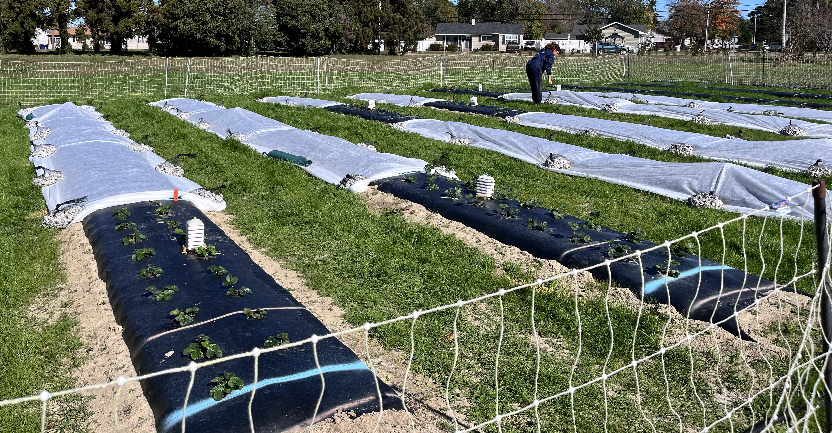
Field Study, Year 1, Virginia Beach, VA
Objective: To assess impact of additional GDD: 100, 200, and 400 GDD in fall and early winter on crop canopy, yield, and flower development
Copyright, Samtani 2024

Slide 2
Treatments | RowCover application date | RowCover removal date | GDD achieved
NRC | - | - | 530
100 GDD | 11/02/2023 | 11/15/2023 | 630
200 GDD | 11/02/2023 | 12/11/2023 | 730
400 GDD | 11/02/2023 | 01/04/2024 | 930
Copyright, Samtani 2024

Slide 3
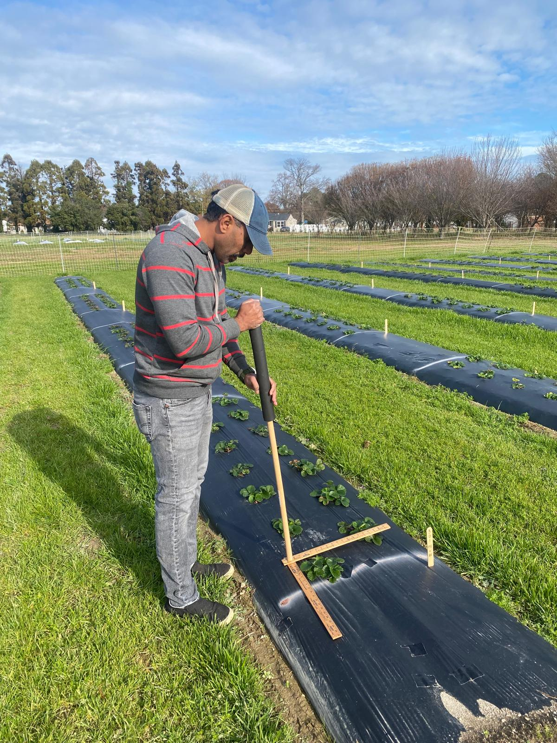
Plant canopy data was collected on January 8, 2024.
Cultivars | Marketable Yield (lb/Acre) | NonMarketable Yield (lb/Acre) | Total Yield (lb/Acre) | Small fruit (lb/Acre)
Chandler | 17,075b | 8908a | 25,955b | 3234a
Ruby June | 23,982a | 6688b | 30,697a | 699b
Copyright, Samtani 2024

