Slide 1
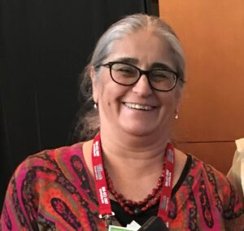
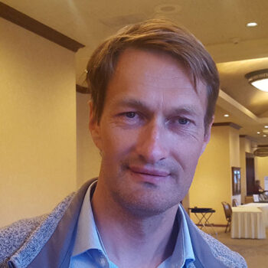
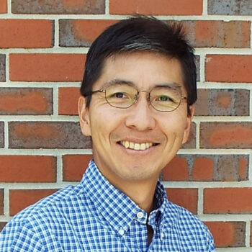
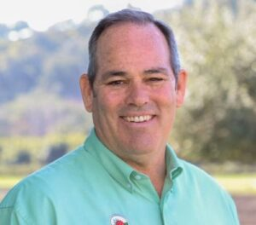
Plant
Performance
Ibraheem Olasupo
Mark Hoffmann
Courtney Weber
Gina Fernandez
Jayesh Samtani
Oleg Daugovich
Shinsuke Agehara
Gerald Holmes

Slide 2
Plant
Performance
How do plants produced in CEA systems perform in production fields?

Slide 3
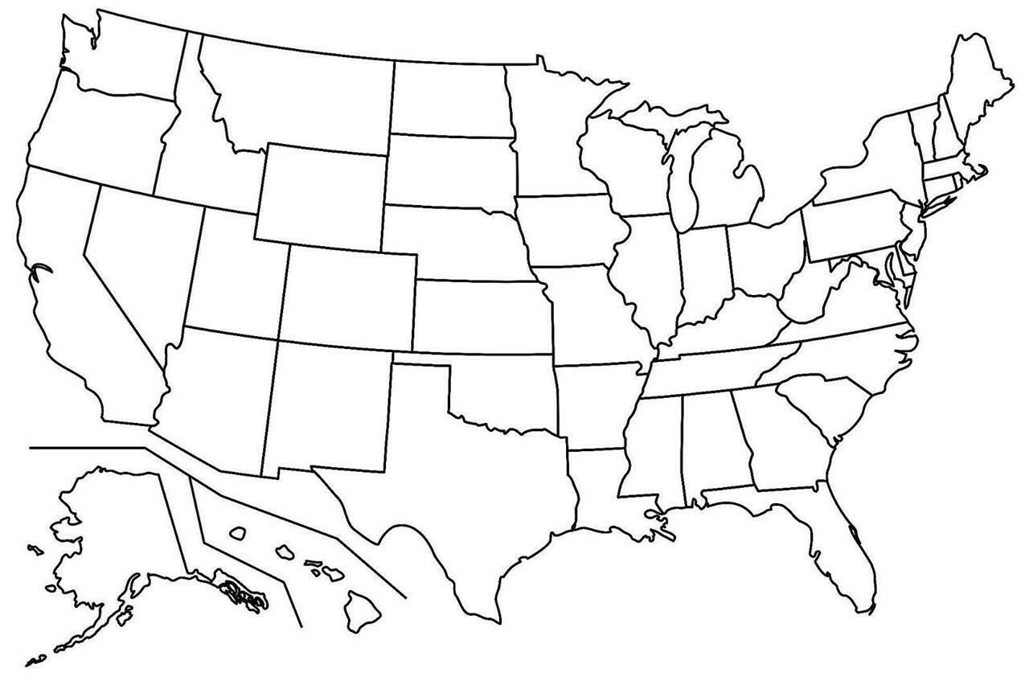
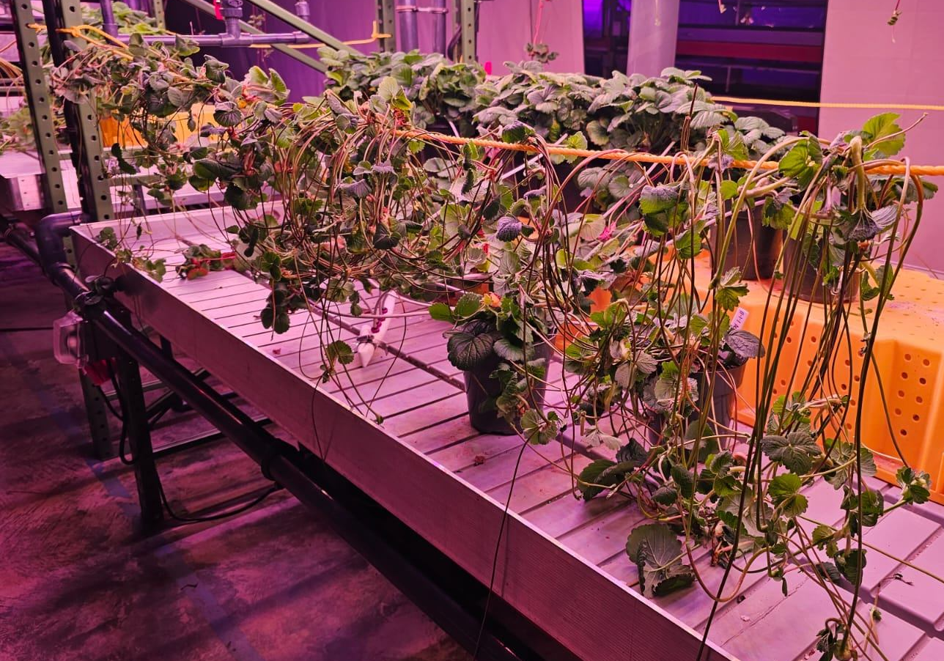
2023-2025
Ibraheem Olasupo

Slide 4
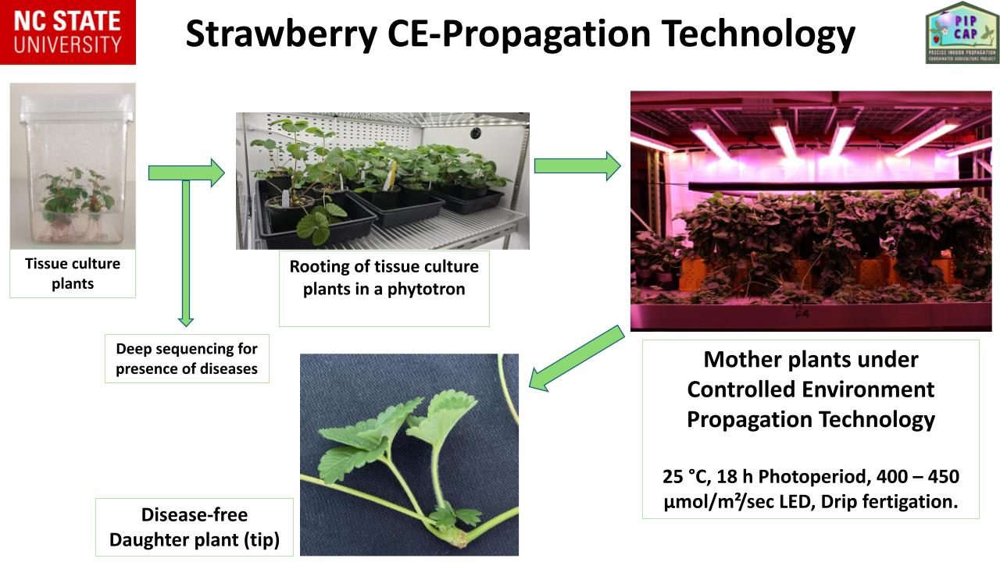

Slide 5
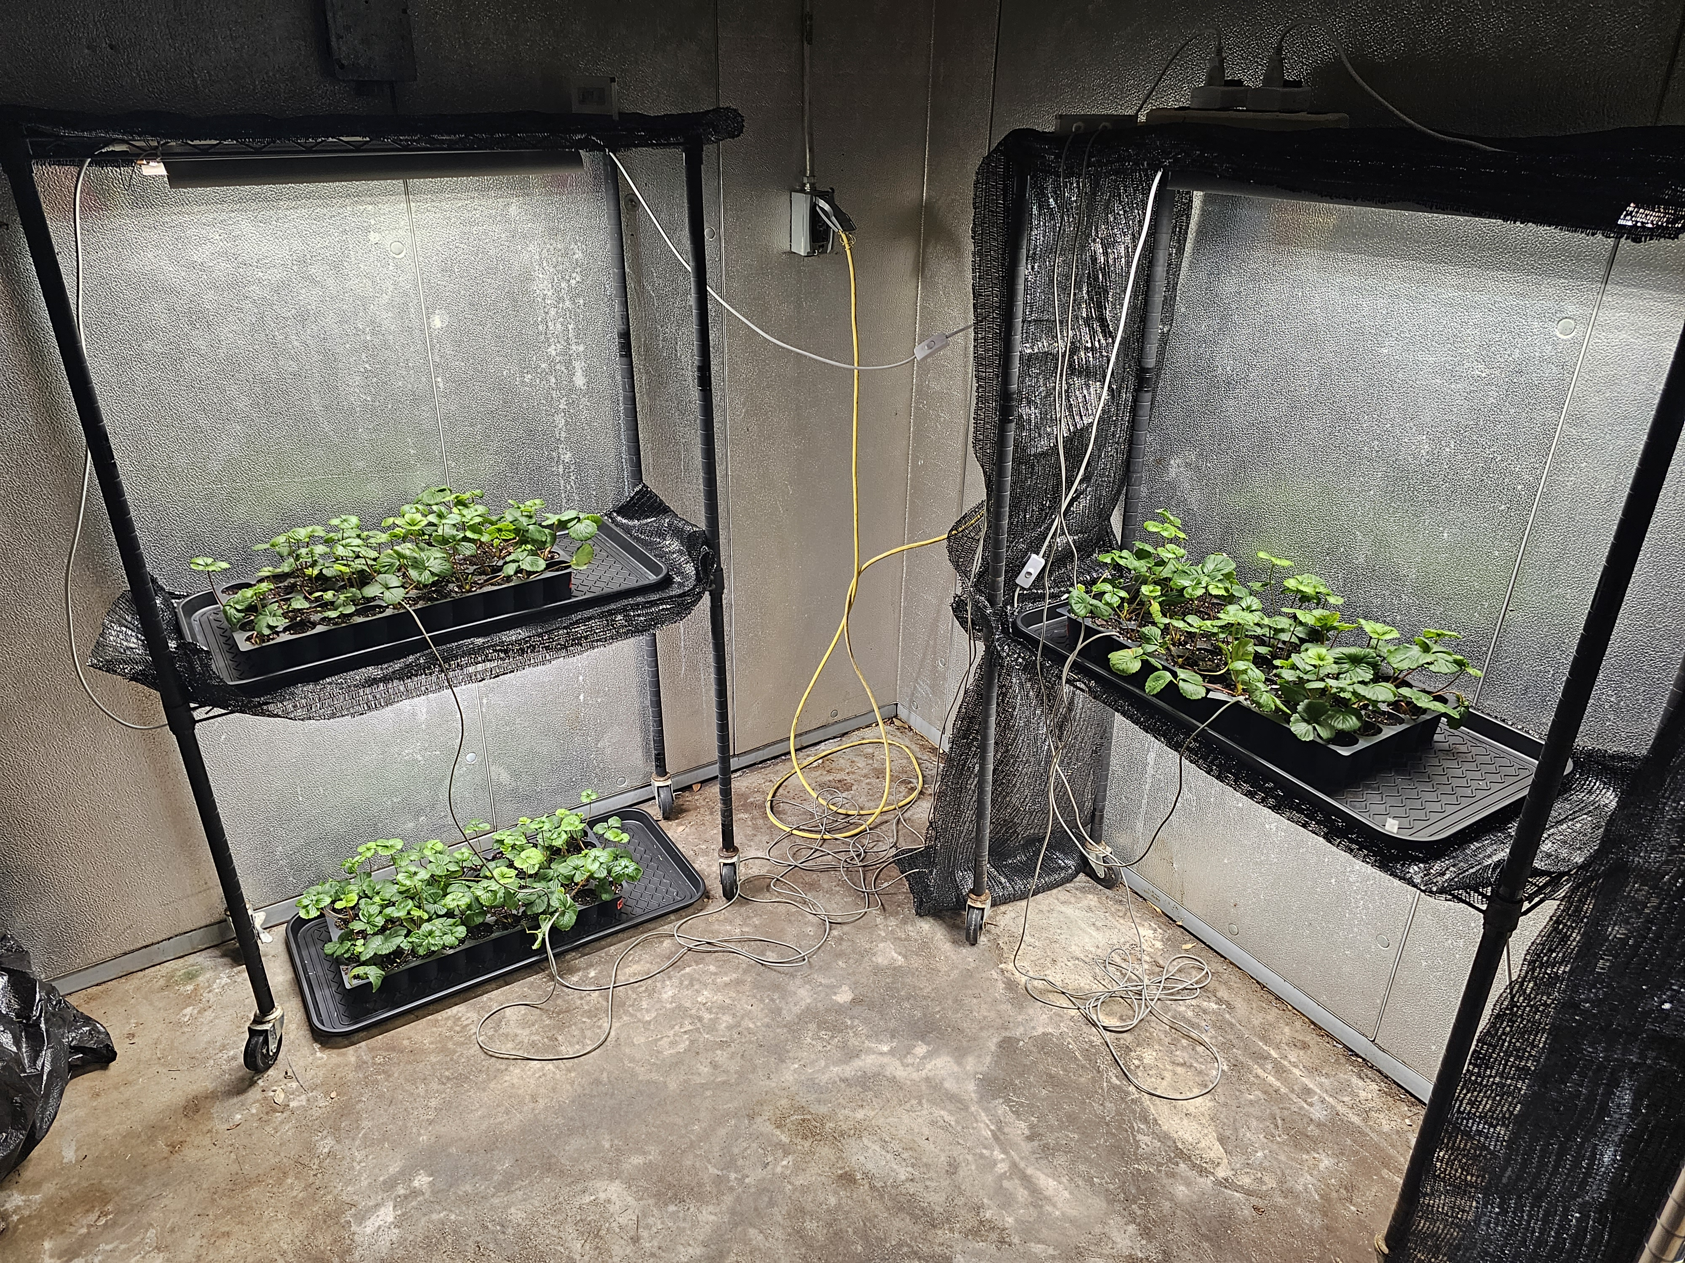
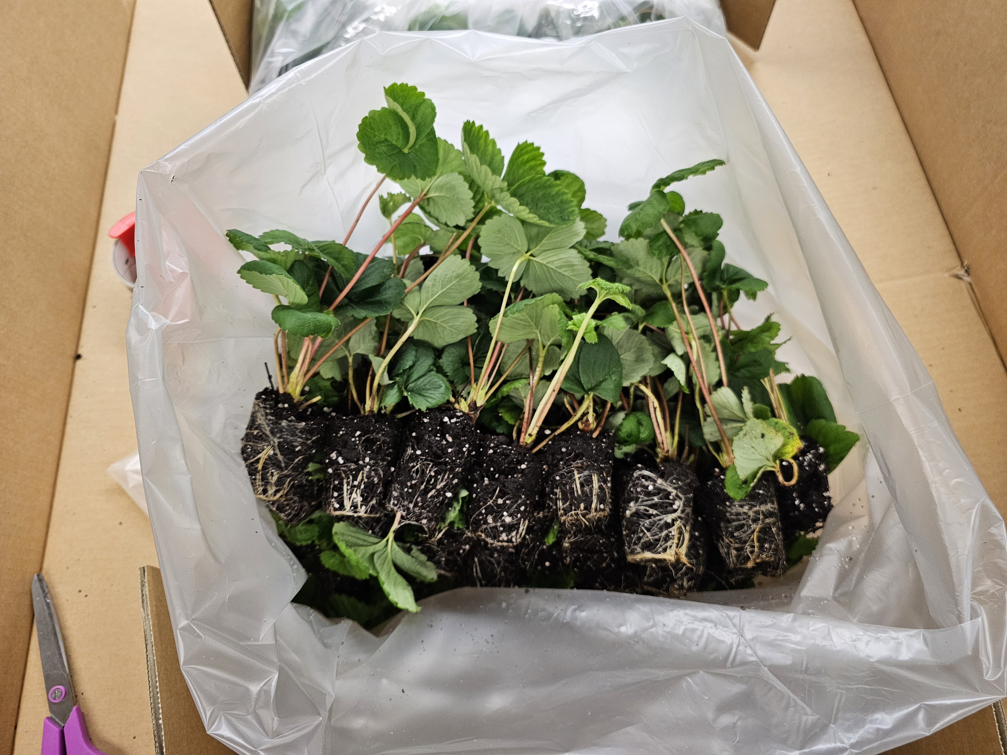
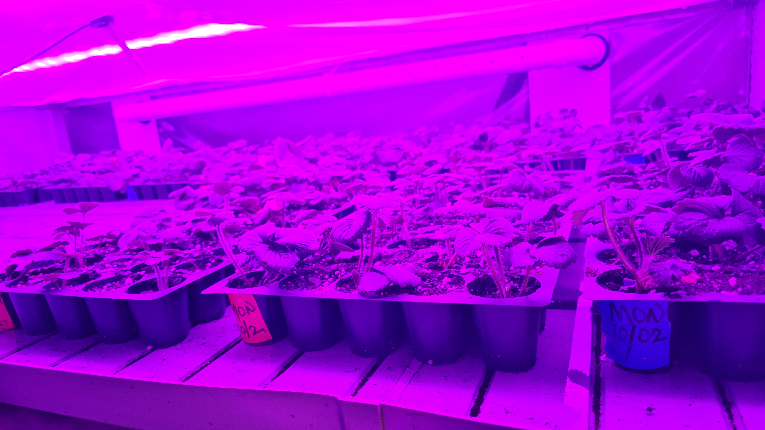
Strawberry Center SLO
Monterey
Southern CA (Ventura Co.)
Fronteras
Chilling Chamber
400-450 chilling hours
North Carolina
Chandler, Camarosa
Florida Gulf Research Center
Sensation, Brilliance
Rooting Chamber

Slide 6
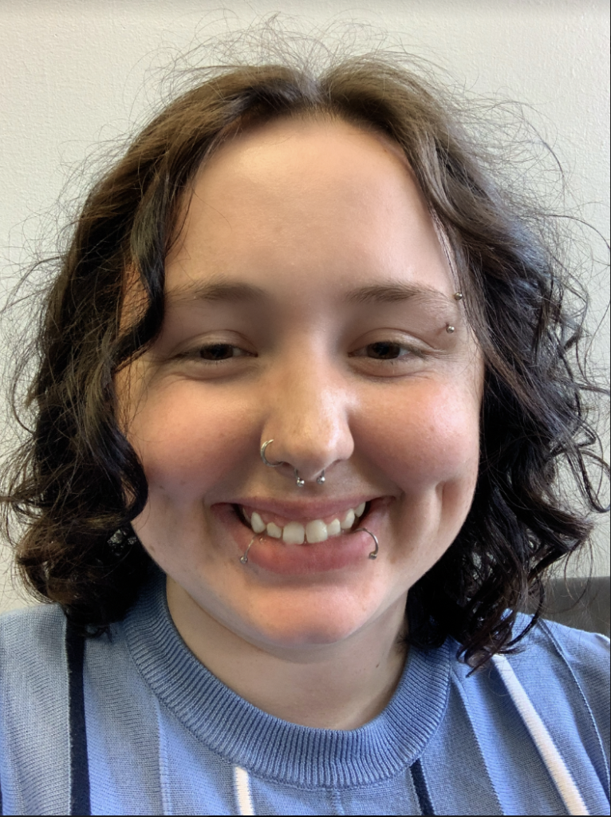
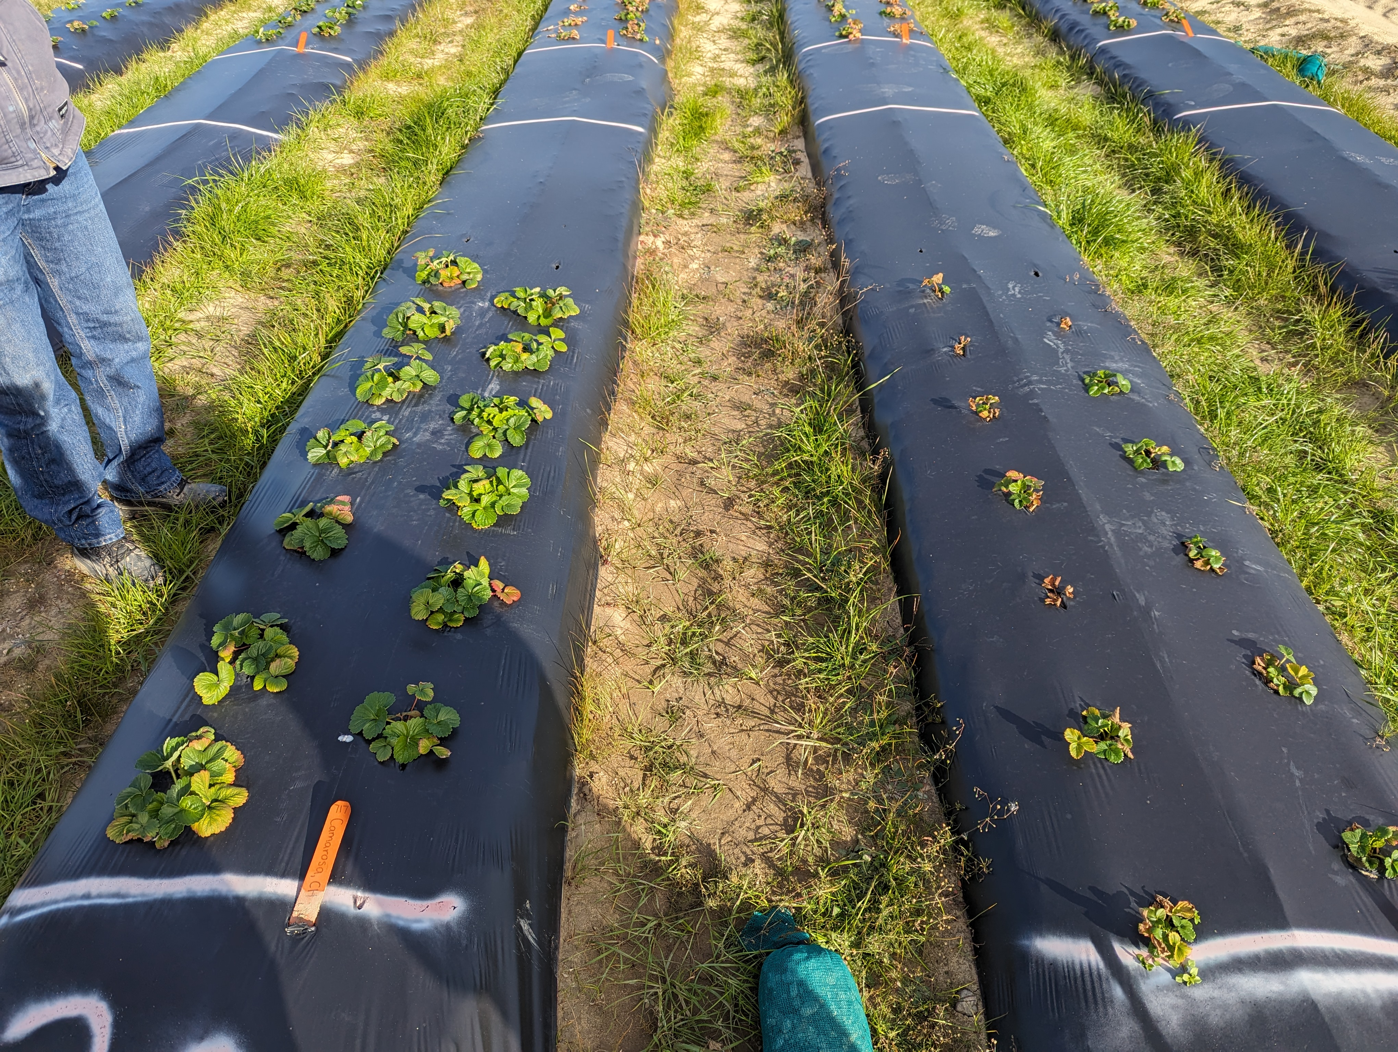
Camarosa, Chandler
Calyssa Stevensen
Gina Fernandez
chill
no chill

Slide 7
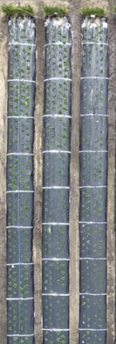
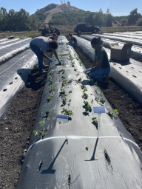
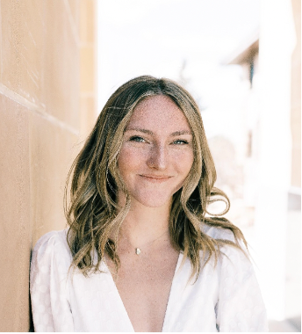
Monterey
Samantha Simard
Gerald Holmes

Slide 8
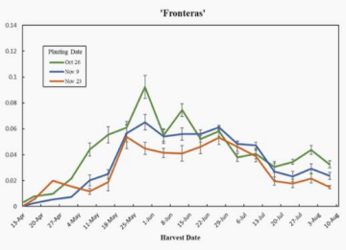
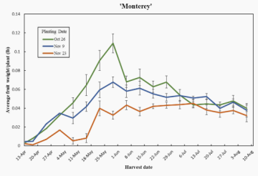

Slide 9
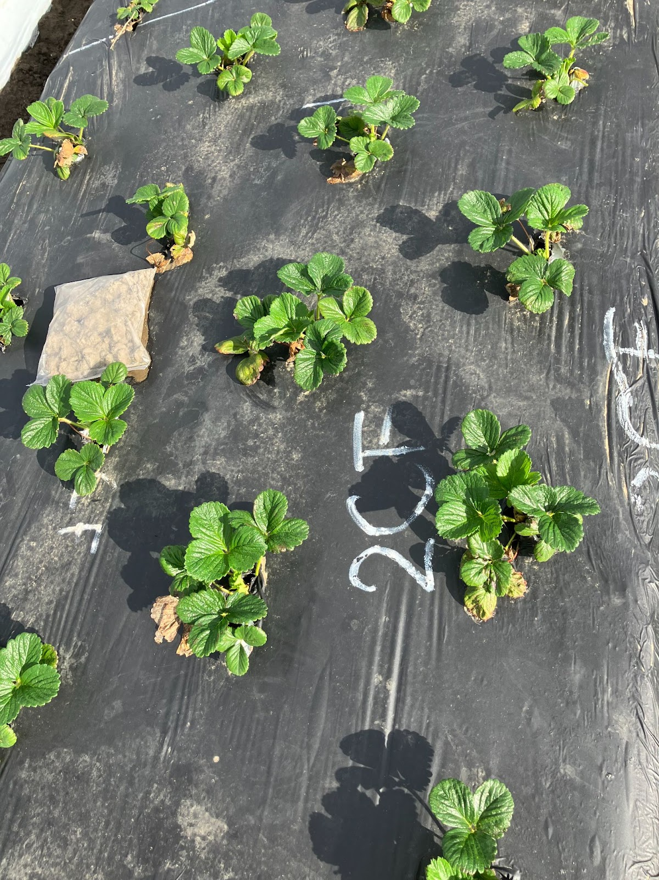
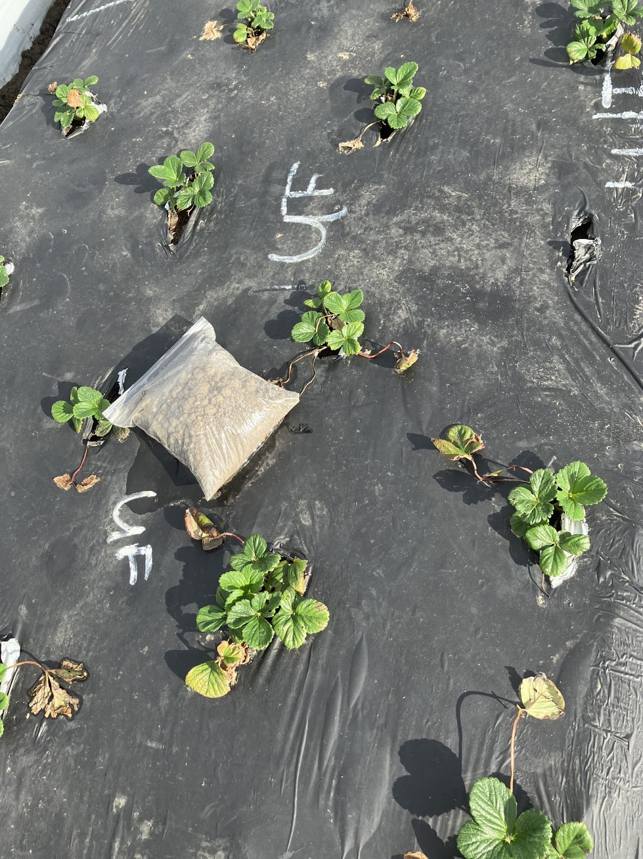
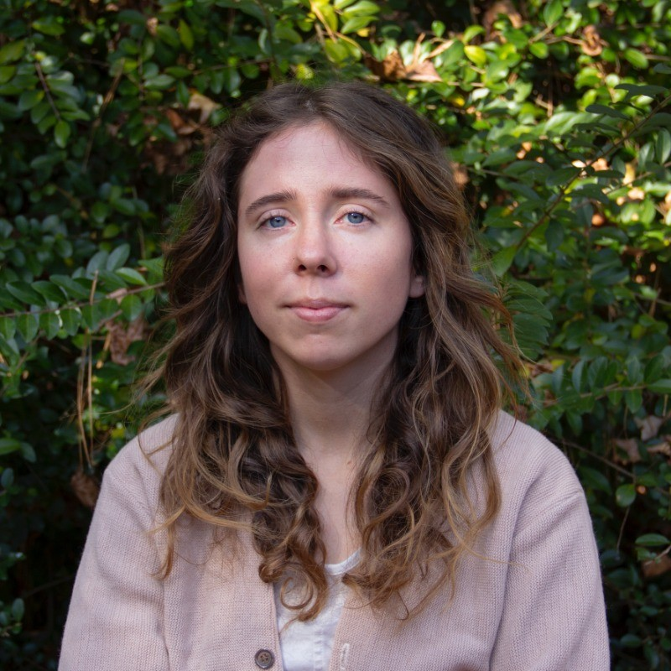
Fronteras
Oleg Daugovich
Emma Volk
chill
no chill

Slide 10
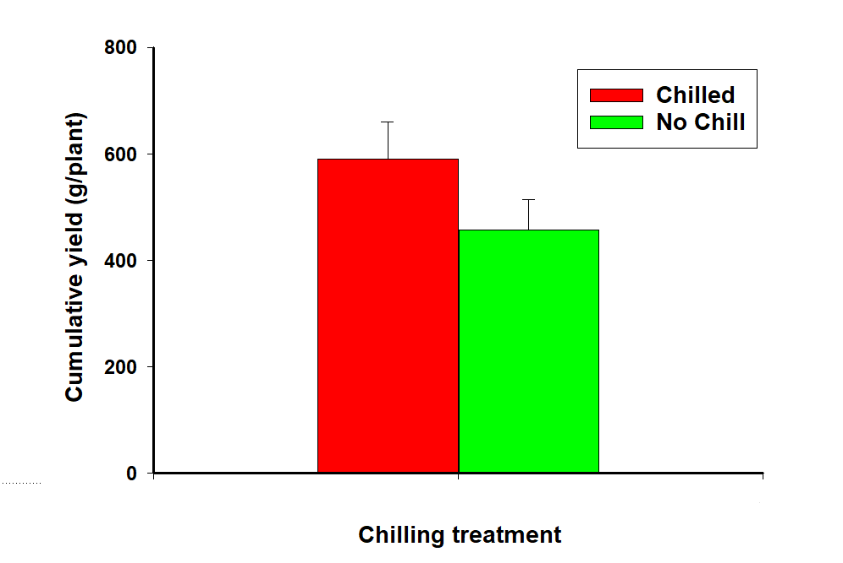
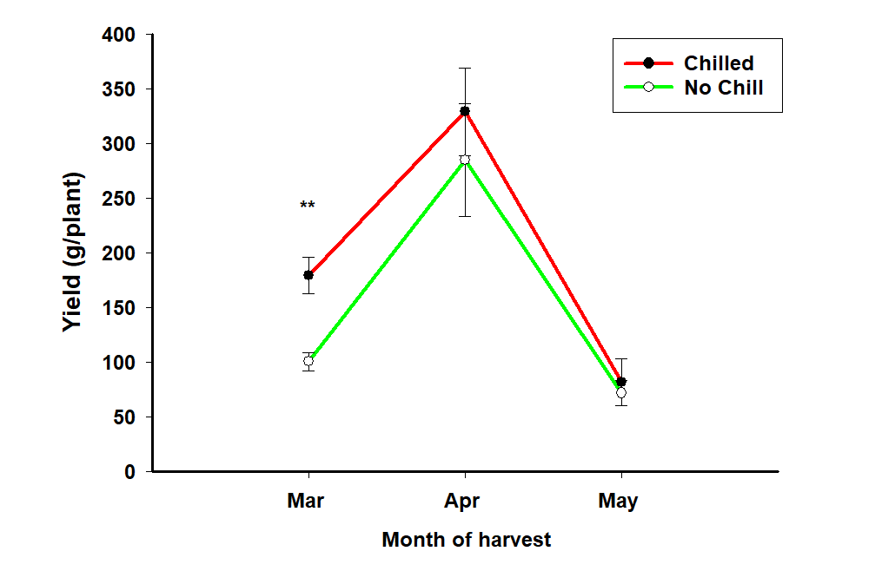

Slide 11
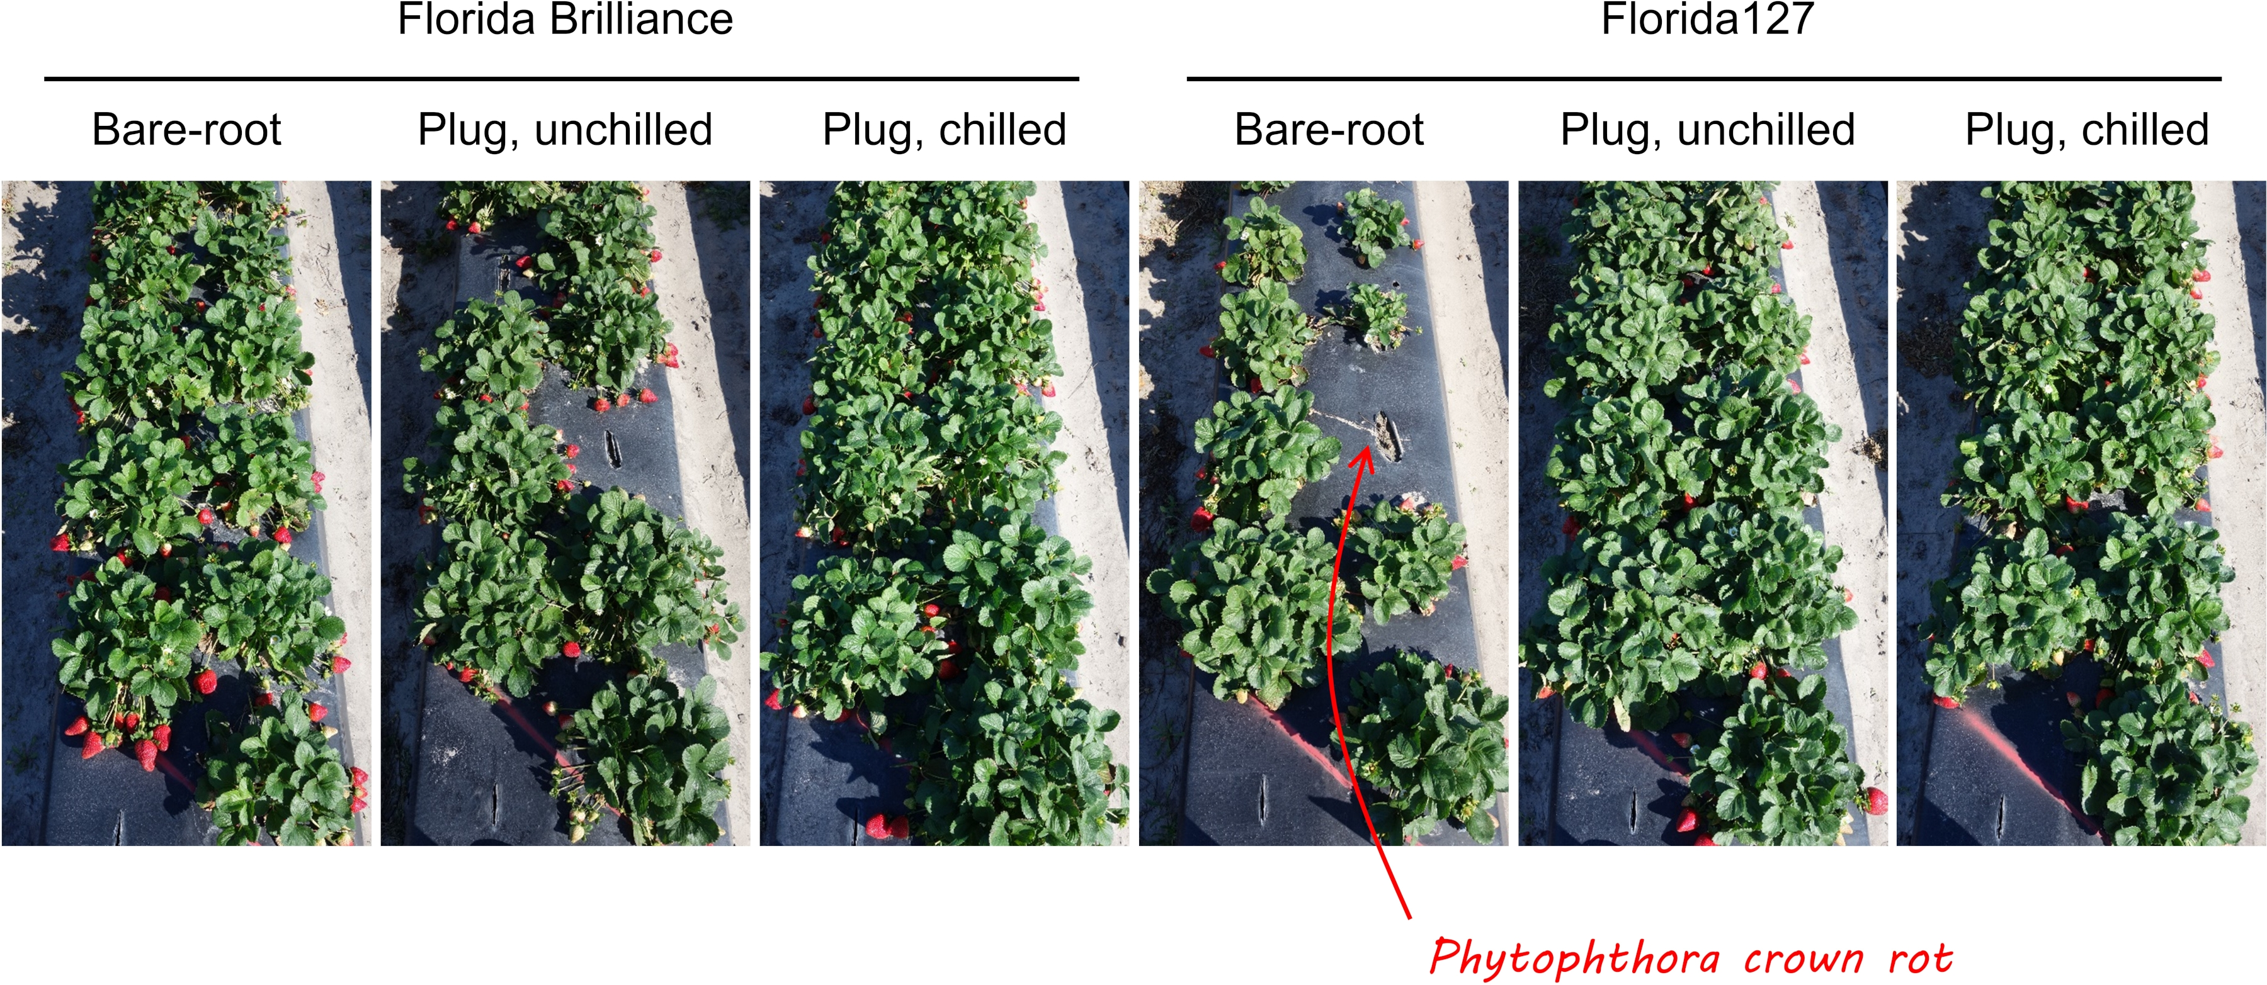
Shinsuke Agehara

Slide 12
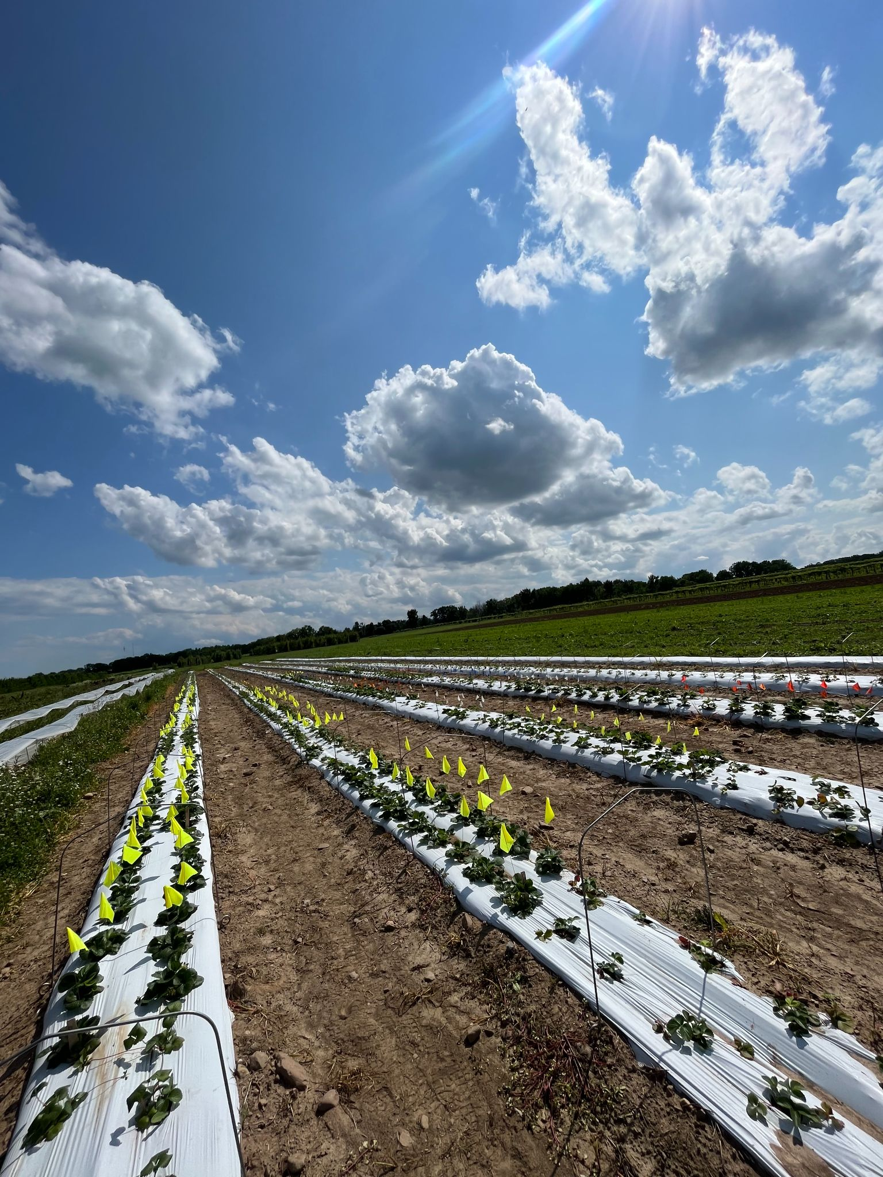
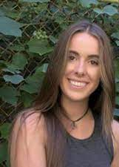
Courtney Weber
Ava Forysteck
Evaluate plug plants vs. industry standard frigo-plants

Slide 13
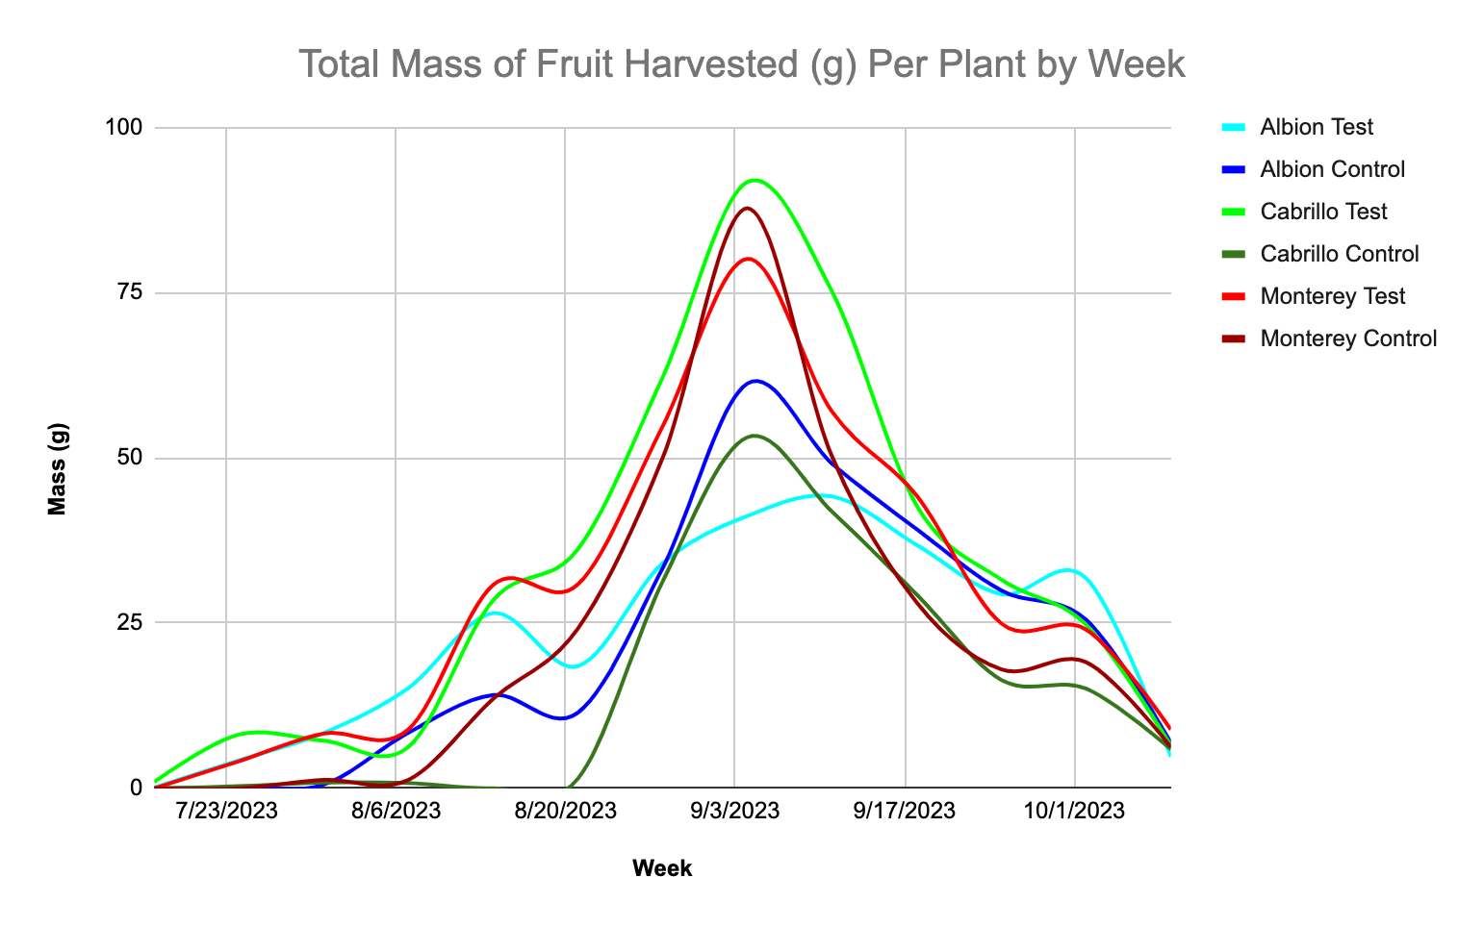

Slide 14
What’s next?
All CEA plant material trials are currently repeated.
Nursery: Potential for discussion on tunnel optimization (PSI)
Coordinated Field Days.

