Slide 1
Award: 2021-51181-35857
Budget: $5,294,195
Annual Meeting
Nov 14-15, 2024
Development and Integration of Next Generation Propagation Strategies to Increase the Resilience of the US Strawberry Supply Chain

Slide 2
Agenda
Nov 14 (today)
Introduction Strawberry Center
Project Overview
Short group overviews
Panel Discussion
Lunch break
Student/staff/post-doc flash talks!
Campus tour
Dinner at Farmers Market

Slide 3
Agenda
Nov 15 (tomorrow)
Detailed Group Presentations
Group Discussion: Next steps for 2025 and 2026.
Lunch break
Farm Tour

Slide 4
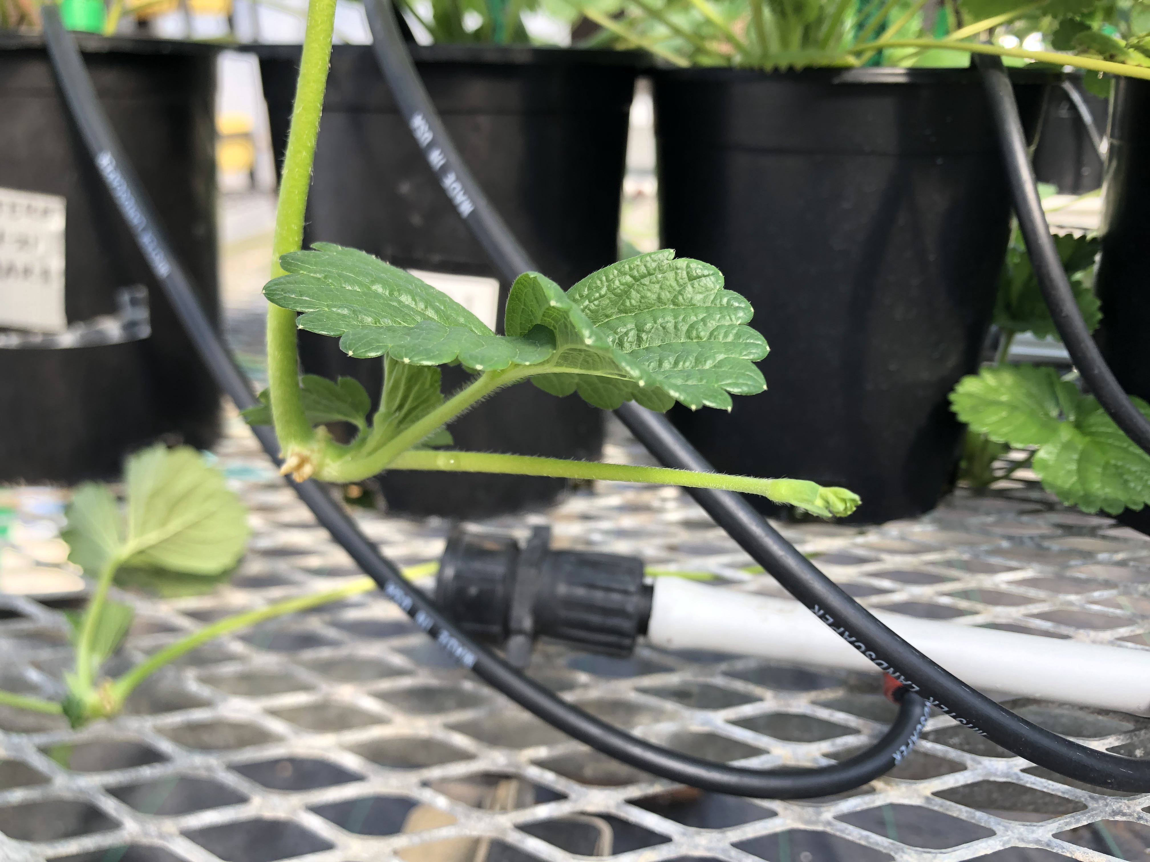
09/2021-09/2026
Major expected outcomes:
Resources, platform and guidelines for protected strawberry propagation
Basic economic, genetic and physiological knowledge

Slide 5
Mission:
Develop and disseminate environmental protocols to propagate strawberries & develop transplants

Slide 7
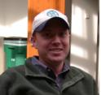
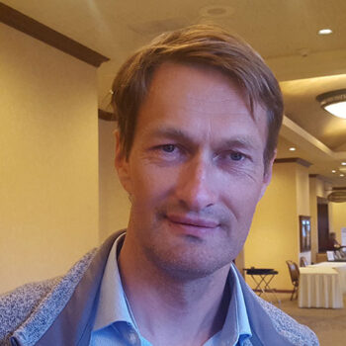
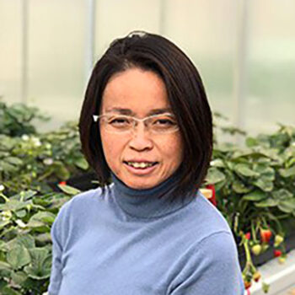
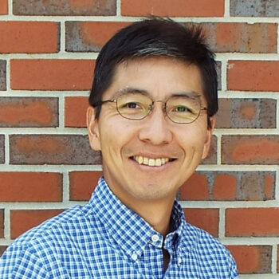
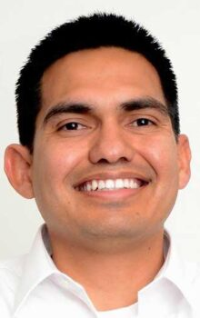
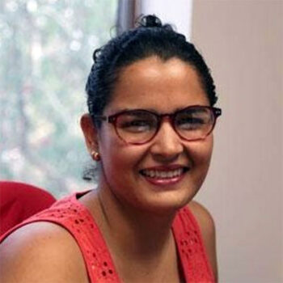
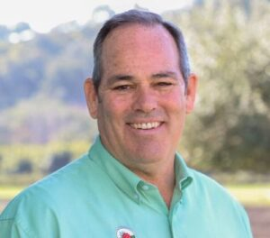
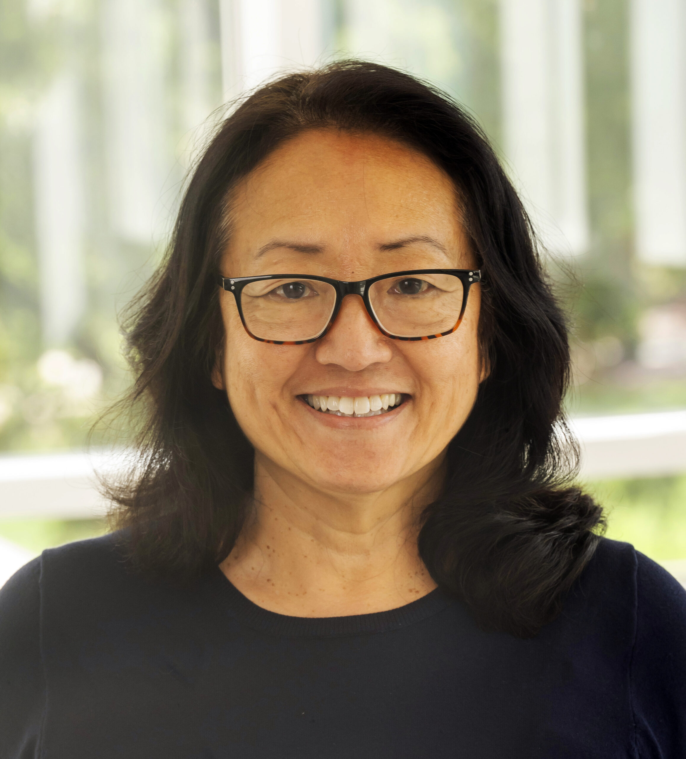
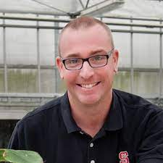
Rob Wilson
Oleg Daugovich
Chieri Kubota
Jennifer Boldt
Shinsuke Agehara
Peter Nitzsche
Courtney Weber
Celina Gomez
Mark Hoffmann
PD
Lizeth Vigil
Manager
Ricardo Hernández, Gina Fernandez
Co-PDs
Gerald Holmes
Jayesh Samtani
Edward Durner
Caren Chang
Daniel Tregeagle
Brian Jackson
Notes:
42 people in total!

Slide 8
Lizeth Vigil
Project Manager
Alexa Artis
Communications Assistant

Slide 9
Plant Genetics
Plant Physiology
Plant
Performance
Technology Transfer
Economics

Slide 10
Major Outcomes
2026: GUIDE that will summarize all our findings.
2026: Hopefully genetic tools for breeding
2025: BETA VERSION of GENETIC DATABASE

Slide 11
What happened until now?
13 strawberry cultivars sequenced
Successful Student Exchanges
Indoor Strawberry Nursery
Field Trials in CA, NC, NY and FL
CO2, Photoperiod, Chilling, Substrates, Nutrition

Slide 12
What we plan for 2025
Experiments on impact of environmental factors on flowering (ongoing)
Putting genomic database online
Begin to develop a guide that summarizes our findings

Slide 13
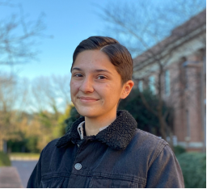
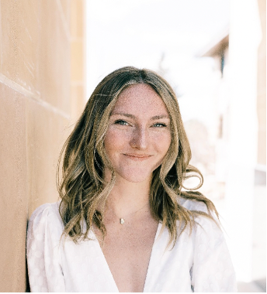
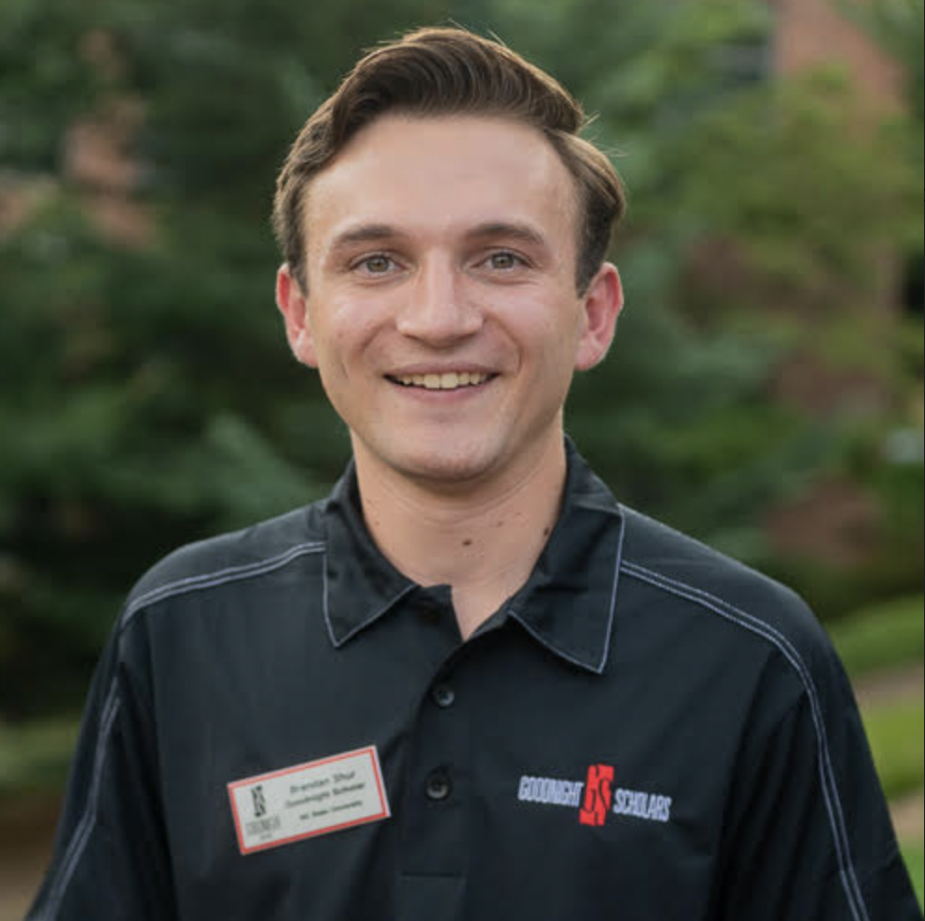
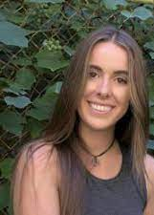
Train at PIP-CAP & enhance your career.
Samson Humphrey. MS. PhD-Student, University of Tennessee
Brandon Shur. MS. PhD-Student, Virginia Tech University
Ava Foryseck. MS. PhD-Student, Cornell University
Samantha Simard. MS. Research Technician, Cal Poly SLO

Slide 14
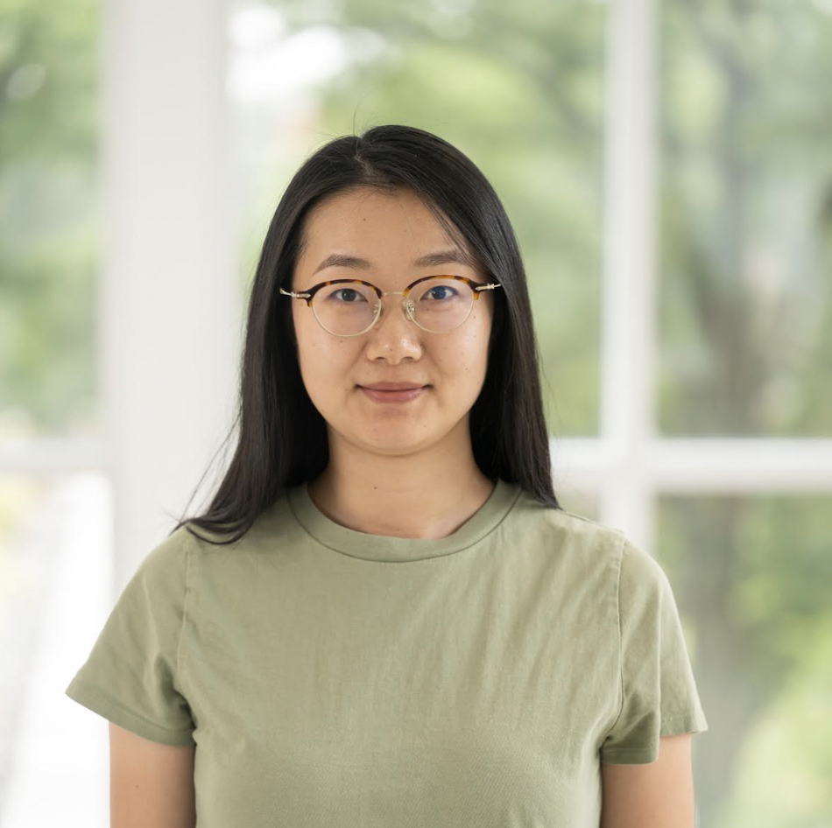
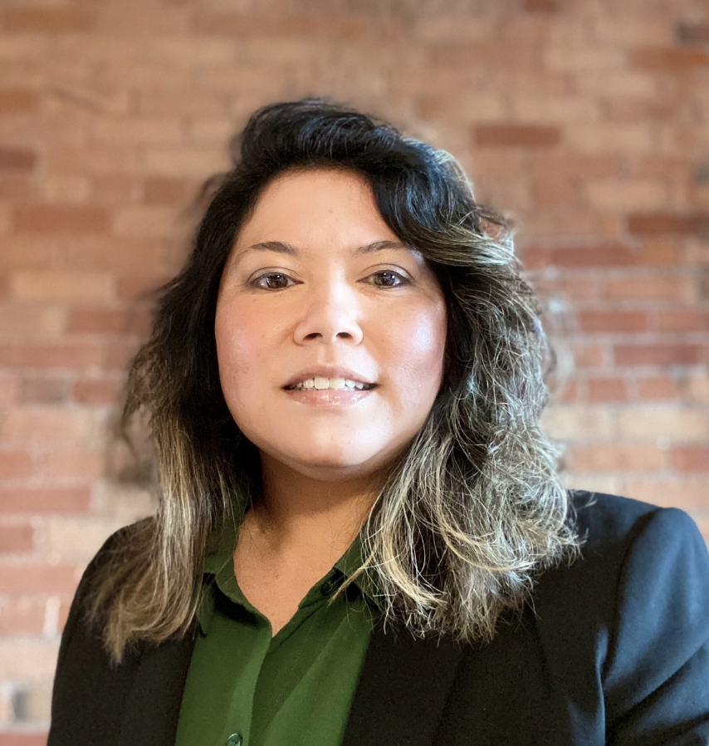
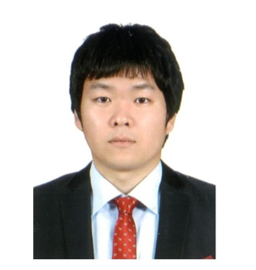
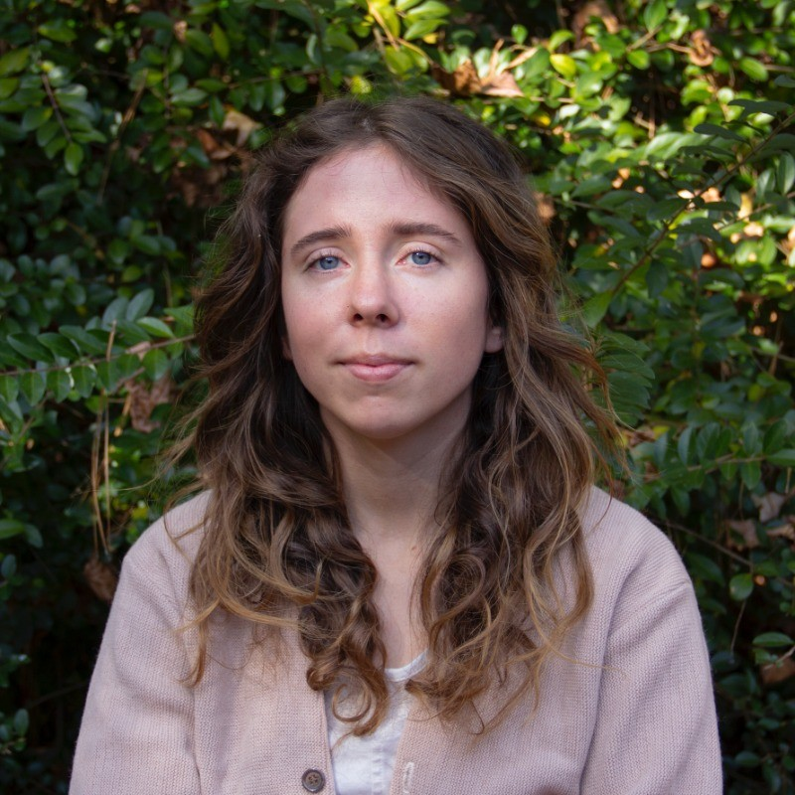
Train in PIP-CAP & become a leader.
Dr. Xi Luo. Assistant Professor, Shandong Agriculture University, Tai’an, China.
Dr. Erin Yafuso. Plant Scientist, Smithers-Oasis, OH.
Dr. Jung Hoon Han. Associate Research Fellow, Korea Rural Economic Institute, SOK.
Emma Volk. UC ANR Field Advisor, Ventura and Santa Barbara Co., CA.
Amanda Lewis. Program Manager, Ker-Tarr Regional Council of Gov, NC.
Kaitlyn Aguiles. Digital Content Manager, WECT News, NC.

Slide 15
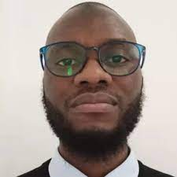
Appreciation
Students and Post-Docs won presentation awards in national and state competitions.
Great collaboration: PSI, Plenty, Driscoll’s, Lassen Canyon
Leadership: Lizeth Vigil, Alexa Artis, Ibraheem Olasupo, Chieri Kubota, Ricardo Hernandez, Gerald Holmes

Slide 16
Challenges
Several PI Departures
Budgetary miscalculations at NCSU
Start-Up economy is volatile
Company ownership changes

Slide 17
Plant Genetics
Correlate phenotypic response to genotype
Tool to predict genotypic response?

Slide 18
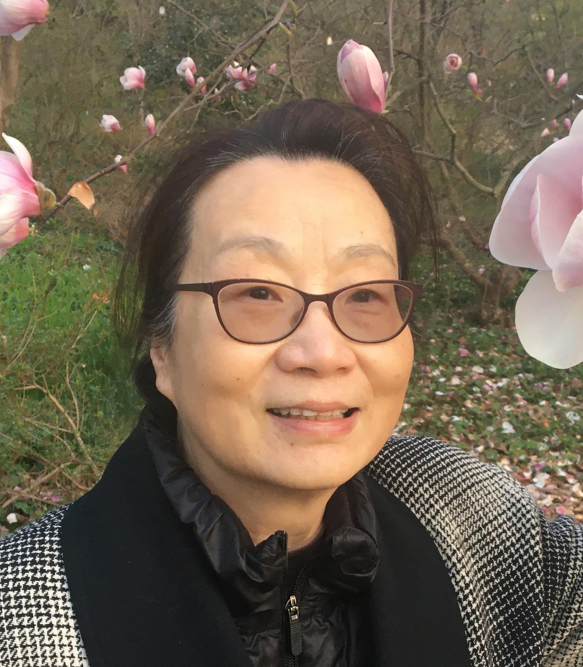
Plant Genetics
Zhongchi Liu
Caren Chang
Ibraheem Olasupo
Xi Luo

Slide 19
Plant Genetics
Genotyping and Phenotyping
Genome Database
Genomic Classification Tool

Slide 20
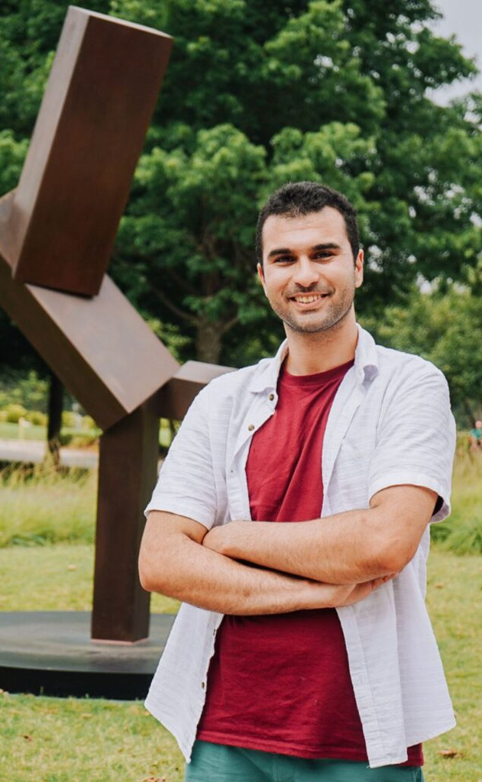
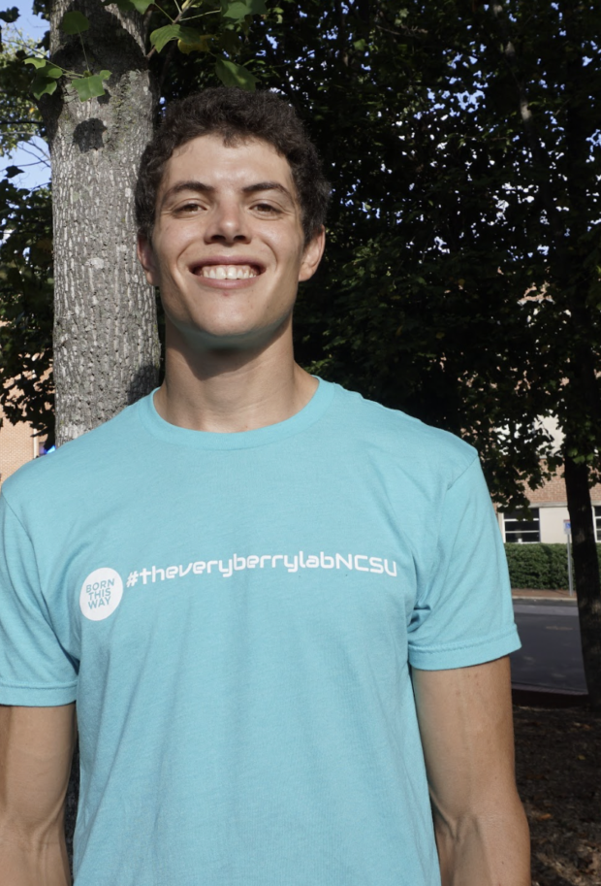
Student Exchange
Dr. Xi Luo
Sam Humphrey
Lizeth Vigil
Samantha Simard
Moein Moosavi-Nezhad
Ava Forysteck
Michael Palmer

Slide 21
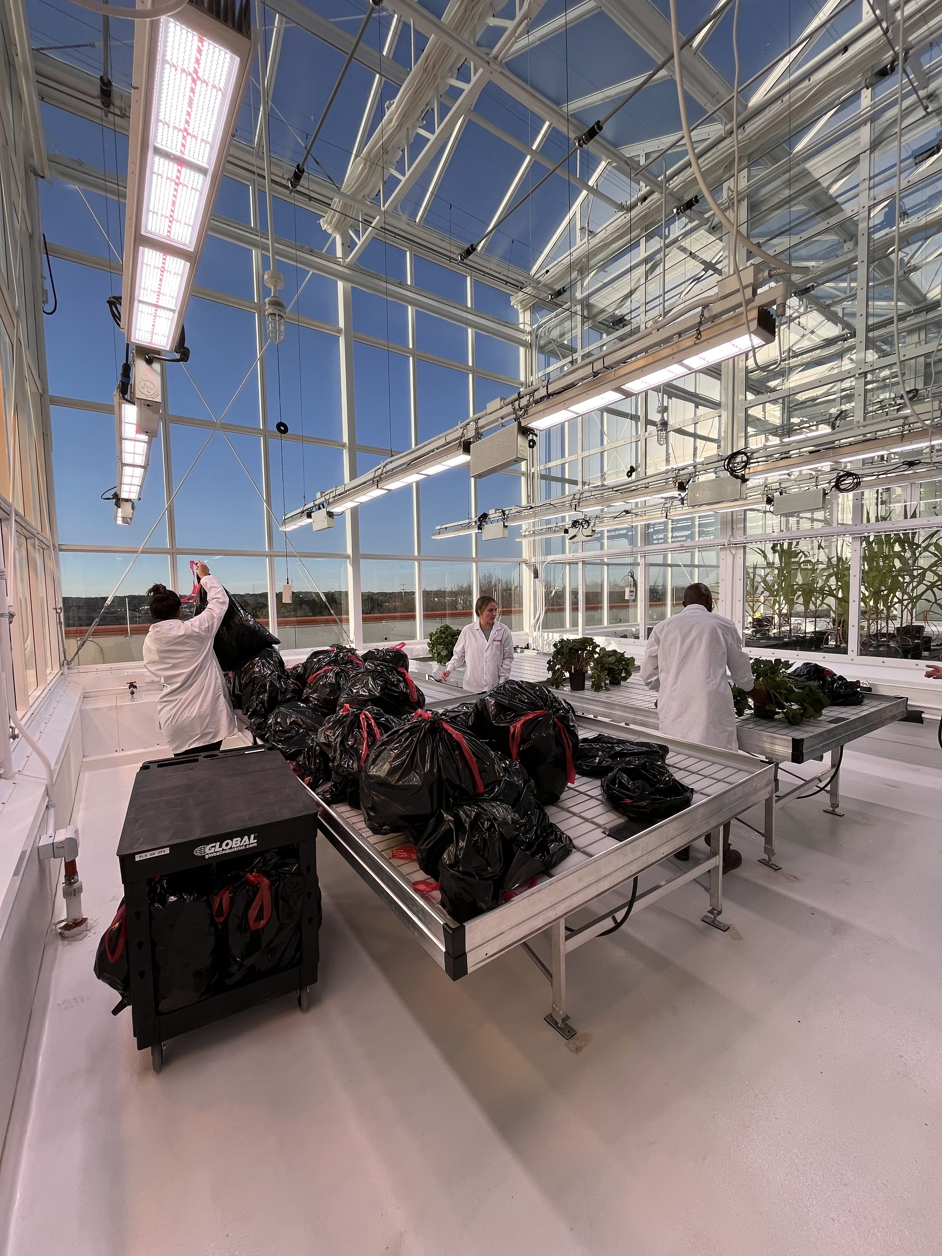
Ricardo Hernández
Mark Hoffmann
Ibraheem Olasupo
Abby Bope

Slide 22
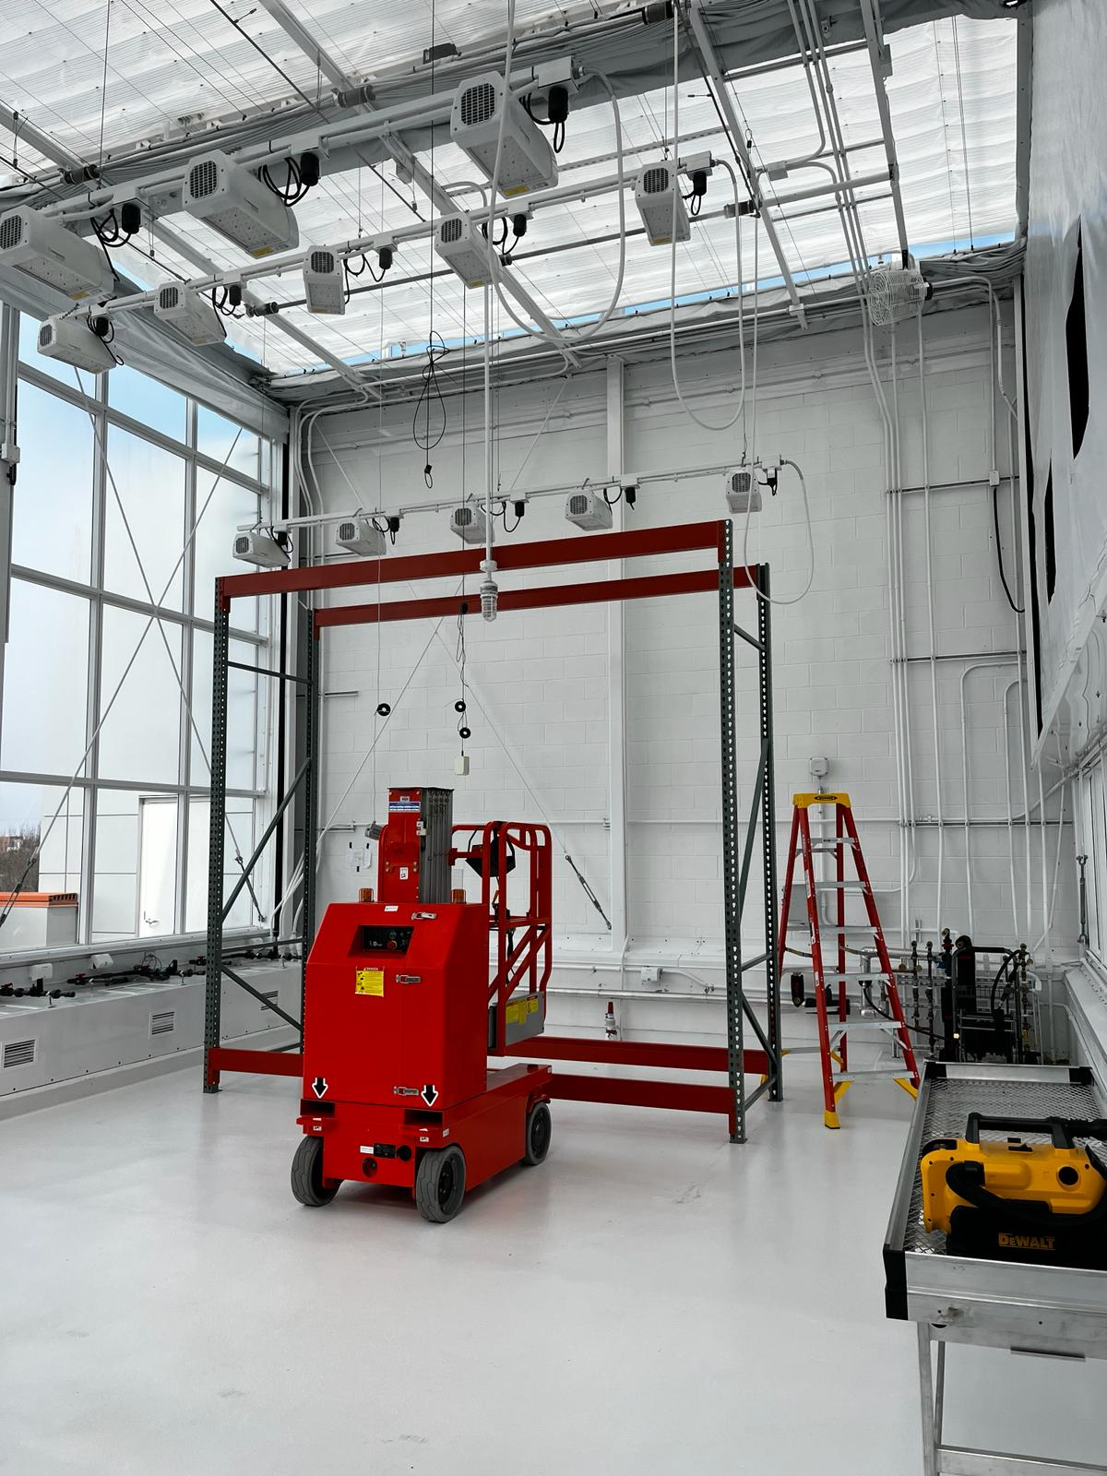
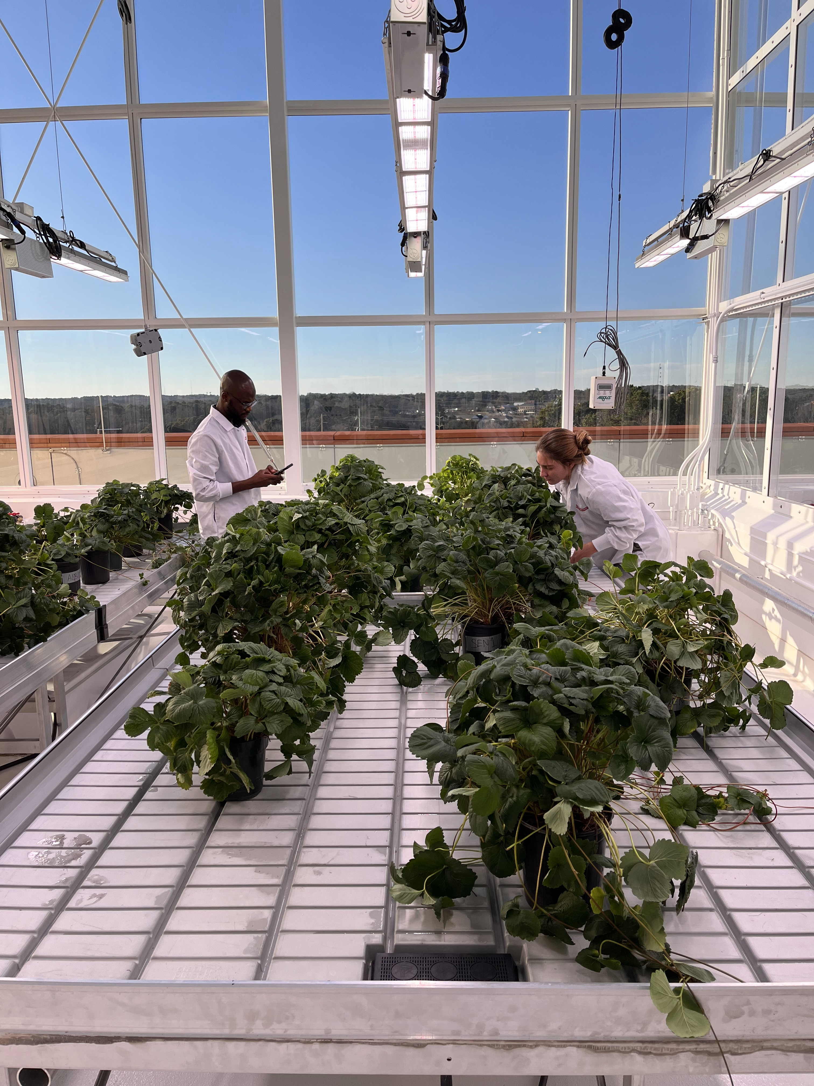

Slide 23
Plant
Performance
How do plants produced in CEA systems perform in production fields?

Slide 24
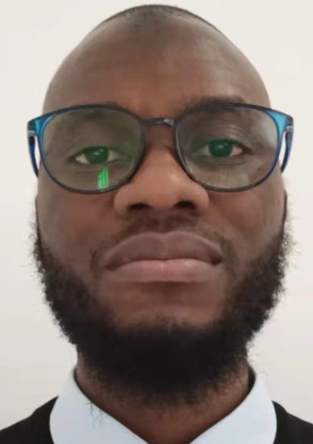
Plant
Performance
Gerald Holmes
Shinsuke Agehara
Mark Hoffmann
Courtney Weber
Gina Fernandez
Ibraheem Olasupo
Oleg Daugovich

Slide 25
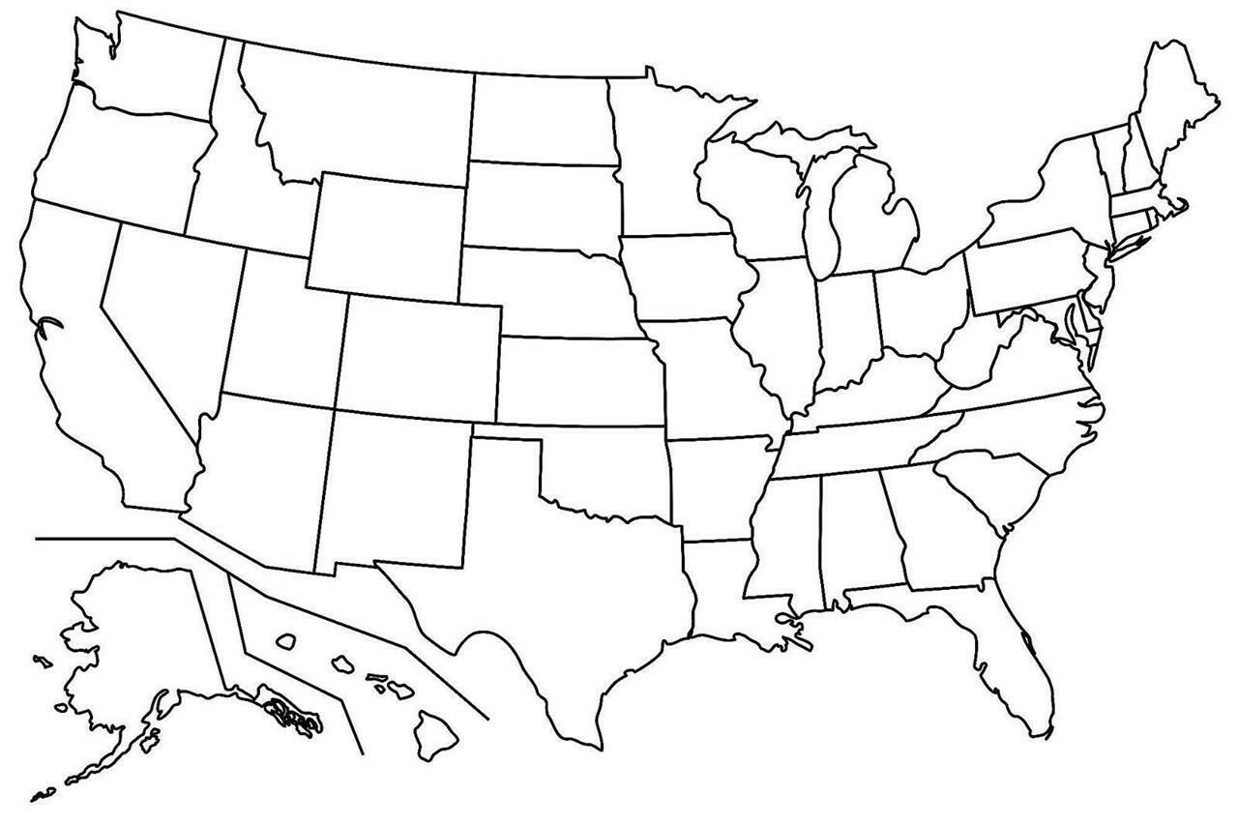
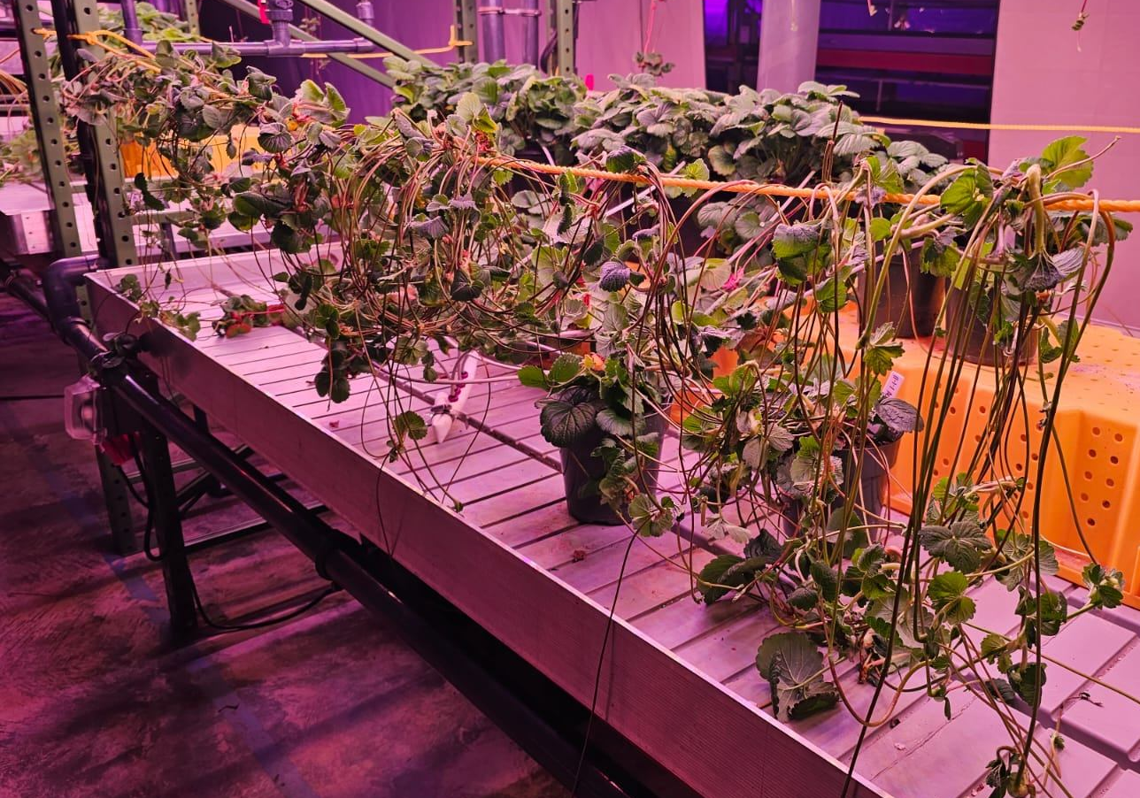
2023-2025

Slide 26
Plant Physiology
Optimize environments to propagate mother plants

Slide 27
Ricardo Hernandéz
Plant Physiology
Jennifer Boldt
Chieri Kubota
Brian Jackson

Slide 28
Plant Physiology
Optimal root zone and nutrition
Optimal environmental conditions

Slide 29
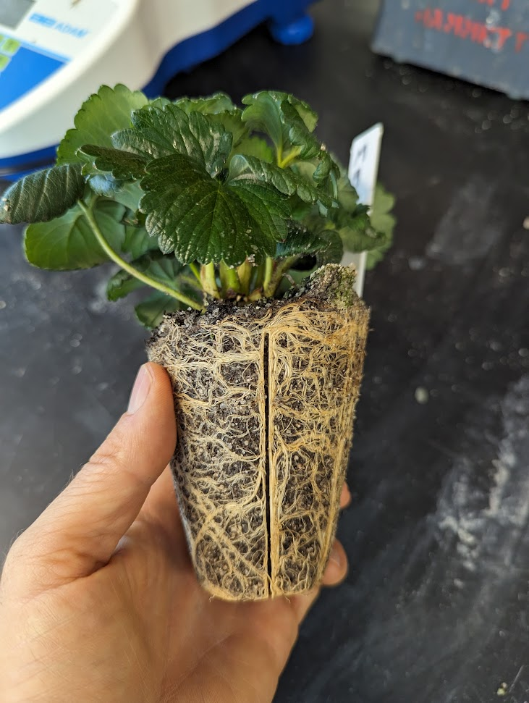
Plant Physiology
Optimize environments for daughter plants

Slide 30
Chieri Kubota
Plant Physiology
Mark Hoffmann
Edward Durner
Celina Gomez

Slide 31
Plant Physiology
Storage
Rooting
Flowering

Slide 32
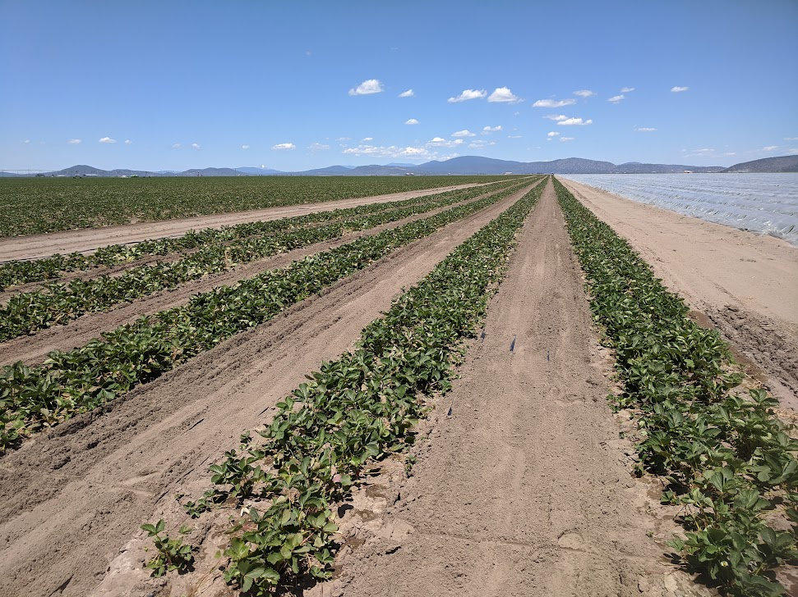
Plant
Performance
Can we enhance efficacy in propagation fields?

Slide 33
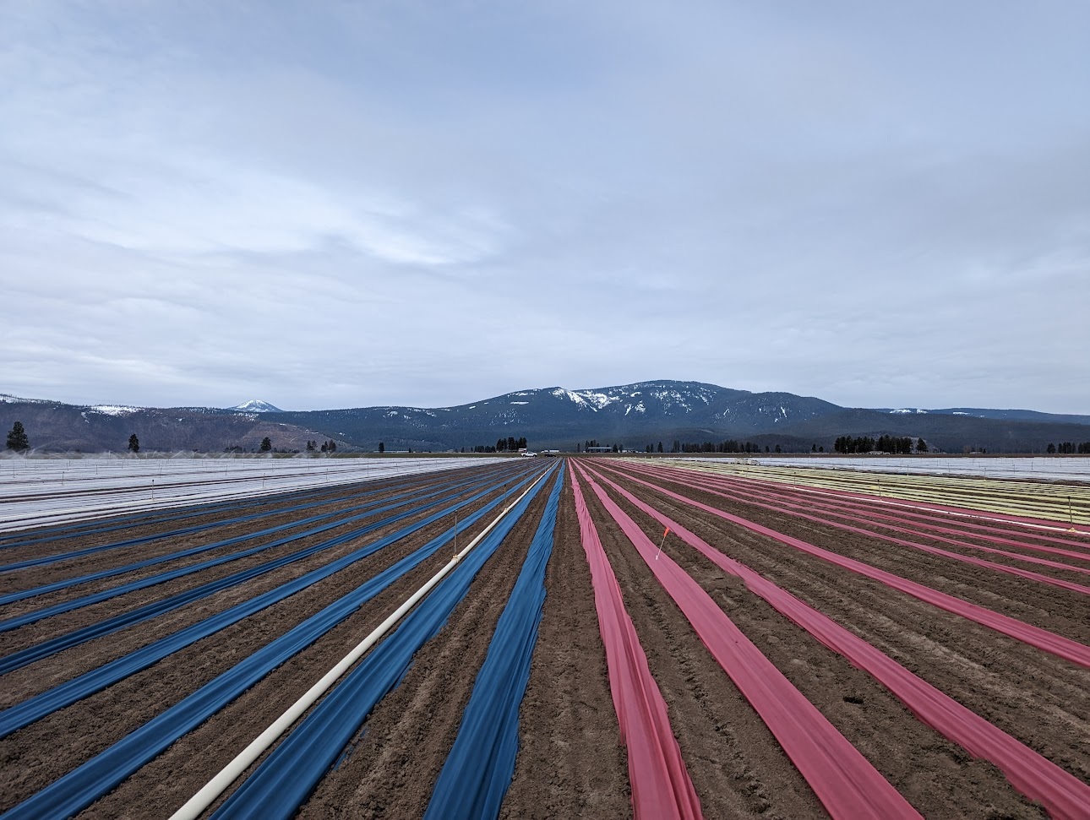
Mark Hoffmann
Plant
Performance
Rob Wilson
Siskiyou Co.
Ibraheem Olasupo
Unfortunately discontinued

Slide 34
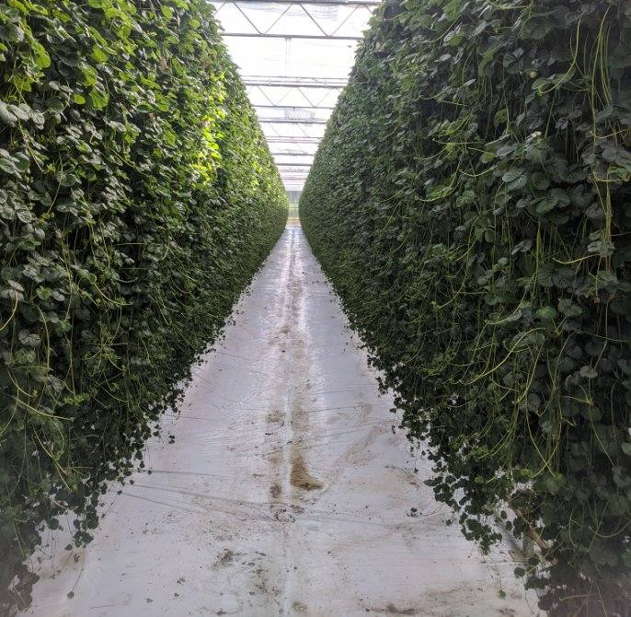
Economics
Affect & adaptation in supply chain?
Cost in current systems & of new technology?

Slide 35
Economics
Daniel Tregeagle

Slide 36
Technology Transfer
Peter Nitzsche
Mark Hoffmann
Lizeth Vigil
Newsletter
Website
Extension Publications
Webinars
Field Days
Shinsuke Agehara
Oleg Daugovich
Jayesh Samtani
Alexa Artis

Slide 37
Alexa Artis
Lizeth Vigil
https://strawberries-pip.cals.ncsu.edu

Slide 38
Norton Creek
Farms

Slide 39
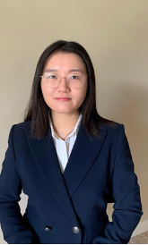
Post-Doctoral Researchers:
Dr. Xi Luo. Assistant Professor, Shandong Agriculture University, Tai’an, China.
Dr. Erin Yafuso.
Dr. Ibraheem Olasupo. NCSU, Plant Physiology
Dr. Yue Shan. NCSU, Economics

Slide 40
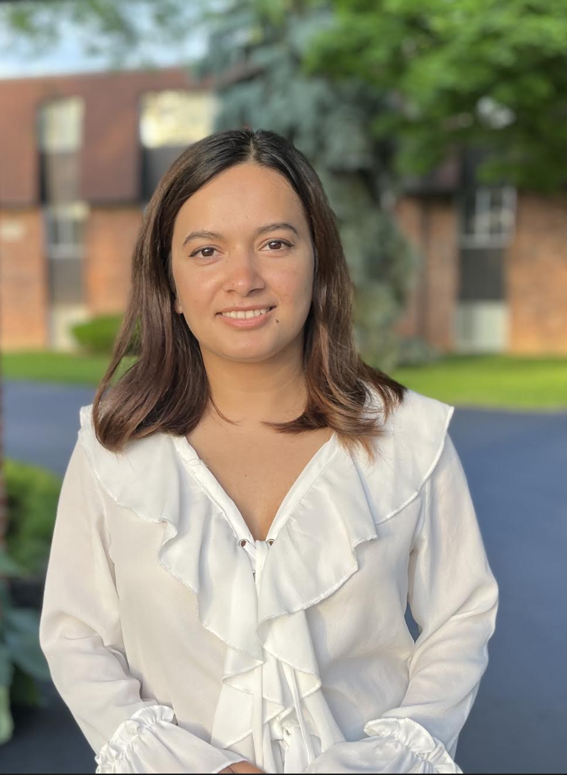
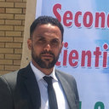
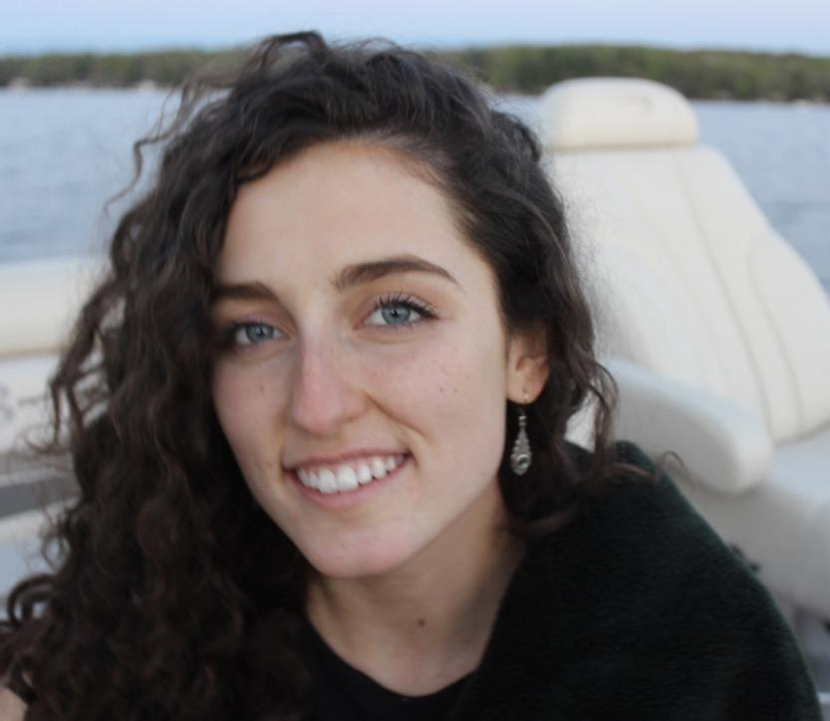
PhD Students:
Christina Ippoliti, University of Maryland, Genomics and genetics
Pooja Tripathi, The Ohio State University, Plant Physiology
Baker Aljawasim, Virginia Tech, Field Evaluations
Michael Palmer, NCSU, Plant Physiology
Moein Moosavi-Nezhad, NCSU, Plant Physiology

Slide 41
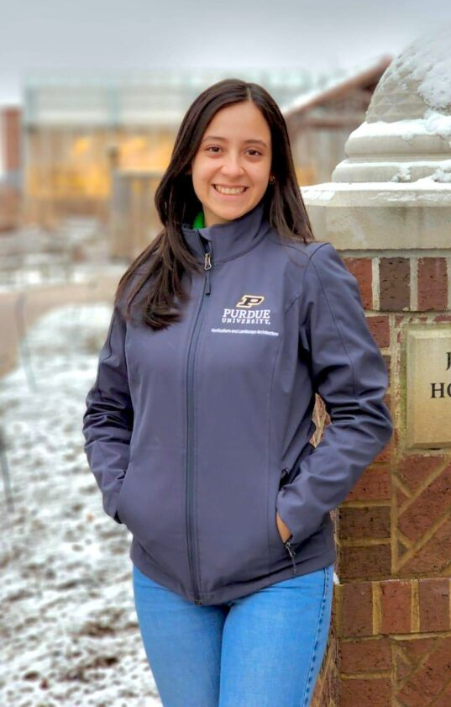
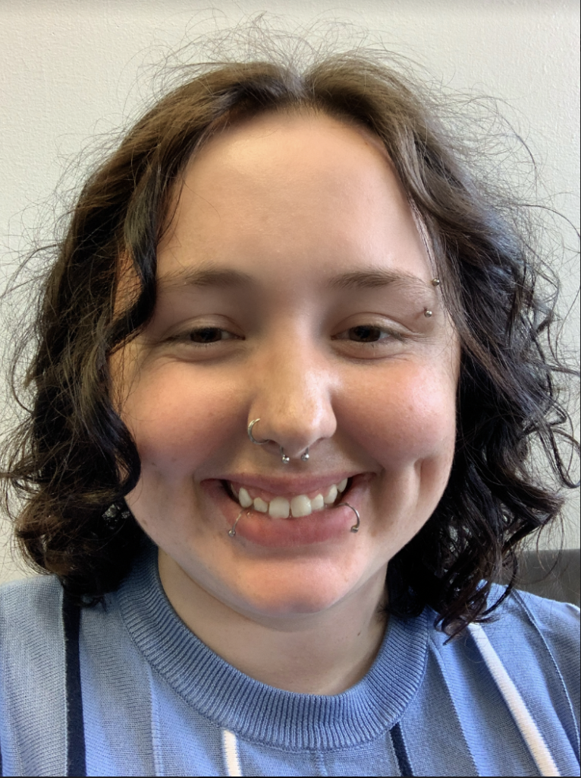
Master Students:
Lian Mahorith Duron Alvarado, Purdue University, Plant Physiology
Calyssa Stevensen, NCSU, Field Evaluations

Slide 42
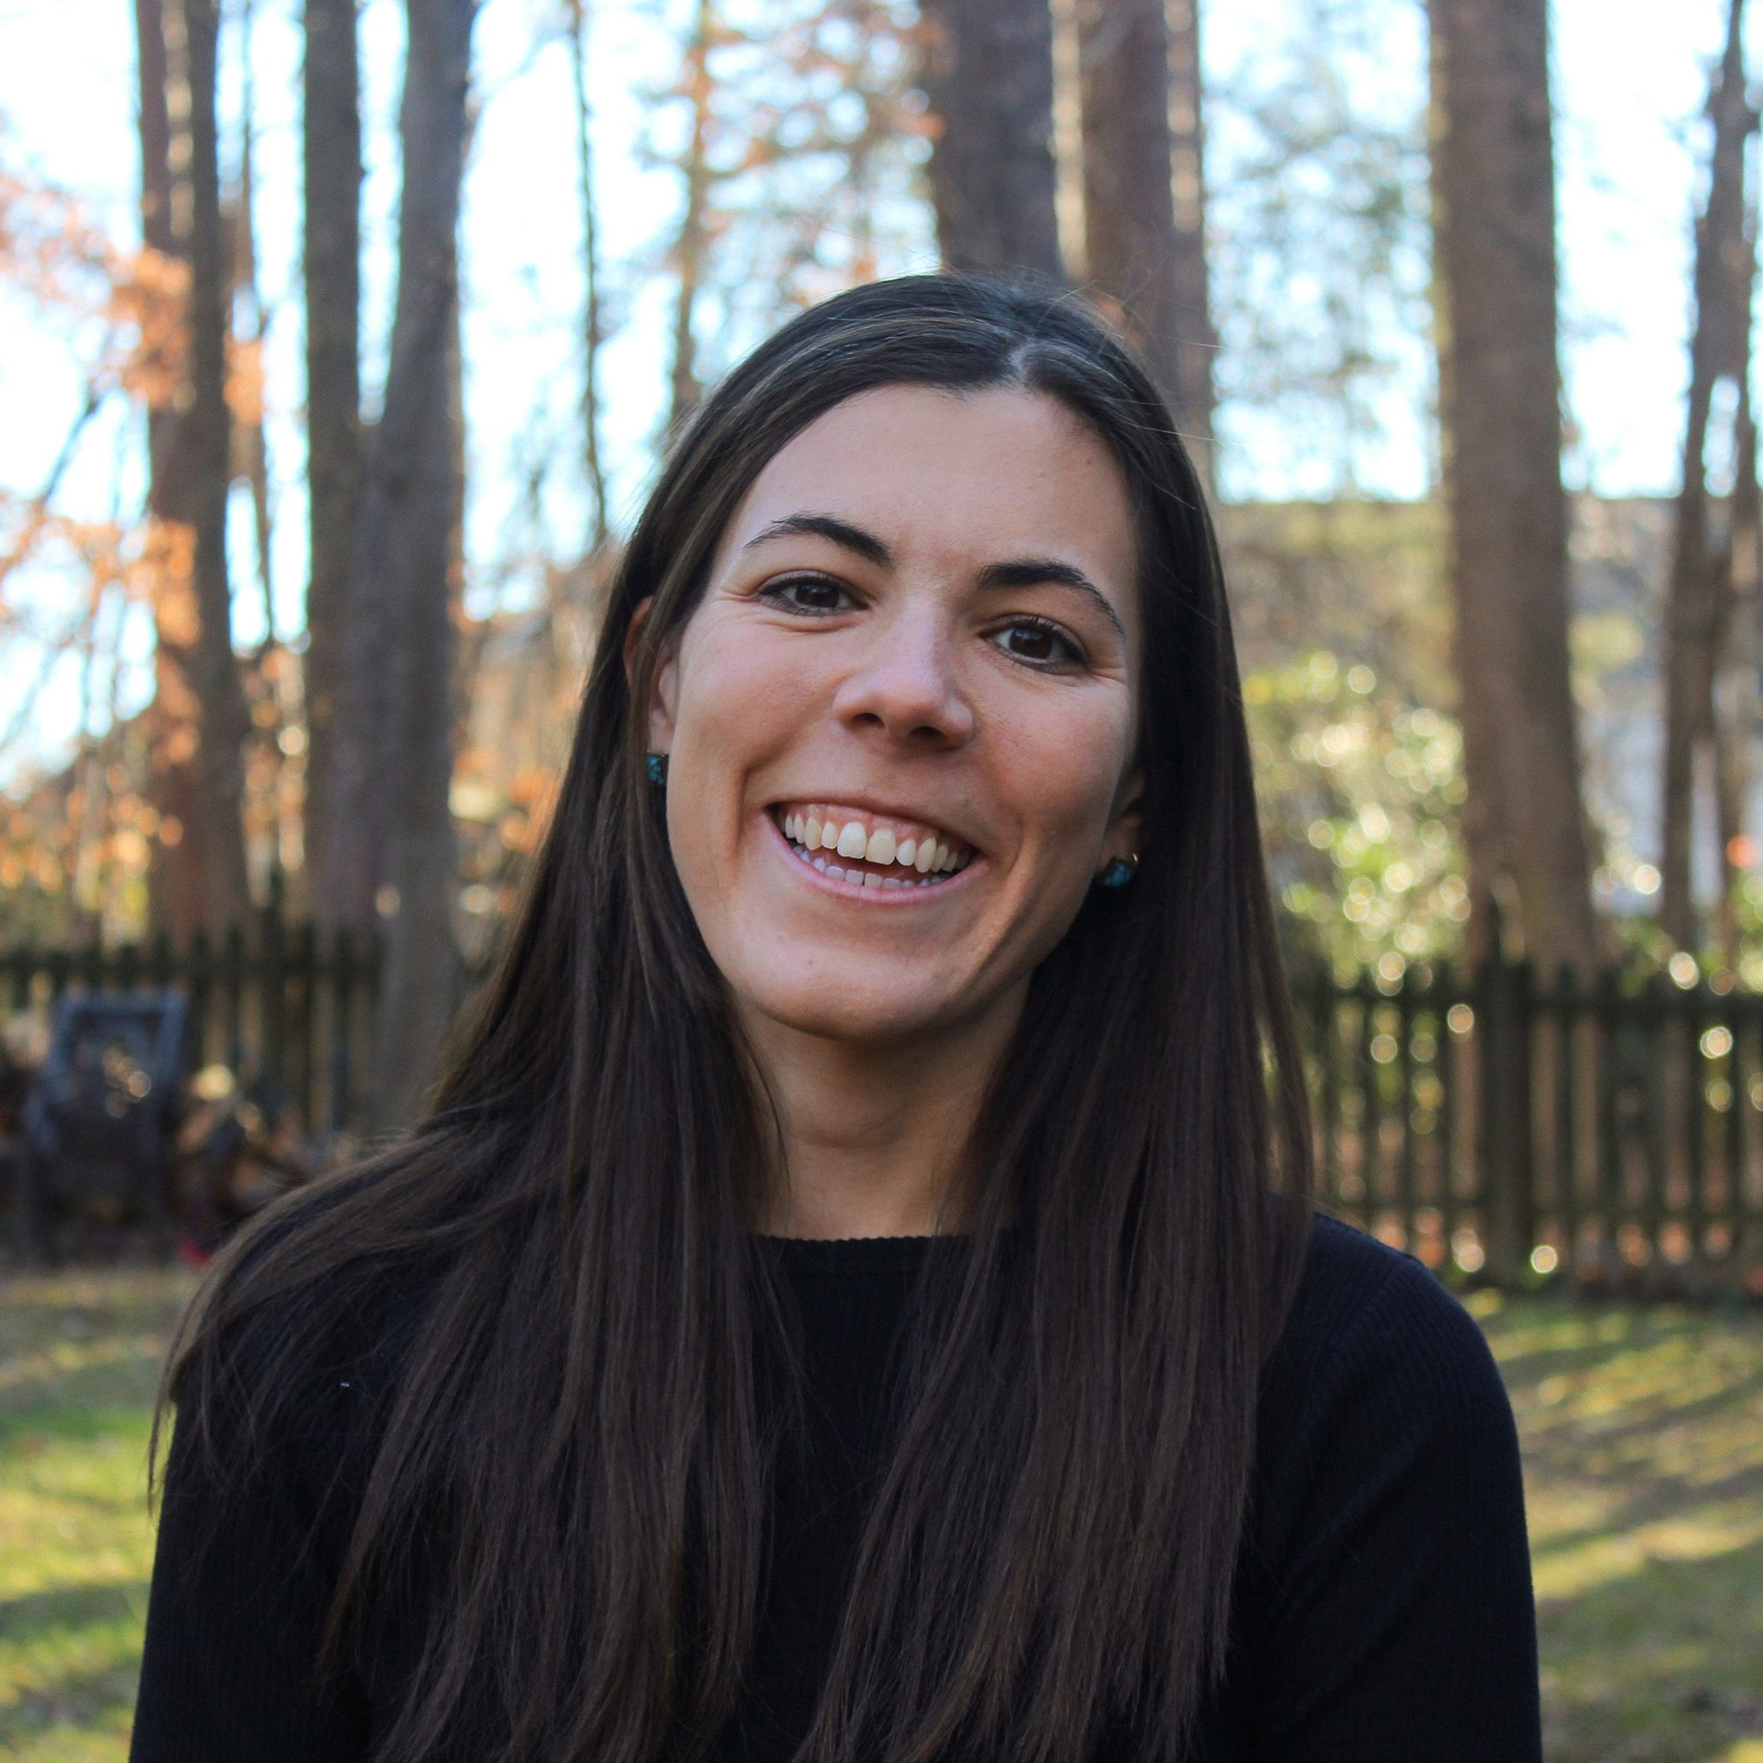
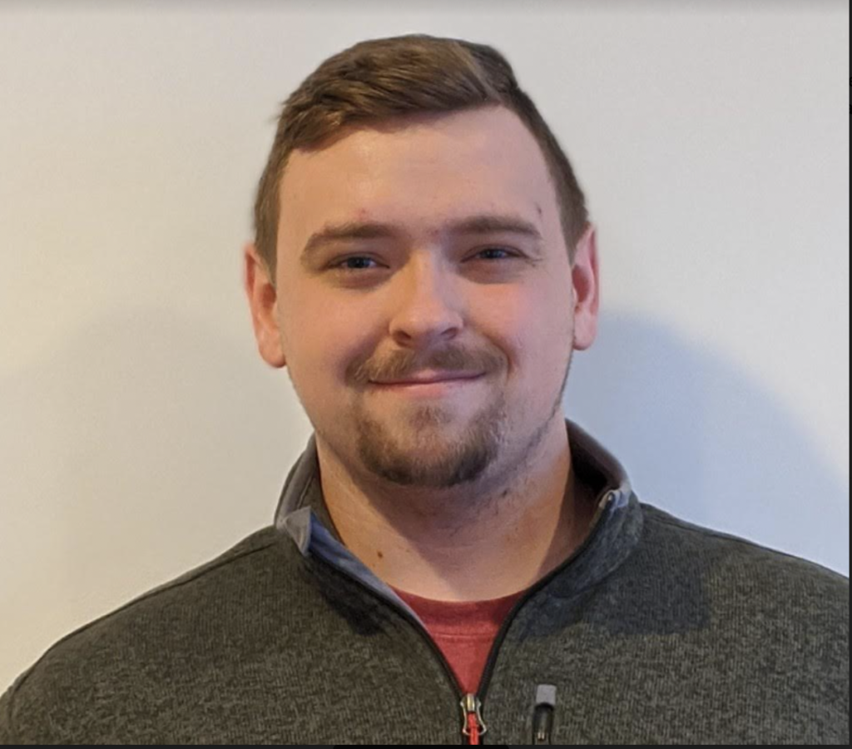
Technical Support:
Kim Heagy, NCSU, Research Assistant
Ian Mellon, NCSU, Research Technician
Samantha Simard, CalPoly SLO, Research Assistant

Slide 43
Acknowledgements:
UC Davis Strawberry Breeding Program
UF Strawberry Breeding Program
Lassen Canyon Nursery
PSI Inc.
Grafted Growers LLC
Plenty Inc.
Fresh Forward Netherlands
ALL Board Members
Mark Hoffmann, NCSU
Associate Professor
Extension Specialist
mark.hoffmann@ncsu.edu
919-352-8006
Lizeth Vigil, NCSU
Project Coordinator
Strawberry PIP-CAP
kvigil@ncsu.edu
Thank you!
USDA-NIFA Award: 2021-51181-35857

